Slide 1
Welcome.
1
WELCOME

Slide 2
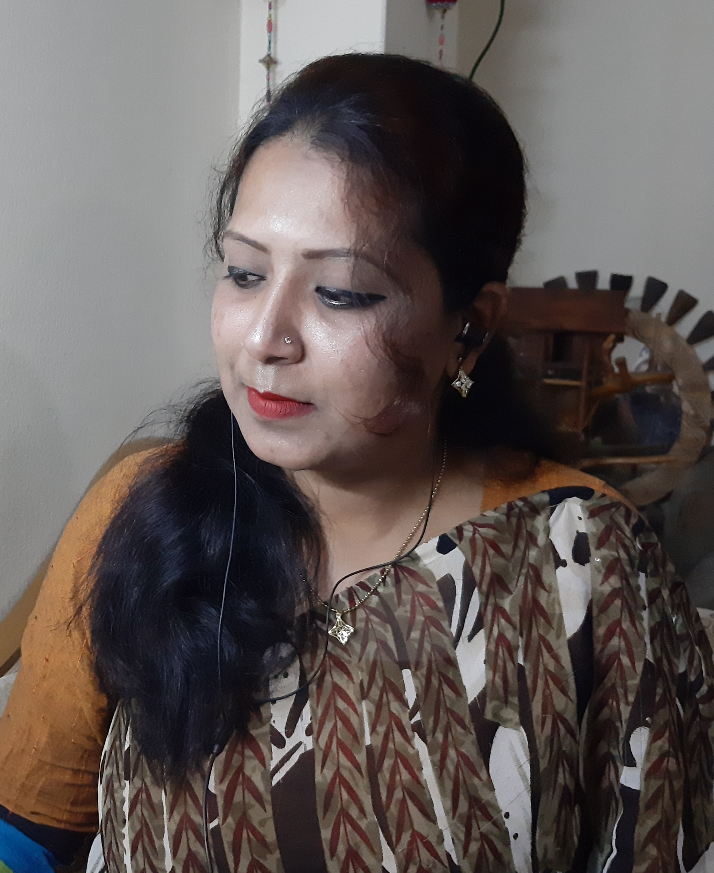

Rowshan Sharif Tani
Assistant teacher
B.M.Govt.Primary School
Kaptai,Rangamati
Subject:English
Class:Five
Unit:8,Lesson:1-2
Activity:A
(Sima…………..well soon.)
Page no:30
2
Identity

Slide 3
By the end of the lesson students will be able to…
Listening:
1.2.1:recognize which syllable in a word is stressed.
1.2.1 recognize which words in a sentences are stressed
Speaking:
1.1.1: say words, phrases and sentences with proper sound and stress.
6.2.1: Talk about people objects, events etc
Reading:
1.5.1: read words phrases and sentences in the text with proper pronunciation stress and intonation.
1.7.1: read paragraphs , dialogues stories , letters and other text .
.
3
Learning outcomes

Slide 4



Good Morning students.
Good Morning teacher.
How are you today?
Fine ,Thank you. You?
I’m fine too.Thank you.
4
Greetings

Slide 5

Dear student ,let’s watch a video together.
https://www.youtube.com/watch?v=Vtos9gw1HJI
5
Watch video

Slide 6
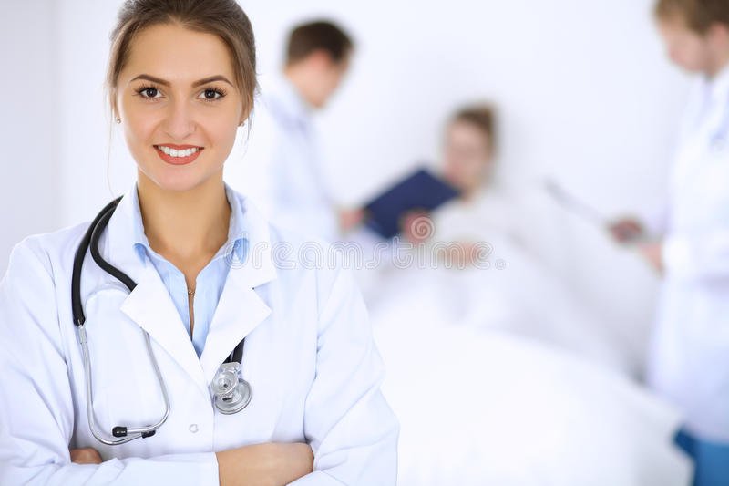
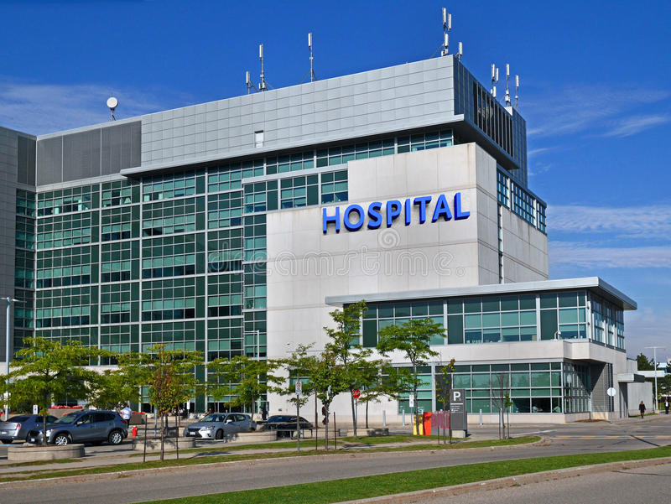
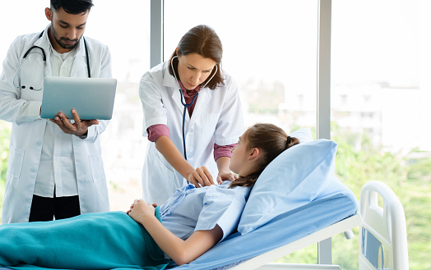
Look at the pictures very carefully and think.
Do you know who is she?
Where does she work ?
When do we go to the doctor ?
She is a doctor.
She works in a hospital.
We go to the doctor when
we are sick.
6
see pictures

Slide 7
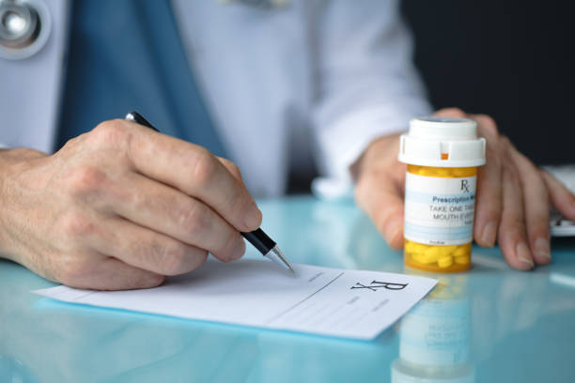
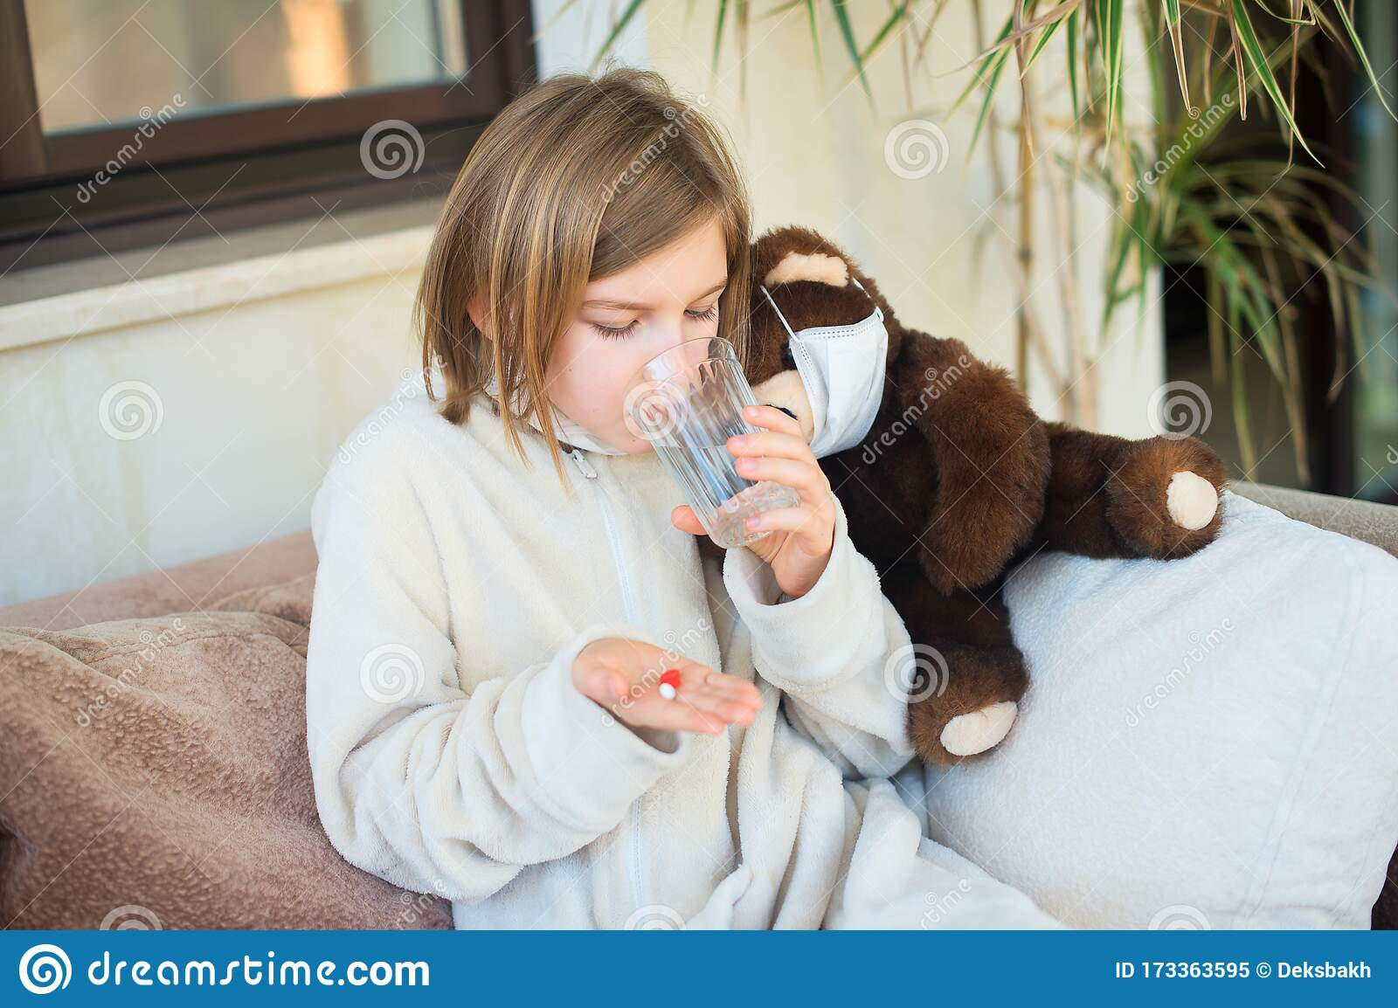
Look at the pictures very carefully and think.
What does the doctor do?
What does the girl do ?
The doctor is prescribing medicine and advice.
She is taking her madicine.
7
See pictures

Slide 8
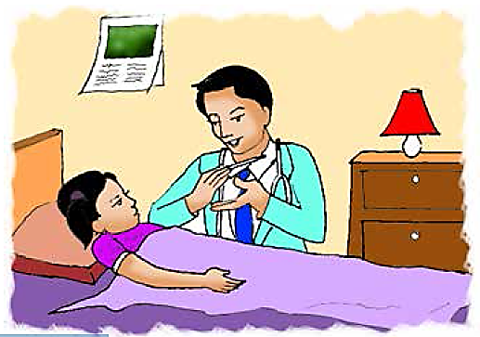
Lesson declaration
Unit: 8(Write to me soon)
Lesson:1-2
Activity: A
Page: 30
8
Declaration

Slide 9

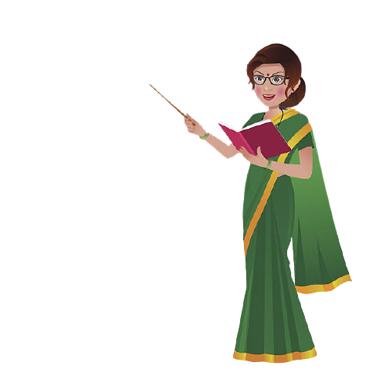
Student’s we are going to read our today’s lesson.
Students listen to me carefully
Sima is at home today.She didn’t go to school because she is ill.She has a cough and a sore throat.She also feels very warm because she has a fever.She has the flu.The doctor visited Sima last night.She needs some medicine.He also told her what to do in order to get well soon.
9
TEACHER’S
LOUD READING

Slide 10
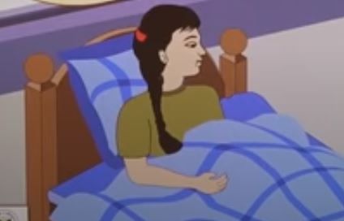
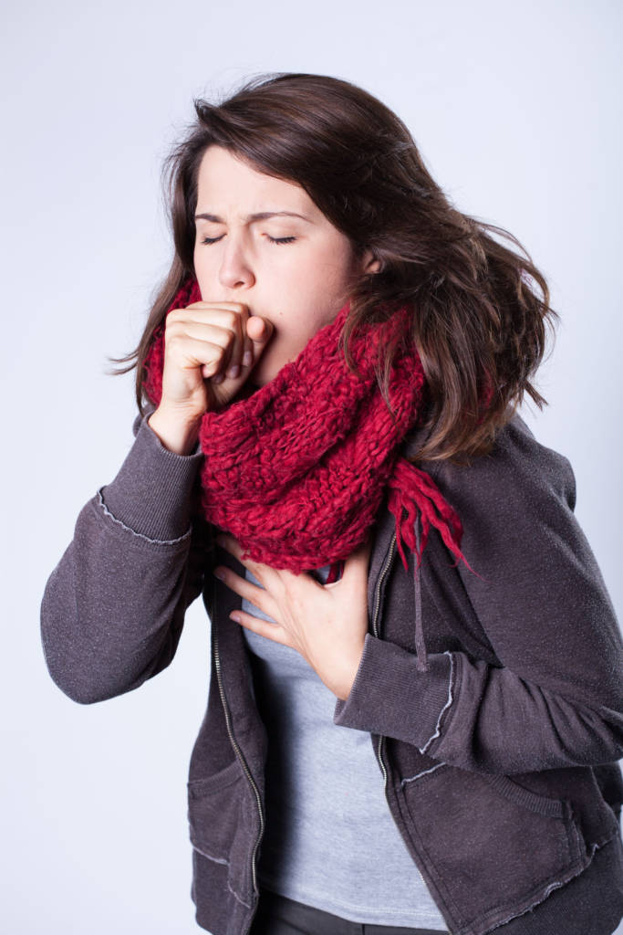
Sima is at home today. She didn’t go to school because she is ill.
She has a cough and a sore throat.
10
Reading

Slide 11
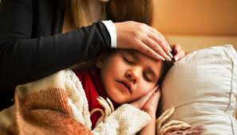
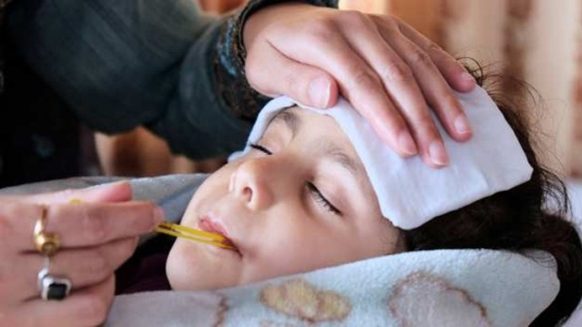
She also fells very warm because she has a fever.
She has the flu.
11
Reading

Slide 12
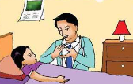
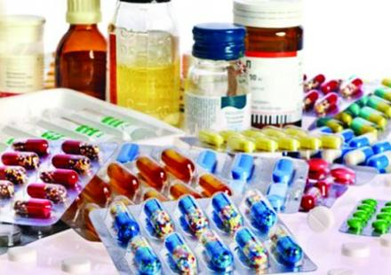
The doctor visited sima last night.
She needs some medicine.He also told her what to do in order to get well soon.
12
Reading

Slide 13
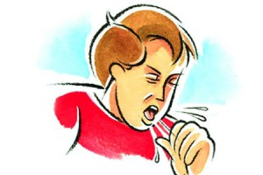
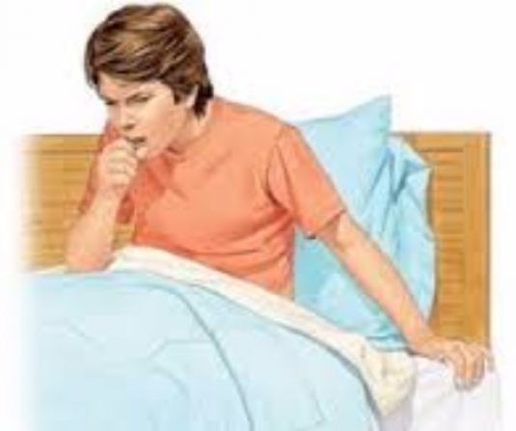
Now,we will know the meaning of some new words.
Cough
Sore throat
mucus stored in the throat
pain in one’s throat.
কাশি
গলাব্যাথা
13
Word meaning

Slide 14
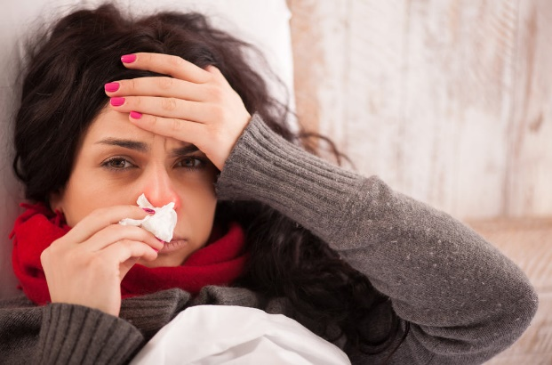
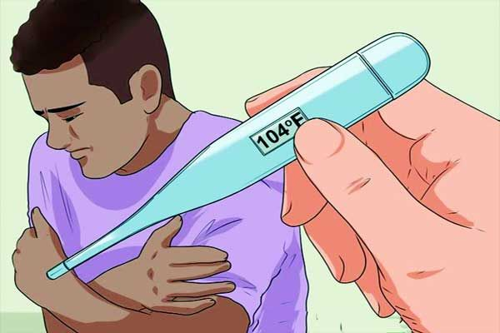
Now,we will know the meaning of some new words.
Flu
Fever
One kind of fever
A disease of high temperature
ইনফ্লুয়েঞ্জা
জ্বর
14
Word meaning

Slide 15
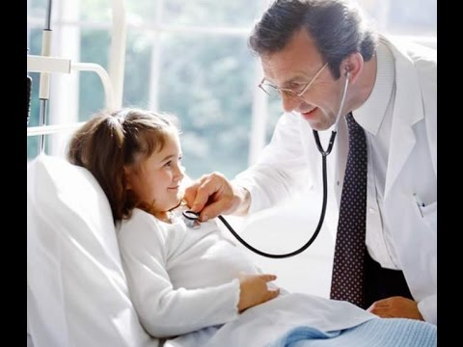
Now,we will know the meaning of some new words.
Medicine
Doctor
A drug for the treatment of disease
a person who treats the patient
ঔষধ
চিকিৎসক
15
Word meaning

Slide 16
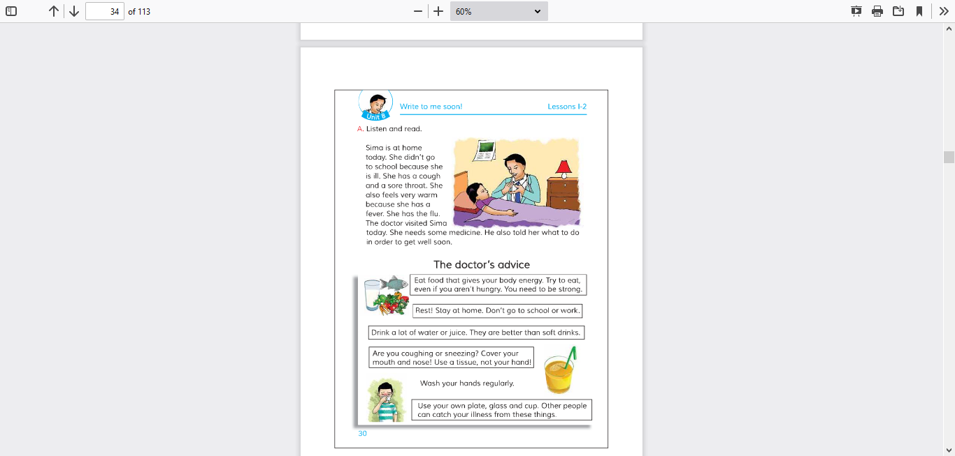
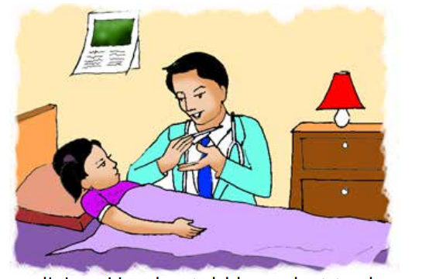
Everyone open your textbook page at 30
Sima is at home today.She didn’t go to school because she is ill.She has a cough and a sore throat.She also feels very warm because she has a fever.She has the flu.The doctor visited Sima last night.She needs some medicine.He also told her what to do in order to get well soon.
16
Text book

Slide 17

Dear Students, read the text silently from your textbook.
Page no:30, Activity-A
(Listen and read)
Sima……………..
…………..get weli soon.
17
Silent reading

Slide 18

Dear students, Let’s listen the audio
18
Listen audio

Slide 19
Fill in the blanks with the appropriate word
Fever
ill
needs
home
cough
doctor
a. Sima is at ………….today.
b. She has a …………and a sore throat.
c. The ………….visited Sima last night.
d. Sima has a…………..
e. Sima …………. some medicine .
19
Individual work

Slide 20

Answer the questions
1.Why Sima didn’t go to school ?
Ans : Because Sima is ill.
2.Why is she feeling warm?
Ans : Because she has a flu.
3.Who visited Sima?
20
Ans : The doctor visited Sima.
Pair work

Slide 21
Match the words of the column A with their meanings in column B
Column A
Column B
Cough
A drug for the treatment of disease
Flu
Pain in one’s throat
Medicine
Mucus stored in the throat
Doctor
One kind of fever
Sore throat
A person who treats the patient
21
Group work

Slide 22
DEAR STUDENT’S
Write a short composition about Sima’s illness.
22
Home work

Slide 23

Thank You all
23
Thank you

