Slide 1
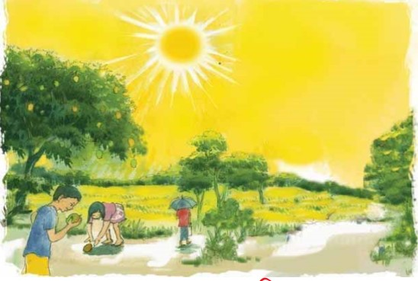
Welcome to Everyone

Slide 2
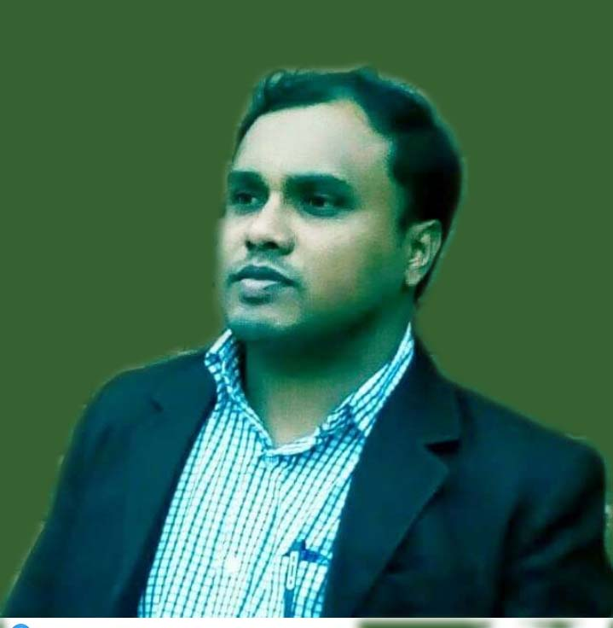
Teachers Identification
Md.Rabiul Islam
Assistant Teacher
Nanderai Govt. Primary School
Chirirbandor,Dinajpur

Slide 3
Lesson Identification
Sub:English
Class:2
Parts of the Body

Slide 4
Learning Outcomes
Students will be able to read the name of the parts of the body

Slide 5
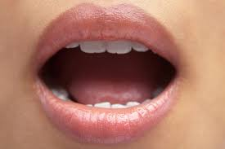
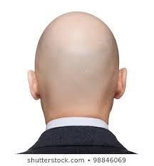
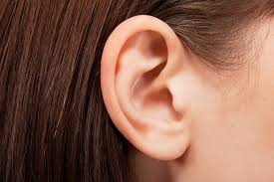
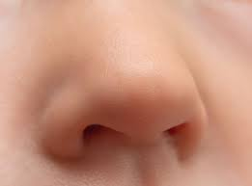
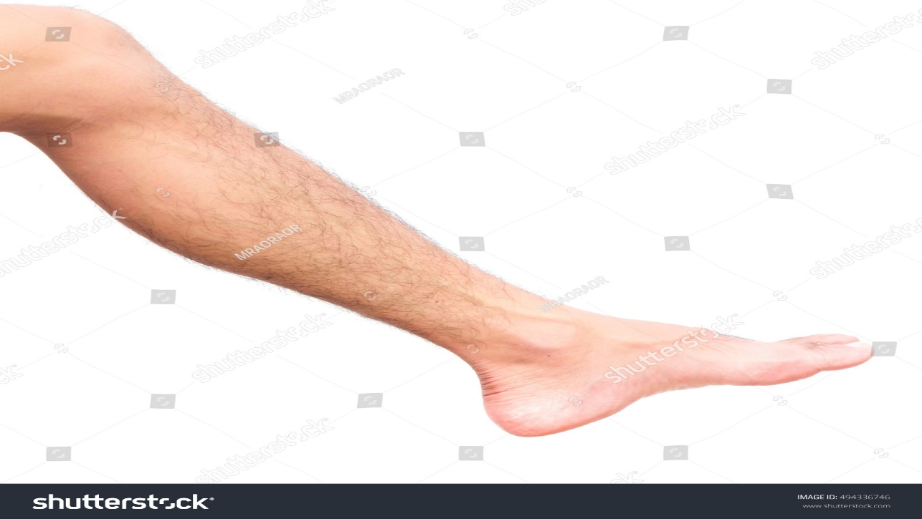
MOUTH
HEAD
HAIR
EAR
NOSE
LEG

Slide 6
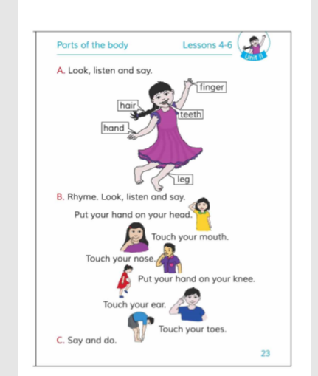
OPEN AT PAGE NO 21

Slide 7
MATCH THE PICTURE
MOUTH
NOSE
HAIR
EAR
HEAD
LEG

Slide 8
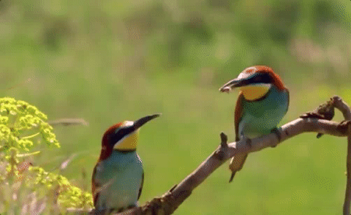
Thank you, see you again.

