Slide 2
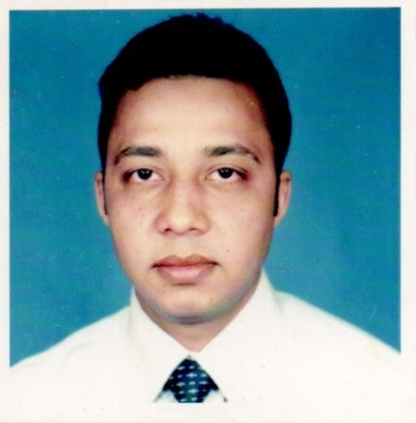
Teacher`s Identity
Satyajit Goswami Head Teacher Betory GPS. Moulvibazar Sadar.

Slide 3
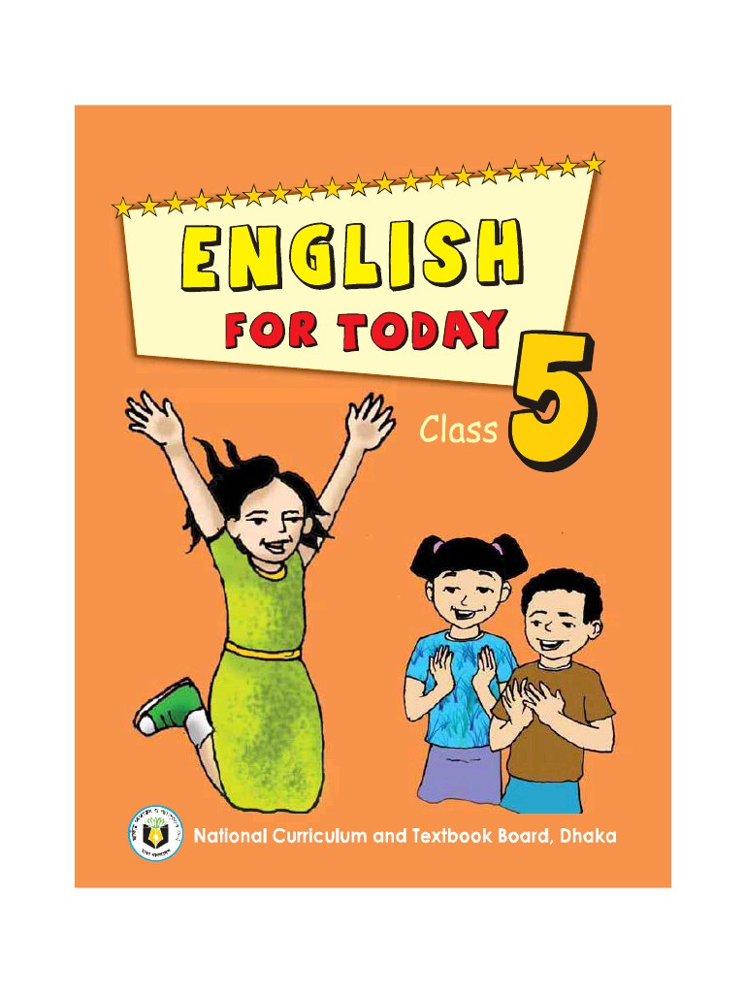
Lesson Identity
Class : Five
Subject : English
Unit : 15
Lesson : 1- 2

Slide 4
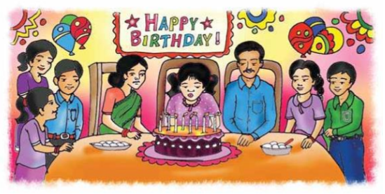
Let`s see a picture
What do you see in the picture
What are they doing?

Slide 5
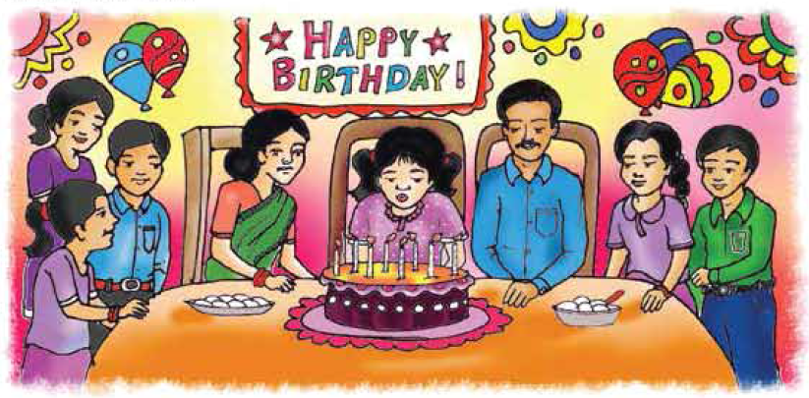
Today our lesson is……
Happy Birthday

Slide 6
Learning outcomes
At the end of this lesson Students will be able to
Listening:
1.2.1 – recognize which syllable in a word in stressed.
3.4.1 understand statements made by the teacher and students.
Speaking: 1.1.1- repeat words, phrases and sentences after the teacher with proper sounds and stress.
1.1.2- say sentences with proper intonation .
Reading: 1.5.1- read words, phrases and simple sentences with proper pronunciation , stress and intonation.

Slide 7
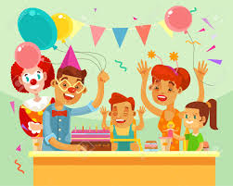
Word meaning
Celebrate:
পালন করা, উদযাপন করা
To observe something happily
Candle:
ফুঁ দিয়ে নেভানো
A stick of wax with a string through the middle.
Word meaning
Blow out:
To extinguish by air.

Slide 8
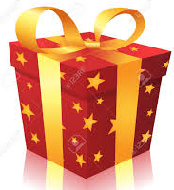
Gift
উপহার
Something given to another without charge.
Wrap
মোড়ানো
To cover something completely in paper or other material.

Slide 9
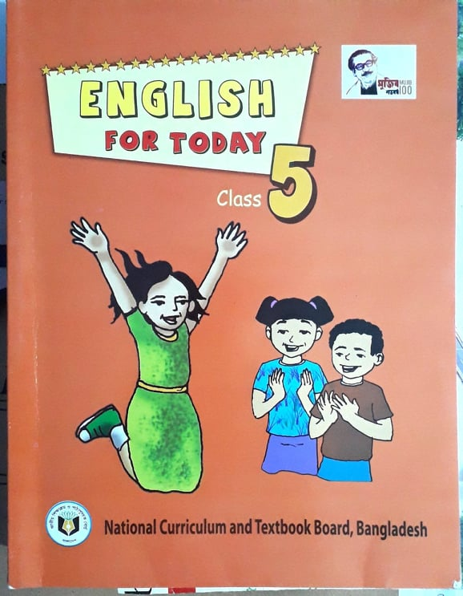
Listen the text and match with your book
A person`s birthday is a special day. This is the date when the person was born. People around the world celebrate birthdays in different ways. In many countries, people celebrate with a cake. There are candles on the cake .There is one candle for each year of the person`s life. People sing a song for the person. At the of the song, the person blows out the candles.

Slide 10
In some countries, there is often a party for a child's birthday. The child's friends come to the home. There is special food, like sweets. The children play games and sing. The friends often bring a birthday gift for the child. The gifts are wrapped in colourful paper. The gift may be a toy, a book or some clothes. In some countries, the friends don't bring gifts. The most important thing is to enjoy the day and spend time with friends and family.

Slide 11
Pair Work
Write ‘True’ for correct statement and ‘False’ for incorrect statement.
People around the world celebrate birthdays in the same way.
2. A birthday is a special day.
3. People sing a birthday song for the birthday person.
4. The friends do not bring any gift for the birthday person.
5. The most important thing is to enjoy the day.
False
True
True
False
True

Slide 12
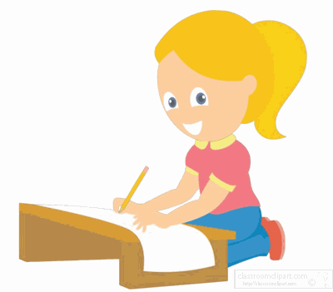
Home work
Write 5 sentences about “Your Birthday” in your exercise book .

Slide 13
GOOD BYE

