Slide 1
WELCOME TO MULTIMEDIA CLASSROOM

Slide 2
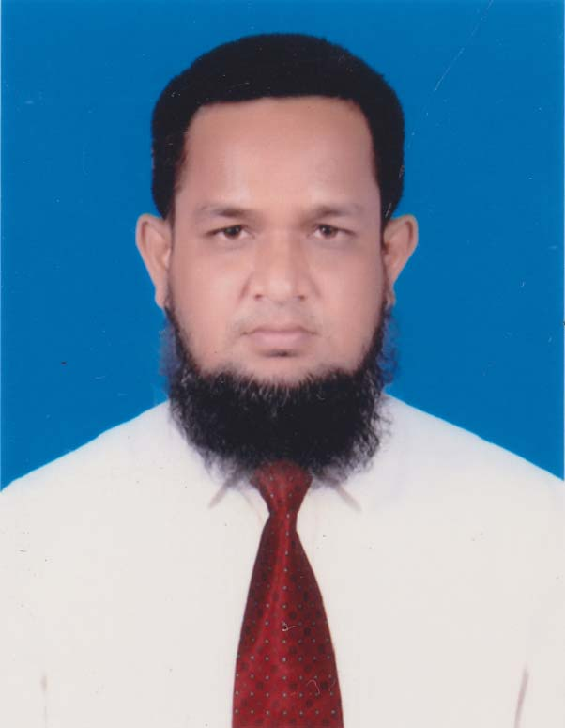
Identity
Lecturer of English, Khalna Islamia Fazil(Degree) Madrasah,Naogaon.
English for Today
Class-(XI-XII)
MD.ABDUR ROUF

Slide 3
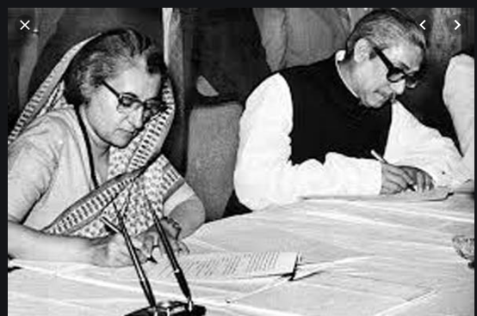
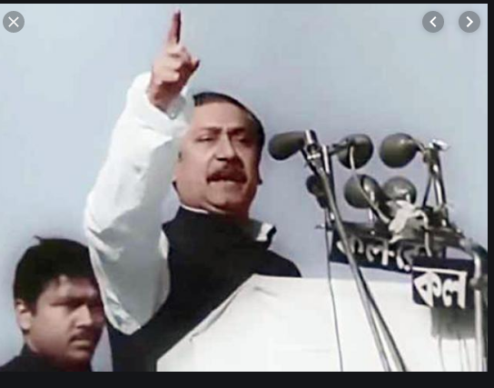

Slide 4
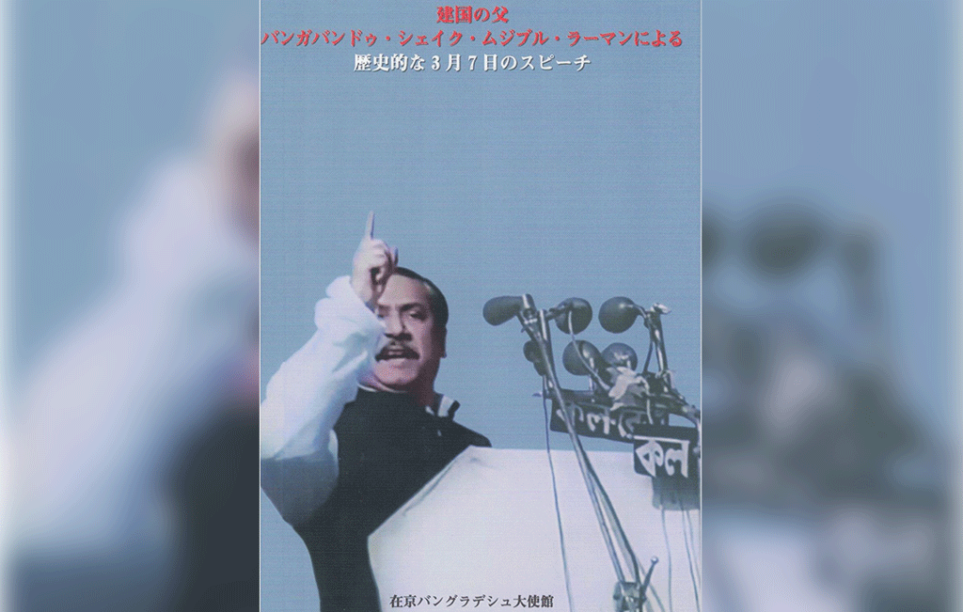
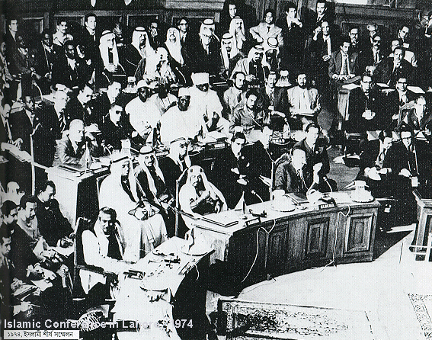

Slide 5
Our Today’s lesson
The Unforgettable History
Unit-one, lesson -1

Slide 6
Learning outcomes
After completing the lesson , we will be able to-
Say the features of the historic speech of 7th march.
Discuss the two main parts of the speech.
Differentiate between the struggle for freedom and struggle for emancipation.
Practise Vocabulary.

Slide 7
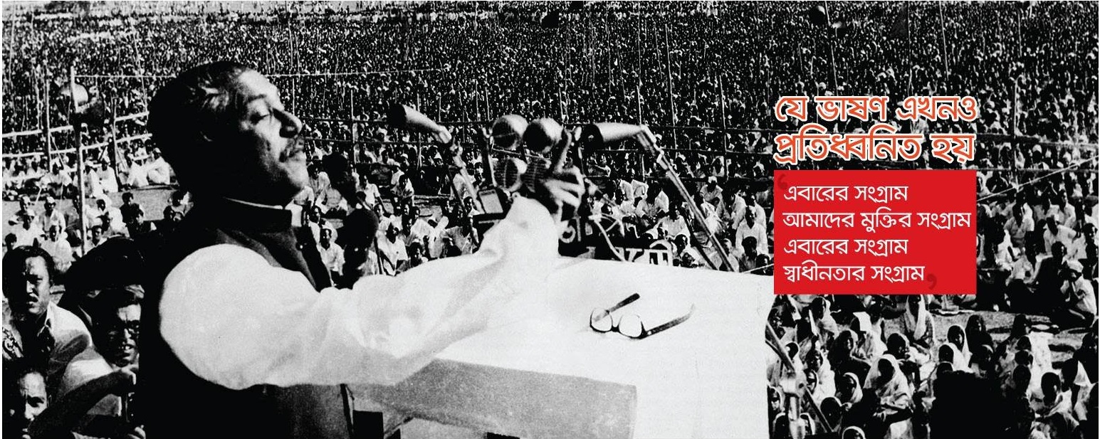
Speech‘s uphold the rights of the people of East Pakistan.

Slide 8
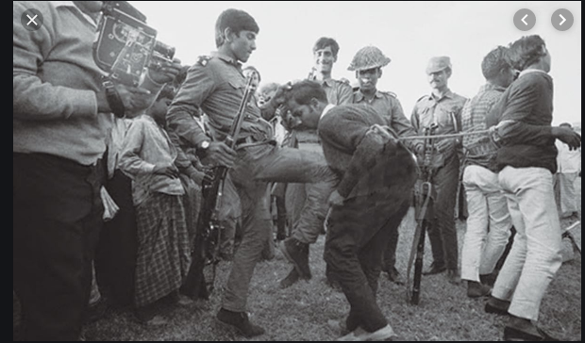
Sufferings of the people of East Pakistan by the west Pakistans provides a direction for the emancipation of the people from Pakistani ruler

Slide 9
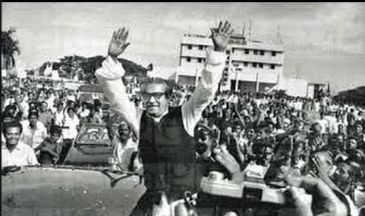
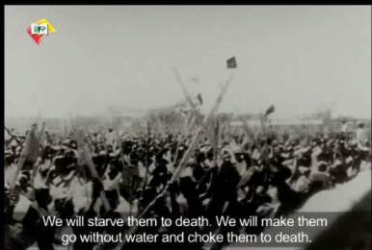
Banghabondhu ‘s calling strike was a protest against the brutality and injustice of the autocratic rulers of west Pakistan

Slide 10
Single work
Write a summery of the Passage .

Slide 11
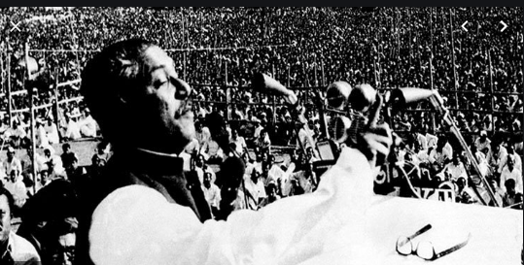
Two main parts of the speech
Description of the oppression and injustice of the Pakistani rulers and emancipation of east Pakistani Bangalees.

Slide 12
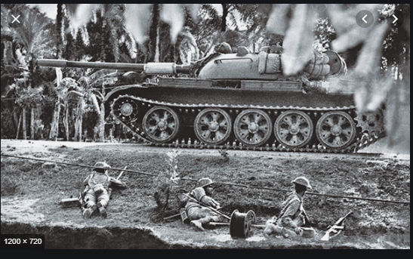
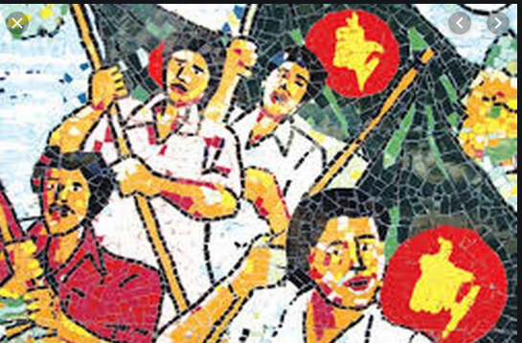
Struggle for freedom
Struggle for freedom refers to the struggle to get free from foreign rule or domination.

Slide 13
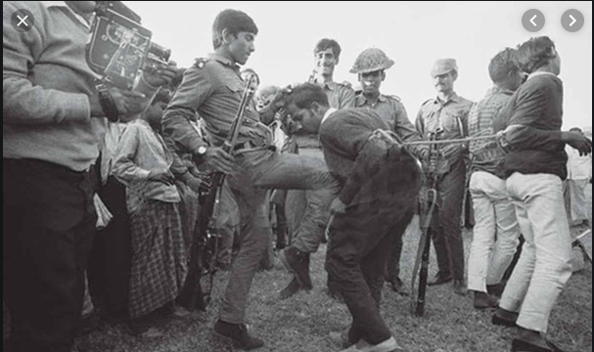
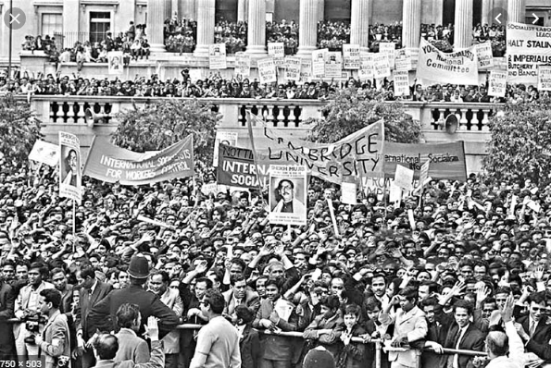
Struggle for emancipation
Struggle for getting rid of injustice ,oppression, domination and depriviation

Slide 14
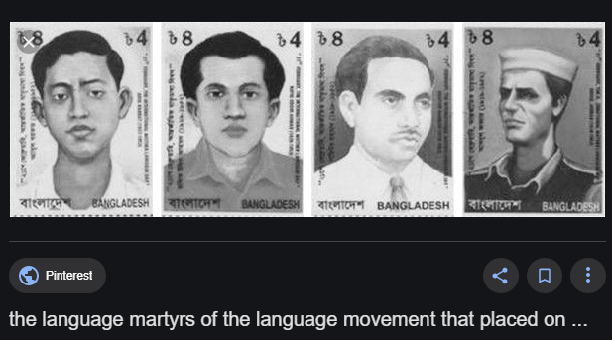
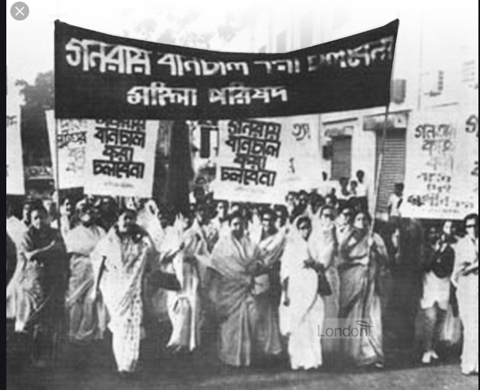
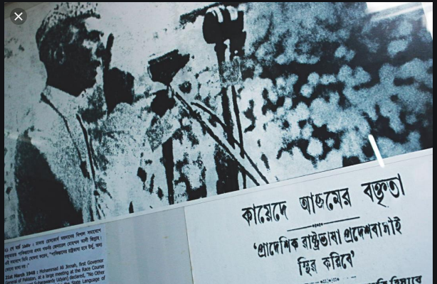
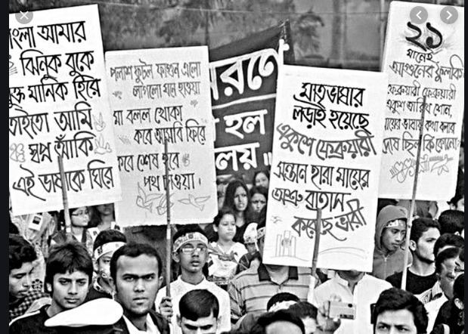
Bangalees shed blood in 1952 at the time of language movement .In 1954 Bangalees won the election but couldnot form government and enslaved by Ayub khan for ten years.

Slide 15
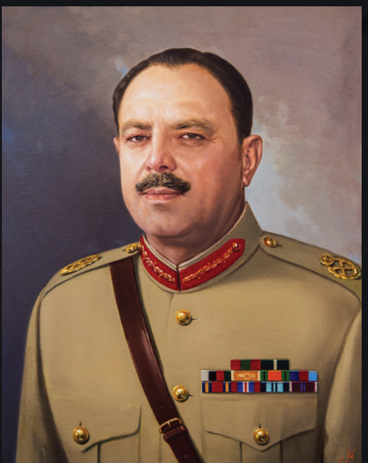
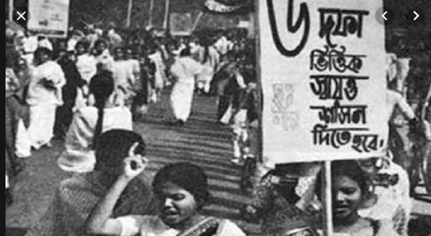
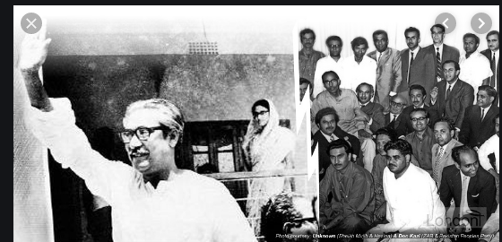
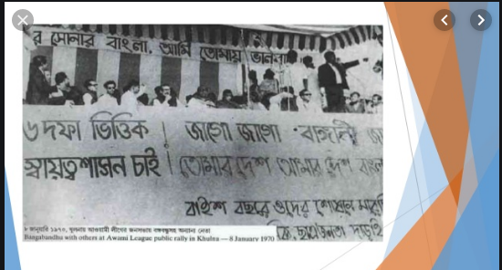
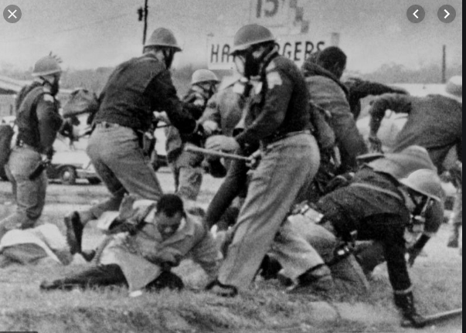
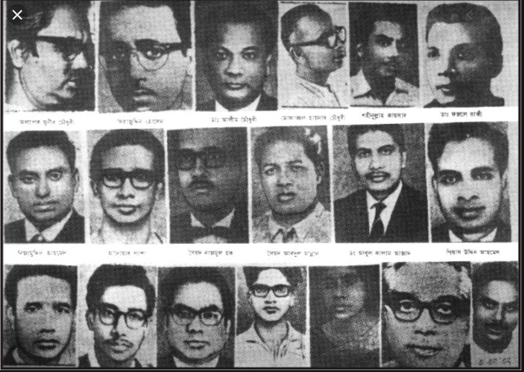
From 1966 to 1970 ,the history of Bangalees
Leadership of sheikh Mujib
In 1966 six point demand was launched
People were shot dead on june 7,1966.
Ayub Khan
A lot of killing happened after the election in 1970.

Slide 16
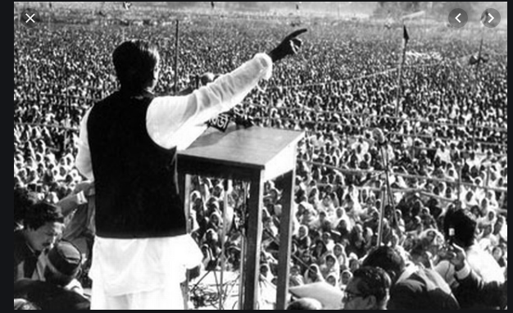
Bangabandhu’s7th march speech can be compared with the speech of the American civil rights activist Dr.Martin luther King.

Slide 17
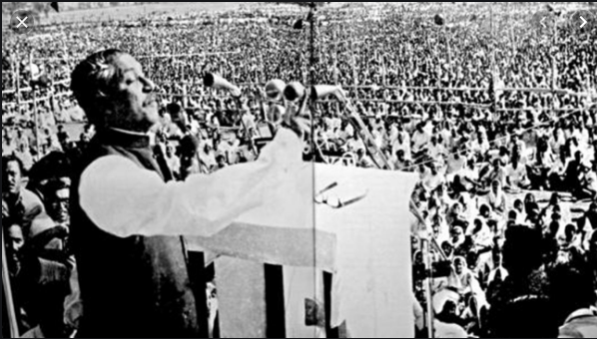
Group Work
Look at the photograph and answer the questions
1.Who is the man ? What is he doing?
2.What do you know about Bangabandhu? Where is he giving the speech?
3.What is the significance of speech?
4.Have you ever heard the speech ? Where?

Slide 18
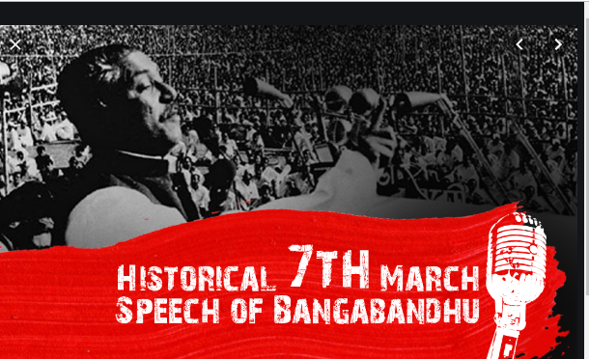
Pair work
To see the picture ask and answering the questions in pair.

Slide 19
Practise Vocabulary
Synonym
Conference, meeting
Antonym
Silence
Discussion(আলোচনা)

Slide 20
Can you tell me the word to see the picture
Synonym
Combat, battle
Antonym
Accord,Peace
Struggle (সংগ্রাম)

Slide 21
Synonym
Oppressed,afflicted
Downtrodden(নিপীড়িত)
Antonym
Privileged

Slide 22
Synonym
Run over,flood, inundate .
Overflow(উপচে পড়া)
Antonym
subside

Slide 23
Evaluation
The word “Assume” means------(a) surrender (b) seize (c) undertake (d) renew.
What does declare mean?
(a) To read something (b) to utter something (c) to say informally
(d) To announce officially.
3. What does the word movement means—
(a) Mobility (b) revolt (c) process (d) departure.

Slide 24
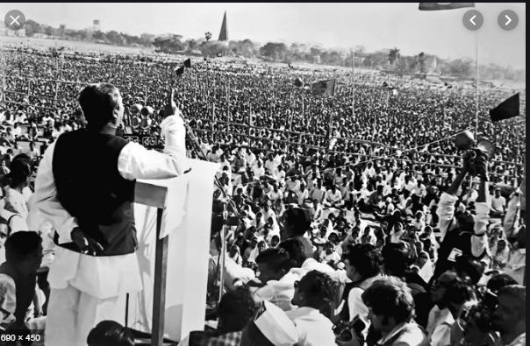
Homework
Write a paragraph about “7th march speech of Bangabandhu Sheikh Mujibur Rahman.”

Slide 25
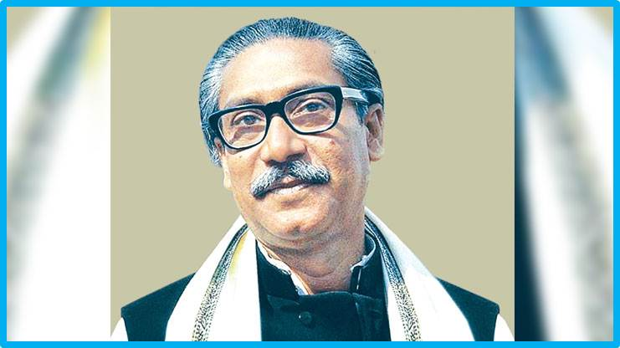
THANKS OF ALL

