Slide 2
Welcome to my new English class

Slide 3
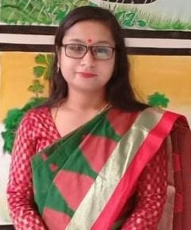
Identity
Kanan Roy
Assistant Teacher
Dakshin Chad Pur-1 Govt Primary School
Horirampur, Manikganj .

Slide 4
Our today’s topic is …..
Use of question (?) and exclamation mark (!)

Slide 5
Learning outcomes
Students will be able to
Listening 3.2.1 Understand and questions about family and friends of students .
Speaking 1.1.1 Say words, phrase and sentences with proper sounds , stress and intonation .
Reading 1.4.1 Read words , phrases and sentences in the text.
Writing 5.1.1 Use fullstop, comma, question mark and exclamation mark.

Slide 6
Looks carefully
1. What’s your name ?
2. Are you in class four ?
3. Do you go to school ?
4. Who is your English teacher ?
When we want information, we ask a question. We use a question mark at the end of these sentence .

Slide 7
Lets Practice
Add capital letters and question marks
1. do you live in rajshahi
Ans: Do you live in Rajshahi ?
2. where do you play
Ans: Where do you play ?
3. is mithun your friend
Ans: Is Mithun your friend ?

Slide 8
Lets Practice
Add capital letters and question marks
4. how old are you
Ans: How old are you ?
5. can you use a computer
Ans: Can you use a computer ?
6. where are you from
Ans: Where are you from ?

Slide 9
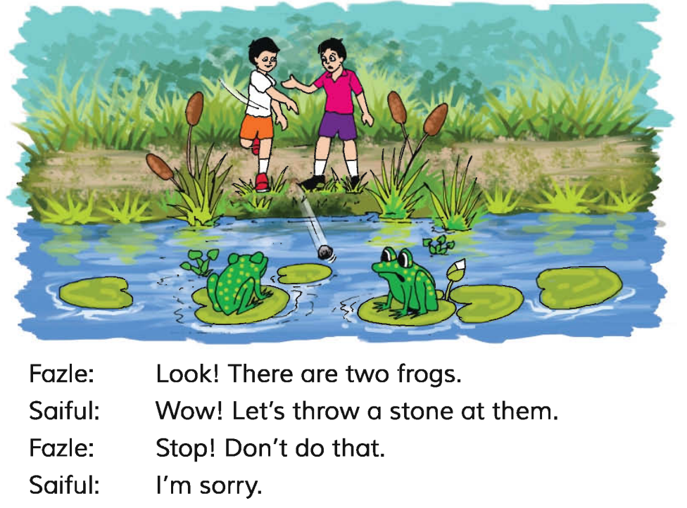
Lets Read

Slide 10
Look carefully
1. Be carefully !
2. Don’t stand up !
3. Oh , no !
4. I am so happy !
We use an exclamation mark for strong feelings or surprise .

Slide 11
Lets Practice
1. stop now
Ans : Stop now !
2. that’s great
Ans: That’s great !
3. don’t do that
Ans : Don’t do that !

Slide 12
Lets Practice
4. come here now
Ans: Come here now !
5. hurray
Ans : Hurray !

Slide 13
Home Work
Add capital letters , exclamation mark and question marks
1. What do you do in the evening
2. don’t go outside
3 what is her name
4. Can you see the man
5. How old are you

Slide 14
Good bye for today

