Slide 1
Welcome

Slide 2
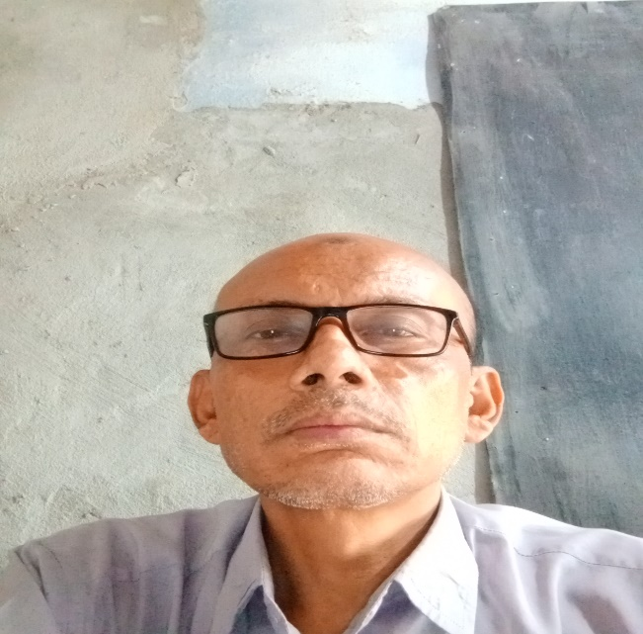
Inroduction
Class: Nine
TODAY’S LESSON
Transformation of sentences
Md.Jamal Hossan
Assistant teacher
Govt. Goila Model Secondary School
Agailjhara, Barishal

Slide 3
Learning outcomes
At the end of the lesson, Students will be able to ---- ---- ----
##. Identify kind of sentences.
#. Change the sentences (Affirmative to Negative)

Slide 4
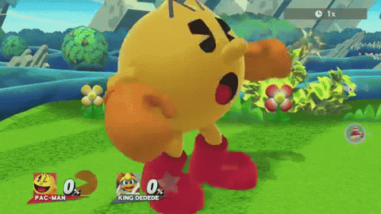
Example
Affirmative: Only Allah can save us.
Neg: None but Allah can save us.
Affair: We must go there.
Neg: We cannot but go there
Affir: The man had to do the work.
Neg: The man could not but do the work
Rules: যদিOnly/alone থাকে, তবে এর পরিবর্তে none but হয়, আর যদি বস্তু বুঝায় nothing but হয়। যদি must/has to থাকে,এর পরিবর্তে cannot but কিন্তু had to থাকলে could not লিখে Negative Sentence হয়।

Slide 5
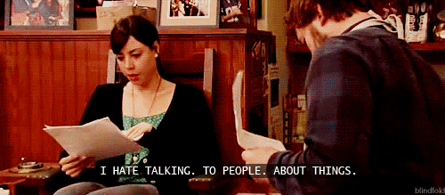
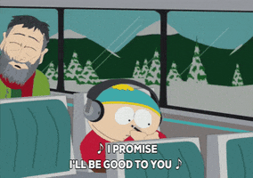
Example
#. Both Karin and Reza can do it.(Neg.)
Ans. Not only Karim but also Reza can do it.
#.He is honest and Sincere.(Neg.)
Ans. He is not only honest but also sincere.
[ Rules: Both পরিবর্তে not only এবং and এর পরিবর্ত but also ব্যবহার করে Negative করতে হয়।]
(a) Everybody wants to be happy.(Negative)
Ans. There is no nobody but wants to be happy.
(b) Everyman knew him. (Negative)
Ans. There was no man but knew him.
[Rules: Everybody/Everyman এর পরিবর্তে There is/was nobody/ no man হয়, এবং এর পরে but + verb পর others ]

Slide 6
Example
Affir: The man is too weak to walk.
Neg: The man is so weak that he cannot walk.
[ Rules: Sentence এ too থাকলে, too এরপরিবর্তে so হয়, to এর স্থলে that হয় এবং Subject এর পরে cannot + verb হয়।]
Affir: As soon as he came here, I met him.
Neg: No sooner had he come here than I met him.
[Rules: As soon as এর পরিবর্তে no sooner+ had পরে subject হয় এবং verb এর past-participle হয়, than এর পরে past indefinite tense হয়।]

Slide 7
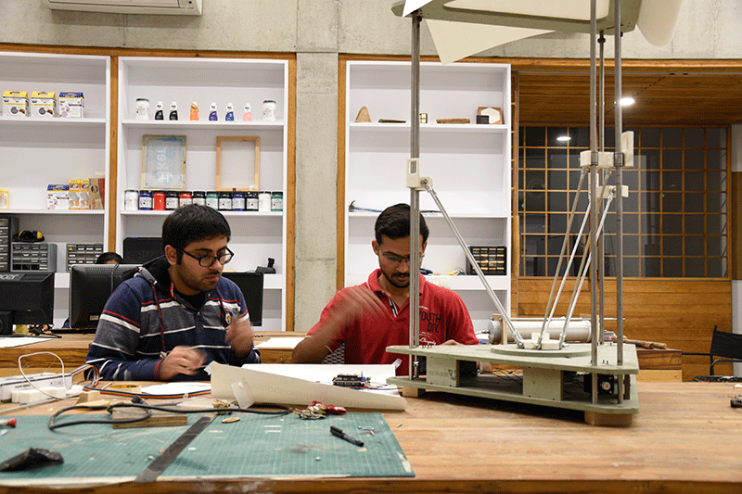
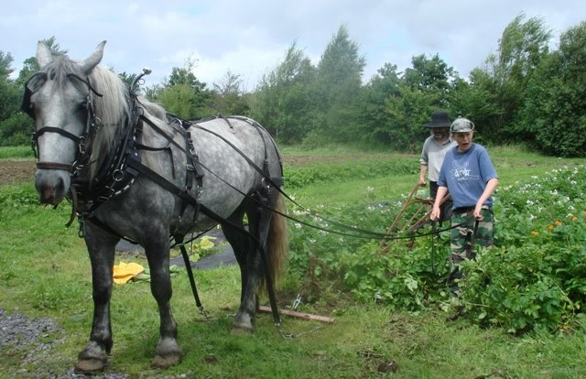
Evaluation
Student
(a) He is a regular student. (Negative)
(b) Mohsin was not an unkind man. (Affirmative)
(c) He gave me only a book.(Neg.)
(d) The farmer cannot but work in the field. (Affirmative)
(e) He will always remember you. (Neg.)
farmer

Slide 8
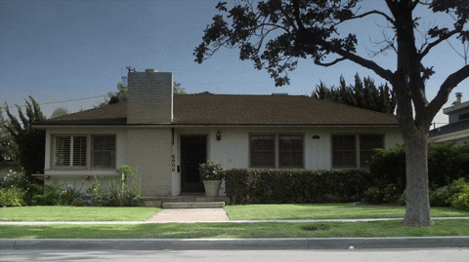
Home work
(a) He is unable to work.(Neg.)
(b) As soom as we reached the station, the train left. (Neg.)
(c) The man is too old to walk. (Neg.)
(d) There is nobody but knew him.(Affirmative)
(e) He is honest and sincere. (Neg.)

Slide 9
Thanks all

