Slide 2
Identity
Teacher’s Identity
Abdur Rahaman
Head Teacher
Otarhat Government Primary School
Kabirhat, Noakhali
Lesson Identity
Class : Two
Sub : English
Unit : 1
Lesson: 4-6
Page No: 3

Slide 3
Let’s we sing a song.
We shall overcome
We shall overcome
We shall overcome someday
Oh deep in my heart, I do believe,
………………………………..

Slide 4
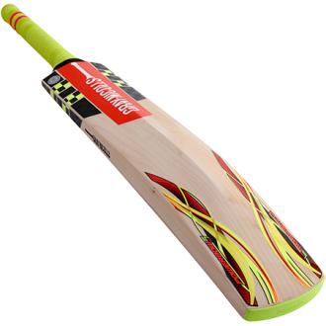
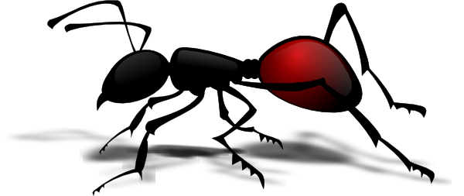
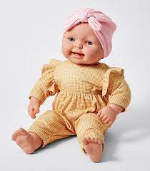
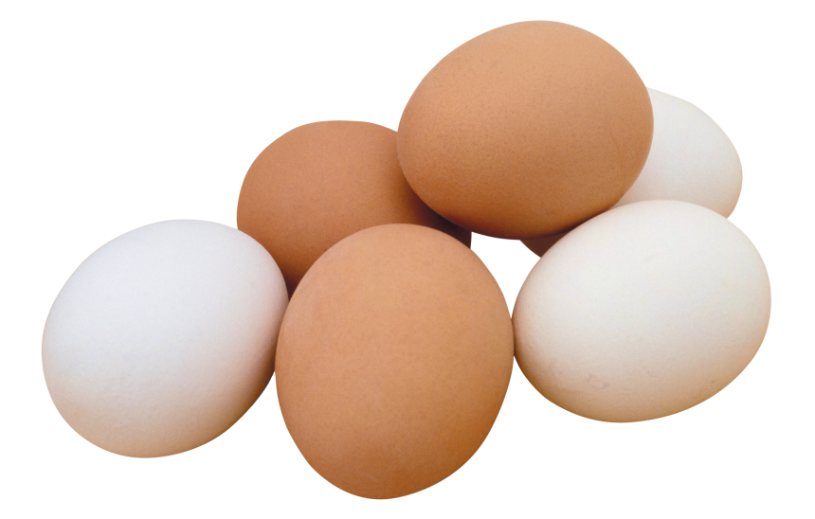
What can you see in this pictures?
Bat
Ant
Cup
Egg
Doll

Slide 5
Today’s lesson
Alphabat Aa-Ee

Slide 6
Learning outcomes
At the end of the lesson students will be able to-
1.1.1 become familiar with English sounds by listening to common English words.
1.1.1 repeat after the teacher simple words and phrases with proper sounds and stress.
1.1.2 say simple words and phrases with proper sounds and stress.
1.2.1recognize and read the alphabet both small and capital (non-cursive).
1.3.1 recognize and read the name of objects having the same initial and final sounds.

Slide 7
Look listen and say-
W.C.W
Aa
ant

Slide 8
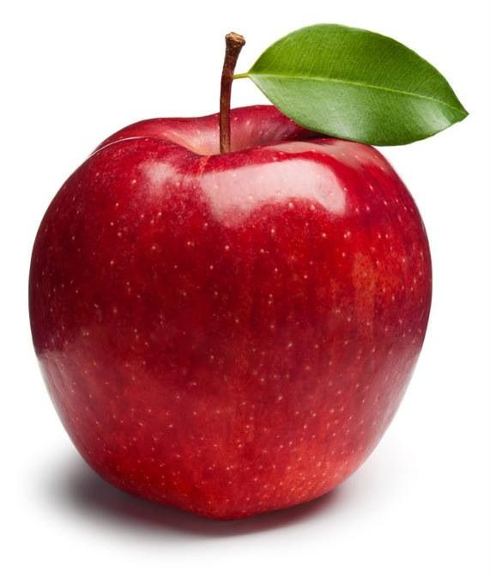
Look listen and say-
W.C.W
Aa
apple

Slide 9
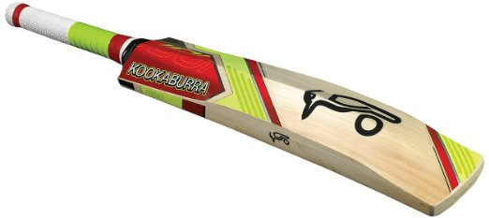
Look listen and say-
W.C.W
Bb
bat

Slide 10
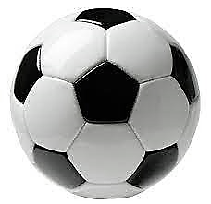
Look listen and say-
W.C.W
Bb
Ball

Slide 11
Look listen and say-
W.C.W
Cc
cup

Slide 12
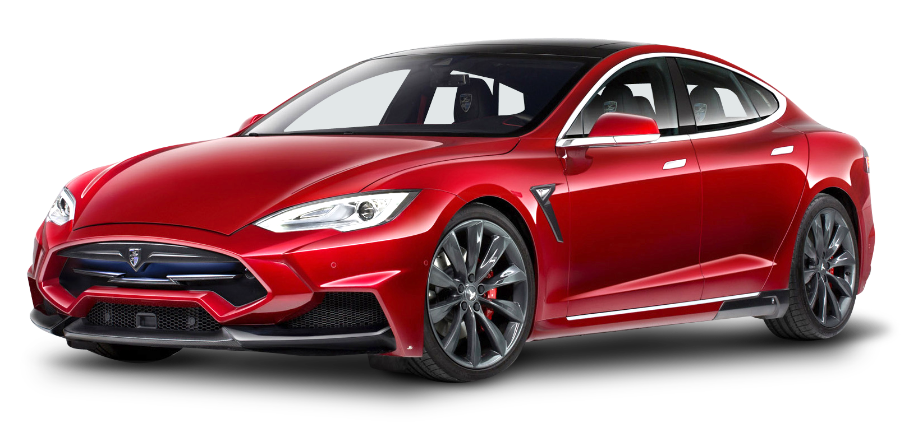
Look listen and say-
Cc
W.C.W
car

Slide 13
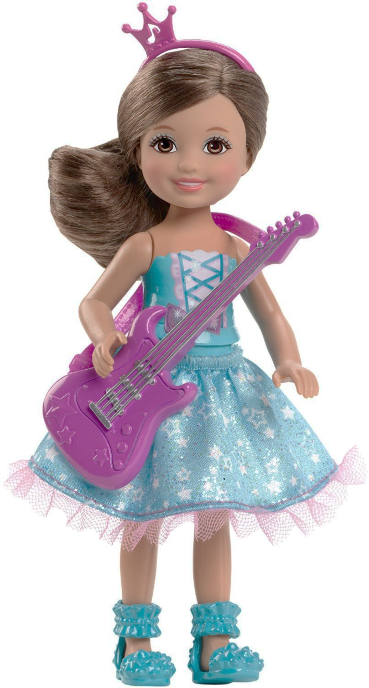
Look listen and say-
W.C.W
Dd
doll

Slide 14
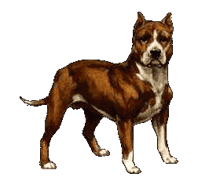
Look listen and say-
W.C.W
Dd
dog

Slide 15
Look listen and say-
W.C.W
Ee
egg

Slide 16
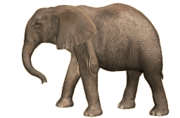
Look listen and say-
W.C.W
Ee
elephant

Slide 17
Read and say. Trace and write-
Pair work
ant
bat
cup
doll
egg

Slide 18
Individual work
Write word
a=
b=
a=
b=

Slide 19
Individual work
Write word
c=
c=
d=
e=

Slide 20
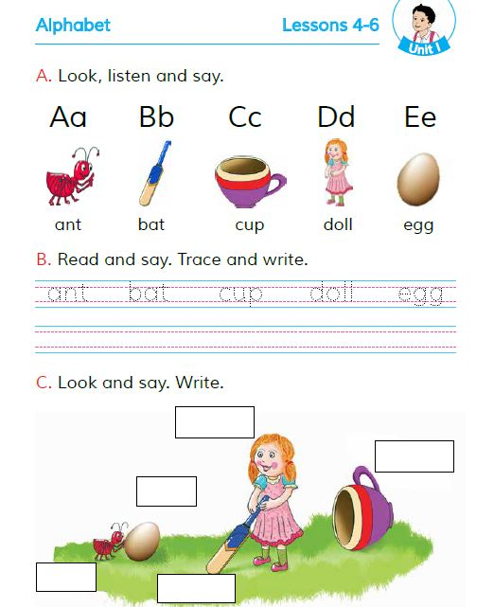
Open your English book Page 3

Slide 21
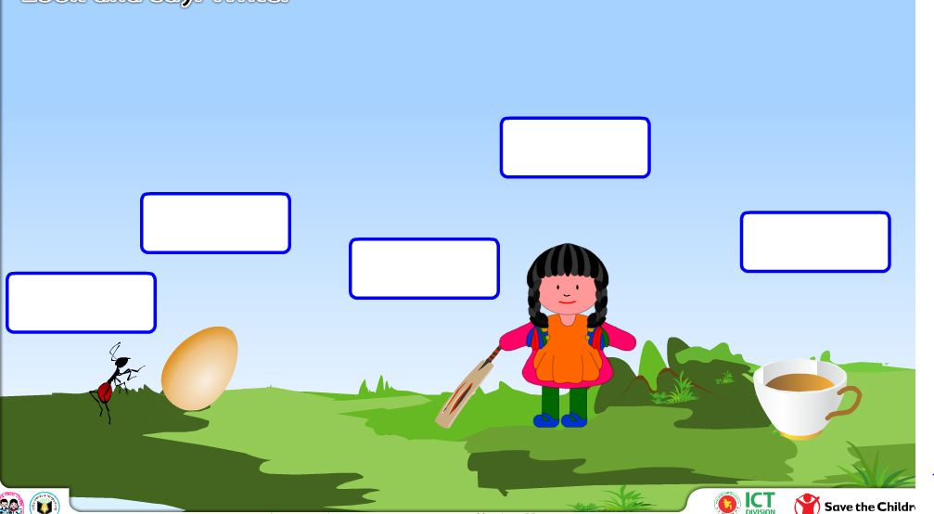
Group work
Fill in the box.
Doll
Egg
Cup
Bat
Ant

Slide 22
Click the right letter
Evaluation
Ant
wrong
wrong
wrong
wrong
B
A
C
D
E

Slide 23
Click the right letter
Evaluation
Bat
wrong
wrong
wrong
wrong
B
C
D
F
E

Slide 24
Click the right letter
Evaluation
Cup
wrong
wrong
wrong
wrong
B
A
E
D
C

Slide 25
Click the right letter
Evaluation
Doll
wrong
wrong
wrong
wrong
B
A
E
D
C

Slide 26
Click the right letter
Evaluation
Egg
wrong
wrong
wrong
wrong
B
A
C
E
D

Slide 27
Say, read and match
ant
d0ll
egg
bat
cup

Slide 28
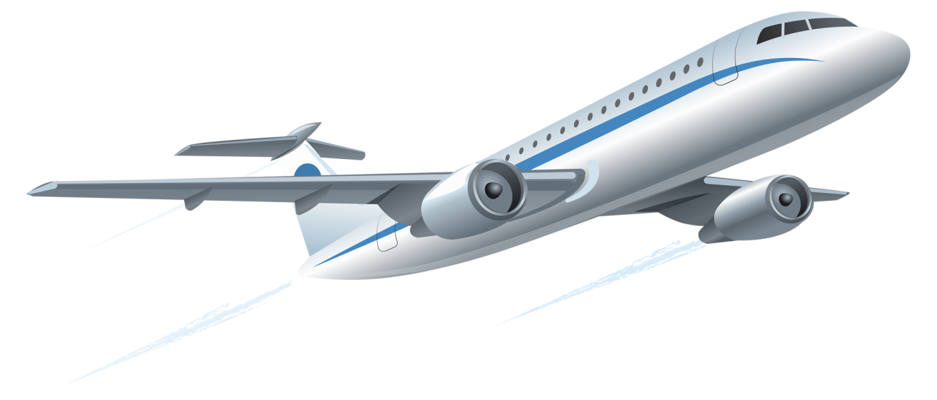
Bye bye

