Slide 1
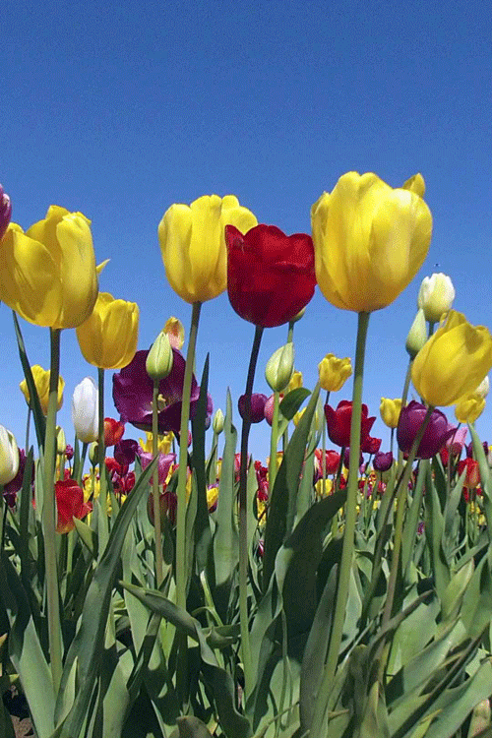
WELCOME TO ALL

Slide 2
Unit-7
Lesson-3
Flashback
ফিরে দেখা
Word Analysis
Ancestral (পিতৃ পুরুষের/পুরুষাণুক্রমিক) of previous generations
Appreciated (প্রশংসা করা) be grateful for
Artiste( পেশাদার গায়ক, অভিনেতা, নৃত্যশিল্পী ) professional entertainer
Forefather ( পূর্ব পুরুষ/পিতৃ পুরুষ) male ancestor/ precursor
Locality (জনপদ ) a particular area or neighbourhood
Spellbound ( মন্ত্রমুগ্ধ) completely captivated

Slide 3
Partha protim Majumder was born in 1954 in Pabna to a family of artistes. He spent most of his early years in his big ancestral home, situated in a small locality known as Kalachandpara.
At that time Kalachandpara was well known for its cultural activities.
There were festivals and various types of cultural shows round the year.
Majumder’s father, photographer by profession was an art lover.
He taught and inspired his son to appreciate different forms of art.
Majumder went to live with his aunt in Chandernagar, 30 kilometres away from Kolkata in 1966.It was there that he first came across a mime artiste named Jogesh Dutta. The way Dutta narrated stories without uttering a single word, left Majumder spellbound. He took lessons on mime from Dutta in his mime academy in Kolkata from 1966 to 1972.

Slide 4
Let’s Read the text with Bengali translation.
Partha protim Majumder was born in 1954 in Pabna to a family of artistes.
পার্থ প্রতীম মজুমদার ১৯৫৪ সালে পাবনার একটি শিল্পী পরিবারে জন্মগ্রহণ করেন।
He spent most of his early years in his big ancestral home, situated in a small locality known as Kalachandpara.
শুরুর দিকে তিনি তার বেশীর ভাগ সময় কাটিয়েছেন তার পূর্ব-পুরুষদের বাড়িতে যা ছিল কালাচাঁদপাড়া নামক এক ছোট্র জনপদে অবস্থিত।
At that time Kalachandpara was well known for its cultural activities.
সে সময় কালাচাঁদপাড়া সু-পরিচিত ছিল তার সাংস্কৃতিক কর্মকাণ্ডের জন্য।
There were festivals and various types of cultural shows round the year.
সারা বছর ধরে উৎসব ও বিভিন্ন ধরনের সাংস্কৃতিক প্রদর্শণী হত।
Majumder’s father, photographer by profession was an art lover.
মজুমদারের বাবা, একজন পেশাদার ফটোগ্রাফার ছিলেন শিল্পের অনুরাগী।

Slide 5
He taught and inspired his son to appreciate different forms of art.
তিনি তার ছেলেকে বিভিন্ন ধরনের শিল্পের সমাদর করতে শেখান ও উৎসাহ প্রদান করেন।
Majumder went to live with his aunt in Chandernagar, 30 kilometres away from Kolkata in 1966.
১৯৬৬ সালে মজুমদার তার চাচীর সাথে বসবাস করার জন্য কলকাতা থেকে ৩০ কিলোমিটার দূরবর্তী চন্দননগরে যান।
It was there that he first came across a mime artiste named Jogesh Dutta.
এখানে প্রথমবারের মতো তিনি যোগেশ দত্ত নামের এক মূকাভিনয় শিল্পীর সাক্ষাৎ পান।
The way Dutta narrated stories without uttering a single word, left Majumder spellbound.
দত্ত যেভাবে একটি শব্দ উচ্চারণ না করেও ঘটনা বর্ণনা করছিলেন তা দেখে মজুমদার মন্ত্রমুগ্ধ হলেন।
He took lessons on mime from Dutta in his mime academy in Kolkata from 1966 to 1972.
১৯৬৬ থেকে ১৯৭২ পর্যন্ত তিনি কলকাতায় যোগেশ দত্তের কাছে তার মূকাভিনয় একাডেমিতে মূকাভিনয়ের ওপর শিক্ষা গ্রহণ করেন।

Slide 6
SINGLE TASK
Choose the best answer from the alternatives.
The birth place of Partha Patim Majumder is ……..
i. Jashore ii. Pabna iii. Khulna iv. Chattogram.
Answer- ii. Pabna
b) Majumder was born in…………….
1951 ii. 1952 iii.1953 iv. 1954
Answer- iv. 1954
c) He spent most of his early years in his ………. Home.
i. ancestral ii. Private iii. Own iv. Father-in-laws
Answer- i. ancestral
d) Majumder’s native village is……..
i. Kalachandpara ii. Sonapur iii. Masterpara iv. Ukilpara
Answer- i. Kalachandpara
e) Kalachandpara was well known for its …… activities.
i. Political ii. Cultural iii. Religious iv. Historical
Answer- ii. Cultural

Slide 7
f) Majumder’s father was a …………
i. Photographer ii. Pilitisian iii. Journalist iv. Historian
Answer- i. Photographer
g)Majumder’s father was an art…………
i. Destroyer ii. Preserver iii.lover iv. Technician
Answer- iii.lover
2. Answer the following questions in your own words.
Where was Partha protim Majumder was born?
When was he born?
Where did he spend most of his early years?
What was Kalachandpara famous for?
What was Majumder’s father?
Please match your answers.
Where was Partha protim Majumder was born?
Answer-In Pabna
When was he born?
Answer- in 1954
Where did he spend most of his early years?
Answer-in his ancestral home of kalachandpara.
What was Kalachandpara famous for?
Answer- for its cultura activities.
What was Majumder’s father?
Answer- a photographer.

Slide 8
EVALUATION
2. Answer the following questions in your own words.
Where was Partha protim Majumder was born?
When was he born?
Where did he spend most of his early years?
What was Kalachandpara famous for?
What was Majumder’s father?

Slide 9
HOME TASK
Write a summary of the passage in no more than 70/80 words.

Slide 10

THANK YOU SO MUCH

