Slide 2
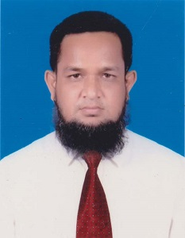
TEACHERS IDENTITY
Md.Abdur rouf
BA(Hons.), English, MA, English
Lecturer in English Khalna Islamia Fazil Madrasah rouf301285@gmail.com

Slide 3
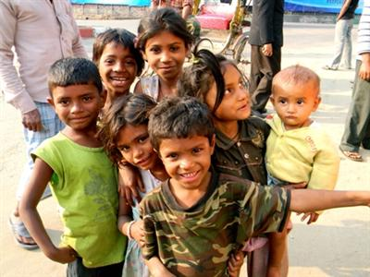
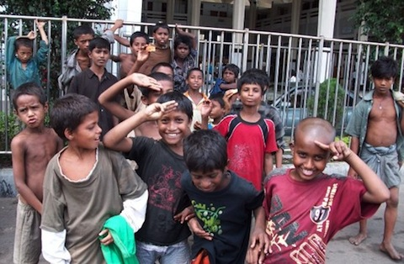
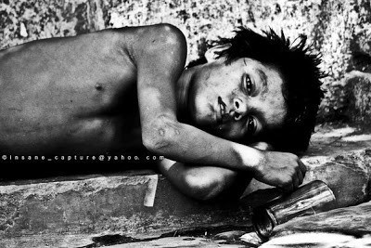
Whom do you see in the pictures?
What are they doing?
Have you seen them in your locality?
Street Children

Slide 4
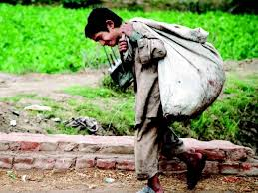
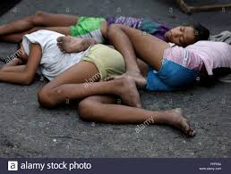
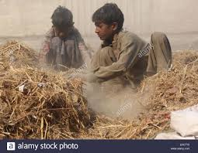
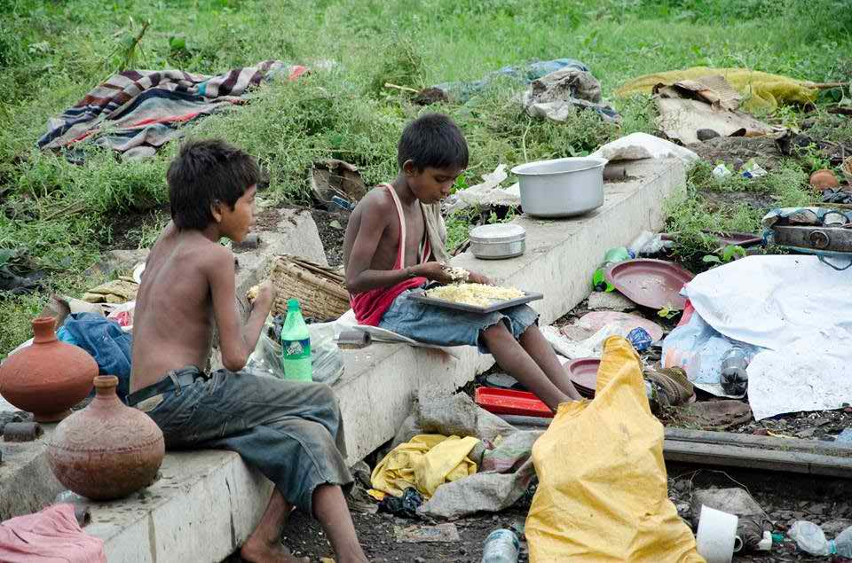
What do you notice in the pictures? Do you think that they are street children? Why?

Slide 5
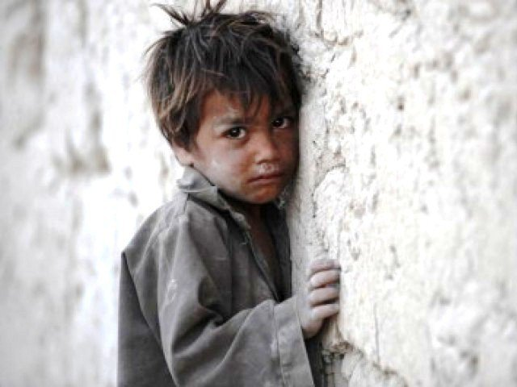
Today’s topic is about- Amerigo, a street child Unit-08,Lesson-04 Classes: XI-XII And Alim

Slide 6
Learning Outcomes:
After the lesson Students will be able to
1. Talk about Amerigo
2. To tell the meanings some words
3. Ask and answer the question

Slide 7
13 years old
Separated from his parents
Works –selling ice cream, collecting waste, shoe-shining.
Suffered from diseases
Wants a peaceful own home
Amerigo

Slide 8
13 Years old
Wants a peaceful own home
Suffered from diseases
Works- selling ice cream, collecting trash, shoe-shining
Separated from his parents

Slide 9
New Words:
Synonyms
Separated (v)
Detached, Cut in two
Antonyms
United, Associated
Amerigo’s parents are separated from each other.

Slide 10
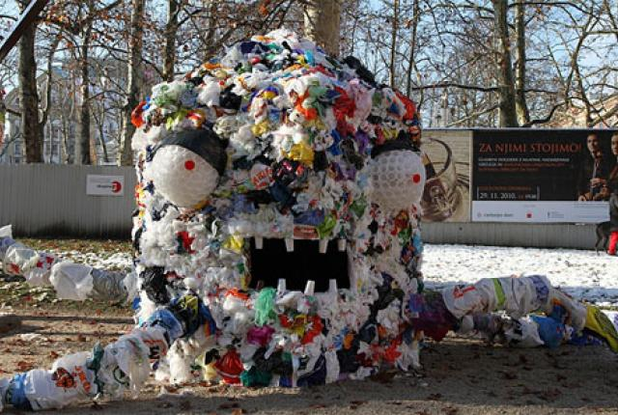
Synonyms
Waste, Rubbish
Trash(n)-
Antonym
Cleanliness
Amerigo used to collect trashes.

Slide 11
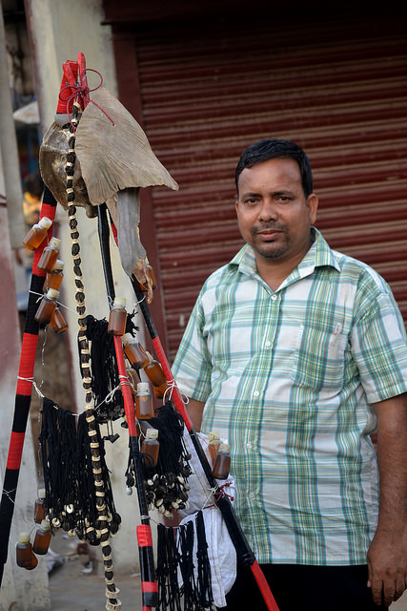
Synonyms
Hawker, Dealer
Vendor(n)-
Antonym
Customer
Amerigo used to sell trashes to a vendor.

Slide 12
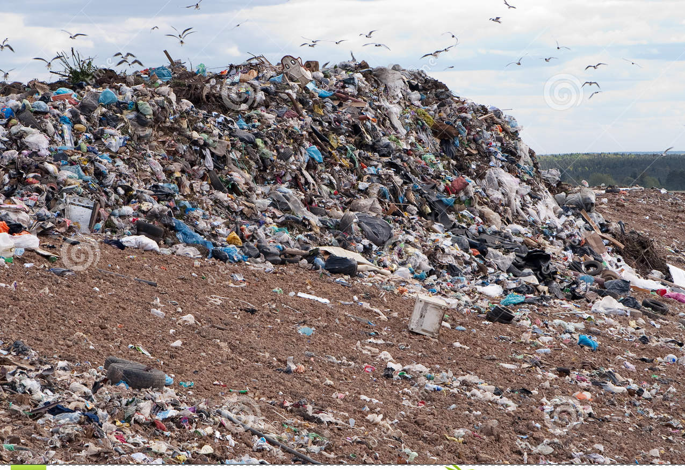
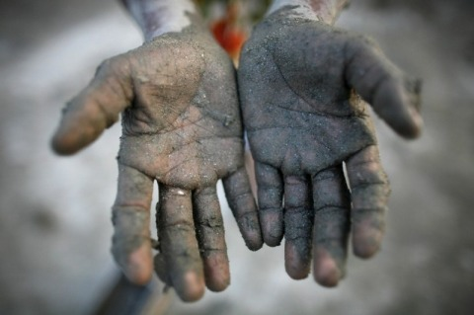
Synonyms
Depot, Rubbish pile
Dump-
We should use dumps for throwing our waste.
Synonyms
Attack, Unsoundness
Antonyms
Disease -
Soundness, Good health
My friends suffered from serious diseases who worked in dumps.

Slide 13
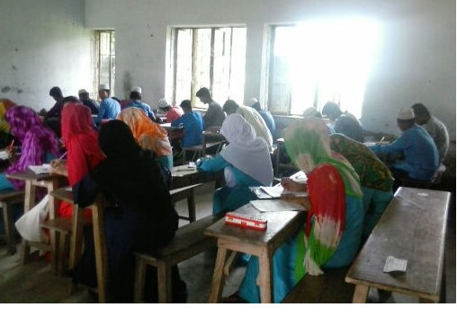
Silently Read The Text

Slide 14
GROUP WORK
Answer the following questions :
1. What is your impression about Amerigo’s parents? (Group-1)
2. What was Amerigo’s first job? What made him stop doing that job? (Group-2)
3.Do you feel pity for him? Why?(Group-3)
4.How does Amerigo evaluate his life now? (Group-4)

Slide 15
PAIR WORK
Imagine you are Amerigo and Rumpa is your partner.Now make a conversation between you and your partner using the words- separation, trash, vendor, dump. Other ss will listen.

Slide 16
INDIVIDUAL WORK
Write a list of the differences between yours, and Amerigo’s lives by following the table.
Amerigo’s life My life (similarities) My life (dissimilarities)
1.
2.
3.
4.
5.
1.
2.
3.
4.
5.
1.
2.
3.
4.
5.

Slide 17
HOME WORK
1.Who is Amerigo?
2.Where do street children sleep?
3.What is the condition of them in winter?
4.Have you got such children in your locality? What problems do they have in their lives?
5.Do you think that Amerigo is having human rights?

Slide 18
THANKS OF ALL

