Slide 2
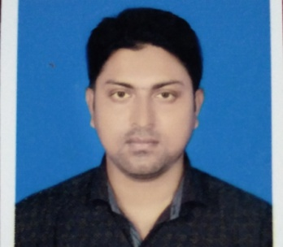
Introduction of teacher
Zihad Ahmad Sardar
Asst. teacher
Barber Govt. Primary School
Kapasia, Gazipur.

Slide 3
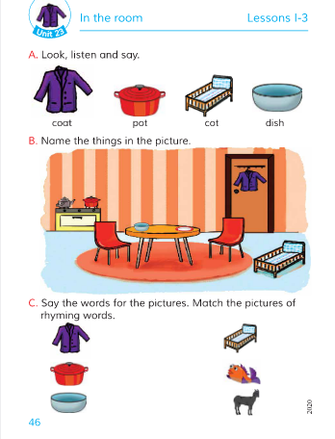
Introduction of Lesson
Class: One
Sub: English
Unit: 23
Lesson: 1-3

Slide 4
Learning outcomes:
By the end of the lesson students will be able-
1.1.1: To become familiar with English sounds by listening to common English words.
1.1.2: To say simple words and phrases.

Slide 5
Greetings and warm up
https://www.youtube.com/watch?v=EHUP9fakoos

Slide 6
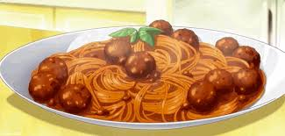
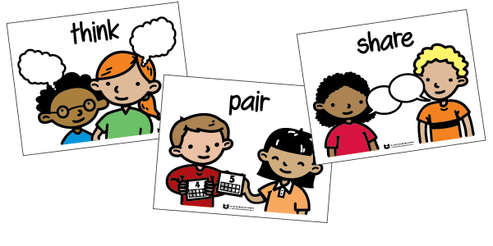
Showing picture
Say about the pictures

Slide 7
Today’s Lesson
In the room

Slide 8
Teacher’s Reading

Slide 9
Coat
Pot
Cot
Dish

Slide 10
Match the pictures of rhyming words

Slide 12
Students will practise in small group
Small group work

Slide 13
Students will practise in small group
Small group work

Slide 14
Students will practise in small group
Small group work

Slide 15
Task
1.Write the name of the pictures.
2.Match the pictures of rhyming words.

