Slide 1
o
W
e
e
M
l
C

Slide 2
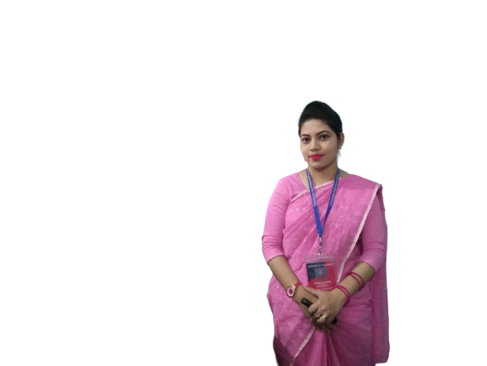
Teacher’s Identity
ASMA KHANOM
ASSISTANT TEACHER
KALACHANDPUR GPS SADAR,NOAKHALI

Slide 3
LESSON
INTRODUCTION
Class :Two
Subject: English
Lesson’s name : Colours
Unit:16
Lesson:4-6(A)

Slide 4
Let’s sing a song

Slide 5
Look at the picture
What is this?
Rainbow.
How many colours are there in Rainbow?
7 Colours

Slide 6
Our Today’s Lesson is-
COLOURS

Slide 7
Learning outcomes:
Students will be able to -
1.1.1 Become familiar with English sounds by listening to common English word.
1.1.2 Say simple words and phrases with proper sounds and stress.
1.4.1 Read words and phrases sentences with the help of visual clues and simple sentences.
3.1.1 Write words and phrases using non-cursive capital letters.

Slide 8
A.Look, listen and say.
What colour is this?
Red

Slide 9
A.Look, listen and say.
What colour is this?
Orange

Slide 10
A.Look, listen and say.
What colour is this?
Yellow

Slide 11
A.Look, listen and say.
What colour is this?
Green

Slide 12
A.Look, listen and say.
What colour is this?
Blue

Slide 13
A.Look, listen and say.
What colour is this?
Indigo

Slide 14
A.Look, listen and say.
What colour is this?
Violet

Slide 15
Let’s play a bingo game
Colours
Red
Orange
Yellow
Blue
Green
Indigo
Violet

Slide 16
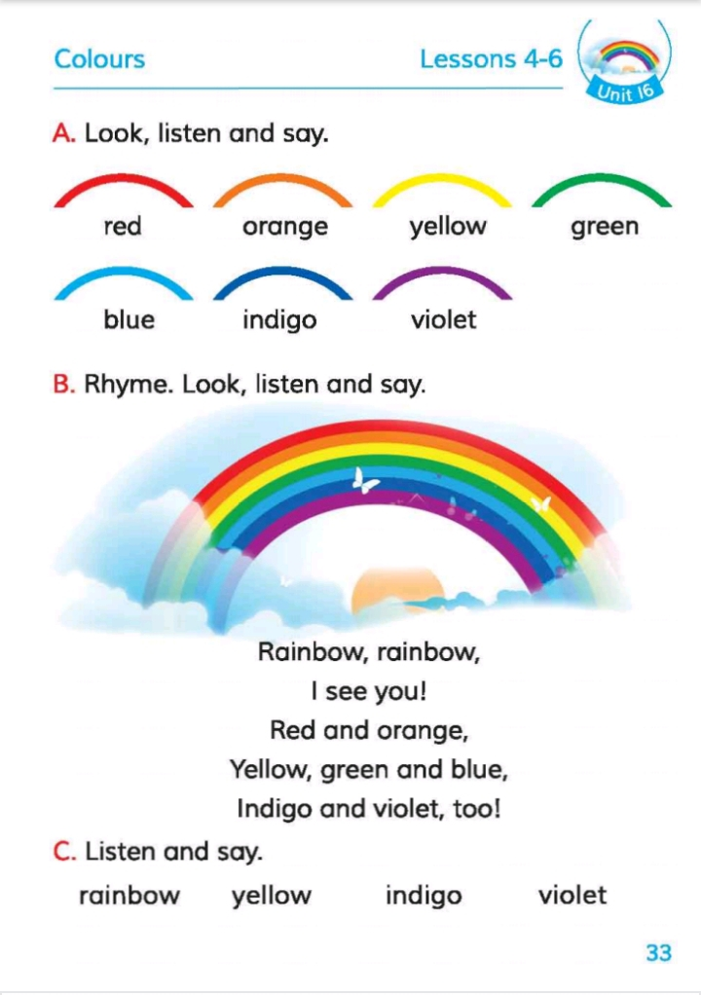
Open at page 33

Slide 17
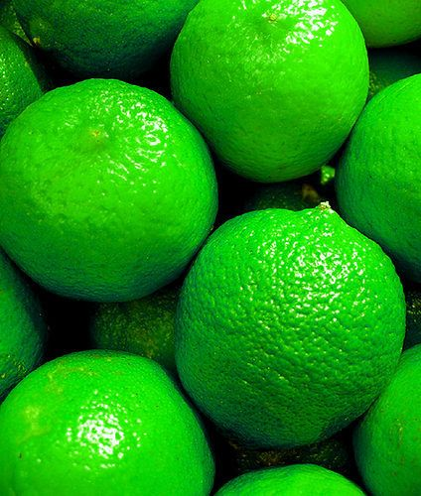
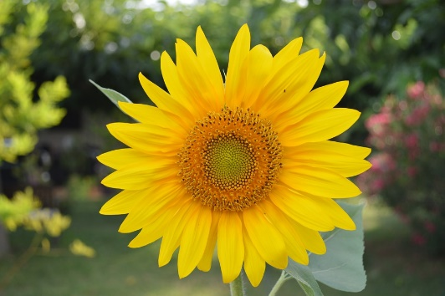
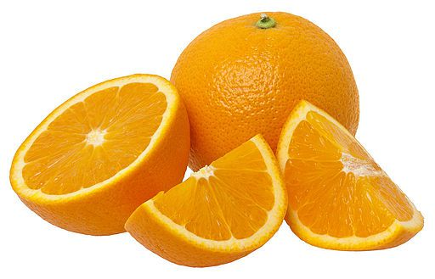
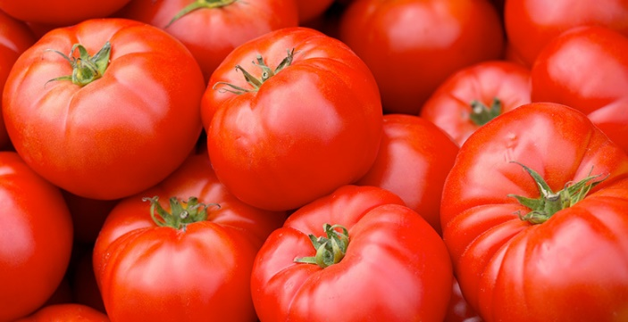
GROUP WORK
Write the colour’s name below the picture.
Group-1
………………………..
……………………….....
……………………….....
Group-2
…………………………
………………………..
………………………..

Slide 18
Match the pictures with the colours name.
Pair Work
violet
blue
orange
yellow
indigo
red
green

Slide 19
Individual Work
Look, listen and say the name of the colour.
VIOLET
INDIGO
BLUE
GREEN
YELLOW
ORANGE
RED

Slide 20
Evaluation
Answer the following questions
a)How many colours are there in a rainbow?
a)There are 7 colours in a rainbow.
b)Write the name of seven colours
b)Red,Orange,Yellow,Green,Blue,Indigo and Violet.

Slide 21
Home work
Draw a Rainbow and colour it

