Slide 1
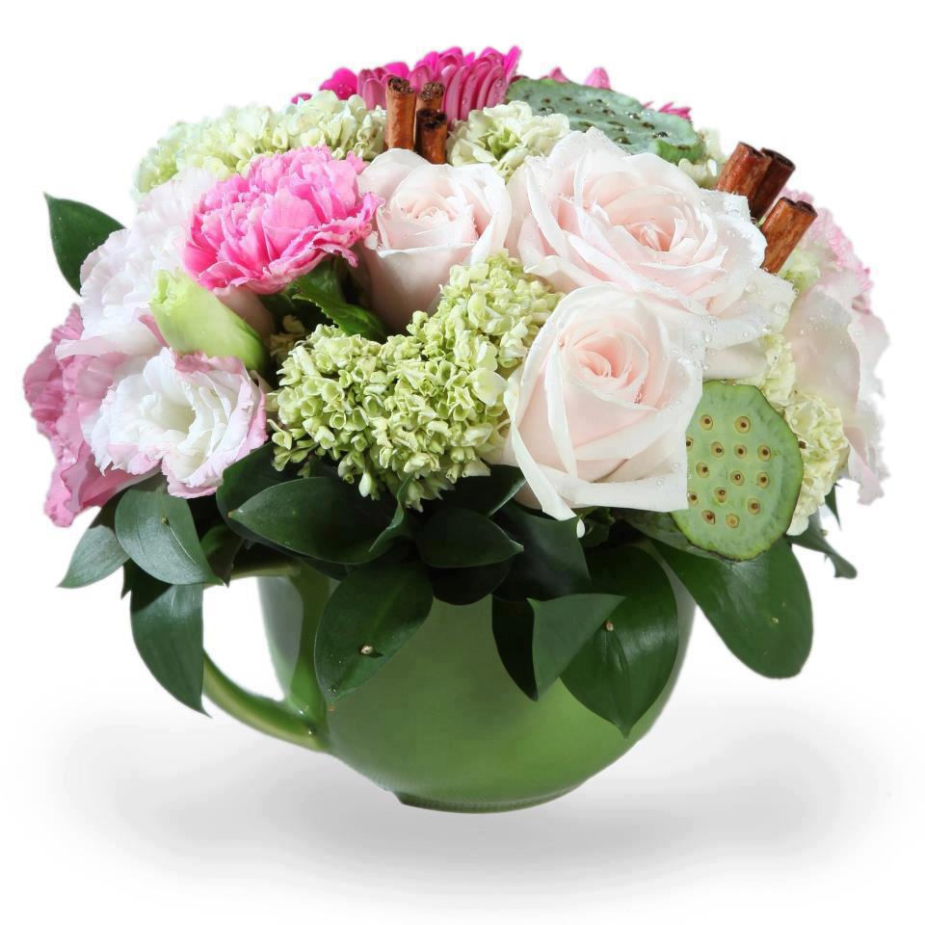
WELCOME

Slide 2
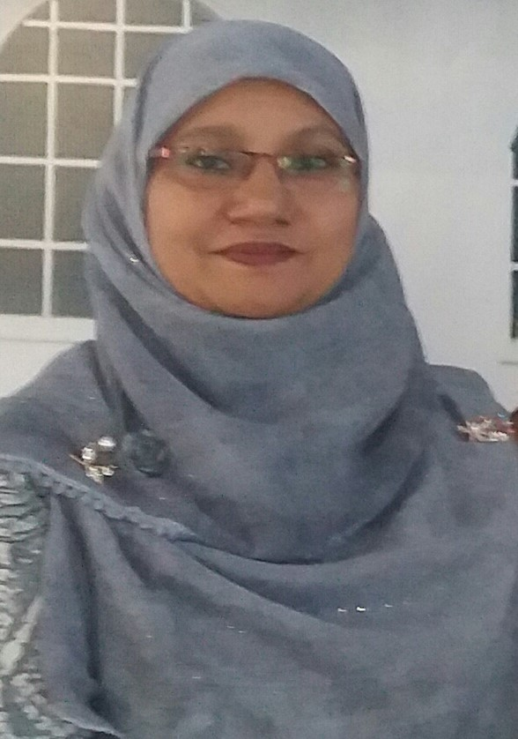
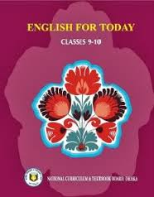
Identity
Shamsun Naher
Senior Teacher
Dider Model High School ,Sadar ,comilla
ENGLISH FOR TODAY
CLASS : Nine & Ten

Slide 3
Look at the flags and talk with your partner: what are the countries names of these flags?
BHUTAN
SRI LANKA
INDIA
MALDIVES
NEPAL
PAKISTAN
They are our neighboring countries.

Slide 4
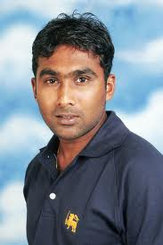
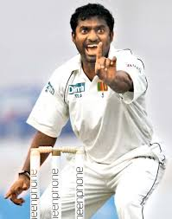
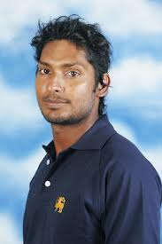
Look at the following pictures and guess who they are and what their names are.
Mahela Joybordhonay
Murali Dharan
Kumar Sangakara
They all are Sri Lankan cricketers.

Slide 5
So, today we’ll Know about
OUR NEIGHBOURS
* SRI LANKA *

Slide 6
Learning outcomes
After completing this lesson, students will be able to …..
read, comprehend and summaries text.
ask and answer questions.
write a paragraph about some interesting places of a country.

Slide 7
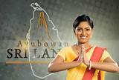
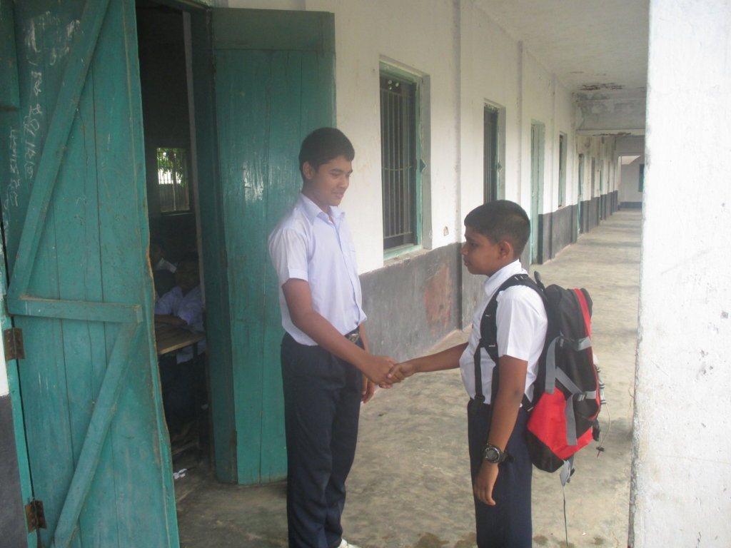
Do you know what do Sri Lankan people say at this situation?
Look at the picture and discuss with your friend : what do we say when any new person come to us?
Usually we say :
welcome
Sri Lankan people say
Ayubowan
Ayubowan mean: “ May you have the gift of long life”.

Slide 8
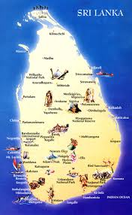
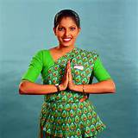
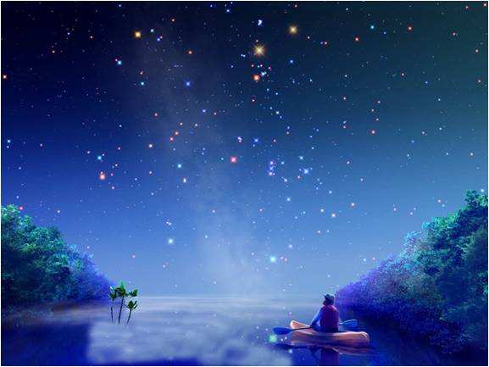
Model Reading
Listen the text attentively then answer the questions that has been given section ‘A’.

Slide 9
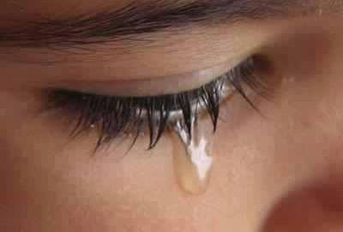
Teardrop
Key word
The nickname of Sri Lanka is teardrop of India.
Meaning
(Click here)
A drop of water that comes from eye in sorrow.

Slide 10
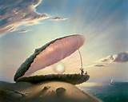
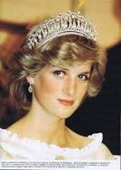
Pearl
Key word
Can you make a sentence with the word “pearl”.
Princes Diana used to wear crown made of pearl.
Meaning
(Click here)
Pearl is a hard object that grows in a shell.

Slide 11
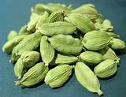
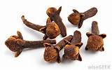
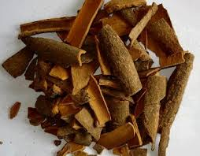
Spice
Key word
Can you make a sentence with the word “spice”.
Spices make our carry delicious.
Meaning
(Click here)
A spice is a dried seed, fruit, root, bark

Slide 12
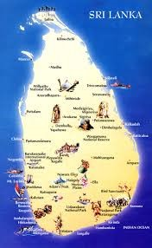
The nicknames of Sri Lanka.
Teardrop of India
Pearl of the Indian Ocean
Serendip

Slide 13
Land area of Sri Lanka.
Sri Lanka measures about 415 kilometres from north to south.
22o kilometres from east to west and total land area of about 65,600 square kilometres.

Slide 14
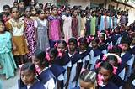
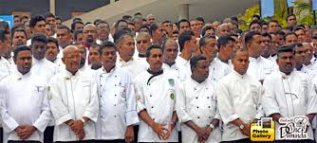
Population of Sri Lanka.
Talk your partner: What do you know about Sri Lankan population?
There are about 20 million people in Sri Lanka.

Slide 15
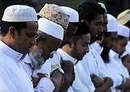
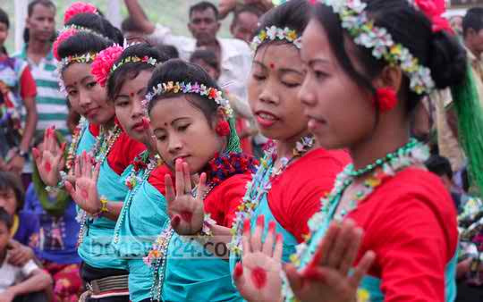
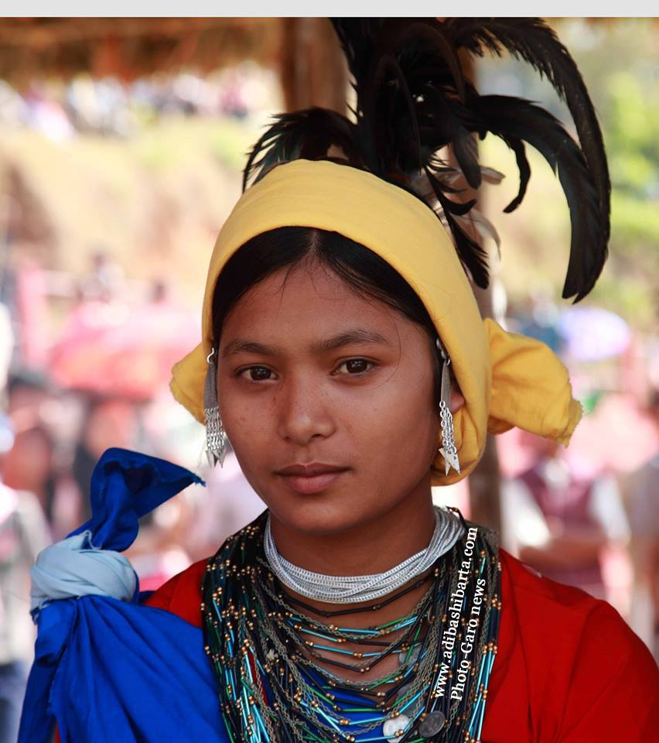
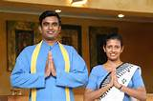
Ethnic groups in Sri Lanka
Sri Lankan Moors or Muslims
Sinhalese
Sri Lankan Tamils
Indian Tamils
Look at the pictures of ethnic groups of Sri Lanka and guess what are their names?

Slide 16
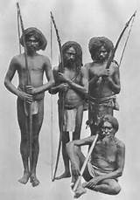
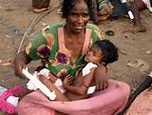
Look at the picture and guess who are they?
They are a fifth ethnic group named Veddhas, original inhabitants of Sri Lanka.

Slide 17
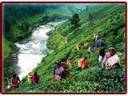
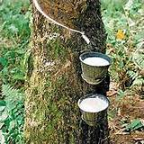
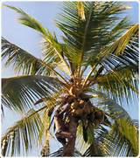
Economy of Sri Lanka
Look at the above pictures and discuss with your partner: Then write down about the economy of Sri Lanka?

Slide 18
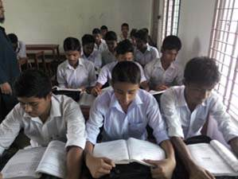
Silent Reading.
Read the passage carefully then answer the questions that have given section ‘C’ and ‘D’.

Slide 19
HOME WORK
Write a paragraph about the agriculture of Bangladesh.

Slide 20
Home works
Fill in each gap with a suitable word of your own based on the information from the text.
If you go to visit Sri Lanka, you will be (a)……………….. With a traditional greeting–Ayubowan. Sri Lanka is an island country which is situated in the Indian Ocean. Its shape is like a (b)……………….. . It is medium in size and population. Among all the ethnic groups, the Veddhas are the (c) …………….. Inhabitants of the island. The ancient history of this land is (d) ………………… In Ramayana. This island like country attracted many travellers as well as the ancient mariners and it still (e) ……………….the tourists of modern age by its enormous.
welcomed
teardrop
original
presented
attracts.
a
b
c
d
e

Slide 21
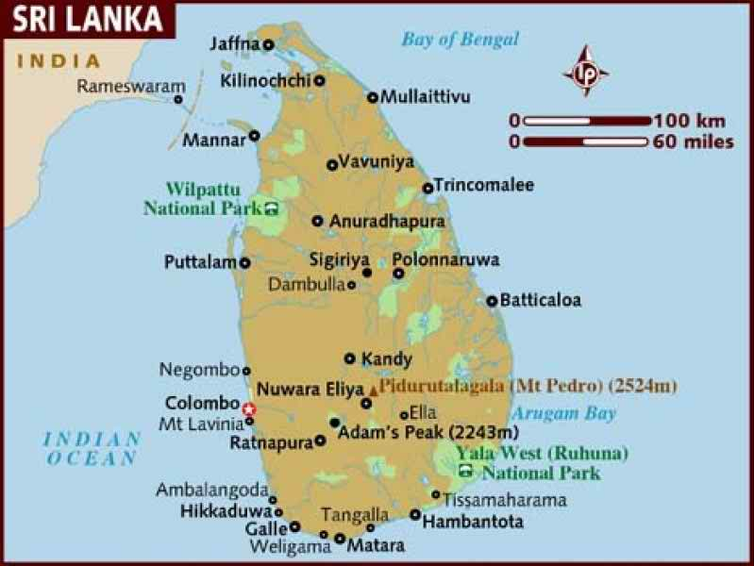
Look at the map then write down the location and shaped of Sri Lanka
Sri Lanka is located in the Indian Ocean, shaped like a teardrop.

Slide 23
Group works
Fill in each gap with a suitable word of your own based on the information from the text.
If you go to visit Sri Lanka, you will be (a)……………….. With a traditional greeting–Ayubowan. Sri Lanka is an island country which is situated in the Indian Ocean. Its shape is like a (b)……………….. . It is medium in size and population. Among all the ethnic groups, the Veddhas are the (c) …………….. Inhabitants of the island. The ancient history of this land is (d) ………………… In Ramayana. This island like country attracted many travellers as well as the ancient mariners and it still (e) ……………….the tourists of modern age by its enormous.
welcomed
teardrop
original
presented
attracts.
Solution
a
b
c
d
e

