Slide 3
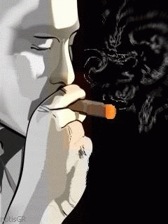
The video is about “ Smoking.”

Slide 4
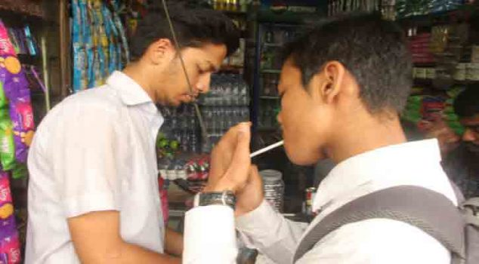
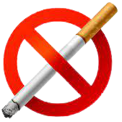
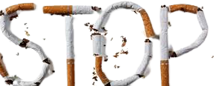
Today’s lesson is on
Paragraph Writing
“Bad effect of Smoking”

Slide 5
We will be able to know
a) what smoking is.
b) what it results in future.
c) what smoke contains.
d) how it harms to body.
e) what we should do to get ride of
this problem.

Slide 6
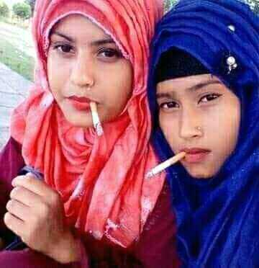
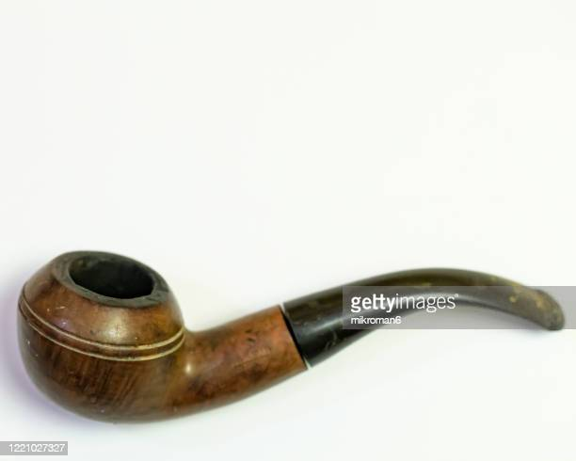
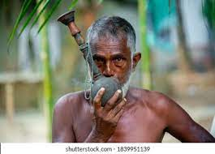
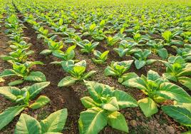
Smoking is inhaling smoke through cigarettes or other components. It is a combination of tobacco and fire. It is a very bad habit.

Slide 7
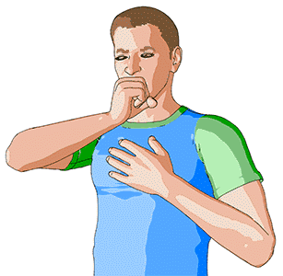
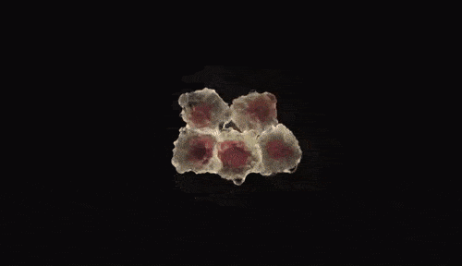
It causes many fatal diseases like cough,
bronchitis,
heart attack,
Cancer,
and many
other chronic diseases.

Slide 8
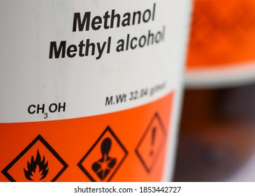
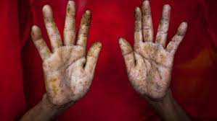
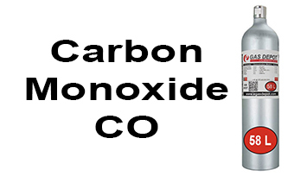
It contains alcohol, methyl, arsenic, carbon monoxide and other ingredients.

Slide 9
1.What is smoking ?
Ans - Smoking is inhaling smoke through cigarettes or other components.
Check the answer.
2. what does it cause in future?
Ans - It causes many fatal diseases like cough, bronchitis, heart attack, cancer. and many other
chronic diseases.

Slide 10
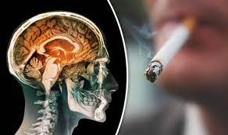
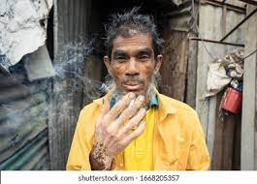
It damages our brain, eyes, skins, lips.

Slide 11
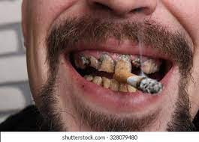
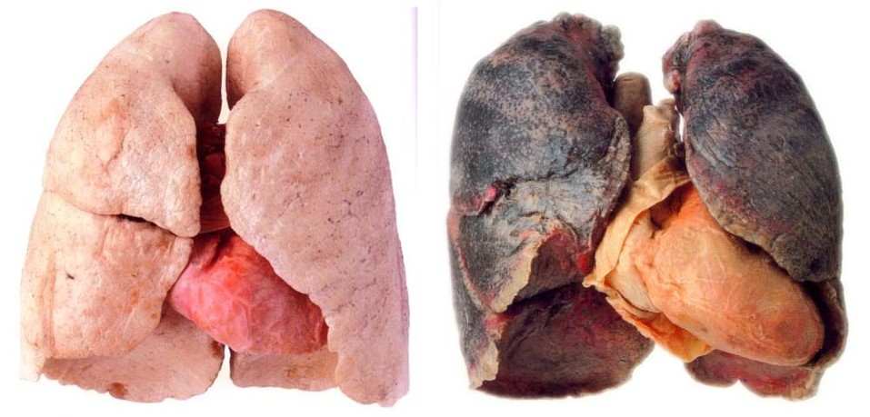
It also damages our teeth and look. It causes a great harm to our lungs.

Slide 12
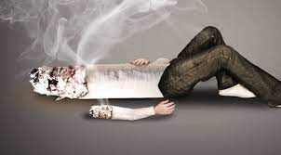
Smoking is not only injurious for health but it also causes a heavy damage of money.

Slide 13
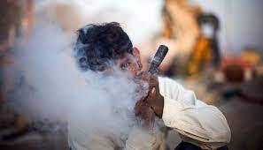
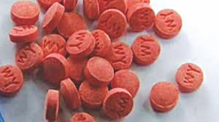
Gradually it leads a man to be habituated
to take ganja, heroine, marijuana, whisky, Yabba and other dangerous addiction.

Slide 14
Check the answers
What are the demerits of smoking ?
Smoking damages our brain, eyes, skins, lips, teeth and look. It causes a great harm to our lungs.
Write some dangerous addictions name.
Ganja, Heroine, Marijuana, Whisky and Yabba.

Slide 15
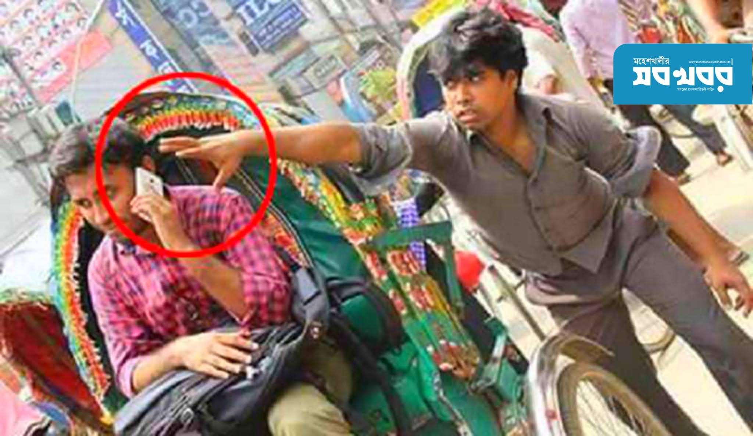
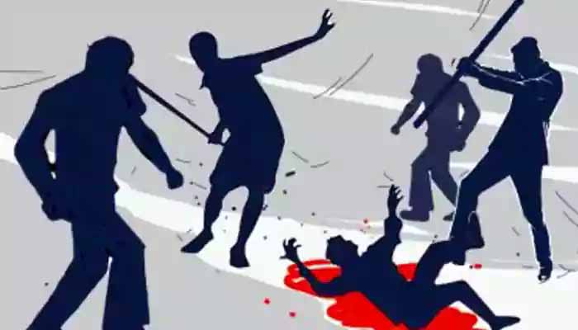
At last it results a smoker to be a thief,
hijacker, terror and killer.

Slide 16
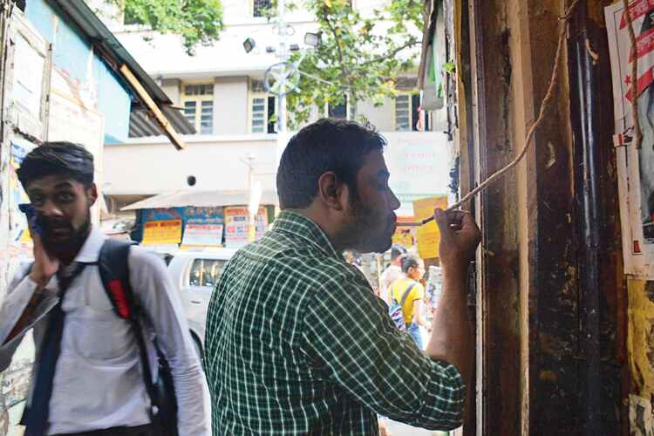
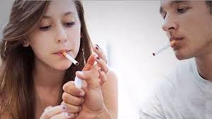
Generally middle aged people are in the habit of smoking but now a days young people are becoming seriously addicted to smoking.

Slide 17
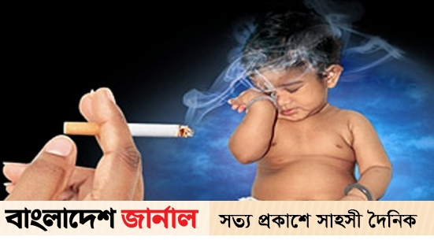
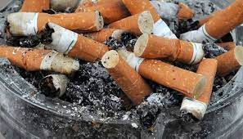
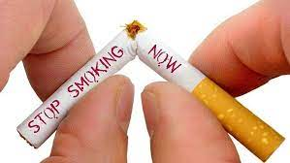
In order to get rid of the problem we should be very sincere of the bad effect of smoking.

Slide 18
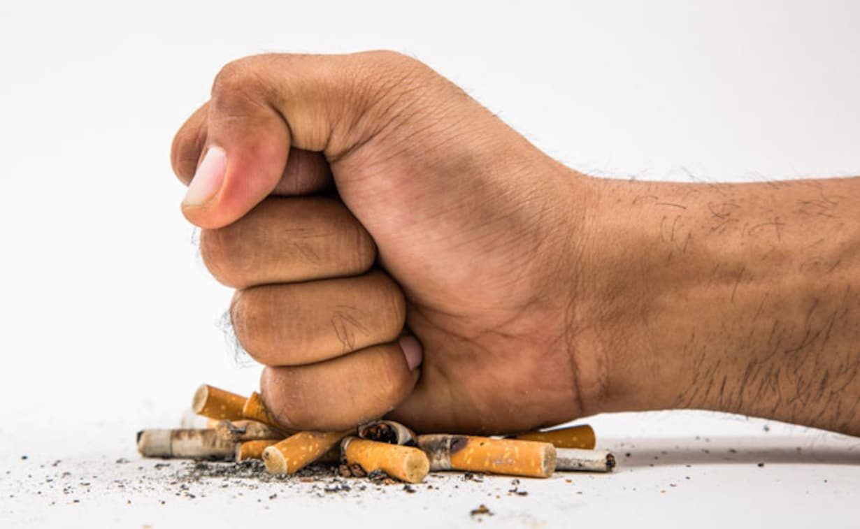
We have to realize that life is more precious than anything. So to reach the goal of life it is most essential to avoid smoking. The government should also take proper steps to discourage smoking mentioning its negative sides in the text books and media.

Slide 19
Evaluation
√
Put ( ) mark to the correct answer.
1. Smoking causes lung -----
2. Heart attack is a ----- disease.
(a) good
(b) big
(a) normal
(b) good
(c ) clean
(d ) cancer
√
√
(c ) fatal
(d ) light
3. Smoking is ----- for health.
4. It----- our brain, eyes, and teeth.
(a) good
(b) helpfull
(b) protects
(a) washes
√
√
(c ) injurious
(d ) essential
(c ) clears
(d ) damages

Slide 20
Bad effects of smoking

Slide 21
