Slide 1
WELCOME TO OUR TODAY’S CLASS

Slide 2
Class: VIII
Sub: English Grammar
IBRAHIM KHALIL
B.Com.(Hons), M. Com.(Accounting), M.Ed.
SENIOR TEACHER,
ICHHAPURA GOVT. MODEL HIGH SCHOOL.
Sirajdikhan, Munshiganj.
Mob: 01732180327, Email: ibrahimkhalil600@gmail.com

Slide 3
Can you say what type of nouns the following words are?

Slide 4
Our today’s Lesson is-
Proper Noun
Unit-1, Lesson-2
Notes:
Lesson declaration.

Slide 5
Learning outcomes…
After studied this lesson, we will be able to-
• define the proper noun.
• give examples of proper noun.
• identify the proper nouns.
Notes:
Speaking, listening, reading and writing skills will be focused in this lesson.

Slide 6
যে Noun দ্বারা কোন নির্দিষ্ট ব্যক্তি, বস্তু বা স্থানের নাম বোঝায় তাকে Proper Noun বলে।
A proper noun refers to specific names of persons, things, places, organizations etc. and always start with a capital letter.
Examples:
* I like the story of Shakespeare. (Shakespeare নির্দিষ্ট একজন ব্যক্তির নাম)
* We planned to visit Sylhet. (Sylhet নির্দিষ্ট একটি জায়গার নাম)
* Have you ever seen the Tajmahal? (Tajmahal একটি স্থাপনার নাম)
https://www.youtube.com/watch?v=62jBsmqFUP8

Slide 7
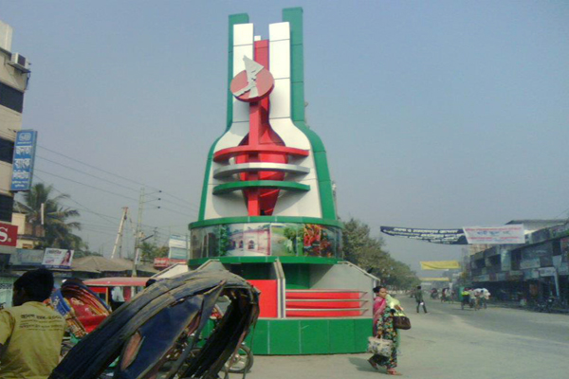
Specific names of places are proper nouns.
munshiganj
Examples:
• Chandpur
• Dhaka
• Rajshahi
• Faridpur
Hatimara
Taltola
Beltoli
Rasunia
Dohar

Slide 8
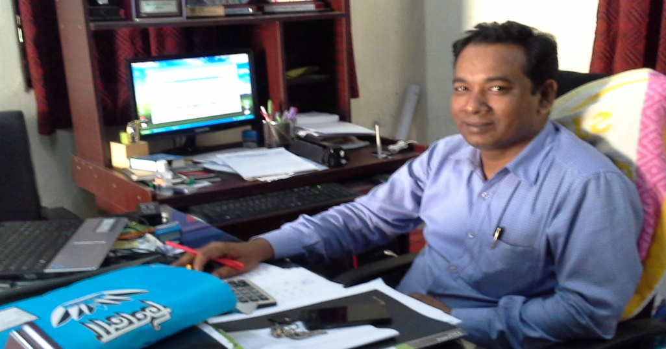
People’s names are proper nouns.
Nasir Uddin
Examples:
• Sundar Ali
• Sujon
• Robia
Salman
Robi
Rabia
Hasan
Imran

Slide 9
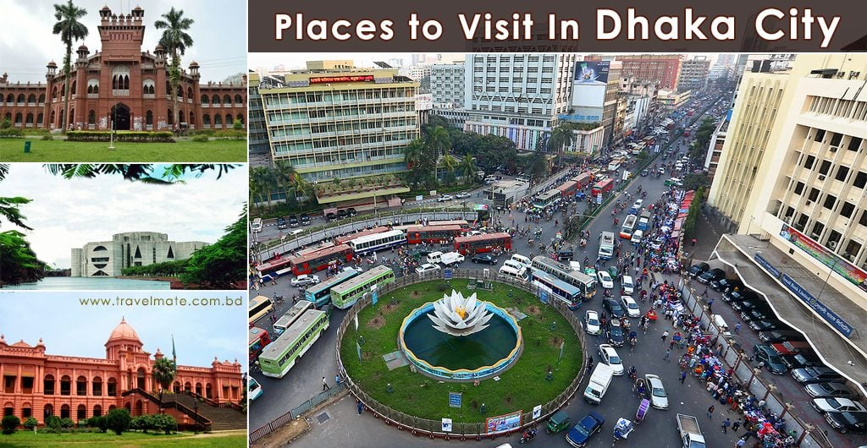
The names of towns or cities are proper noun.
Examples:
•London
•Chattogram
•Bogura
•Cumilla
New York
Bangkok
Singapore
Seoul
Kuala Lumpur.
Dhaka

Slide 10
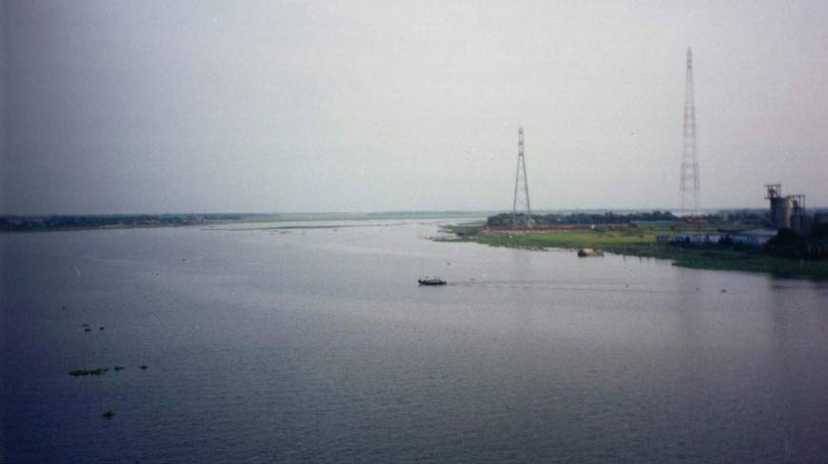
The names of rivers are proper nouns.
Examples:
1. The Amazon
2. The Nile
3. The Buriganga
4. The Mississippi
5. The Ichhamoti
6. The Kushiyara
7. The Jamuna
8. The Karnaphuly
9. The Dhaleswari
The Meghna

Slide 11
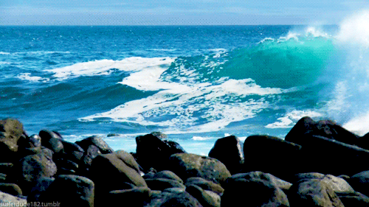
The names of seas or oceans are proper noun.
The Arabian Sea
Examples:
The Pacific Ocean.
The Atlantic Ocean.
The Indian Ocean.
The Arctic Ocean.
The Caribbean Sea.

Slide 12
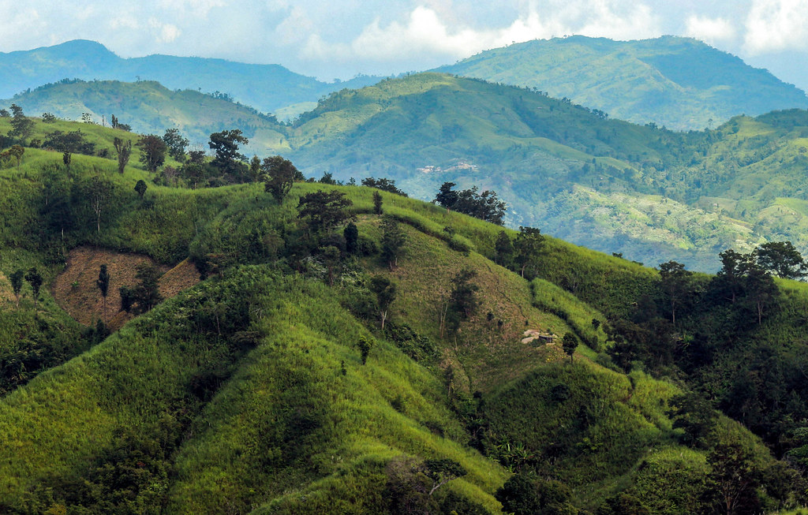
The names of hills are proper noun.
The Keokradong
Examples:
The Dumlong
The Jogi Haphong
The Manali,
The Thredbo
The Mussoorie
The Zermatt

Slide 13
The names of islands are proper noun.
Examples:
The Greenland
The New Guinea
The Sumatra
The Chhera Island.
The Kutubdia Island.
The Nijhum Dwip.
The Sonadia Island.
The Manpura Island.
The Sandwip.
The Andamans

Slide 14
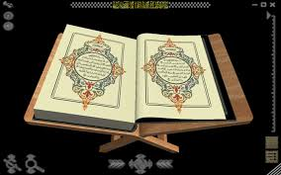
The names of holly religious books are proper noun.
The Holy Quaran
Examples:
The Kojiki
The Talmud
The Tao Te Ching
The Holy Vedas
The Tripitaka
The Bhagavad Gita
The Holy Bible

Slide 15
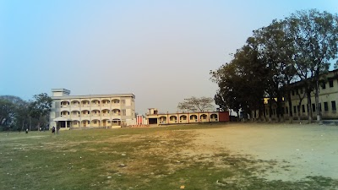
The names of educational institutes are proper noun.
Ichhapura Govt. Model High School
Examples:
•Notre Dame College.
•Adamjee Cantonment College.
•Dhaka City College
• Govt. Laboratory High School.
• Ideal School & College.
• RAJUK Uttara Model College.
• Dhaka Residential Model College.
• Holy Cross Girls High School.

Slide 16
The names of books are proper noun.
Examples:
Bisher Bashi
Agni Bina
Rakhali
Nakshi Kanthar Maath
Baluchor
Dhankhet
Sujan Badiyar Ghat

Slide 17
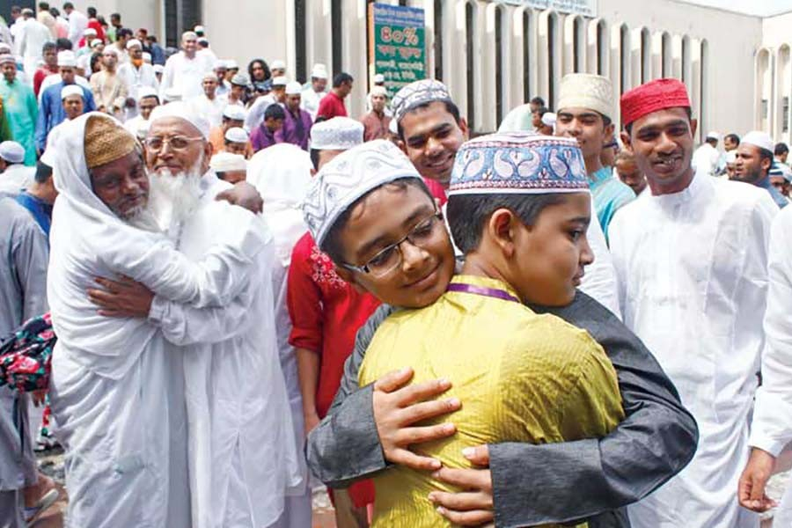
The names of festivals are proper noun.
Examples:
• Eid-Ul-Fitr.
• Eid-ul-Azha
• Durga Puja.
• Kali Puja.
• Chirstmas.
• Buddha Purnima.
• Easter Sunday.
• Pahela Baishakh.
The Eid

Slide 18
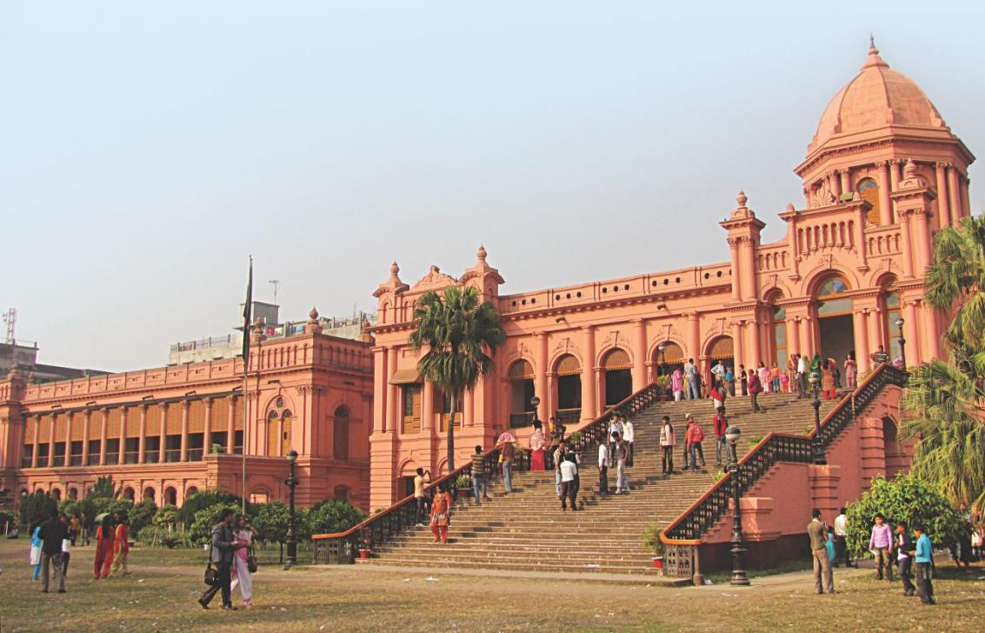
The names of famous buildings are proper noun.
Examples:
• The White House
• The Banga Bhaban
• The Burje Dubai
• The Taj Mahal
• The Burj Khalifa.
The ahsan manjil

Slide 19
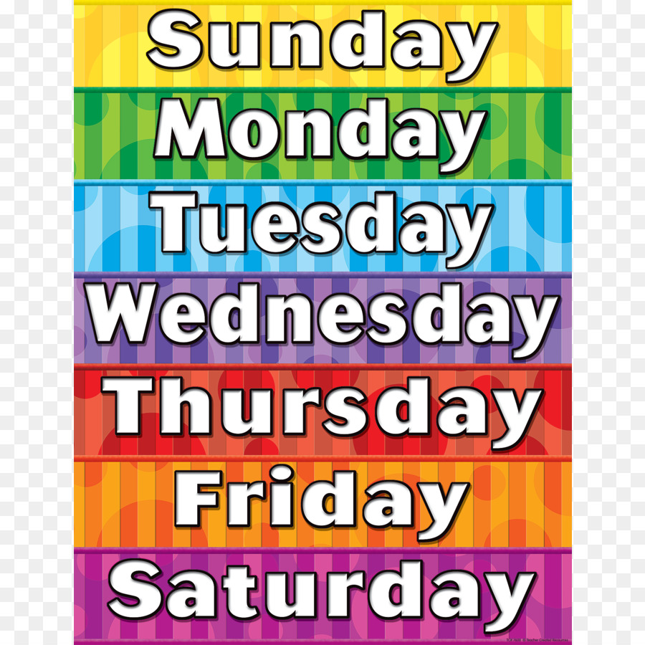
The names of months and days are proper noun.

Slide 20
The names of the news papers are proper noun.
Examples:
The Daily Prothom Alo
The Daily Jugantor
The Daily Samakal
The Daily New Nation
The Daily Manab Zamin

Slide 21
The names of countries and their capital cities are proper noun.
Country | Capital City
Great Britain | London
China | Beijing
Japan | Tokyo
Italy | Rome
Bangladesh | Dhaka
Sri Lanka | Colombo
Saudi Arabia | Riyadh
Pakistan | Islamabad

Slide 22
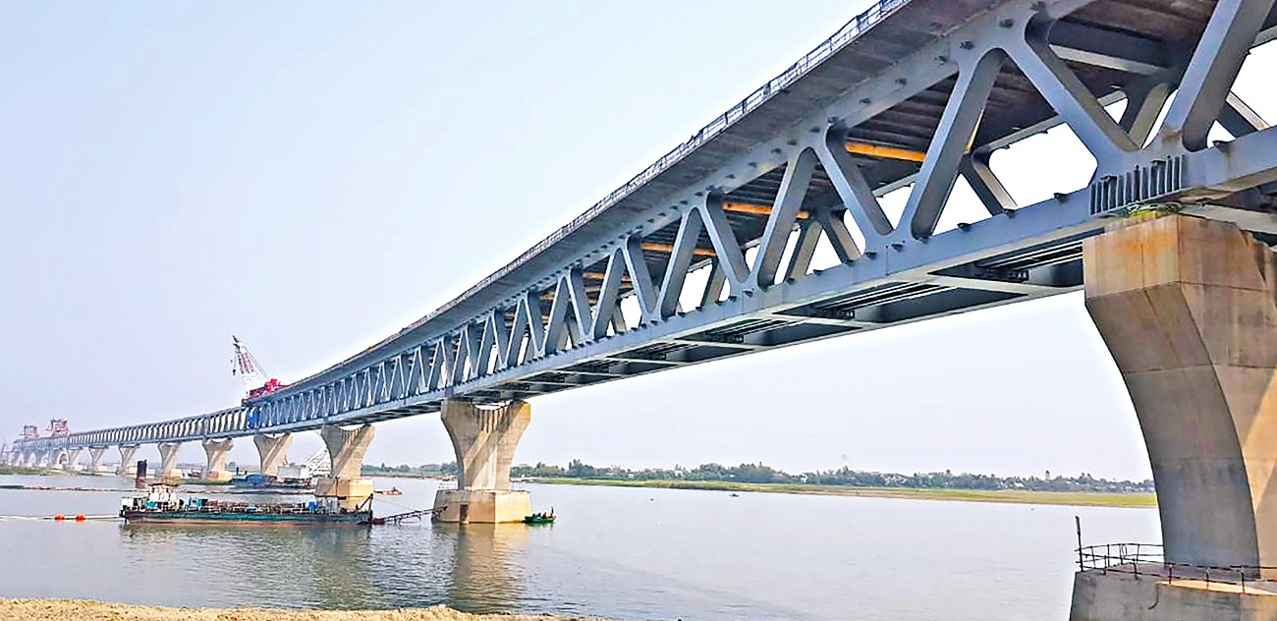
The names of Bridges are proper noun.
Examples:
The Meghna Bridge
The Shah Amanat Bridge
The Lebukhali Bridge
The Hardinge Bridge
The Lalon Shah Bridge
The Padma Bridge

Slide 23
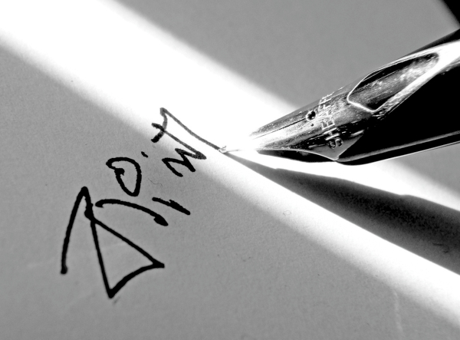
The names of languages are proper noun.
Examples:
• English
• Mandarin Chinese
• Hindi
• Spanish
• Arabic
• Bangla/Bengali
• Russian

Slide 24
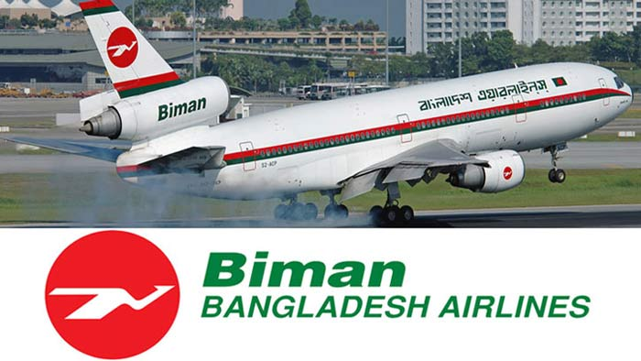
The names of Airlines are proper noun.
Examples:
American Airlines.
Saudi Arabian Airlines
Delta Air Lines.
United Airlines.
Qatar Airways.
British Airways

Slide 25
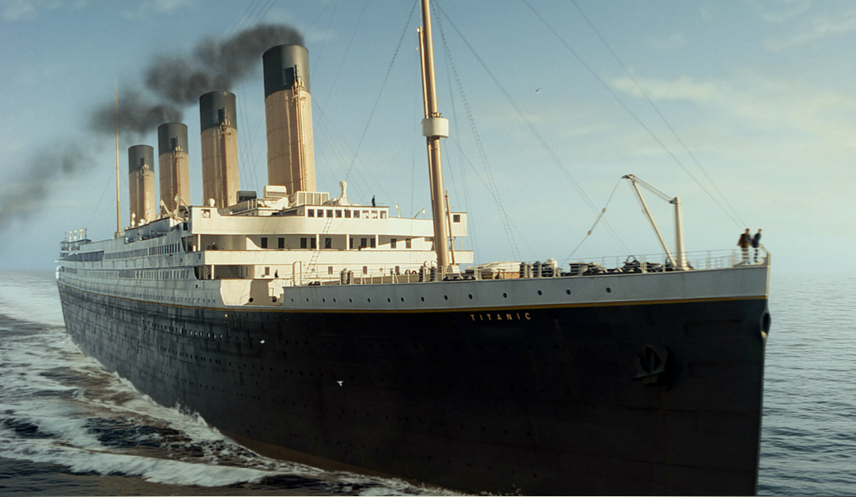
The names of ships are proper noun.
The Titanic
Examples:
Wonder of the Seas
Keari Sindbad
Symphony of the Seas
Harmony of the Seas
Oasis of the Seas

Slide 26
The names of movies or dramas are proper noun.
Examples:
• Srabon Megher Din
• Shopner Thikana
• Sotter Mrittu Nei
• Ammajan
• Lalsalu
• Chhutir Ghonta
• Dipu Number 2
• Monpura
• Aguner Poroshmoni

Slide 27
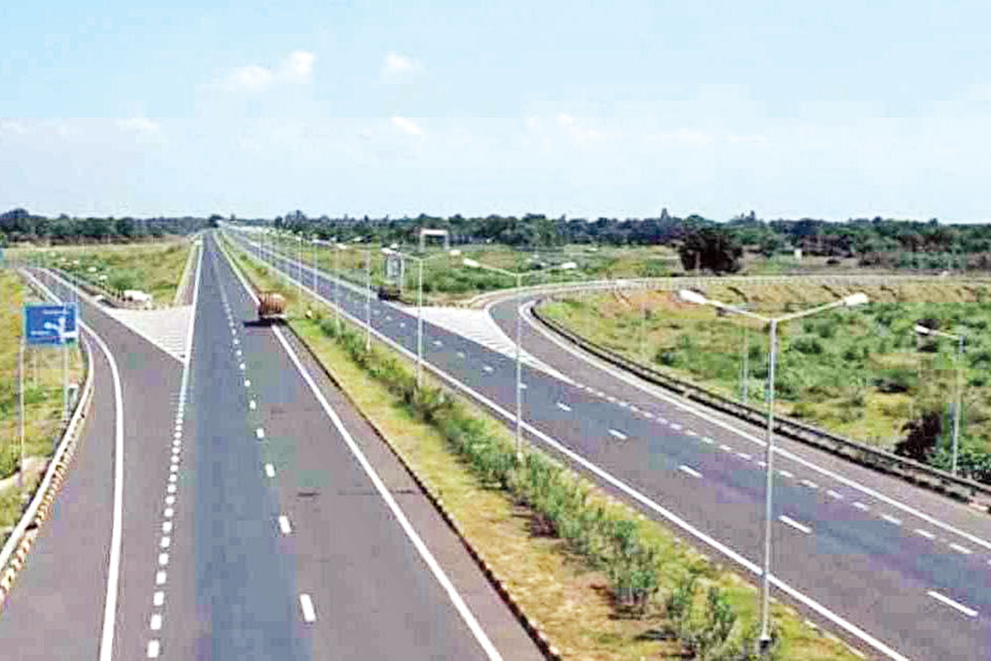
The names of ‘Roads or Highways are proper noun.
Dhaka-Mawa highway
Examples:
• Sadarghat-Gabtoli Road.
• Mirpur Road.
• Kazi Nazrul Islam Avenue.
• Moghbazar Road.
• Station Road
• Jubilee Road.
• Sat Masjid Road

Slide 28
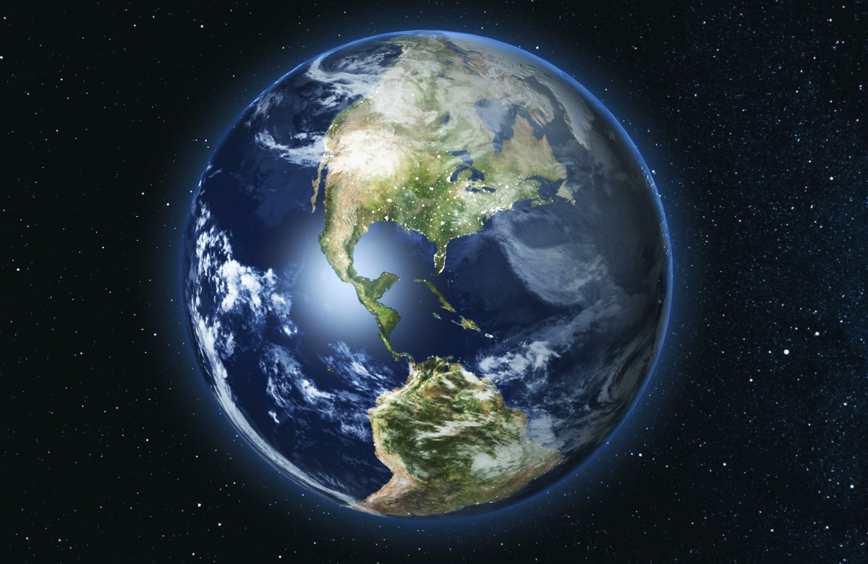
The names of Planets or Satellites are proper noun.
Examples:
Mercury – বুধ Venus – শুক্র Earth – পৃথিবী Mars – মঙ্গল Jupiter – বৃহস্পতিগ্রহ Saturn – শনি Uranus – ইউরেনাস Neptune – নেপচুন Pluto – গ্রহবিশেষ
The Earth

Slide 29
Evaluation
Identify the proper nouns from the followings sentences
1. I met James at the post office.
2. December is the last month of a year.
3. India is the biggest democratic country in the world.
4. Millions of people speak English as a second language.
5. She comes from Nigeria.
6. The Amazon is the largest river in the world.
7. Jupiter is the largest planet in our solar system.
8. Which is the capital city of Australia?

Slide 30
Homework
Make 10 sentences by using proper nouns

