Slide 1
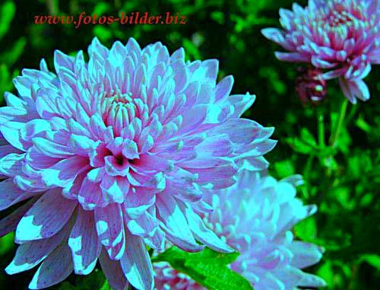
welcome

Slide 2
Nasrin jahan
Assistant teacher
53 no govt Batikamary primary school
Muksudpur , Gopalgonj.

Slide 3
Sub: English
Class: Two
Unit: 16
Lesson: 04
Time- 40 minutes.

Slide 4
Learning Outcomes
Students will be able to:
1.1.1 Listening poper sound actively.
3.1.1 Say the colour name correctly

Slide 5
Colours
Page:33

Slide 6
Rainbow

Slide 7
Umbrella
Blue

Slide 8
Leaf
Green

Slide 9
circle
Red

Slide 10
Orange
Orang Colour

Slide 11
Banana
Yellow

Slide 12
Brinjal
Indigo

Slide 13
Flower
Violet

Slide 14
Evaluation
What is the picture colour ?
What is the picture colour ?
What is the Picture colour ?
What is the picture colour?

Slide 15
THANKS

