Slide 1
Welcome to my multimedia class

Slide 2
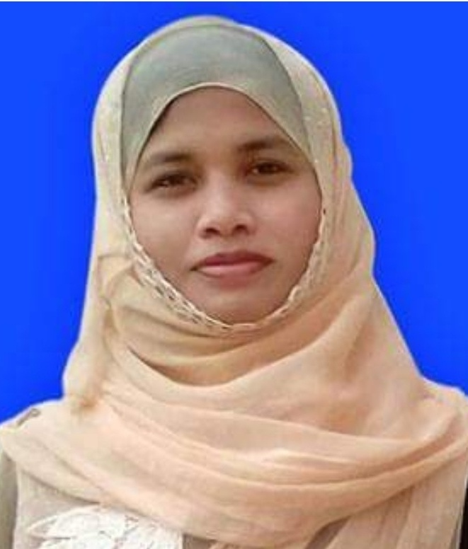
Introduction
Kuhinur Jannat
Assistant teacher
Fakirakata Govt. primary school.
Moheshkhali, Cox’sbazar
Class: Five
Subject: English
Caption of the lesson: Days in a calendar.
Today`s Lesson: Lessons: 1-2

Slide 3
Learning outcomes
Students will be able to
1.3.1 recognize which words in a sentence are stressed.
1.1.1 say words, phrases and sentences with proper sounds and stress.
1.5.1 read words, phrases and sentences in the text with proper pronunciation, stress and intonation.
3.1.1 recognize and study the calendar.

Slide 4
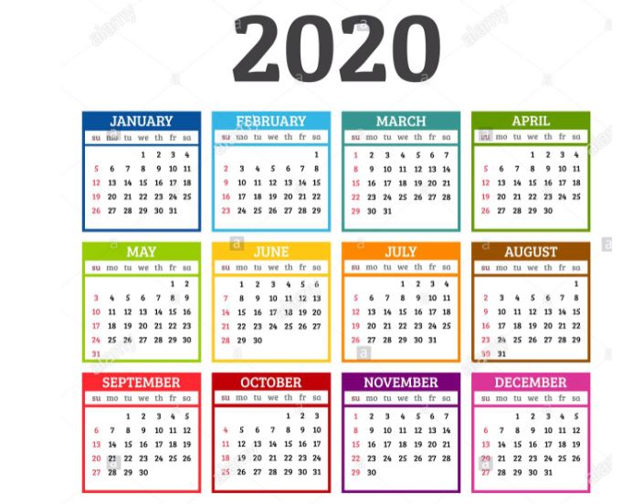
Think about the picture
What is it?
A Calendar

Slide 5
Today`s lesson
Days in a calendar
Lessons 1-2

Slide 6
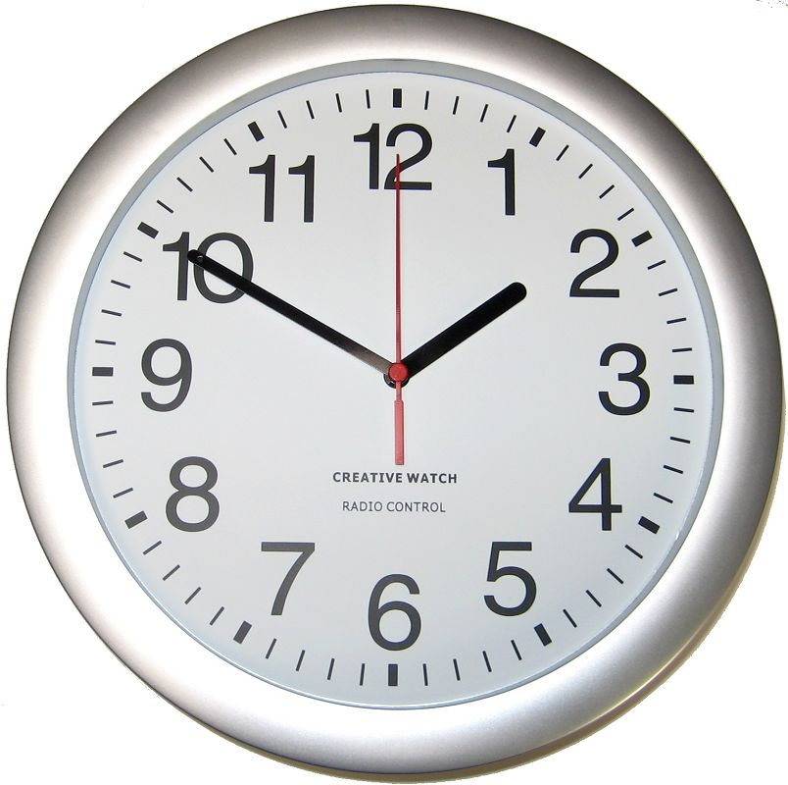
Think about the picture
What is it?
A Clock

Slide 7
How many seconds make a minute?
How many minutes make an hour?
60 seconds make a minute.
60 minutes make an hour.

Slide 8
Group work
Answer the following questions.
Group-A: How many seconds make a minute?
Group-B: How many minutes make an hour?
Ans: 60 seconds make a minute.
Ans: 60 minutes make an hour.

Slide 9
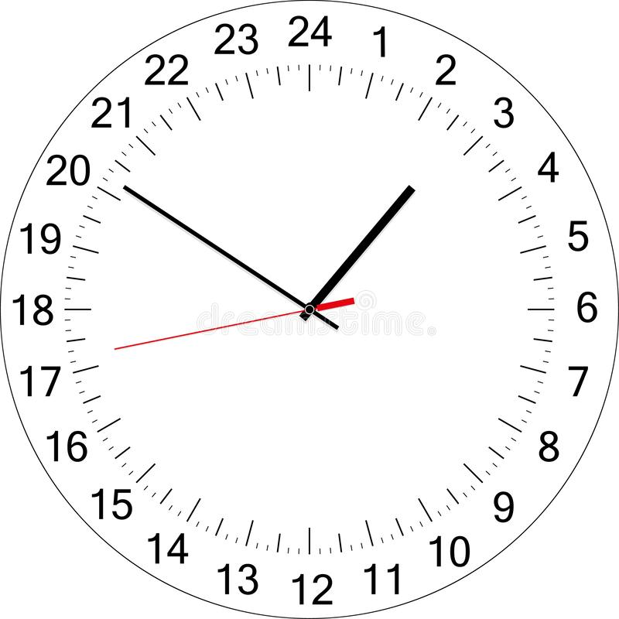
Think about the picture
What is it?
A Clock

Slide 10
Days of the week
Saturday
শনিবার
Sunday
রবিবার
Monday
সোমবার
Tuesday
মঙ্গলবার
Wednesday
বুধবার
Thursday
বৃহস্পতিবার
Friday
শুক্রবার

Slide 11
Months of the year
January
July
February
August
March
September
April
October
May
November
June
December

Slide 12
Pair work
Answer the following questions.
1. How many hours make a day?
2. How many days make a week?
Ans: 24 hours make a day.
Ans: 7 days make a week.

Slide 13
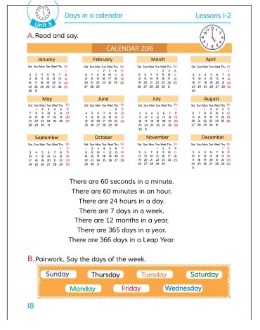
Open your english book at the page no- 18.

Slide 14
Some word meanings
Hour
Day
Week
Month
Year
Leap year
ঘন্টা
দিন
সপ্তাহ
মাস
বছর
অধিবর্ষ

Slide 15
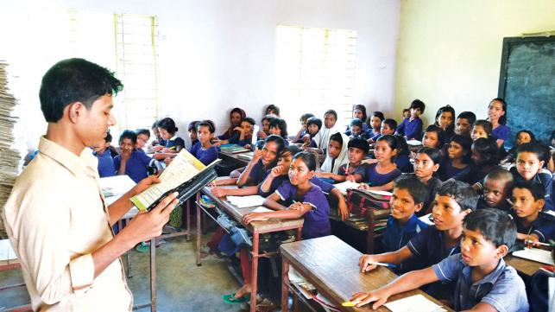
Loud reading

Slide 16
EVALUATION
Write “T” for correct statement or “F” for false statement.
1. 60 seconds make a minute.
2. A week consists of 5 days.
3. 22 hours make a day.
B. Answer the following questions.
1. How many months make a year?
2. How many days are there in a Leap Year?
T
F
F
Ans: 12 months make a year.
Ans: There are 366 days in a Leap Year.

Slide 17
Home work
Write a short composition about “ A calendar”.

