Slide 1
WELCOME

Slide 2
PRESENTED By
Kuhinur Jannat
Assistant Teacher.
Fakirakata Government Primary school.
Moheshkhali, Cox’sbazar.

Slide 3
LEARNING OUTCOMES
Listening:1.2 To recognize which syllable in a word is stressed.
Speaking:1.1 To say words phrases and sentences with proper Sounds stress and intonation.
Reading1.5 Read words, phrases and sentences in the text with proper pronunciation.
Writing:8.1 Make sentences using words and phrases given in the text.

Slide 4
CREATING POSITIVE ENVIRONMENT

Slide 5
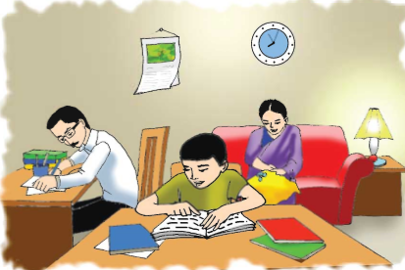
Look at the picture and write down on your exercise book what each person is doing.

Slide 6
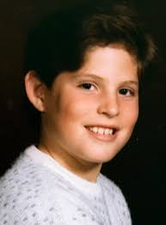
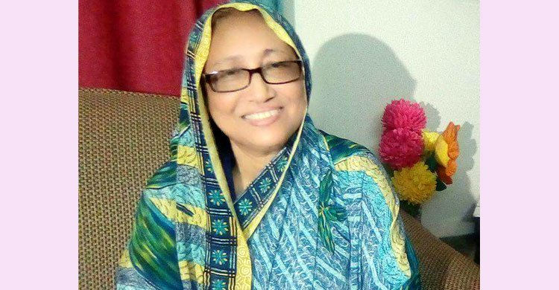
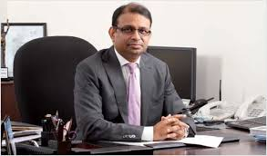
SAIKAT
Saikat’s father Mr.Rashidul Islam
Saikat’s mother Mrs.Monwara
Islam

Slide 7
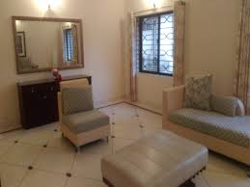
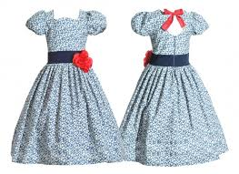
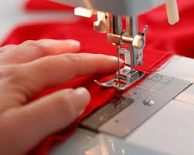
FLAT
DRESSES
SEW
BANKER

Slide 8
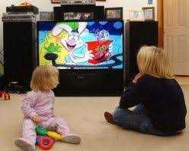
Listening
Watching
Writing
Free time

Slide 9
You Match the words with picture.

Slide 10
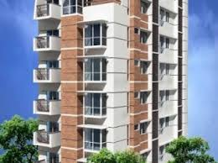
Sew
Watching
Dress
Listening
Flat
Banker

Slide 11
Sew
Watching
Dress
Listening
Flat
Banker

Slide 12
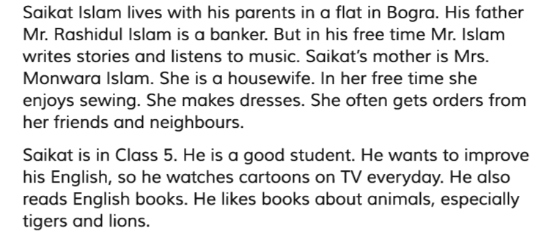
Read this passage with me.

Slide 13
Student’s Reading

Slide 14
Group Work
Now Make 4 Group And You Discuss About Your Family
Your Group Name Is Pink
Your Group Name Is Blue
Your Group Name Is Grey
Your Group Name Is Yellow

Slide 15
Make sentences with the following words
Flat
Listening
Sewing
Dresses
Watching
Banker

Slide 16
TASK
Write ten sentences about “an evening with own your family”

Slide 17
THANKS

