Slide 1
Welcome

Slide 2
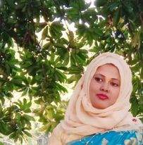
Teacher’s Introduction
Mst.Sharmin Akter
Assistant teacher
Matain Govt. Primary School
Hajiganj, Chandpur
E-mail:
mstsharminakter1985@gmail.com

Slide 3
Class :Two
Subject : English
Lesson :4-5
Unit:6
Activity : F(On…..
choice.)
Time : 40 min
A
e
r
G

Slide 4
Learning Outcomes
Student’s will be able to-
Listening:1.1.1-become familiar with English sounds by listening to common English word.
Speaking:1.1.2-say simple words and phrases with propersounds and stress.
Reading:2.1.1 Recognise and read cardinal numbers up to 30.

Slide 5
Let’s see the vedio
Discuss about the vedio
Can you understand what will be our todays lesson ?

Slide 6
Topic of the lesson
Numbers

Slide 7
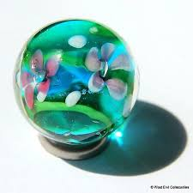
How many marbles you can see in the picture ?
8 (eight) marbles

Slide 8
How many eggs you can see in the picture ?
I can see 9 eggs in the picture .
9 (nine) eggs.

Slide 9
How many balls you can see in the picture ?
I can see 10 balls in the picture .
10( ten) balls.

Slide 10
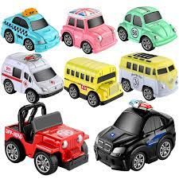
Count and say how many toys you can see ?
8

Slide 11
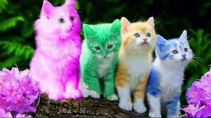
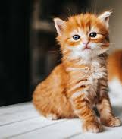
Count and say how many cats you can see ?
9

Slide 12
Count and say how many toys you can see ?
10

Slide 13
Say the number in word.
8-eight
9-nine
10-ten

Slide 14
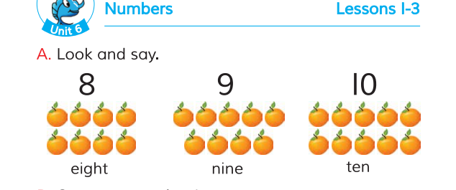
Open your book at page 12.

Slide 15
Match the pictures with correct number.
G w
9
10
8

Slide 16
Say the number? Count the picture and make circle.
evaluation
9

Slide 17
One day one word
Count-গণনা

Slide 18
Thanks

