Slide 1
Welcome
My dear students! 🌈🌹🥀🌺🌻🌼🌷

Slide 2
IDENTITY
MD. FARID UDDIN
Lecturer in English
Chipatali Jamia Gausia Muinia Kamil M. A Madrasah
Hathazari, Chattogram.
E- mail : fariduddin111989@gmail.com

Slide 3
Lesson Declaration
1. Rahim go to school.
2. My mother read the holy Quran Daily.
3. He are playing cricket.
Dear students
In above sentences, is there any mistake? What??
👉 Yes, you are right.
👉 There‘s some mistake of using the VERB.
So, our Today’s Lesson is-
👉👉👉👉👉👉👉Right Form of Verbs👈👈👈👈👈 Part -01

Slide 4
Learning Outcome
After the end of the lesson Students are able to ……
Use verbs correctly
Fill up the gaps with right form of verbs
And the can complete the incomplete passage by using right form of verbs.

Slide 5
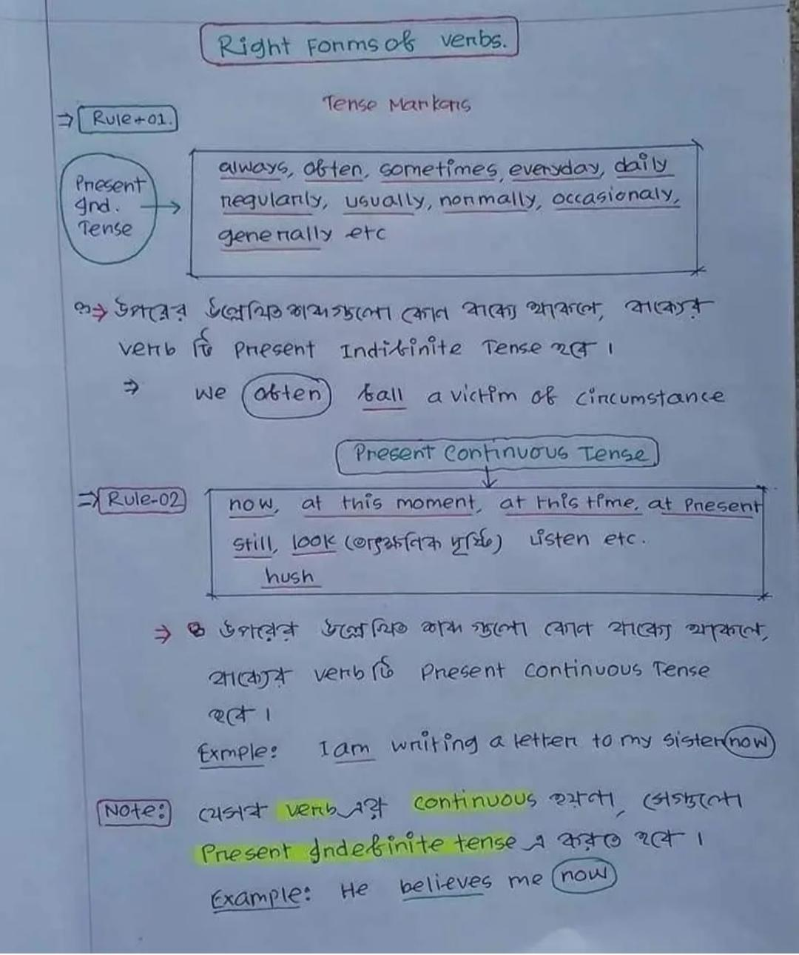

Slide 6
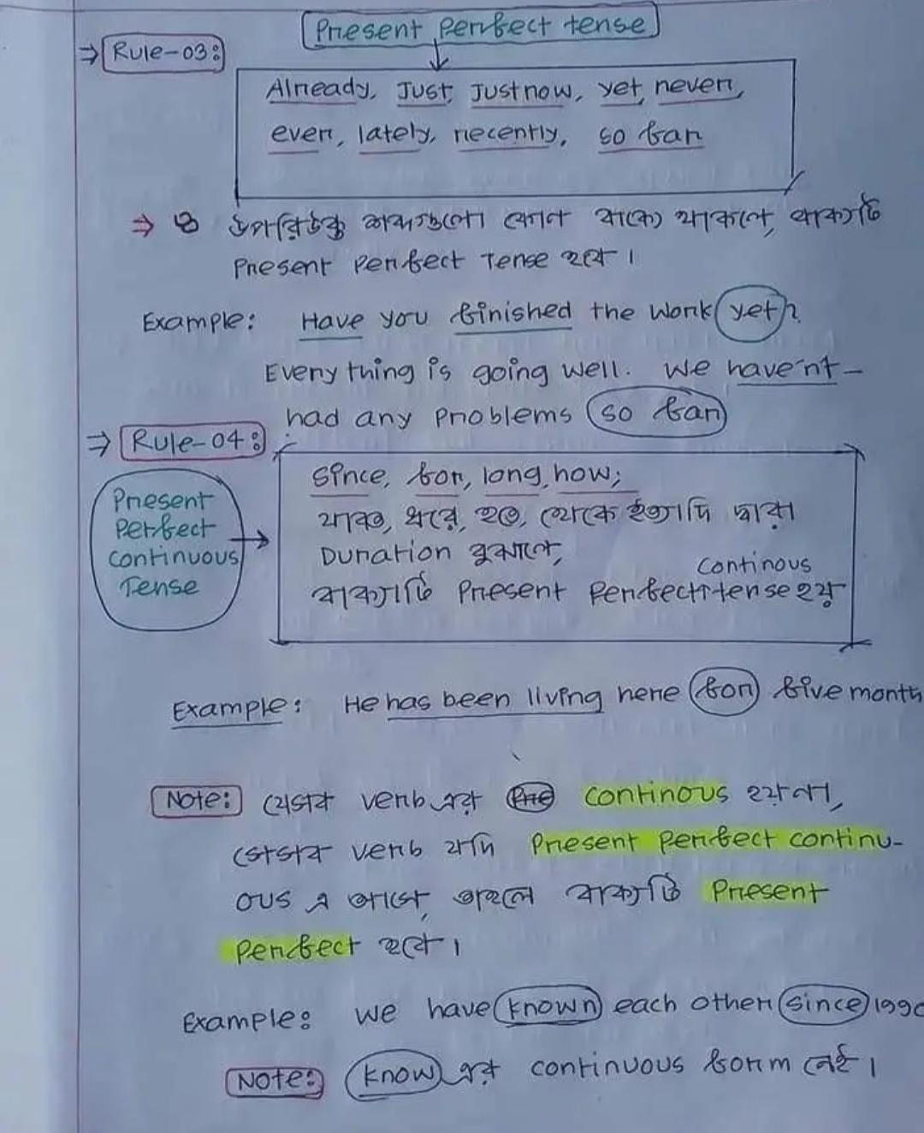

Slide 7
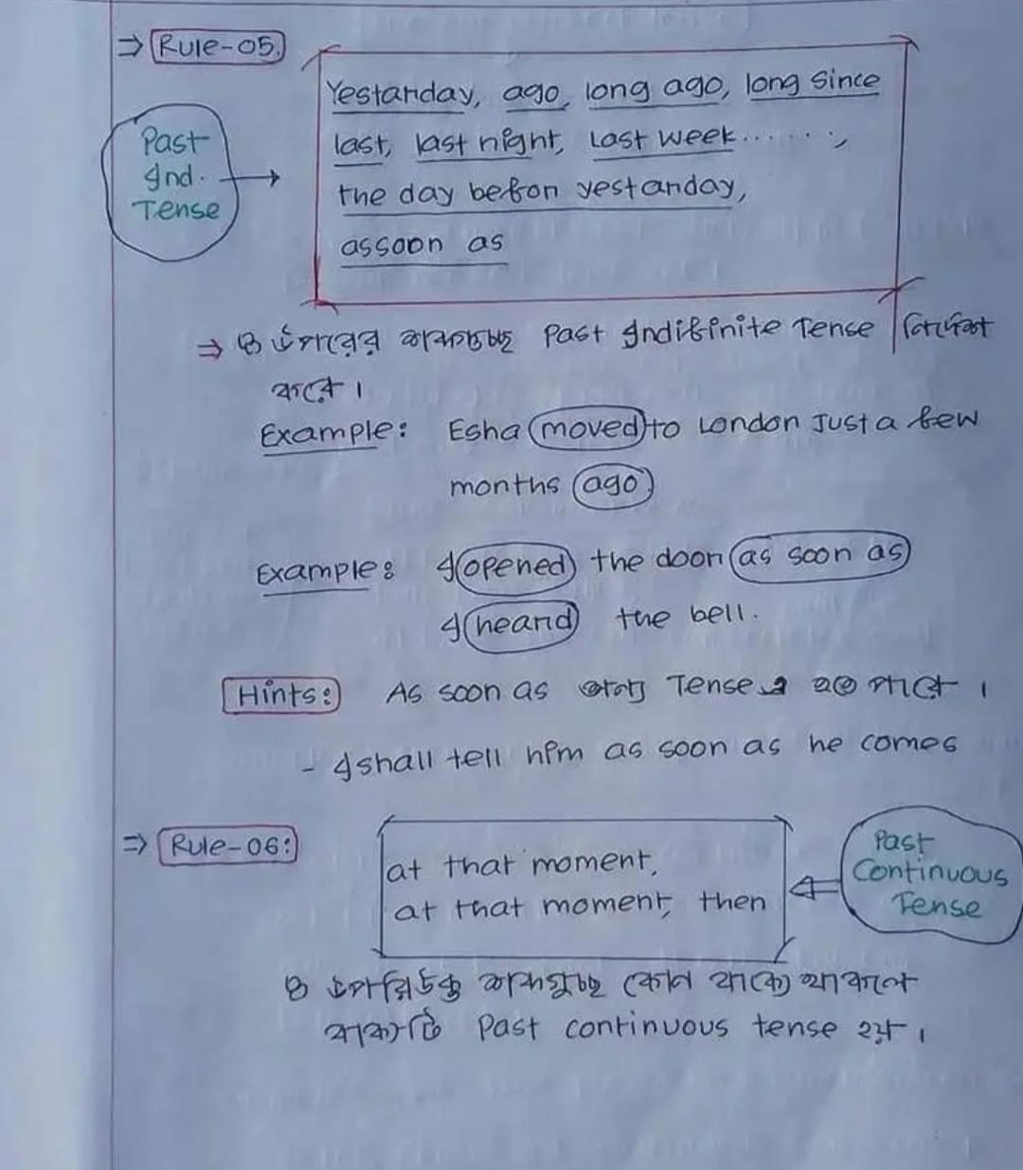

Slide 8
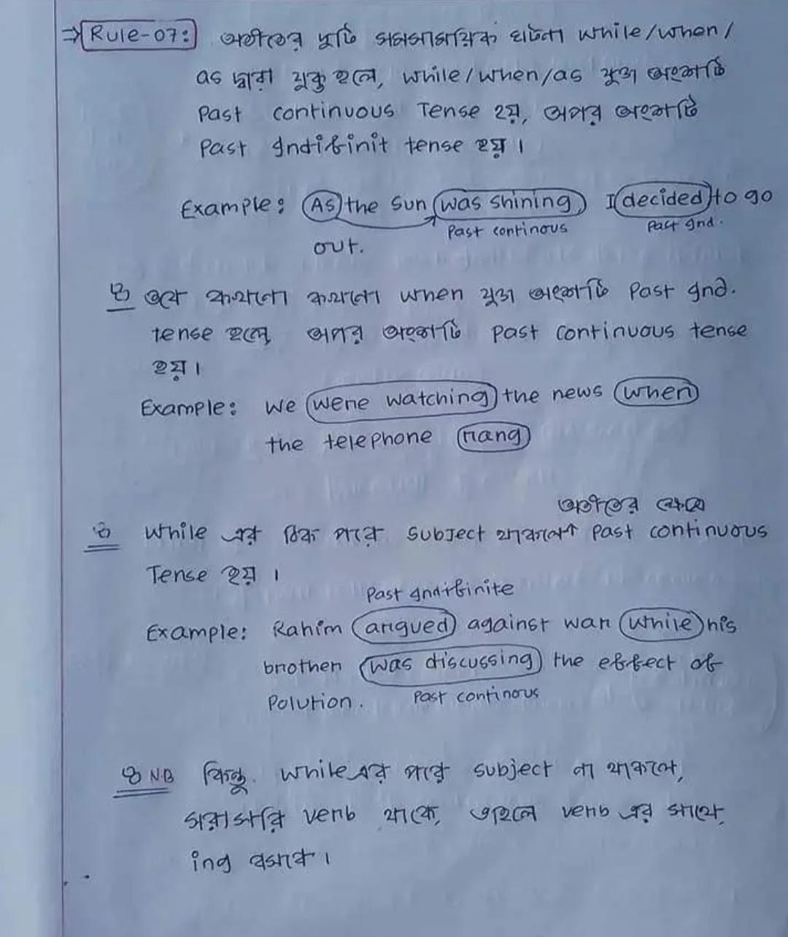

Slide 9
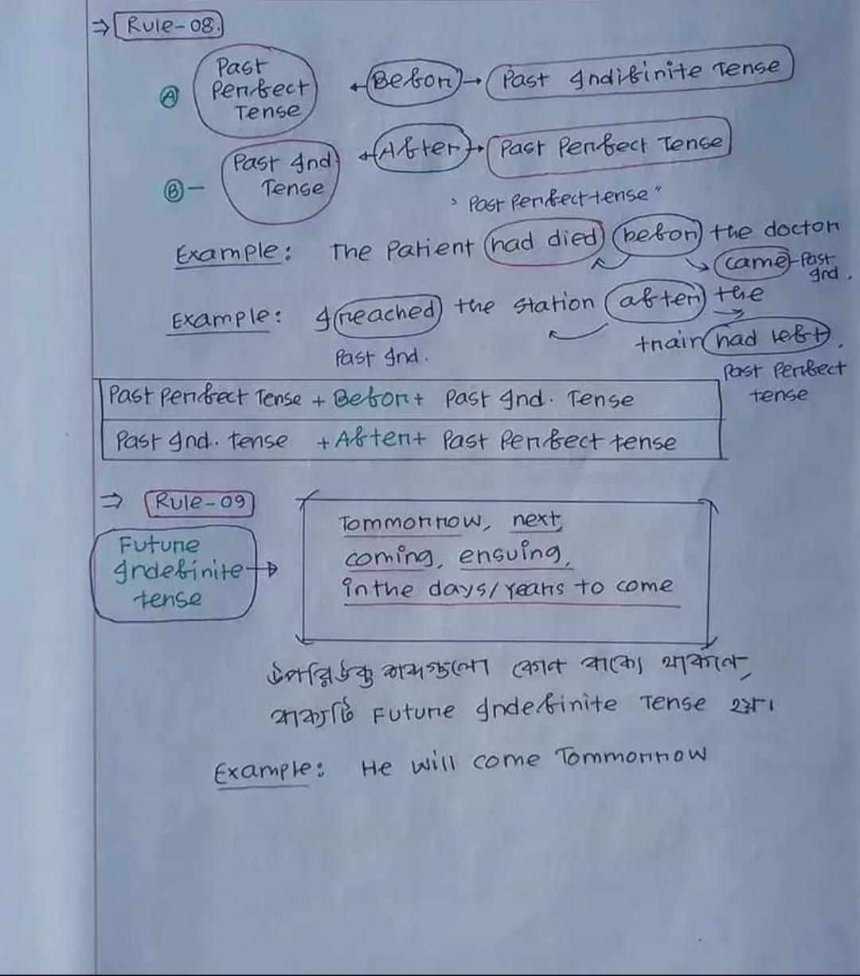

Slide 10
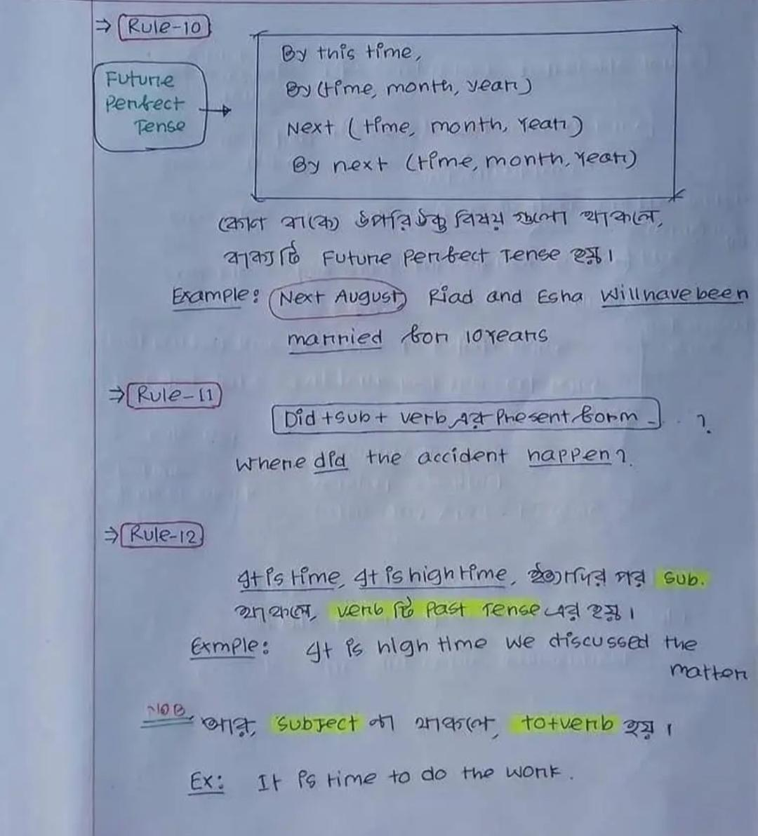

Slide 11
Individual Work
1. The price of commodities (increase) day by day.
2. He always (speak) the truth.
3. Where did the accident (take) place
4. The thief (run) away as soon as he (see) the police.
5. Long ago I (see) your lovely face.
Answer
1. is increasing
2. speaks
3. take
4. ran, saw
5. saw

Slide 12
Pair Work
1. It is high time we (give) up our bad habits.
2. At that moment I (read) a magazine.
3. While he ( speak) in English, he looks like an English man.
4. Next month Rafiq (come) back home.
5. He (live) in America for ten years.
Answer
1. Gave
2. Was reading
3. Was speaking
4. Will come
5. Has been living

Slide 13
Group Work
Merry and I have (know) each other since 1989.
As it was raining, I (decide) to go out.
While (walk) in the street I saw a dead cow.
The bell (ring) before I (enter) the class.
It is time (do) the work.
Answer
Know
Decided
Walking
Rang, Entered
To do

Slide 14
Home Work
It is time (solve) the sum.
Rumana was cooking while I (prepare) my home work.
It is high time we (save) our children.
Last night I (dream) a bad dream.
He often ( make) a mistake.
They (buy) a car tomorrow.
At this moment we (watch) tv.
While (swim) in the river, I saw a large ship.
The rain (stop) after we (reach) home.
The train (leave) the station before we (arrive).
Adu (read) in this school for 15 years.

