Slide 1
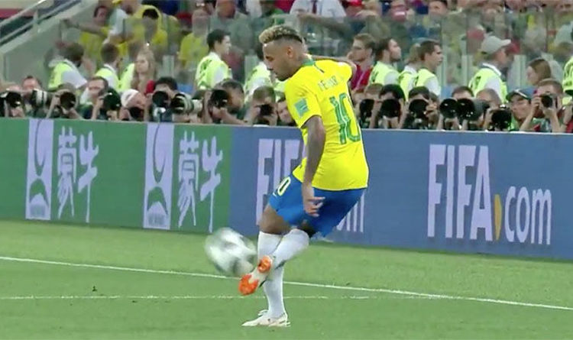
WELCOME TO MY MULTIMEDIA CLASS

Slide 2
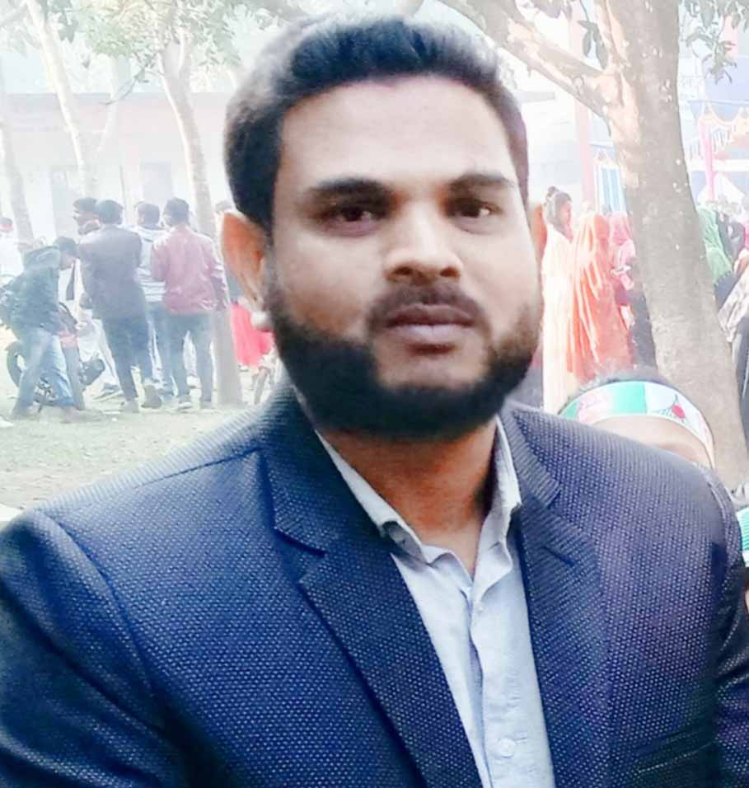
Presented By
Md.Hafizur Rahman
Assistant Teacher
Haripur Government Primary School
Haripur , Thakurgaon .
Phone: 01716437086
Email:hafizict5@gmail.com

Slide 3
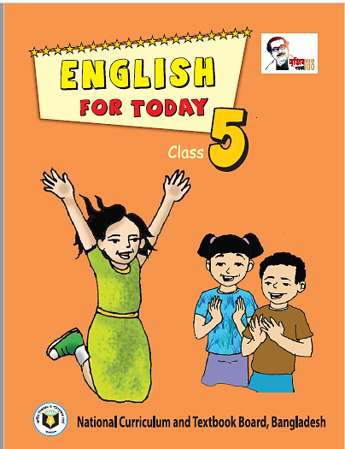
Lesson Identity
Subject : English
Class: Five
Time: 40 minutes
Date: 01-07-2022

Slide 4
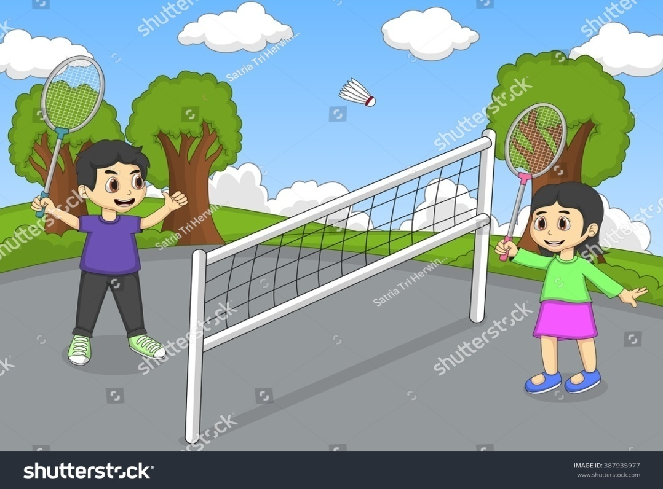
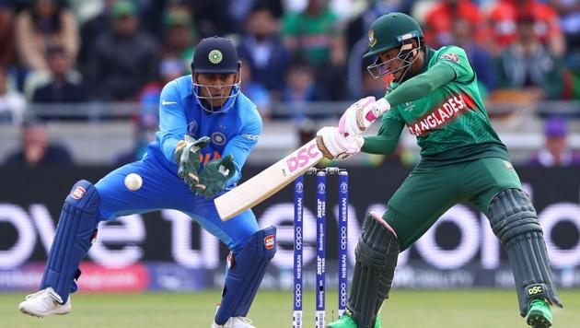
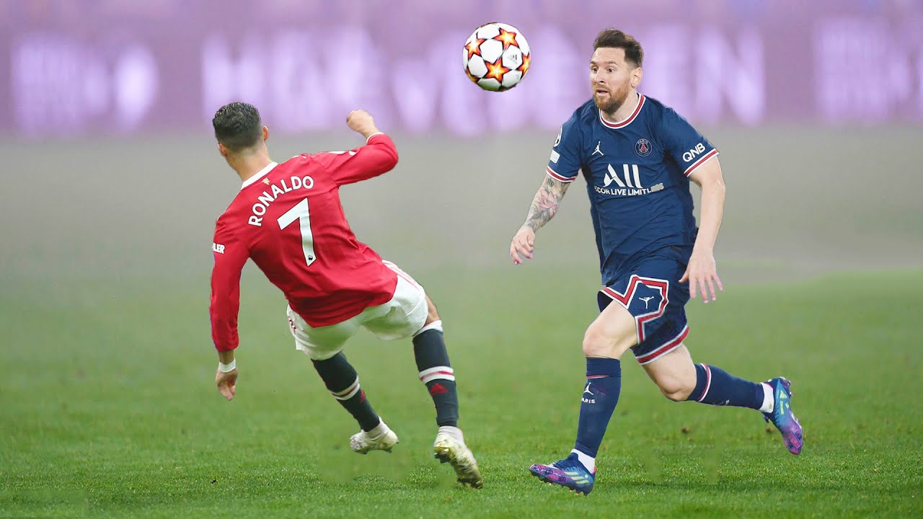
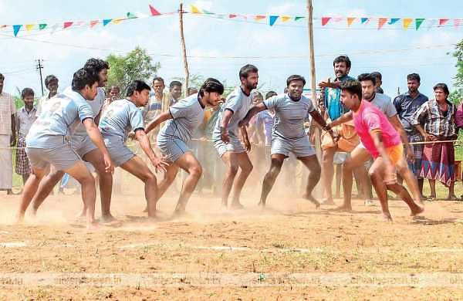
Dear Student ,What is your favourite game?
Cricket
Badminton
Kabadi
Football

Slide 5
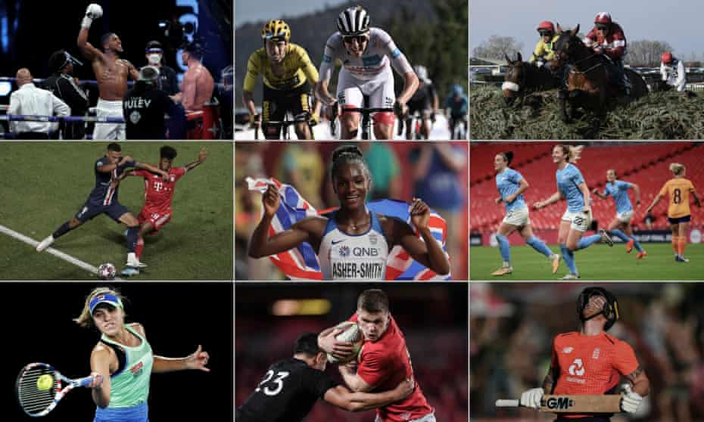
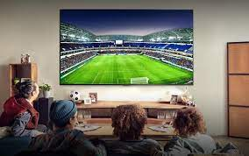
Dear Student ,What do you know about international sport competition?
Has any of you watched international sport competition on TV?
OK

Slide 6
Today lesson
Sports
Lesson: 5-6
Unit: 17
Page No. 68

Slide 7
Learning Outcomes
By end of the lesson student will be able to
Listening:
1.3.1- recognize which words in a sentence are stressed
3.4.1- understand statements made by the teacher and student.
Speaking
1.1.1: Say words, phrases and sentences with proper sound and stress.
3.2.1- understand questions about family and friends of students.
Reading
1.6.1- recognize and read statements, commands, greetings, questions and answers.
I .5.1- read silently with understanding text

Slide 8
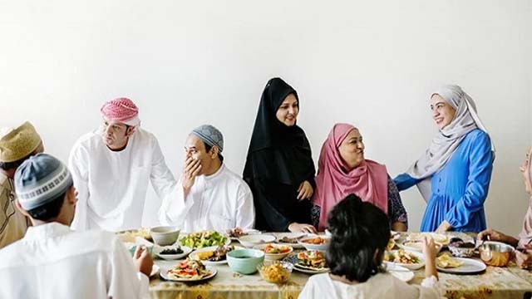
Introducing new words
Host
a person who entertains other people as guests
আয়োজক
Dhaka will be the host city for Cricket World cup.

Slide 9
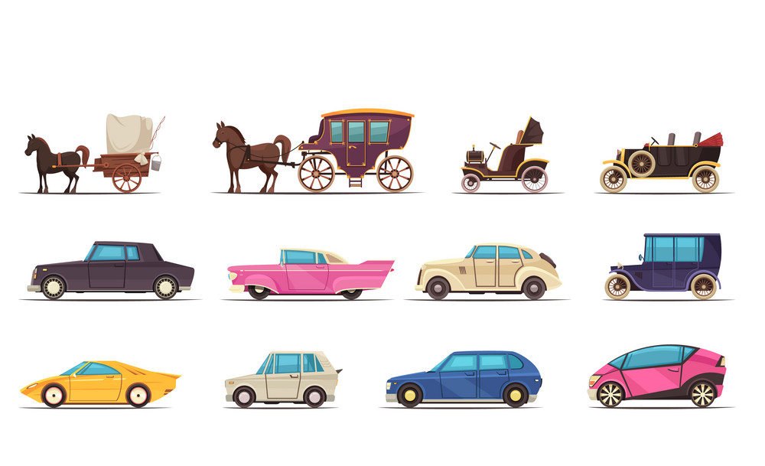
Introducing new words
Modern
recent times as opposed to the remote
আধুনিক
This is a Modern car .

Slide 10
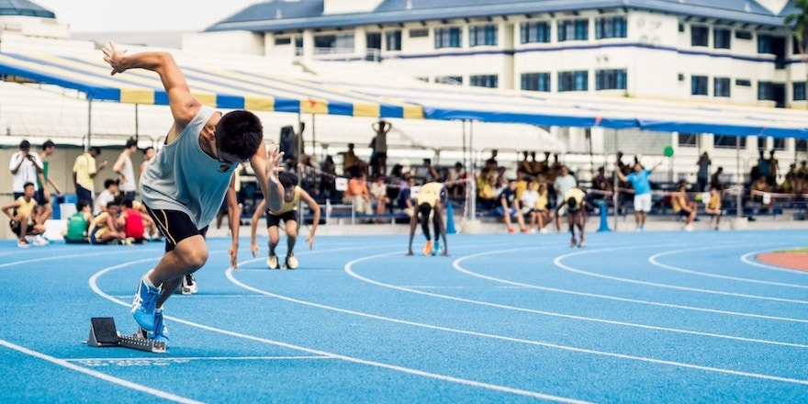
Introducing new words
Compete
take part in a contest.
প্রতিযোগিতা করা
Many athletes compete in the Olympic.

Slide 11
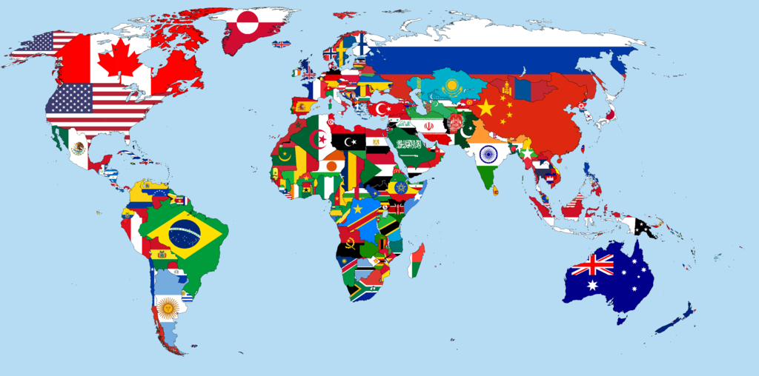
Nations
Introducing new words
Different country people.
জাতি
More than 200 nations compete in Olympic Games.

Slide 12
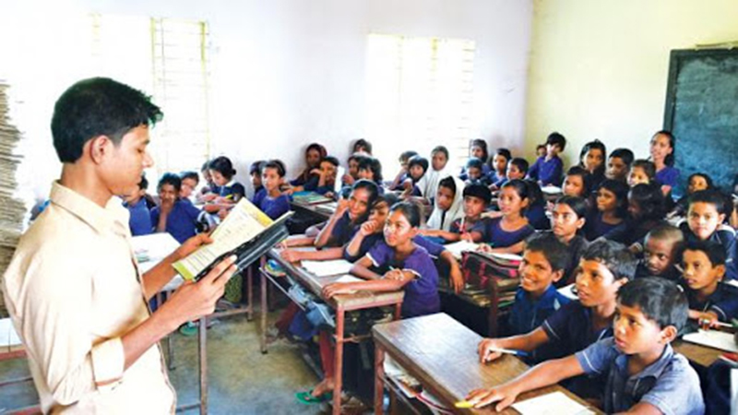
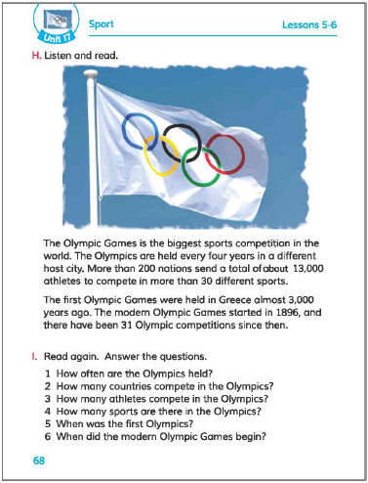
Teacher speaking loudly
Open your book and turn to page 68

Slide 13
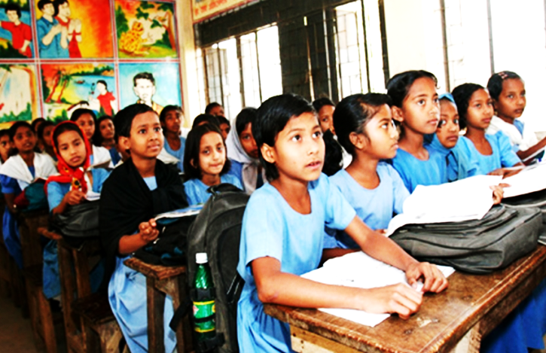
Students reading loudly

Slide 14
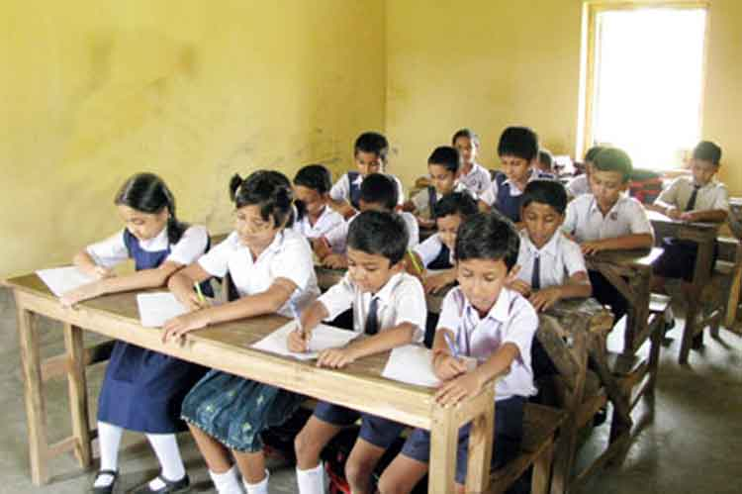
Students silent reading

Slide 15
Individual work
True or False
True
a) The Olympic games started in 1896.
False
b) The Olympics are held in every four years.
False
c) More than 300 nationas participate in this game.
False
d) The first Olympic Games was held London .
True
e) The Olympic Games is the biggest sports competition
in the world.

Slide 16
Pairwork
Fill in the blanks.
Modern
Modern
Sports
Sports
Held
nations
Held
nations
Years
Years
a. The first Olympic ---------- in Greece.
b. The Olympic Games held every four-----------.
c. There are 30 different --------- .
e. More than 200--------- participate in Olympic Games.
e.The ------------Olympic Games started in 1896.

Slide 17
Pair work
Match the words of the column A with their meanings in column B
Column-A | Column-B
a. Panic | i) Professional work .
b. Afraid | ii) To have fear.
c. Volunteer | Iii) Leave
d. Job | iv) Part of a division.
e. Department | iv) Close to the building.
 | vi) One who has fear
 | vii) One who work without payment

Slide 18
Group work
Write the name of your five favourite games
Group
A
Group
B
1.
Group
C
2.
3.
Group
D
4.
5.

Slide 19
Evaluation
Ques:1. How often are the Olympics held?
Ans: The Olympics held every four years.
Ques:2.How many countries compete in this game?
Ans: More than 200 countries compete in the Olympic.
Ques:3.How many athletes compete in the Olympic ?
Ans: More than 13000 athlete compete in the Olympics.
Ques:4. When did the modern Olympic Games began ?
Ans: The modern Olympic Games started in 1896.

Slide 20
One day one word
Athlete
ক্রীড়াবিদ
sentence making
Bangladesh has many popular athlete

Slide 21
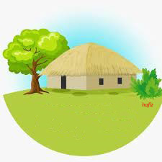
Home Task
Write some sentences about
“Your favourite Game”

Slide 22
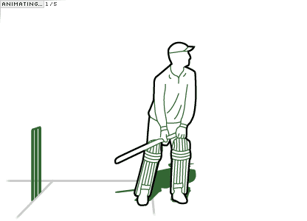
Good Bye
See you….

