Slide 1
WELCOME TO MY MULTIMEDIA CLASS

Slide 2
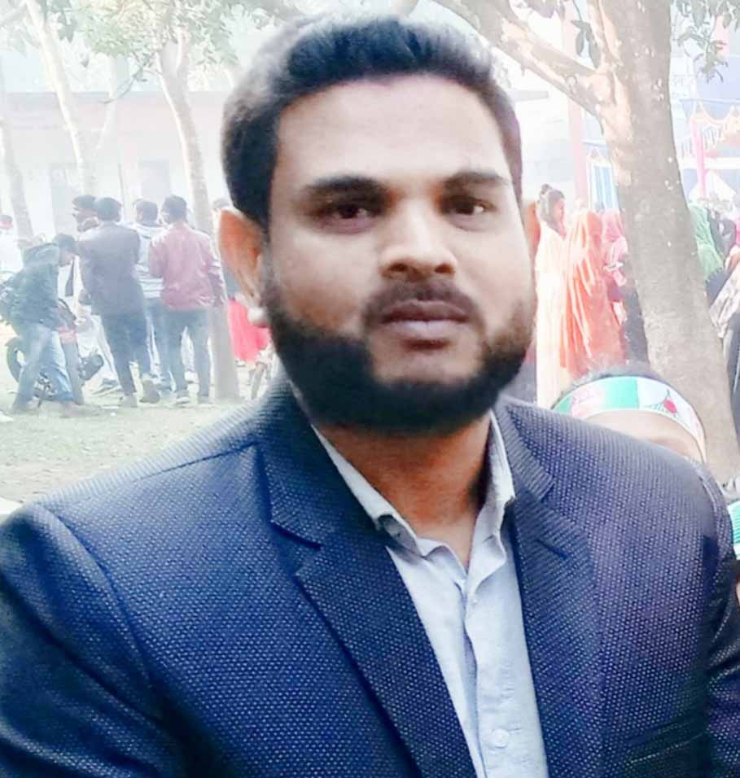
Presented By
Md.Hafizur Rahman
Assistant Teacher
Haripur Government Primary School
Haripur , Thakurgaon .
Phone: 01716437086
Email:hafizict5@gmail.com

Slide 3
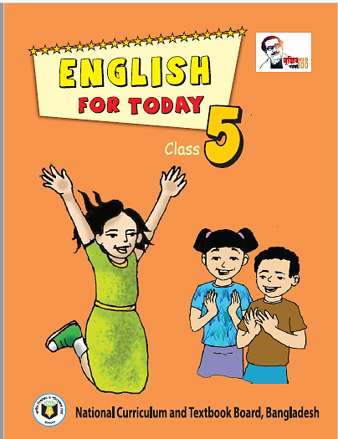
Lesson Identity
Subject : English
Class: Five
Time: 40 minutes
Date: 23-07-2022

Slide 4
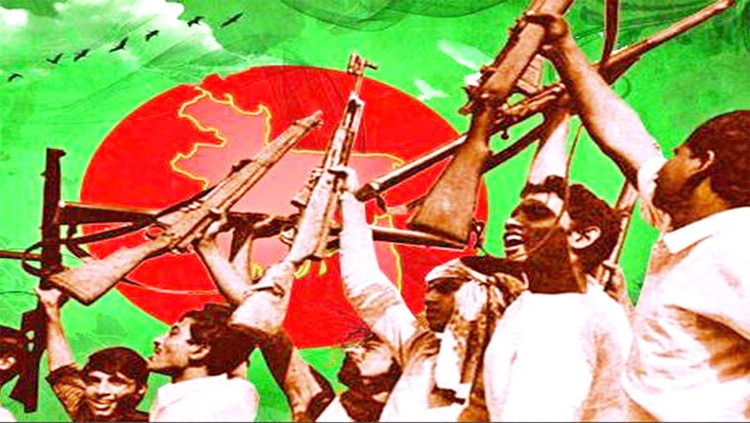
Dear Student ,What do you know about Liberation War?
A war fought to gain independence for a country

Slide 5
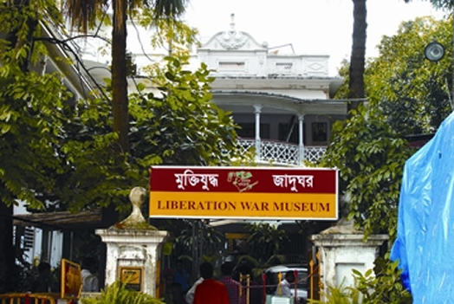
Dear Student ,can you tell me what the Liberation War Museum called in Bangla?
মুক্তিযুদ্ধ জাদুঘর

Slide 6
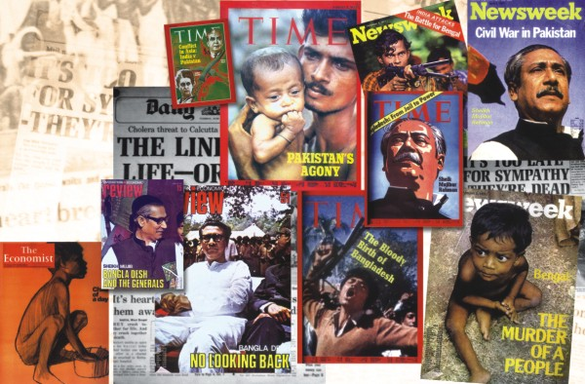
Dear Student ,do you know about a magazine?
A large thin book with a paper cover that you can buy every week or month containing article,photograph etc. ?

Slide 7
Today lesson
The Liberation War Museum
Lesson: 1-4
Unit: 19
Page No. 74

Slide 8
Learning Outcomes
By end of the lesson student will be able to
Listening:
1.3.1- recognize which words in a sentence are stressed
3.4.1- understand statements made by the teacher and student.
Speaking
1.1.1: Say words, phrases and sentences with proper sound and stress.
3.2.1- understand questions about family and friends of students.
Reading
1.6.1- recognize and read statements, commands, greetings, questions and answers.
I .5.1- read silently with understanding text

Slide 9
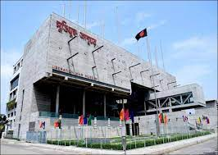
Introducing new words
Museum
A building in which objects of historical, scientific, artistic, or cultural interest are stored and exhibited.
জাদুঘর
We went to the liberation War Museum on Friday.

Slide 10
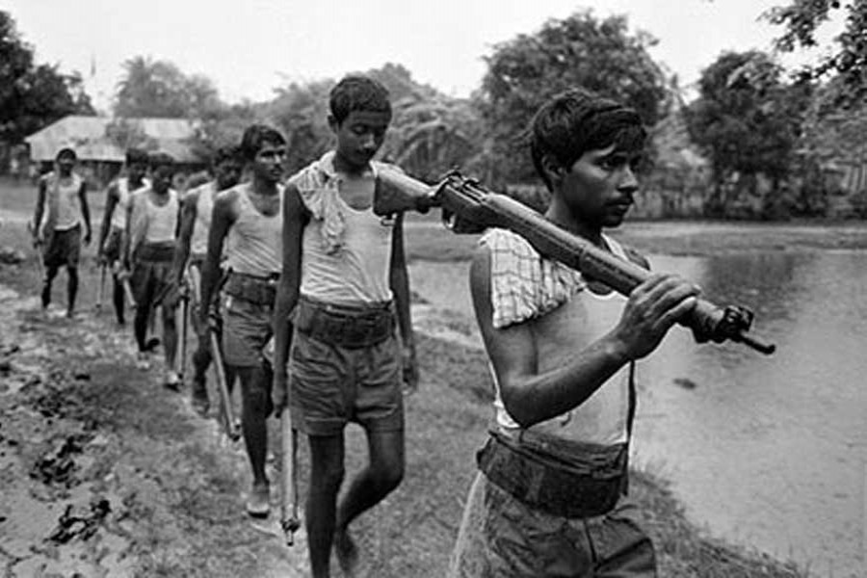
Introducing new words
Liberation War
A war fought to gain independence for a country
মুক্তিযুদ্ধ
Liberation War also known as the Bangladesh War of Independence.

Slide 11
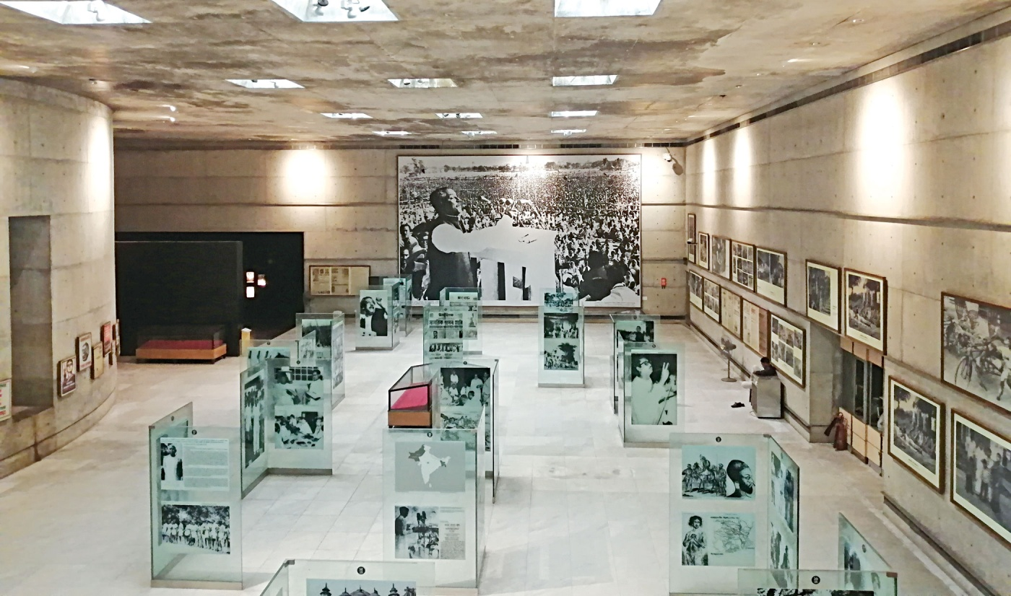
Galleries
Introducing new words
A room for the display of works of art.
লম্বা বারান্দা
We went to inside of the gallery .

Slide 12
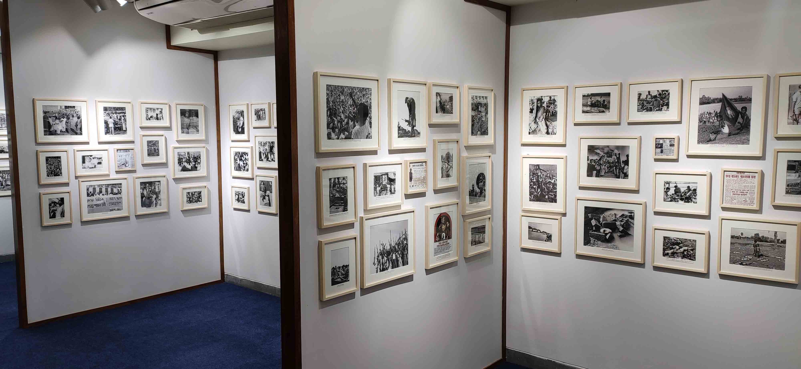
Introducing new words
Photograph
A picture made using a camera
জাতি
I collected many rare photograph .

Slide 13
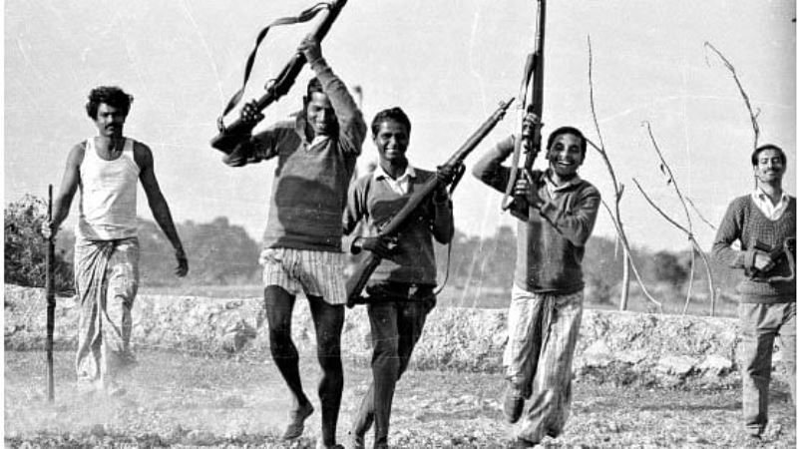
Introducing new words
Freedom Fighter
A person who fight for his/her country
জাতি
Many freedom fighters were martyred in 1971.

Slide 14
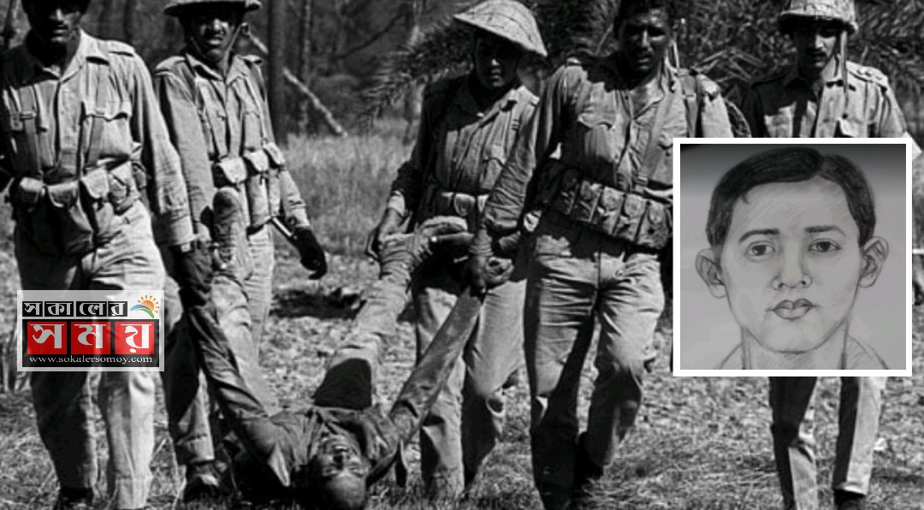
Introducing new words
Martyrs
A person who is killed because of their religious or other beliefs..
শহীদ
We pay tribute to the martyrs of the liberation war.

Slide 15
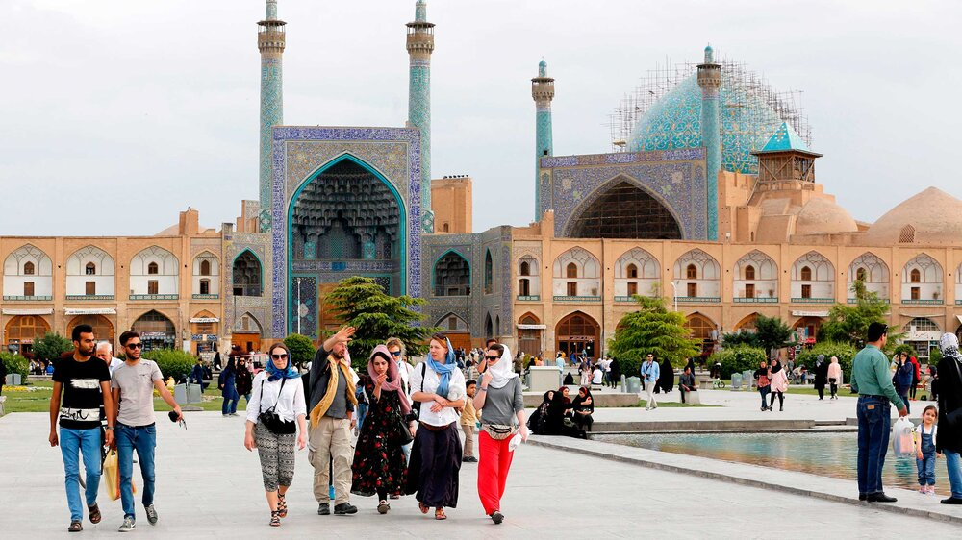
Visitors
Introducing new words
A person visiting someone or somewhere
দর্শনার্থী
Many visitors visit the museum.

Slide 16
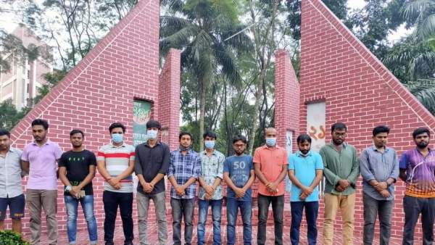
Introducing new words
Silent
Not making any sound.
নিরবতা
We felt silent at gallery -4.

Slide 17
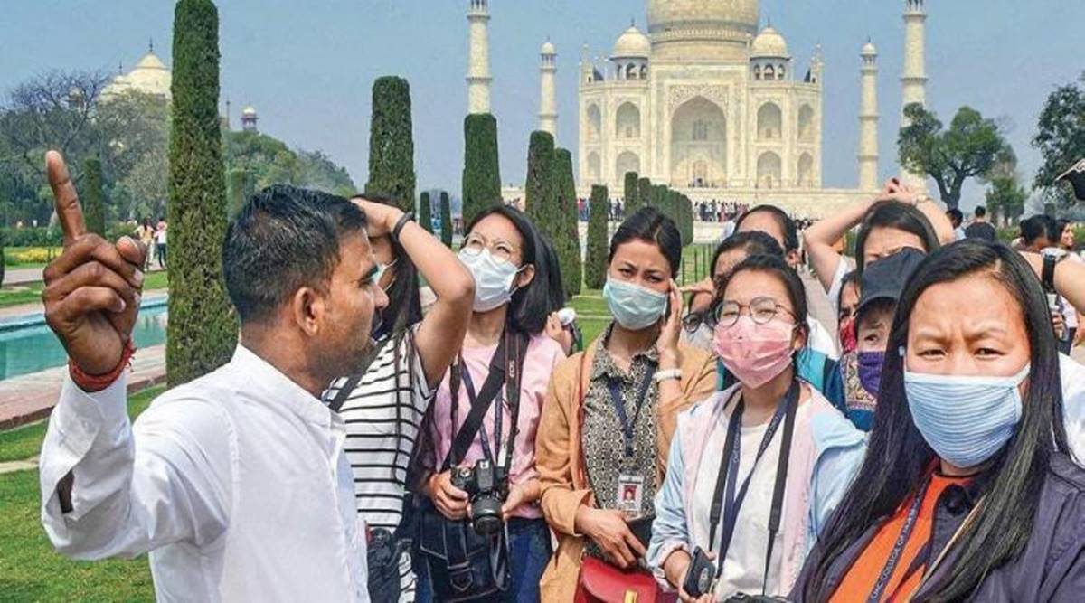
Introducing new words
Guide
A person who shows the way to others
জাতি
A guide welcomed us warmly.

Slide 18
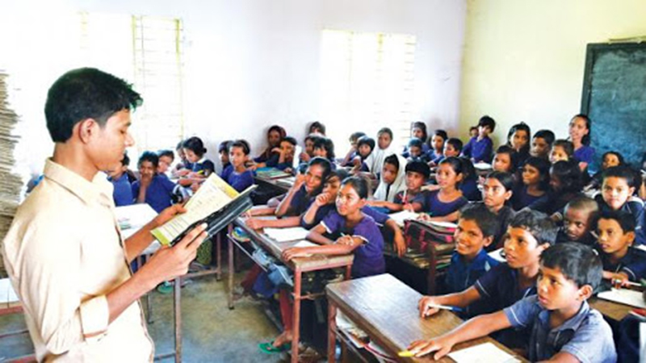
Teacher speaking loudly
Open your book and turn to page 68

Slide 19
Open your book and turn to page 74

Slide 20
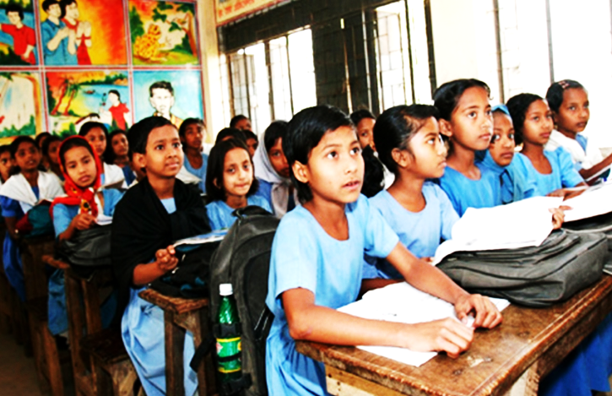
Students reading loudly

Slide 21
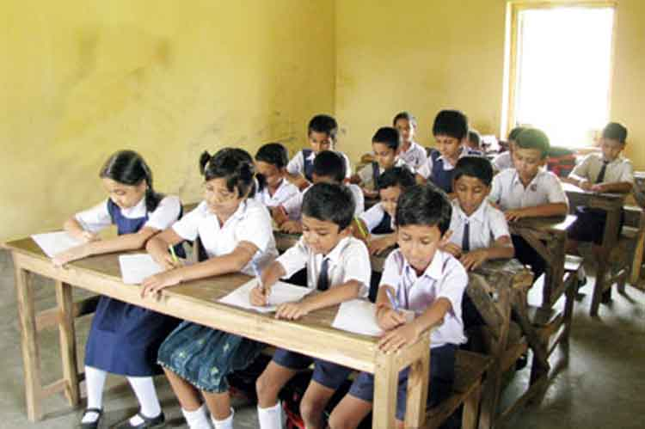
Students silent reading

Slide 22
Individual work
True or False
True
a) the Liberation War Museum at Agargaon dhaka.
False
b) The trip was planned as a part of History.
False
c) They were welcomed by the director .
False
d) The museum has six permanent galleries.
True
e) The student went to the museum in the morning.

Slide 23
Pairwork
Fill in the blanks.
silent
silent
12.30
guide
read
12.30
guide
read
10am
10am
a. The ---------- welcomed us.
b. The bus reached the museum at ----------.
c. We felt --------- .
d. We left the museum at--------.
e. Our teacher ------------ out to us the Declaration of Independence by Bangabandhu Sheikh Mujibur Rahman.

Slide 24
Pair work
Match the words of the column A with their meanings in column B
Column-A | Column-B
a. Freedom Fighter | i) a war fought to gain independence for a country
b. Guide | ii) A person who fight for his/her country
c. Liberation War | Iii) a person who is killed because of their religious or other beliefs.
d. Silent | iv) a person who shows the way to others
e. Martyrs | iv) not making any sound
 | vi). Part of a division.
c
a
e
b
d

Slide 25
Group work
Group
A
Group
B
Group
C
Group
D

Slide 26
Evaluation
Ques:1. When did the class go to the Liberation War Museum?
Ans: On 14 December.
Ques:2. Why did the class go to the Liberation War Museum?
Ans: The trip was planned as part of Bangladesh and global studies course ..
Ques:3.How many permanent galleries are there in the Liberation War Museum?
Ans: There are four permanent galleries are there in the Liberation War Museum?
Ques:4. Which two galleries did the writer and his class visit?
Ans: Gallery-2 and Gallery-4.

Slide 27
One day one word
Field trip
দুরে ভ্রমন
sentence making
We went to a field trip to the Cox’s Bazar

Slide 28
Home Task
PLAN A FIELD TRIP AND WRITE FIVE SETENCE THAT THAT YOU WOULD LIKE TO TAKE”

Slide 29
Good Bye

