Slide 1
Welcome to my dear student

Slide 2
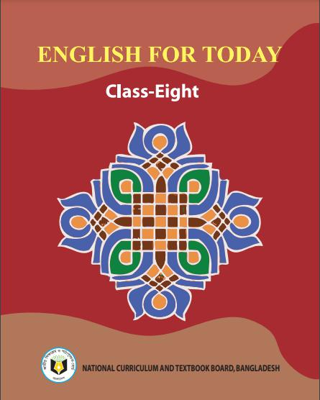
Muhammad Rehan Uddin
Assistant Teacher
Pakshail Ideal High School
Barlekha, Moulvibazar.
Mobile: 01742823363
ICT4E District Ambassador,
Moulvibazar.
Subject: English 1st paper
Class: Eight
Unite-01, Lesson-05
Time: 50 Minute
Lesson Identity
Teacher Identity

Slide 3
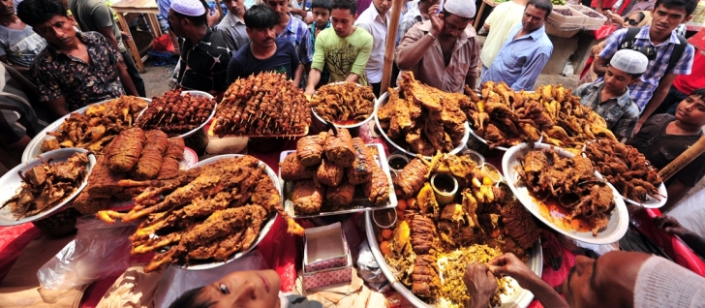
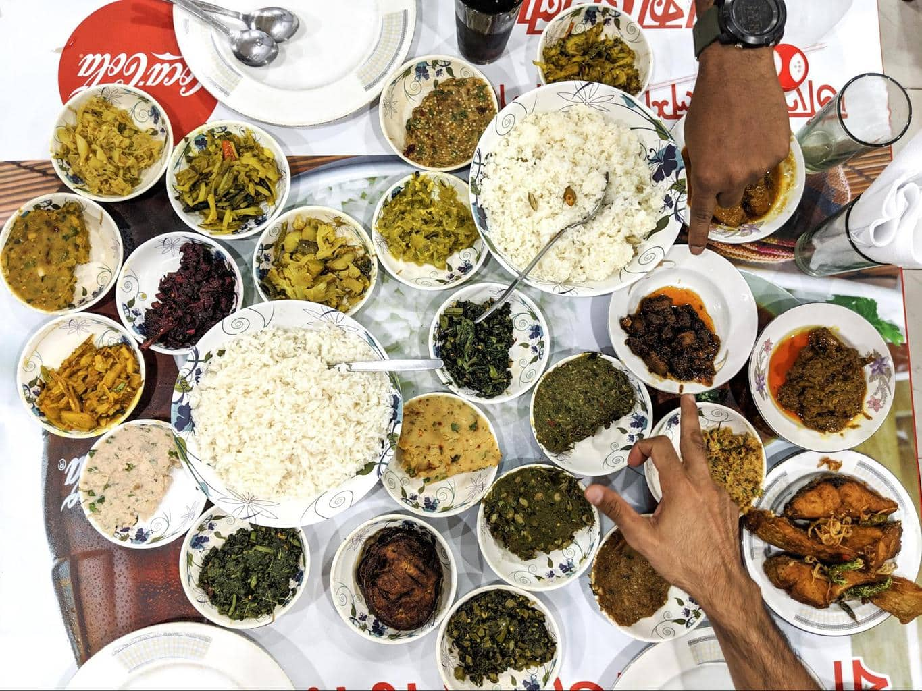
Let’s see some picture…….

Slide 4
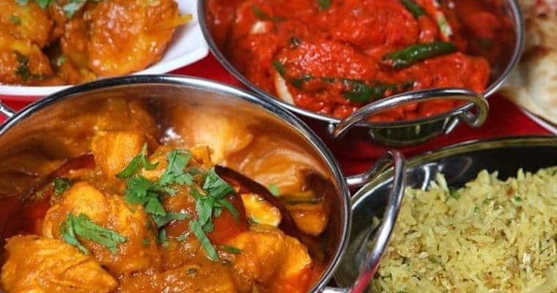
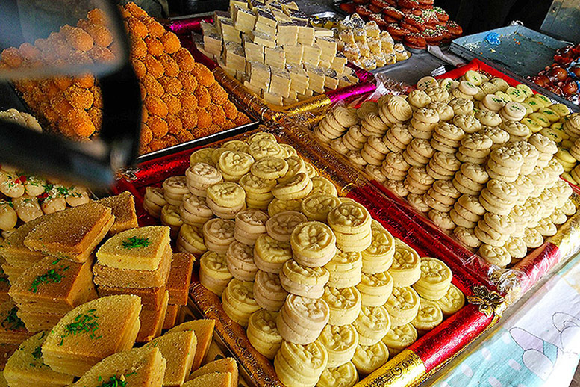

Slide 5
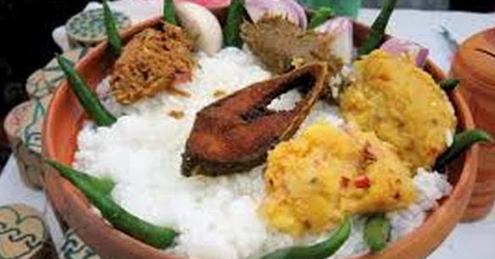
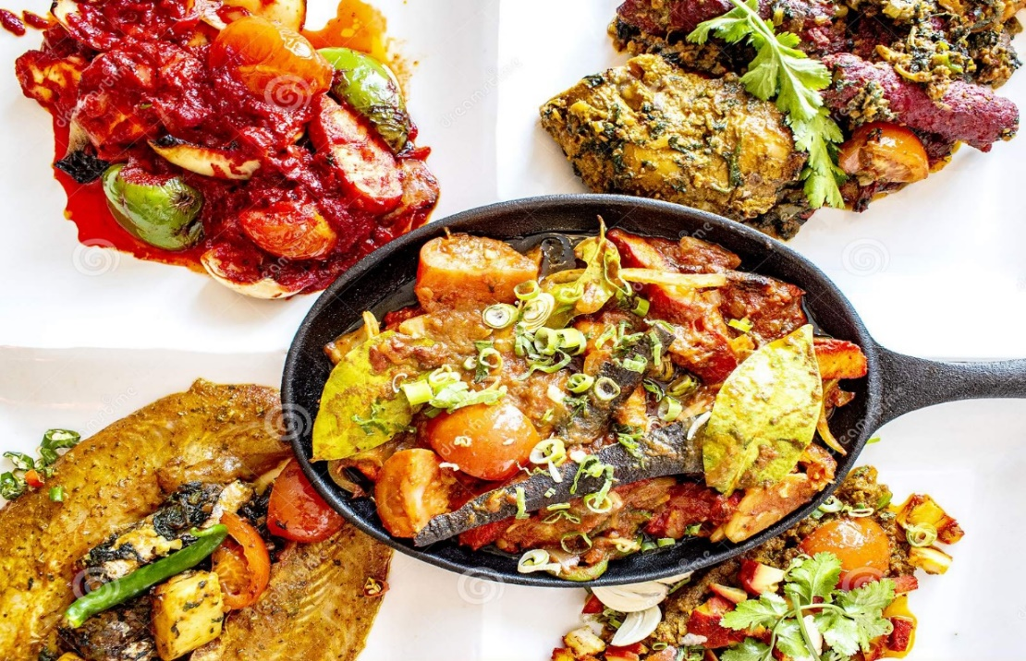
Warm up
1.What do you see in the picture?
2. Which foods are seen in the picture?
3. Do you prepare/eat them at home?
4. Among the foods, which one is your favourite? Why?

Slide 6
So, Today’s our lesson is……….
Bangladeshi Cuisine

Slide 7
Learning Outcomes
After studied this lesson the students will be able to.......
Read and understand the text.
Ask and Answer Questions.
Identified true or false.
Know about Bangladeshi food and food habit.
Narrate about Bangladeshi cooking style.

Slide 8
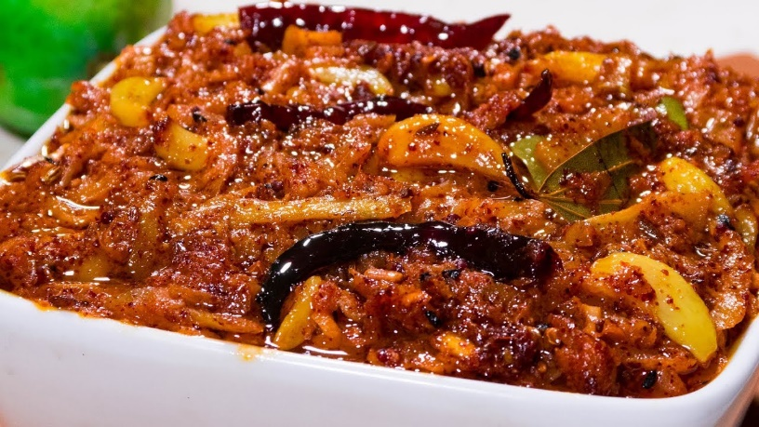
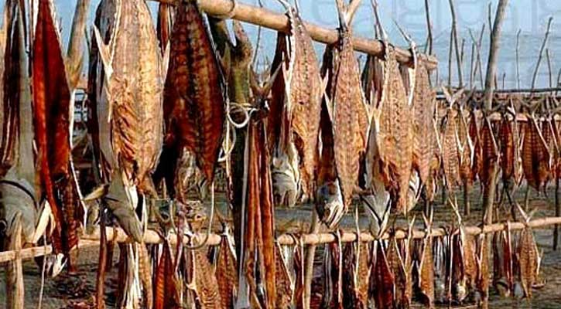
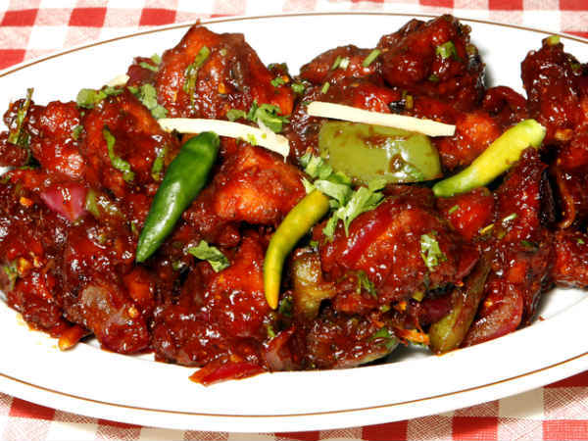
Vocabulary
Dried Fish
Pickles
Fishes which are dried in sun
Predicaments
Spices
Seasonings

Slide 9
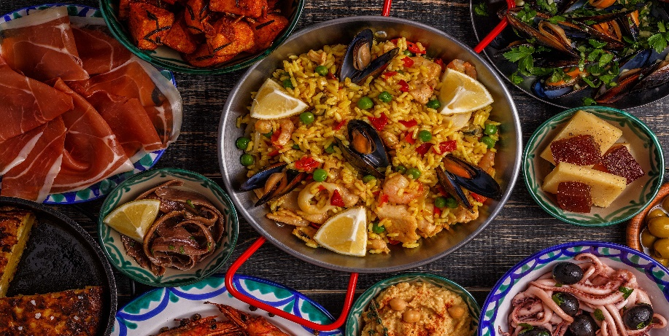
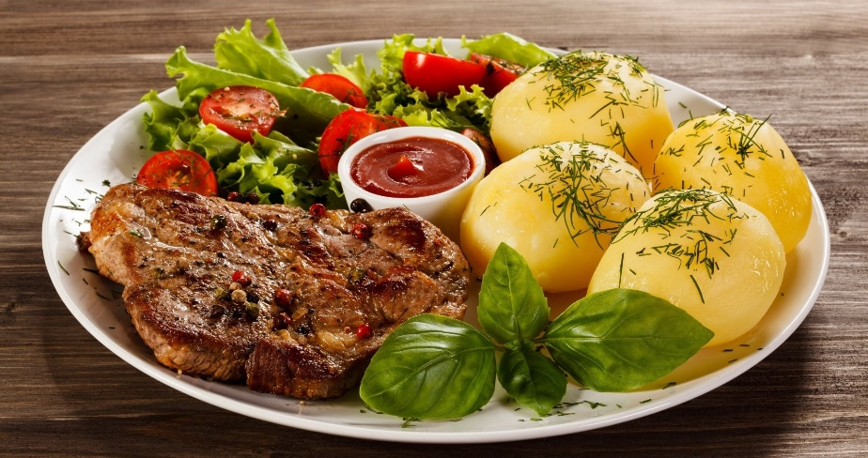
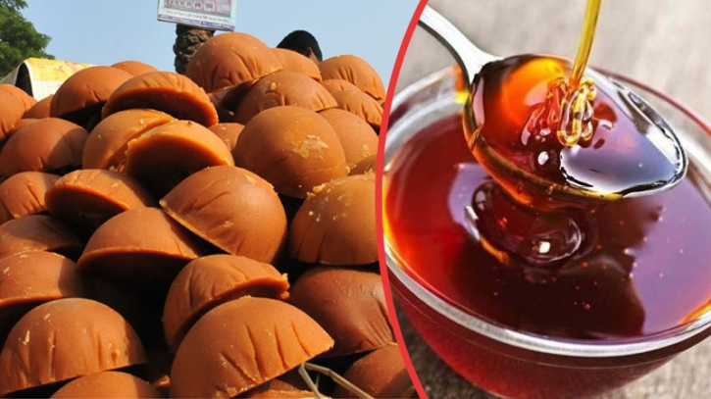
Cuisine
Platter
A style or method of
cooking
Dish/Trencher
Molasses
Treacle

Slide 10
Let’s enjoy the text

Slide 11
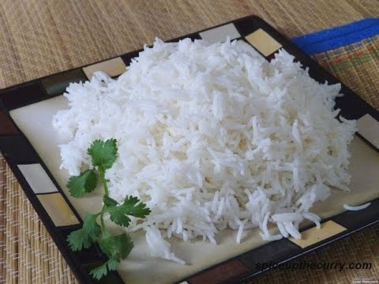
Bangladeshi cuisine is rich and varied with the use of many spices. We have delicious and appetizing food, snacks and sweets. Boiled rice is our staple food. It is served with a variety of vegetables, curry, lentil soups, fish and meat.

Slide 12
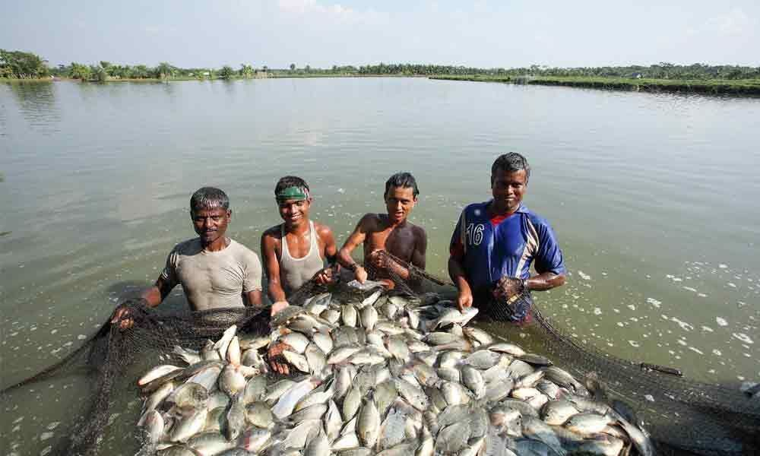
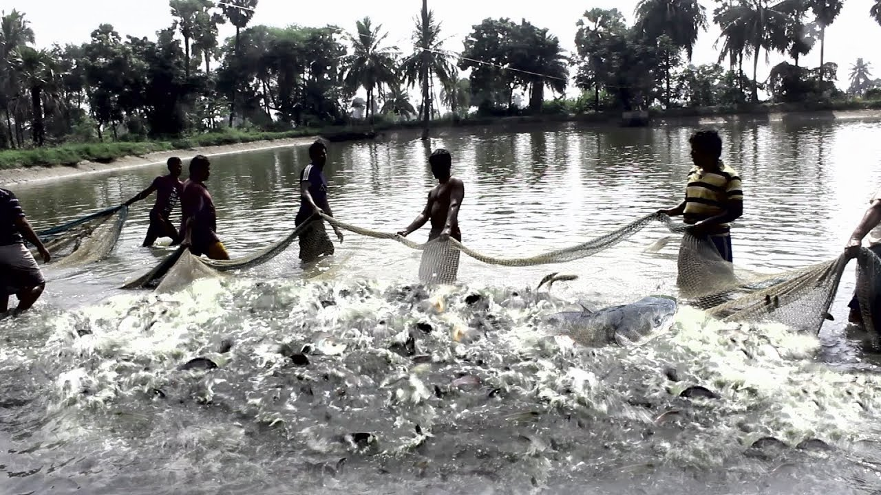
Fish is the main source of protein. Fishes are now cultivated in ponds. Also we have fresh-water fishes in the lakes and rivers.

Slide 13
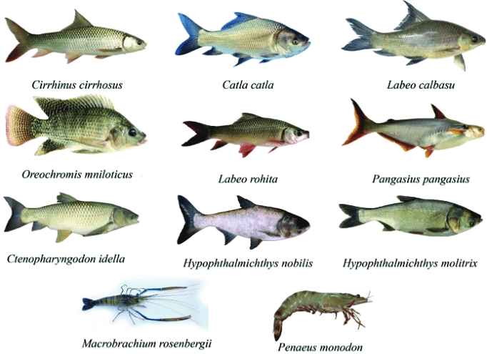
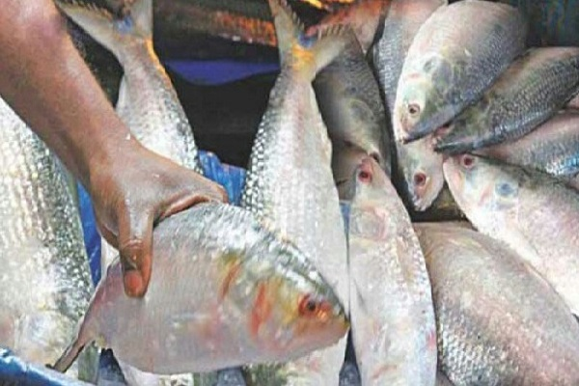
More than 40 types of fishes are common. Some of them are carp, rui, katla, magur (catfish), chingri (prawn or shrimp). Shutki or dried fishes are popular. Hilsha is very popular among the people of Bangladesh.

Slide 14
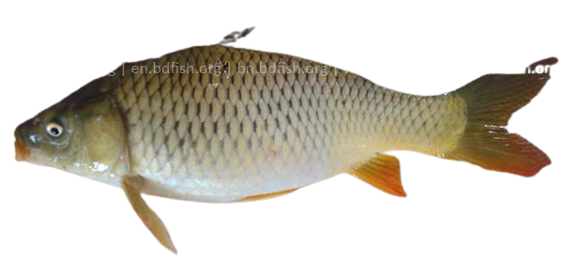
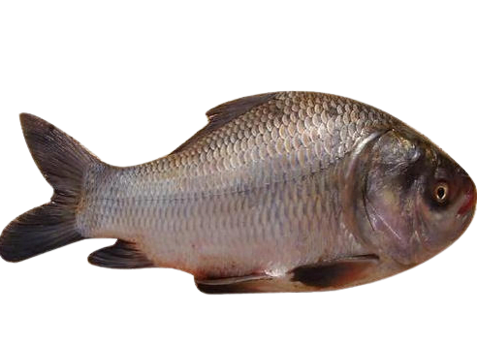
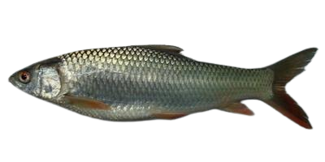
Common fishes in Bangladesh
Carp
Rui
Mrigel
Katla

Slide 15
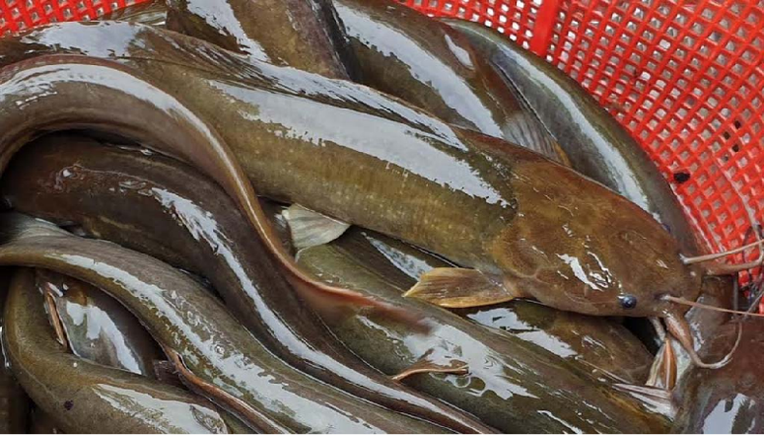
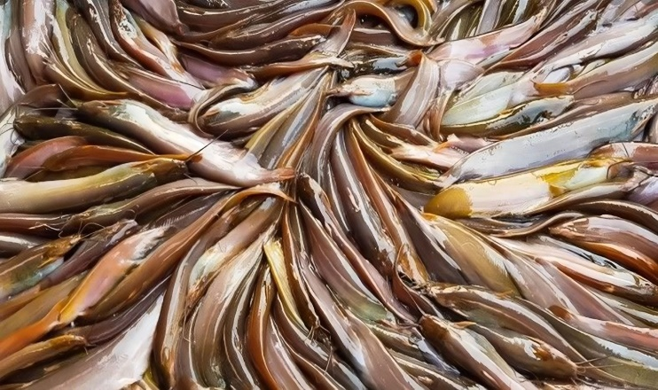
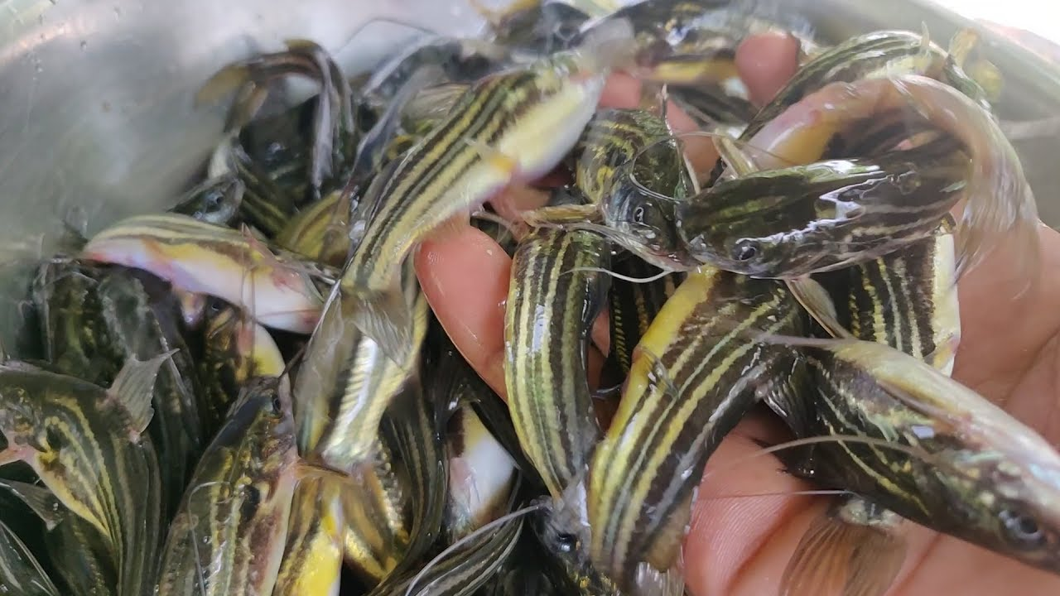
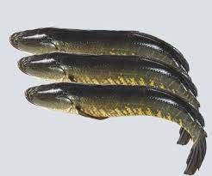
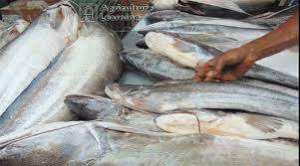
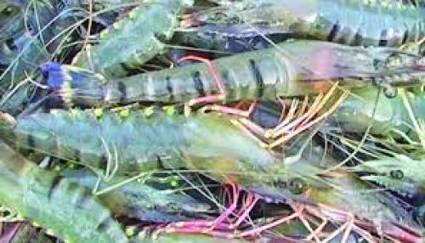
Magur (Catfish)
Shing(scorpion fish)
Tengra
Shol(walking fish)
Buwal(plaice fish)
Chingri(Shrimp)

Slide 16
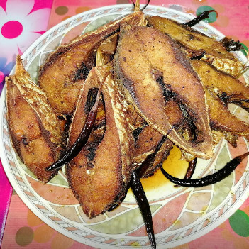
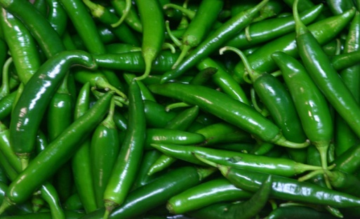
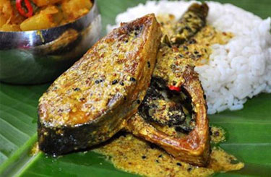
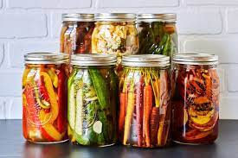
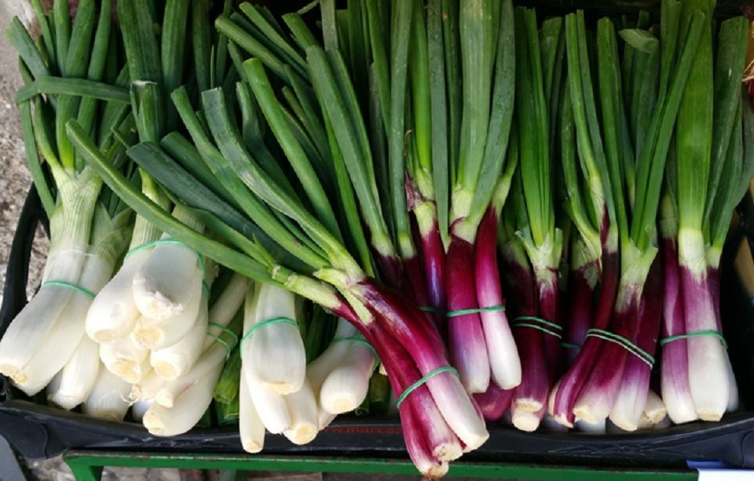
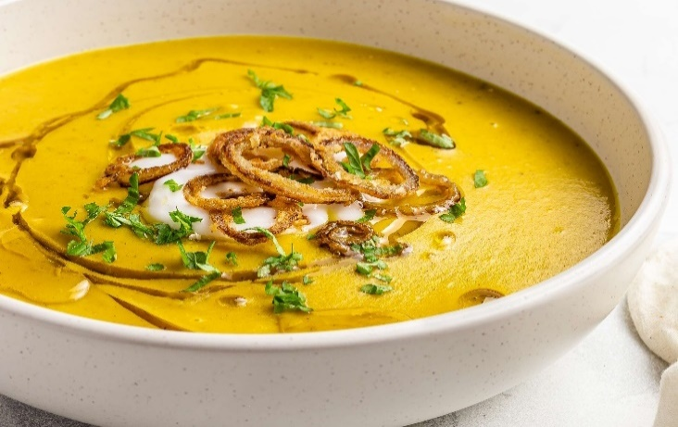
Pantha bhat is served with at Pohela Boishakh…
Fried hilsha
Green chili
Hilsa slice
Pickles
Green onion
Lentil soup
Notes:
It is for listening skill.

Slide 17
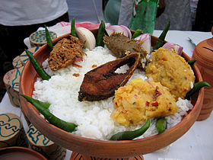
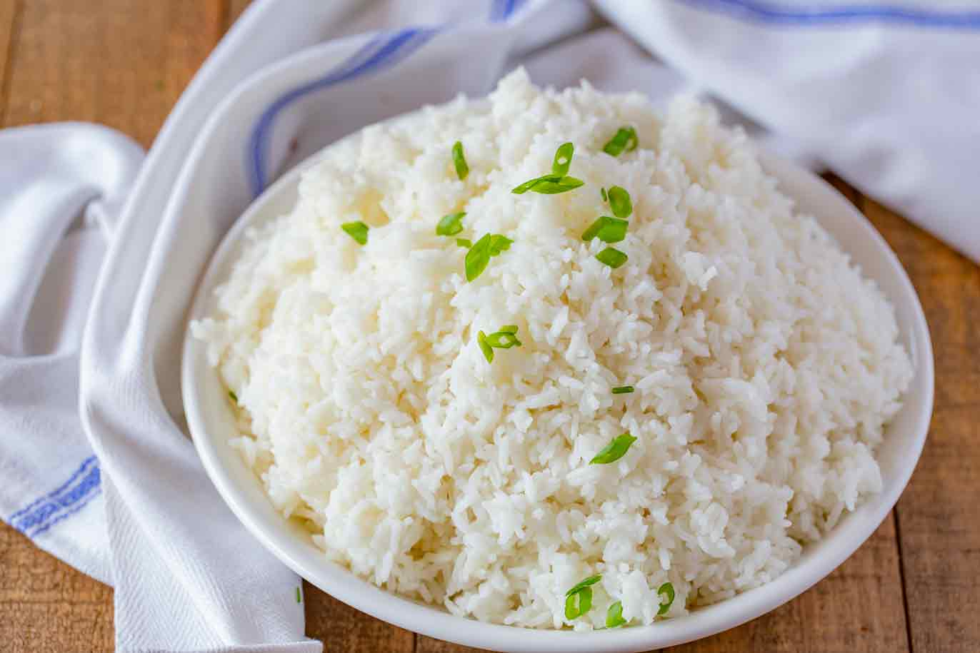
Panta ilish is a traditional platter of Panta bhat. It is steamed rice soaked in water and served with a fried hilsha slice, often together with dried fish, pickles, lentil soup, green chilies and onion. It is a popular dish on the Pohela Boishakh.

Slide 18
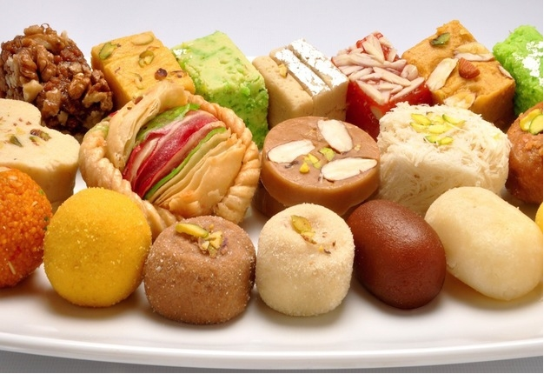
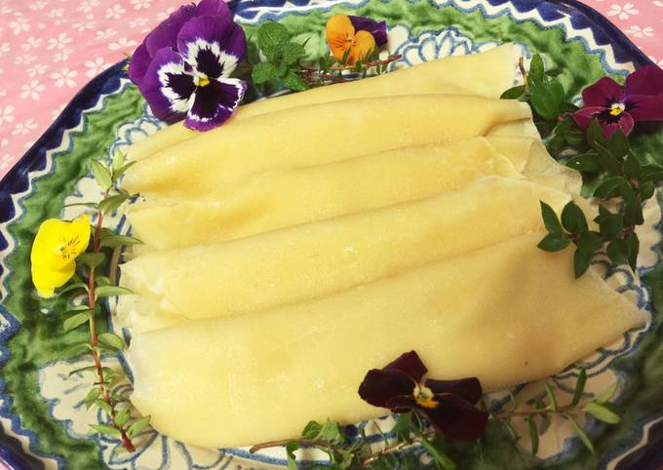
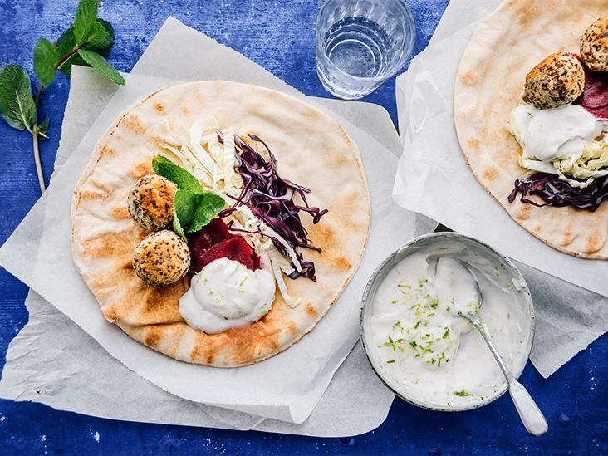
The people of Bangladesh are very fond of sweets. Almost all Bangladeshi women prepare some traditional sweets. Pitha, a type of sweets made from rice flour, sugar, syrup, molasses and sometimes milk, is a traditional food loved by the entire population.

Slide 19
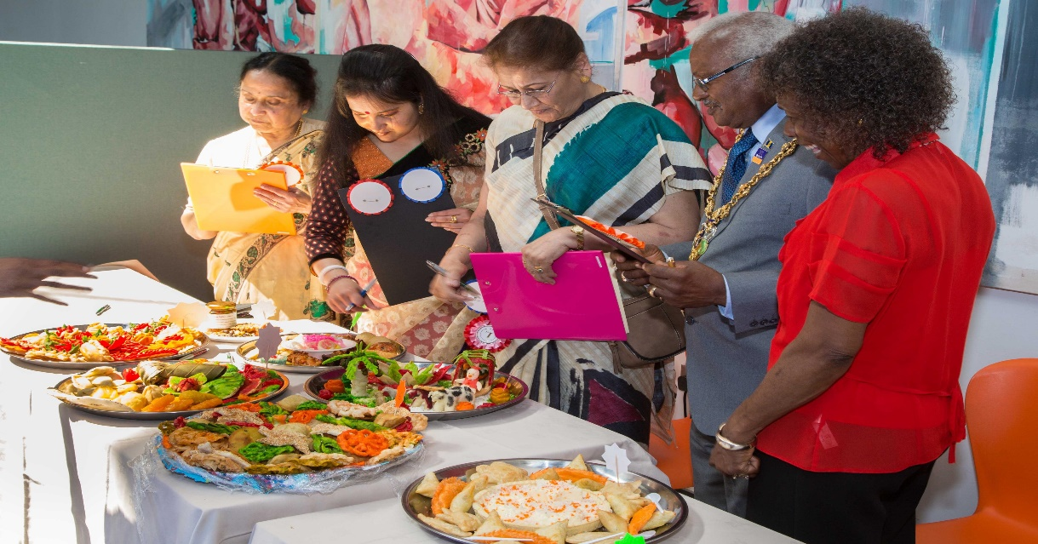
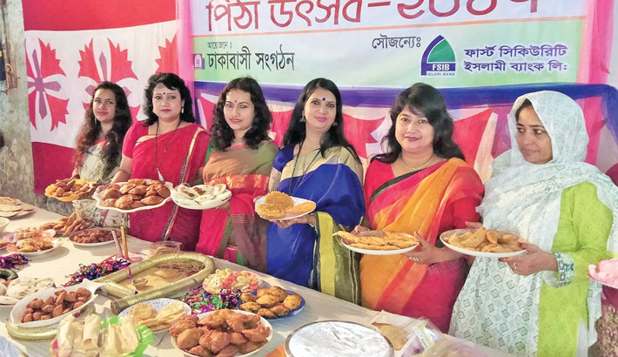
During winter Pitha Utsab, meaning pitha festival, is organized by different groups of people. Sweets are distributed among close relatives when there is good news like births, weddings, promotions, etc.

Slide 20
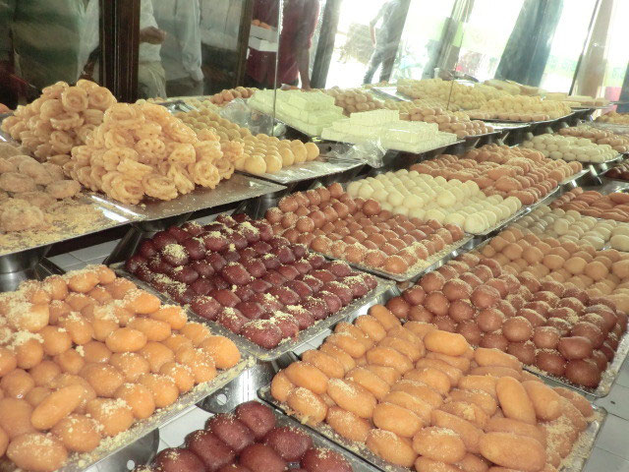
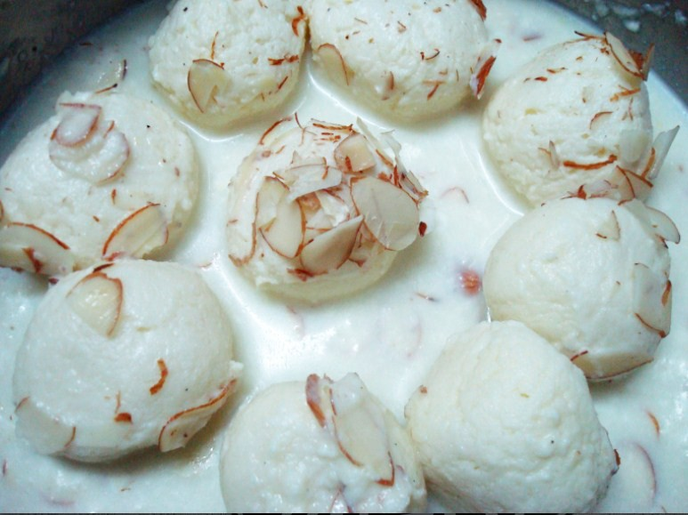
Sweets of Bangladesh are mostly milk-based. The common ones are roshgolla, sandesh, rasamalai, gulap jamun, kalo jamun and chom-chom.There are hundreds of different varieties of sweet preparations. Sweets are therefore an important part of the day-to-day life of Bangladeshi people.

Slide 21
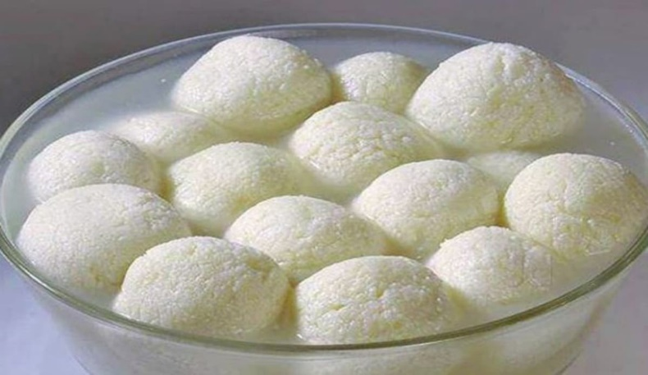
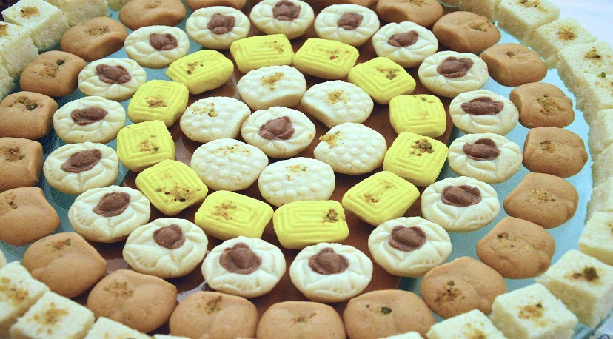
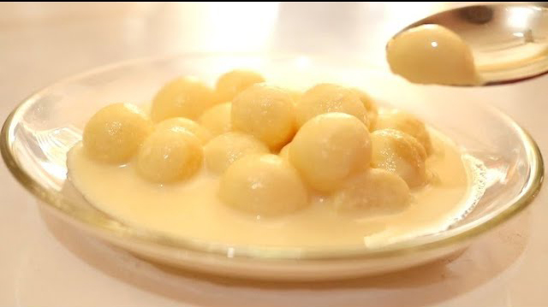
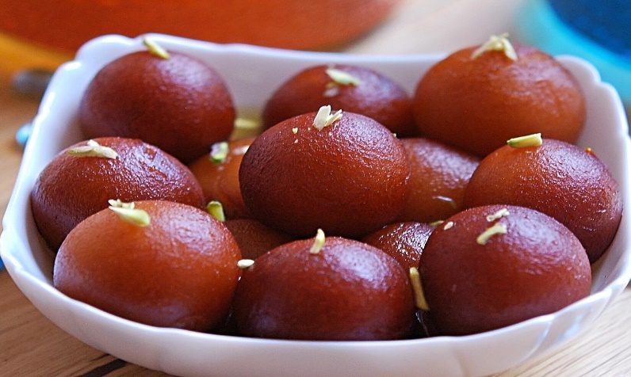
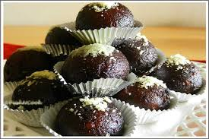
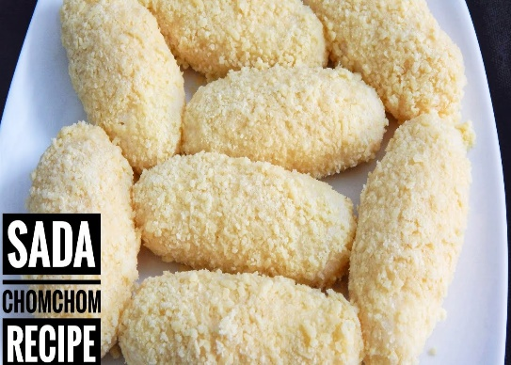
Common sweets in Bangladesh
Roshgolla
Sandesh
Rasamalai
Gulap jamun
Kalo Jamun
Chom-Chom

Slide 22
Pair Work
The following sentences are true or false,
if false give the correct information
Our food is rich because they have a lot of oil in them.
We get protein mostly from fish.
On Pohela Boishak, the traditional is steamed rice and fried hilsha
Pitha Uthsab takes place almost all the year round in Bangladesh.
Sweets are not much appreciated by the people of Bangladesh.

Slide 23
Answer Sheet
1. False: Our food are rich because they have a lot of spices in them.
2. True.
3. False: On pahela Boishakh the traditional food is pantha ilisha.
4. False: Pitha Uthsab takes place in winter.
5. False: Sweets are much appreciated by the people of Bangladesh.

Slide 24
Group Work
Answer the following questions.
What has made Bangladeshi food so special?
Where do we get the fishes from?
Apart from fish, What other foods do we eat with rice?
Why are sweets an important part of our life?

Slide 25
Answer Sheet
1.The variation with the use of many spices has made
Bangladeshi food so special.
2. We get the fishes from ponds, lakes and rivers.
3. Apart from fish we eat vegetable curry, lentil soups
and meat with rice.
Sweets are an important part of our life because
sweets are distributed among close relative on
the occasion of good news like birth, weeding,
promotions, etc.

Slide 26
Home Work
Write a paragraph about Bangladeshi food and food habits.

Slide 27
Thank You All

