Slide 1

Welcome

Slide 2
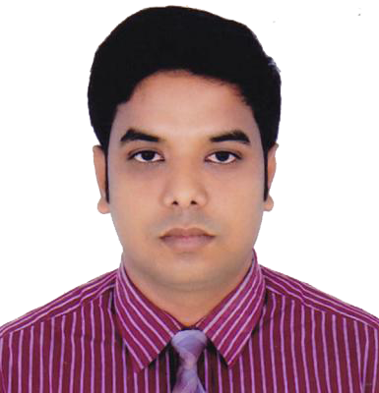
Teacher’s Info
Md. Sadek Ahmed
Asst teacher in English
BAF Shaheen College Shamshernagar
Kamalgonj, Moulvibazar
Mob: 01715859258

Slide 3

Today’s topic
Completing
Sentences
For class IX & X

Slide 4
Let’s have a look at the following sentences…….
He studies more so that/ in order that____.
The old man is too weak to ______.
They walked fast lest_______.
If you read more, you________.
Incomplete sentences

Slide 5
How to complete a sentence
He studies more so that/ in order that ______.
The old man is too weak to ______.
They walked fast lest_______.
If you read more, you________.
Look
closely
Key words/words
so that/ in order that
too…. to
lest
If

Slide 6
How to complete a sentence
so that/ in order that - যাতে
We take exercise so that we can be healthy.
Alex studies more so that he can make a good result.
She went to the railway station so that she could meet her cousin.
…..so that/ in order that + sub + can/may/could/might +v1+ext

Slide 7
How to complete a sentence
too…to - এতই…যে
He is too lazy to walk fast.
The old man is too weak to carry the load.
The poem was too difficult for us to understand.
…..too …..to +v1+ext.

Slide 8
How to complete a sentence
lest - নতুবা/ তা না হলে
He reads more lest he should fail in the exam.
They walked fast lest they might miss the train.
Alisha completed her HW lest her teacher might punish her.
…..lest+ sub + should/might +v1+ext

Slide 9
How to complete a sentence
If/Providing that/ provided - যদি
If you invite me, I will join the party.
If you read more, you will know more.
If he works hard, he will shine in life.
If+ present indefinite + future indefinite.

Slide 10
How to complete a sentence
If - যদি
If you invited me, I would join the party.
If he read more, he might know more.
If he worked hard, he could shine in life.
If+ past indefinite + past conditional
(sub+would/could/might+
V1+ext)

Slide 11
How to complete a sentence
If - যদি
If you had invited me, I would have joined the party.
If he had read more, he might have known more.
If he had worked hard, he could have shined in life.
If+ past indefinite + perfect conditional
(sub+would/could/might+
+have+V3+ext)

Slide 12
Thank you
Stay at home, stay safe

Slide 13
How to complete a sentence
As though/As if - যেন
He behaves as though/as if he didn’t know me.
She speaks as though/as if she knew everything.
He pretends as though/as if he were a mad.
Present Ind + as though/as if + Past Ind

Slide 14
How to complete a sentence
As though/As if - যেন
He behaved as though/as if he hadn’t known me.
She spoke as though/as if she had known everything.
He pretended as though/as if he had been a mad.
Past Ind + as though/as if + Past Per

Slide 15
How to complete a sentence
It is time/It is high time – এখনই সময়
It is time/It is high time we changed our society.
It is time/It is high time for us to stop corruption.
It is time/It is high time we planted trees.
It is time/It is high time + Past Ind
It is time/It is high time + for + obj
+ to + V1 + ext.

Slide 16
How to complete a sentence
No sooner had….. than = যখনই
Hardly had….. when/before= যখনই
Scarcely had…… when= যখনই
No sooner had we reached the station than the train left.
Hardly had he went to school when/before the rain started.
No sooner had … than/Hardly had…when/before/
Scarcely had….when + Past Ind

Slide 17
How to complete a sentence
Let’s do some exercises
It is high time--------------------
He talks as if --------------------
No sooner had the thief seen the police ---
Scarcely had the assembly begun ----------
It is high time for them -------

Slide 18
How to complete a sentence
HW
Practise the rules

Slide 19
Thank you
Stay at home, stay safe

