Slide 1
Welcome

Slide 2
Shushil Chandra Roy Asisstant teacher Muraripur Government Primary School Bochagonj, Dinajpur.
Class: One
Subject: English
Lesson: Rhyme (Unit 13)
Lesson part: Rhyme: 2 hands go…tap (Lesson 2)

Slide 3
Learning outcomes:
Students will be able to:
Listening: 4.1.1 enjoy the rhythm and music of simple rhymes.
Speaking: 4.1.1 repeat rhyme after the teacher.
4.1.2 recite rhyme individually.

Slide 4
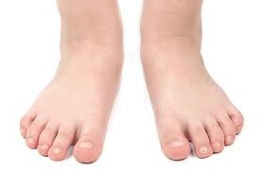
What can we see here?

Slide 5
Rhyme (2 hands go…side to side.)
2 hands
2 feet
2 eyes
1 head

Slide 6
2 hands go clap, clap, clap

Slide 7
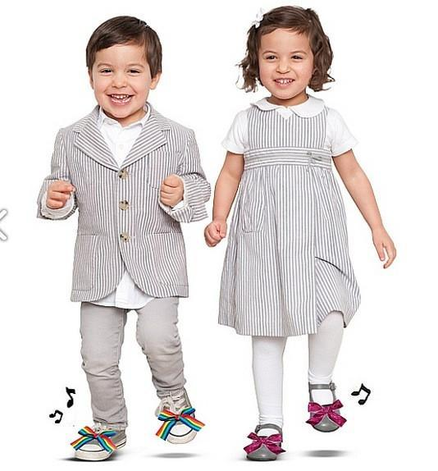
2 feet go tap, tap, tap.

Slide 8
2 eyes are open wide.

Slide 9
1 head goes side to side.

Slide 10
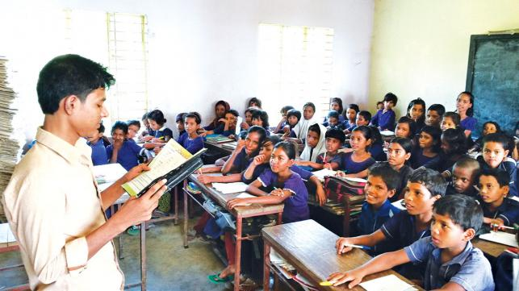
Teacher’s activity:
Open at page 26

Slide 11
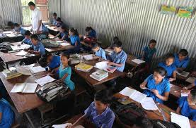
Students’ activity (at page 26):

Slide 12
Group work:
Group: Alif Group: Ba Group: Ta
Group: Sa Group: Zeem Group: Ha
Say the rhyme in group:
2 hands go
Clap, clap, clap.
2 feet go
tap, tap, tap.
2 eyes are
open wide.
1 head goes
side to side.

Slide 13
Assessment/Evaluation/Task
1. Say the rhyme (2 hands go...side to side).

Slide 14
Thank you, everybody.

