Slide 1
Welcome
Shamima Nasrin Sonia

Slide 2
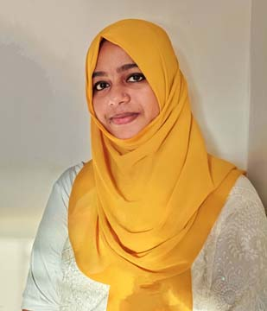
Identity
Shamima Nasrin Sonia
Assistant Teacher
Dokkhin Gachua Govt. Primary School
Muladi, Barishal.
Class- Two
Subject- English For Today
Unit- 13
Lessons: 1-3
Part- B

Slide 3
Greetings
Good morning, students.
How are you, my dear little students?
Good morning, teacher.
Fine, thank you, teacher.

Slide 4
Now let’s see a video song
Shamima Nasrin Sonia

Slide 5
Today’s lesson
is
Days of the week
Shamima Nasrin Sonia

Slide 6
Learning outcomes
Students will be able to
Listening
3.1.2
understand simple questions and statements about familiar objects.
Speaking
1.1.1
repeat after the teacher simple words and phrases with proper sounds and stress.
3.1.2
ask and answer questions about familiar objects.
5.1.1
say the names of the days of the week.
Reading
3.1.1
recognize and read the days of the week.

Slide 7
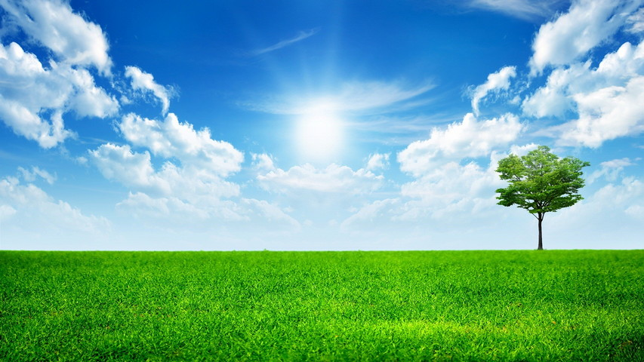
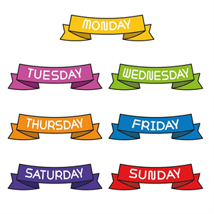
Let’s know the meaning of new words
Day
দিন
Week
সপ্তাহ
Today
আজ

Slide 8
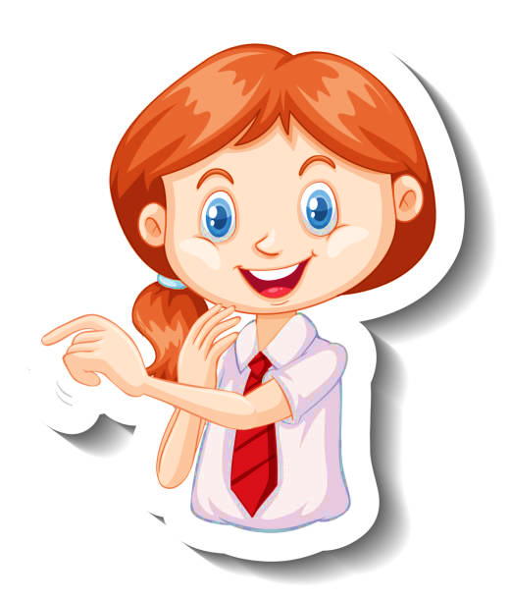
What day is today?
What’s the next day of Saturday?
It’s Saturday.
It’s Sunday.

Slide 9
What do you see in the calendar?
Here are the names of the seven days.
What are you see in the picture?
Calendar
2022
Sat
Sun
Mon
Tue
Wed
Thu
Fri
1
2
3
4
5
6
7
8
9
10
11
12
13
14
15
16
17
18
19
20
21
22
23
24
25
26
27
28
29
30
31

Slide 10
Look, listen and say.
Saturday
Sunday
Monday
Tuesday
Wednesday
Thursday
Friday
Days of a week
Today is

Slide 11
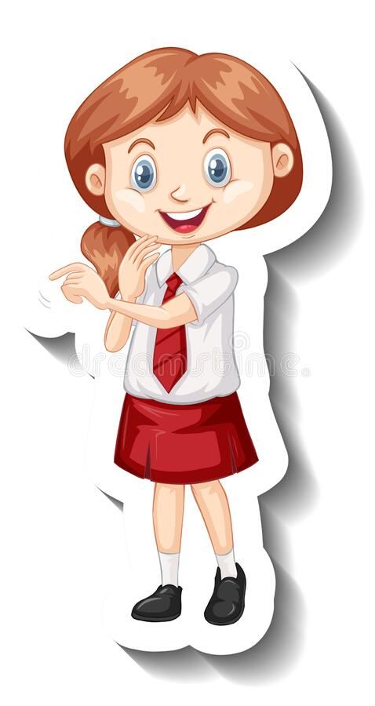
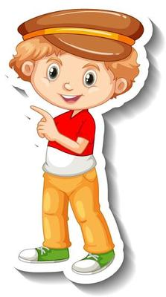
Saturday
Sunday
Monday
Tuesday
Wednesday
Thursday
Friday
Here are 7 days in a week.

Slide 12
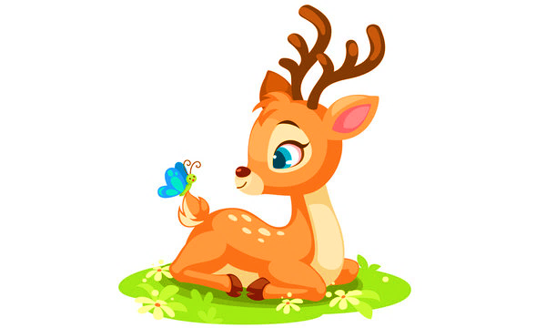
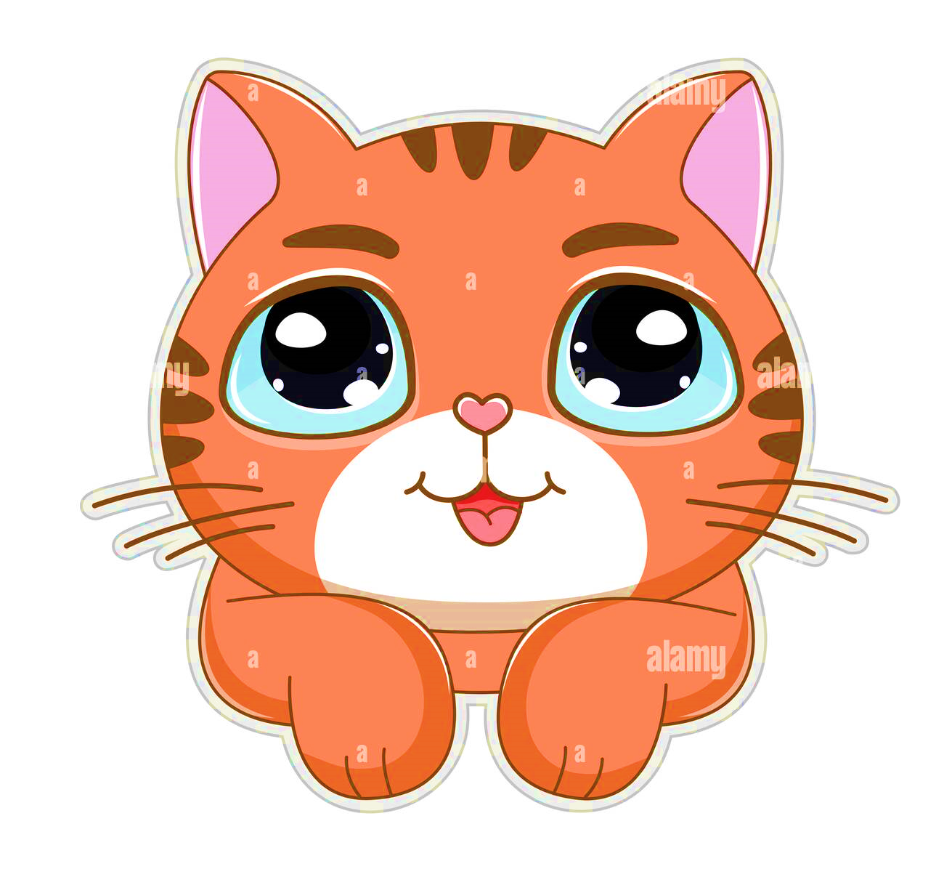
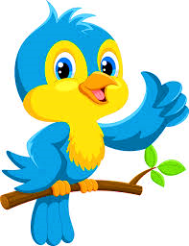
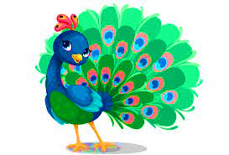
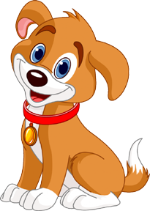
Look, listen and say.
Saturday
Sunday
Monday
Tuesday
Thursday
Wednesday
Friday

Slide 13
Individual work
Write the names of the missing days on each caterpillar.
Saturday
Sunday
Monday
Tuesday
Wednesday
Thursday
Friday
Saturday
Sunday
Monday

Slide 14
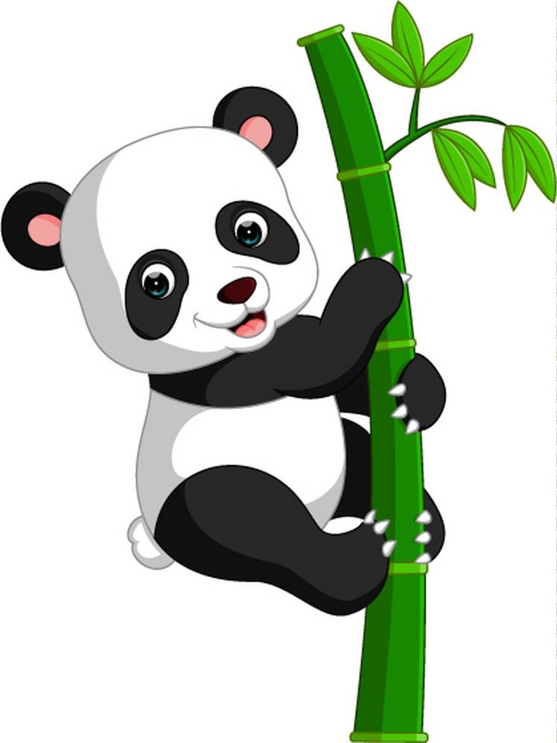
How many days are there in a week?
7
There are days in a week.

Slide 15
Open your English textbook
Page no- 26
Activity -B

Slide 16
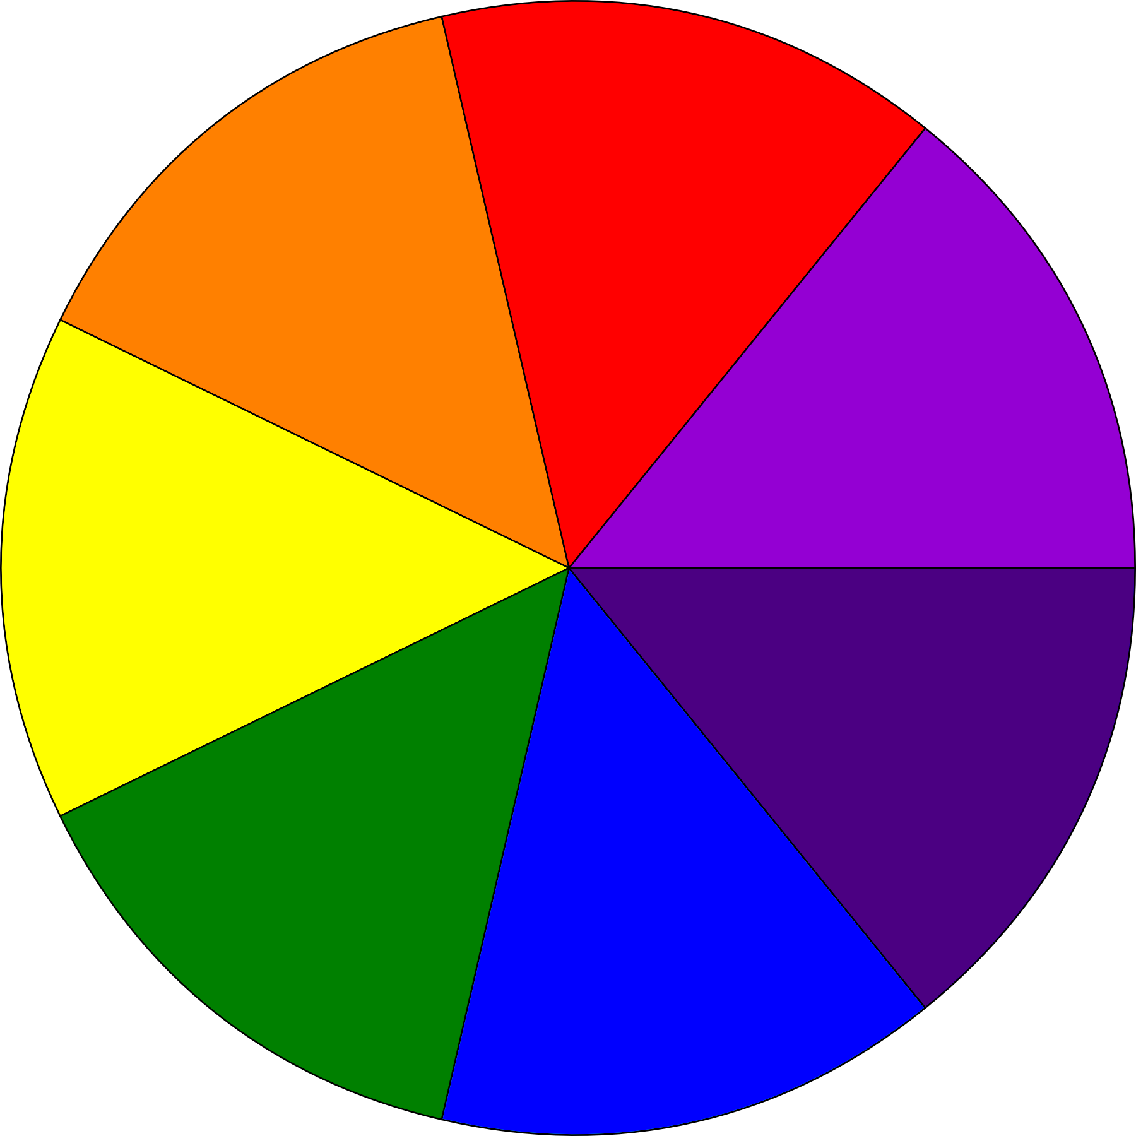
Today
Yesterday
Tomorrow
Sunday
Saturday
Monday
Days of the week
Friday
Tuesday
Wednesday
Thursday

Slide 17
Pair work
Fill in the blanks with correct day
Yesterday
Today
Tomorrow
Thursday
Friday
Saturday
Tuesday
Wednesday
Thursday
Saturday
Sunday
Monday
Friday
Saturday
Sunday
Monday
Tuesday
Wednesday
Wednesday
Thursday
Friday
Sunday
Monday
Tuesday

Slide 18
Unscramble the days of the week
I
Y
R
A
F
D
S
Y
D
E
A
U
T
O
A
Y
N
D
M

Slide 19
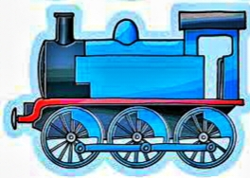
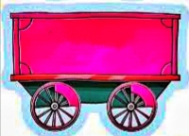
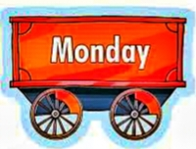
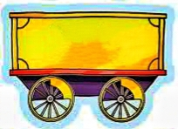
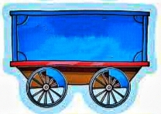
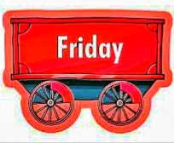
Group work
Group- A
Group- B
Unscramble the days of the week.
Write the correct days of the week.
Sunday
S
Y
N
D
E
W
D
E
A
Tuesday
A
D
R
Thursday
Y
F
I

Slide 20
Evaluation
How many days are there in a week ?
Ans- 7 days.
2. Which is the first day of the week ?
Ans- Saturday.
3. Which is the last day of the week ?
Ans-Friday.
4. Which day comes before Tuesday ?
Ans- Monday.
5. Which day comes after Wednesday ?
Ans- Thursday.

Slide 21
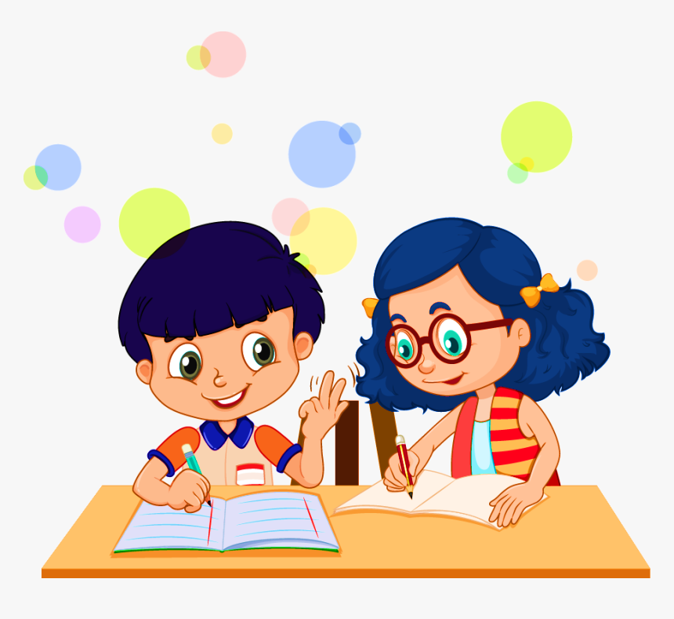
Task
Write the days of the week from your home.

Slide 22
See you tomorrow children. Tomorrow is Sunday. Goodbye.
Goodbye teacher.

