Slide 1
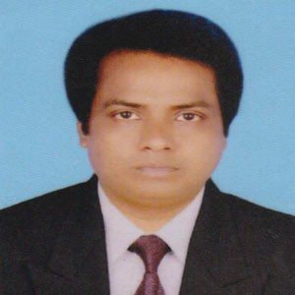
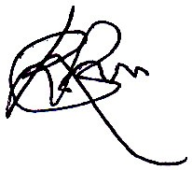
Token Number: 133682
Convocation ID: 210562
Jagannath University Acknowledgement slip for receiving original certificate
Provisional Certificate (if taken earlier) must be surrendered at the time of receiving original certificate
Student`s Name : MD. NEZAM UDDIN
Mother`s Name : Khadiza Begum
Father`s Name : Md. Hemayet Uddin
Name of the Examination : Bachelor`s Degree
Name of the Department : Department of Physics
Admission Session : 2003-04
Student ID/Roll : 483858
........................................................
Controller of Examinations Jagannath University
Print Date & Time: Friday, 20th of December 2019, 06:37:59 PM
....................................................................................................................................................................................................................................................
Token Number: 133682
Convocation ID: 210562
Jagannath University
Entry Pass for Convocation Venue
Student`s Name
Mother`s Name
Father`s Name
Name of the Examination
Name of the Department
Admission Session
Student ID/Roll
: MD. NEZAM UDDIN
: Khadiza Begum
: Md. Hemayet Uddin
: Bachelor`s Degree
: Department of Physics
: 2003-04
: 483858
........................................................
Registrar Jagannath University
Print Date & Time: Friday, 20th of December 2019, 06:37:59 PM
....................................................................................................................................................................................................................................................
Token Number: 133682
Convocation ID: 210562
Jagannath University Convocation Costume Receiving Slip
Student`s Name
Mother`s Name
Father`s Name
Name of the Examination
Name of the Department
Admission Session
Student ID/Roll
: MD. NEZAM UDDIN
: Khadiza Begum
: Md. Hemayet Uddin
: Bachelor`s Degree
: Department of Physics
: 2003-04
: 483858
........................................................
Registrar Jagannath University
Print Date & Time: Friday, 20th of December 2019, 06:37:59 PM

