Slide 2
Introduction
Jamila khatun
Asst. Teacher
Chupria G.P.S
Satkhira sadar, Satkhira

Slide 3
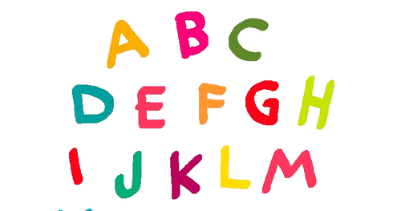
What do you see in the picture?
Yes, my dear. You are right. These are Alphabet.

Slide 4
Lesson Declaration
Z
z
Class : One
Subject : English
Alphabet. Lesson: 4-6,
Unit : 29. Page : 58
Alphabet (Zz)

Slide 5
Learning outcomes
1.1.1- to become familiar with English sounds by listen to common English word.
1.1.2- to say simple words.
1.2.1- to recognize and read the alphabet both small and capital (non-cursive) letters.
3.1.2 - write words using non-cursive small letters

Slide 6
Lets see a video

Slide 7
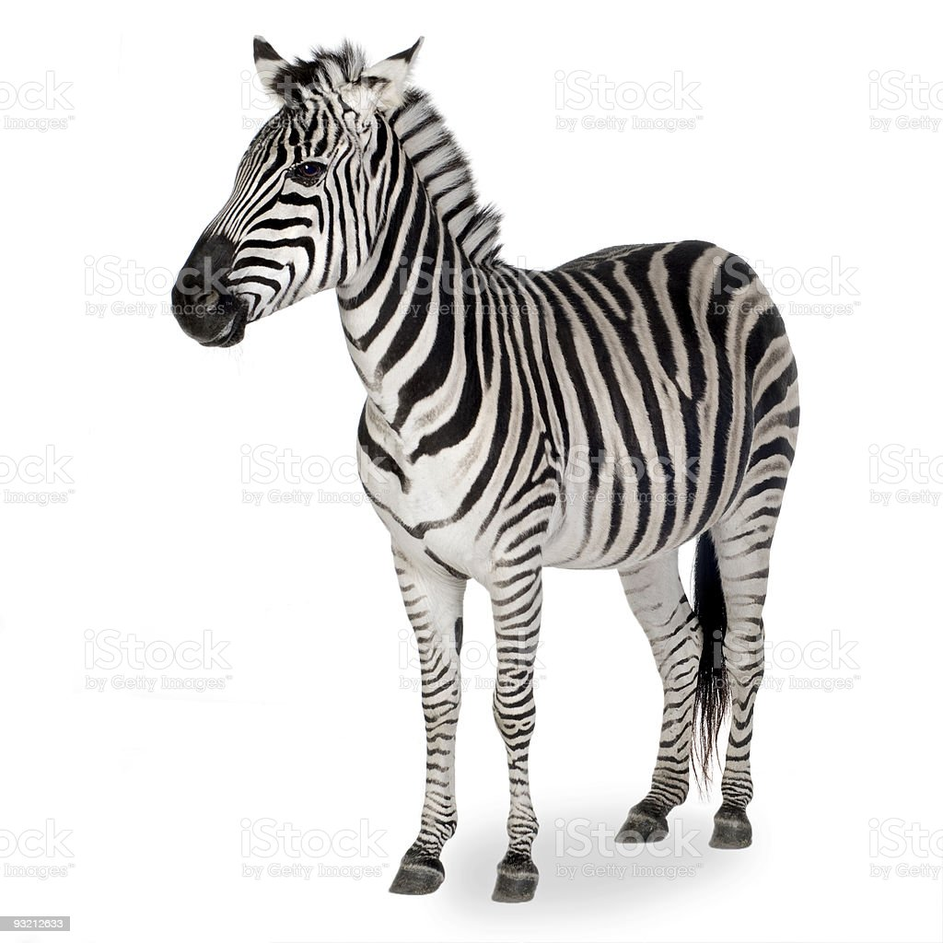
Look, listen and say
Z
z
Zebra

Slide 8
Look, listen and say
Z
z
Zoo

Slide 9
Look, listen and say
Zebra
Z
Capital letter

Slide 10
Look, listen and say
Zoo
Z
Capital letter

Slide 11
Look, listen and say
z
zebra
Small letter

Slide 12
Look, listen and say
zoo
z
Small letter

Slide 13
Individual work
Look, listen and say. Trace in the air.

Slide 14
Open at page 58

Slide 15
Loud reading by the teacher
z
zebra
Z
Zebra

Slide 16
Loud reading by the teacher
z
zoo
Z
Zoo

Slide 17
Match the Capital and small letters:
Pair Work
Z
zebra
z
Zebra

Slide 18
Pair Work
Match the pictures with the letters:
Z
zoo
z
Zoo

Slide 19
Evaluation
Fill in the blanks.
Fill in the blanks.
Z
1…..ebra.
oo.
2. Z ……..

Slide 20
Task
Write noncursive small letter “ z ”.

