Slide 1
How to write an Ideal Notice
** For class
** 9, 10
*** SSC, HSC
**** Hons

Slide 2
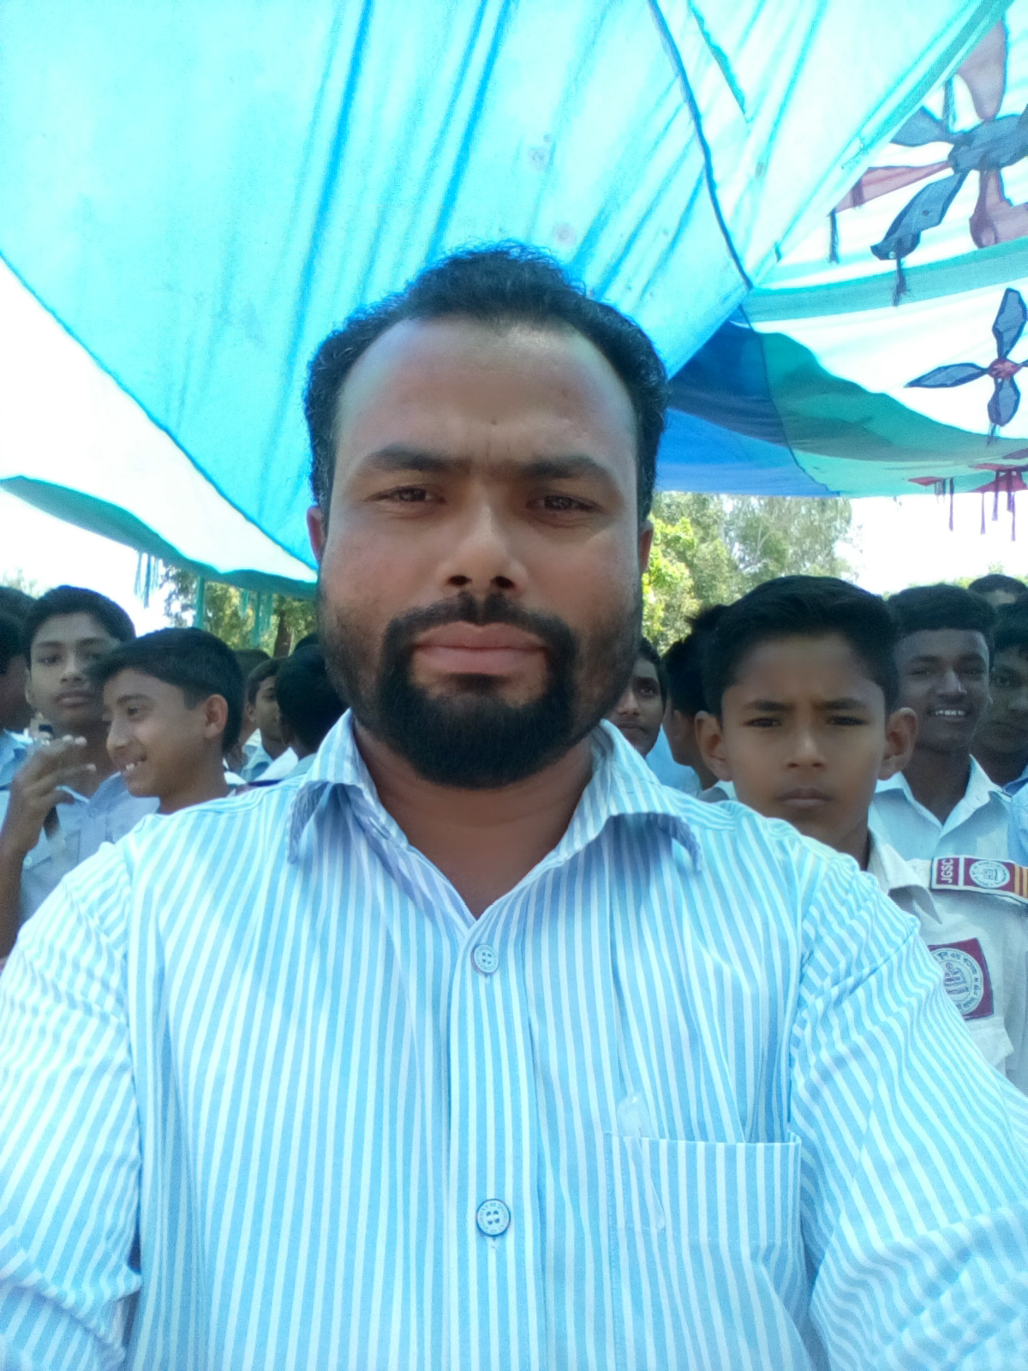
Introduction
Md. Anisul Haque
Assistant Teacher (English)
Jafargonj School and College
Uttam, Hajirhat, Mahanagar, Rangpur
Email. anis127299@gmail.com
YouTube: https://www.youtube.com/c/AnisSirEng

Slide 3
Format
Since notices are a formal document, it should follow a structure or a format. Keep in mind there is no one correct rigid (কঠিন) format. Different formats used by different people/organizations can show some variations. But it is ideal to follow a somewhat (কিছুটা) similar format for ease(সহজ) of understanding and uniformity. Let us look at the most used format of notices.

Slide 4
** Name of Issuing Organization/Authority: Right at the very top, you print the name of the person or company that is issuing the notice. This will help the reader it is important or not.
** Title: When writing notices we mention a title “NOTICE” at the top. Notices are generally posted at a public place or published in newspapers. Use bold title.

Slide 5
** Date: After the tile to the left-hand side we print the notice published date. Since this is a formal document date is an important aspect of it since these documents stay on record.
** Heading: Then we move on to an appropriate heading to the notices. This heading should make abundantly clear the purpose of the notices.
** Body: After the heading, we write the brief and to the point of the body.

Slide 6
Content
Notices should cover some important points that are to be communicated to the readers.
What: What is the notice about? The notice should be clear about what is going to happen (event), or what has already happened (occasion).
Where: If the notice is about an event, the location of such an event must be written clearly. The venue or the location are important for it.

Slide 7
When: This is the time and the date of the event or meeting
Who: who are addressed to the notice? Who all are supposed to adhere to the notice should be clearly mentioned to avoid confusion?
Whom: Must be mention whom should be contact.

Slide 8
Tips to Remember regarding Notice Writing
Be precise to the point. The ideal length of notice is 50 words, so precise language is appreciated.
It is a formal form of communication so the language used should be formal as well. No flowery text.
Keep the sentences short and use simple words. Since notices are fairly brief it is best to keep it simple.
Use passive voice as far as possible.
Present your notices in a proper format in a box. The presentation should be neat and thus be appealing to the eye.

Slide 9
Format Of Notice Writing
1. Write a notice about the annual cultural function in your school.
Police Lines’ School and College, Rangpur
Notice
About the annual cultural function
Ref No:122022PL Date:
This is general information of the students of this School and College that the cultural function will be held tomorrow the 25/05/2022 in the auditorium hall.

Slide 10
The Institution authority has already suspended the classes on that vary date. So that, the students are requested to attend the function to make it successful.
Co-Ordinator
Annual cultural function observed committee.

Slide 11
2. Write a notice about inviting the student contribution to the school magazine.
Jafargonj School and College, Rangpur
Notice
about School Magazine
No:122022PL Date:
The magazine committee Jafargonj School and College, Rangpur is to inform all concerned that it has decided to publish a magazine on the occasion of glorious Victory Day. Interested contributors are encouraged to send their write ups for publication. Any genre kind of writing will be welcomed including short stories, poems, features and articles highlighting the sprit of the Victory Day. The writing should be typed in double space on one side of A4 paper and should be limited to 800 words. Manuscripts can be sent to the address given below. The deadline for submission of manuscripts is 30 August 2022.
Secretary
Jafargonj School and College, Rangpur
PO Box No. 2837

Slide 12
3. Write a notice about the monthly parents and teachers meeting in the school.
Cantonment Public School and College, Rangpur
Notice
About the monthly parents and teachers meeting
No:122022PL Date:
It is notified for general information that the institution will be arranged the monthly parents and teachers meeting in the respected class room. So that, all respected guardians are welcomed in that vary meeting and give their own opinion.
It is mandatory for the teachers and the guardians.
Principal
Cantonment Public School and College, Rangpur

Slide 13
4. Write a notice about informing the students to collect their SSC admit card for the upcoming examination.
PN School and College, ______
Notice
About to collect SSC admit card
No:122022PL Date:
This is for information of the students of SSC candidates 2022 that their examination is going to be started next 19/06/2022 as per the schedule. The concerned students are advised to collect their respective admit card from the office by the 15 July 2022.
It is mandatory for all the SSC candidates 2022.
Principal
PN School and College, ______

