Slide 1
Welcome To All

Slide 2
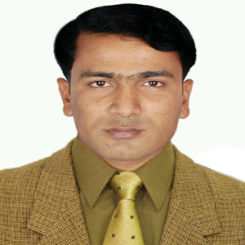
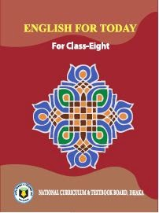
Muhammad Rehan Uddin
Assistant Teacher
Pakshail Ideal High School
Barlekha, Moulvibazar.
ICT4E District Ambassador,
Moulvibazar.
English 1st paper
Class: Eight
Unite: 01, Lesson: 02
Time: 50 Minute
Lesson Identity
Teacher Identity

Slide 3
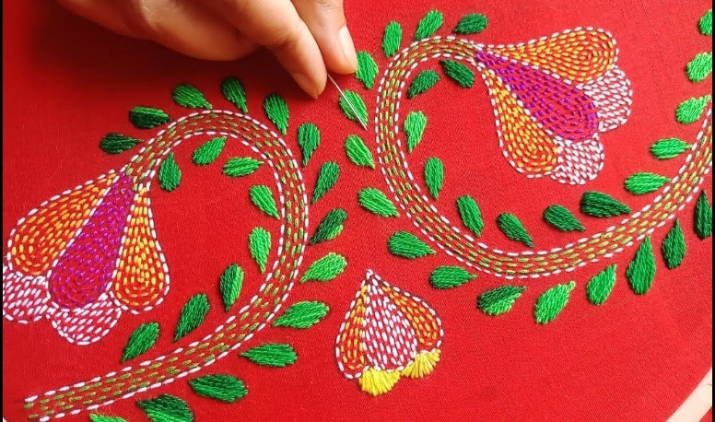
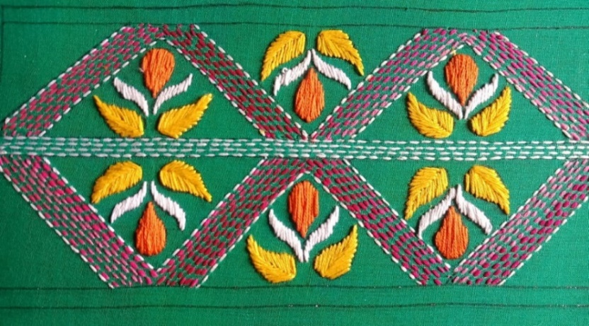
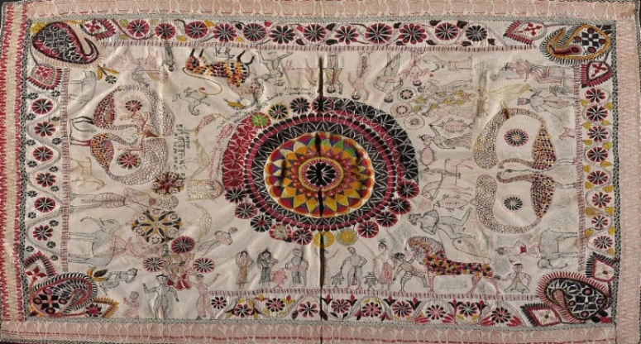
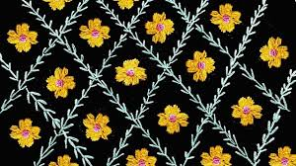
Look at the picture, Then ask and answer the questions.
1. What do you see in the picture?
Ans: Yes, I can see some embroidered piece of cloth.

Slide 4
So Today’s our lession is……….
Nakshi Kantha

Slide 5
Objectives
After studied the lesson, students will be able to……….
Ask and answer questions.
Read and understand texts through silent reading.
Infer meaning from the context.
Develop writing skill.

Slide 6
Look at the picture and the questions . Then ask and answer the questions with your partner.
1. What do you see in the picture?
2. What is it called?
3. Have you seen it before? Where?
4. What do we do with it?

Slide 7
What do you see in the picture?
Generally we cover our bed with it.
Yes. I’ve seen it in my grandfather’s house
It is called Nakshi Kantha.
It is a designed quilt .

Slide 8
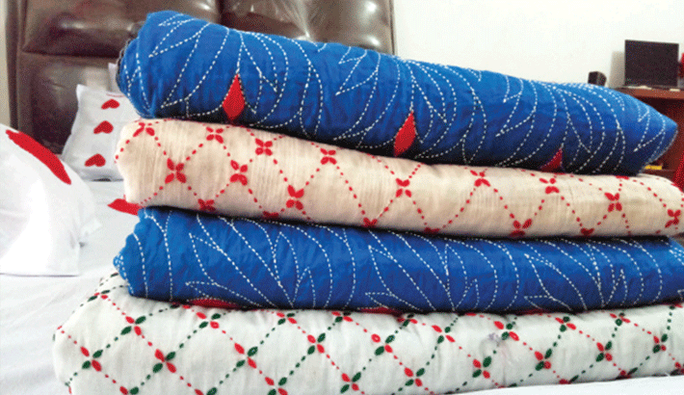
Let’s know some new words
Quilt
A warm bed covering made of padding enclosed between layers of fabric and kept in place by lines of stitching, typically applied in a decorative design.
Nakshi Kantha is a kind of embroidered quilt.

Slide 9
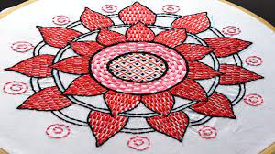
Artistic
creative
imaginative
inventive
original
Having or revealing natural creative skill.
Relating to or characteristic of art or artists.

Slide 10
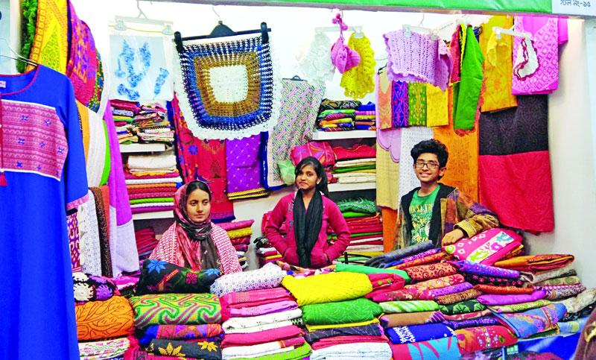
Commercially
in a way that is concerned with buying, selling, and making a profit.
Now Nakshi Kantha is produced commercially.

Slide 11
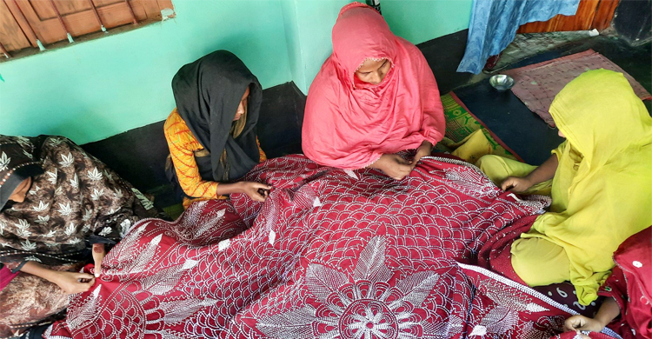
Traditional
conventional
customary
established
long-established
produced, done, or used in accordance with tradition.
existing in or as part of a tradition; long-established

Slide 12
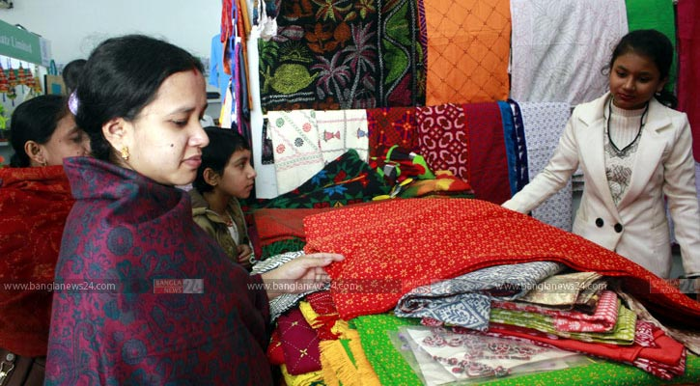
Demand
An insistent and peremptory request, made as of right.
The demand of Nakshi Kantha is increasing because of colourful patterns.

Slide 13
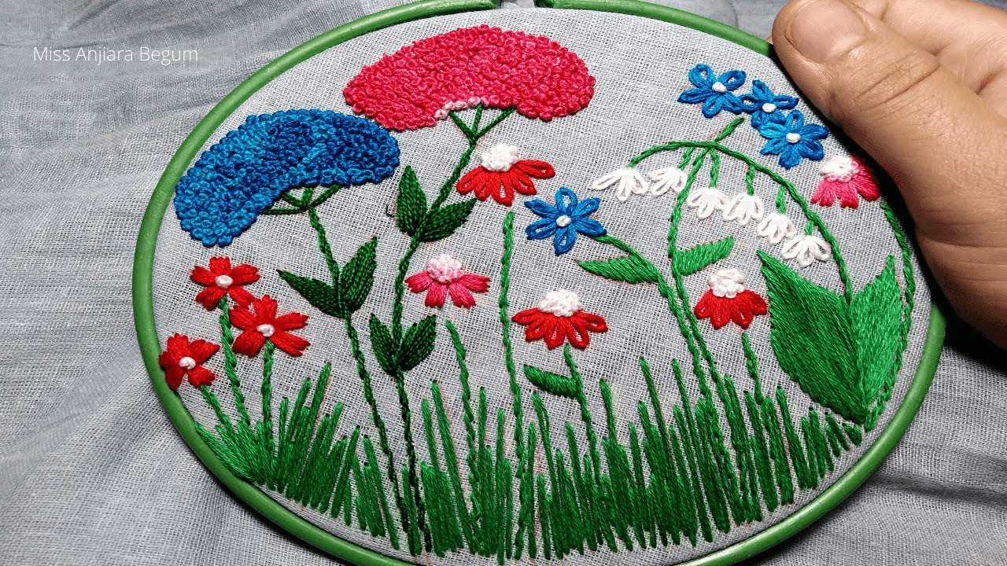
Pattern
a model or design used as a guide in needlework and other crafts.
give a regular or intelligible form to.
The pattern is very artistic.

Slide 14
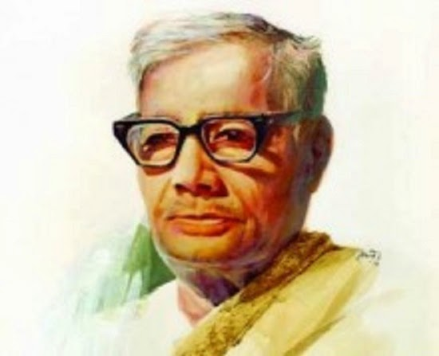
Famous work
Rakhali (1927)
Nakshi Kanthar Maath (1929)
Baluchor (1930)
Dhankhet(1933)
Sojan Badiyar Ghat (1933)
Hashu (1938)
Rupobati (1946)
Jasim uddin
Popularly called Palli Kabi (Pastoral Poet)
Birth date- 1 January 1903
Death - 13 March 1976
The name Nakshi Kantha became popular after the poet Jasimuddin’s poem ‘Nakshi Kanthar Math’ was published in 1929.

Slide 15
Individual work
Patterns
Embroidery
Years
Fashion
Art
Rural
Bengali
Designs
Quilt
Naksha
1. Naksha means artistic…………...
2. The name was taken from a………….word…………
3. The art has been practiced in…………Bengal for………
4. Nakshi Kanthas are now sold in…………shops.
5. Nakshi Kanthas are in great demand because of their
colourful ……………and…………..
6. Nakshi kanthas are a kind of…………

Slide 16
Write down five questions for the completed statements in Activity C above.
1. What does naksha means?
2. Where was the name taken from?
3. How long and where has the art been practiced?
4. Where are nakshi kanthas sold now?
5. Why are nakshi kanthas in great demand?
6. What are Nakshi Kanthas?

Slide 17
Pair work
Do you like a Nakshi Kantha or an ordinary kantha? Why?
Ans: I like Nakshi kantha, of course. Because the colourful patterns and designs embroidered on nakshi kantha make it really a rare.

Slide 18
Evaluation
1. Who is Jasim Uddin?
2. When was publish ‘Nakshi Kanthar Math’.
3. Where was the name ‘Nakshi kantha’ taken from?
4. What is the Nakshi Kantha?
5. Why does Nakshi Kantha famous for the rural people?

Slide 19
Answer
1. Ans: Jasim Uddin is a Bengali poet who is famous for rural poet.
2 .Ans: Nakshi Kanthar Math was published in1929.
3. Ans: Nakshi kantha taken from famous Bengali poet Jasim Uddin poem’s Nakshi Kanthar Math.
4. Ans: Nakshi Kantha is a kind of embroidered quilt.
5. Ans: Nakshi Kantha famous for it’s artistic pattern.

Slide 20
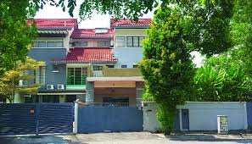
Home work
Write a paragraph about ‘Nakshi Kantha’

