Slide 1
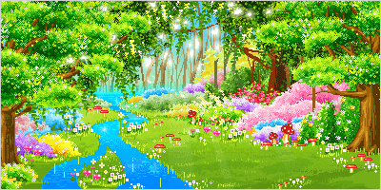
WELCOME

Slide 2
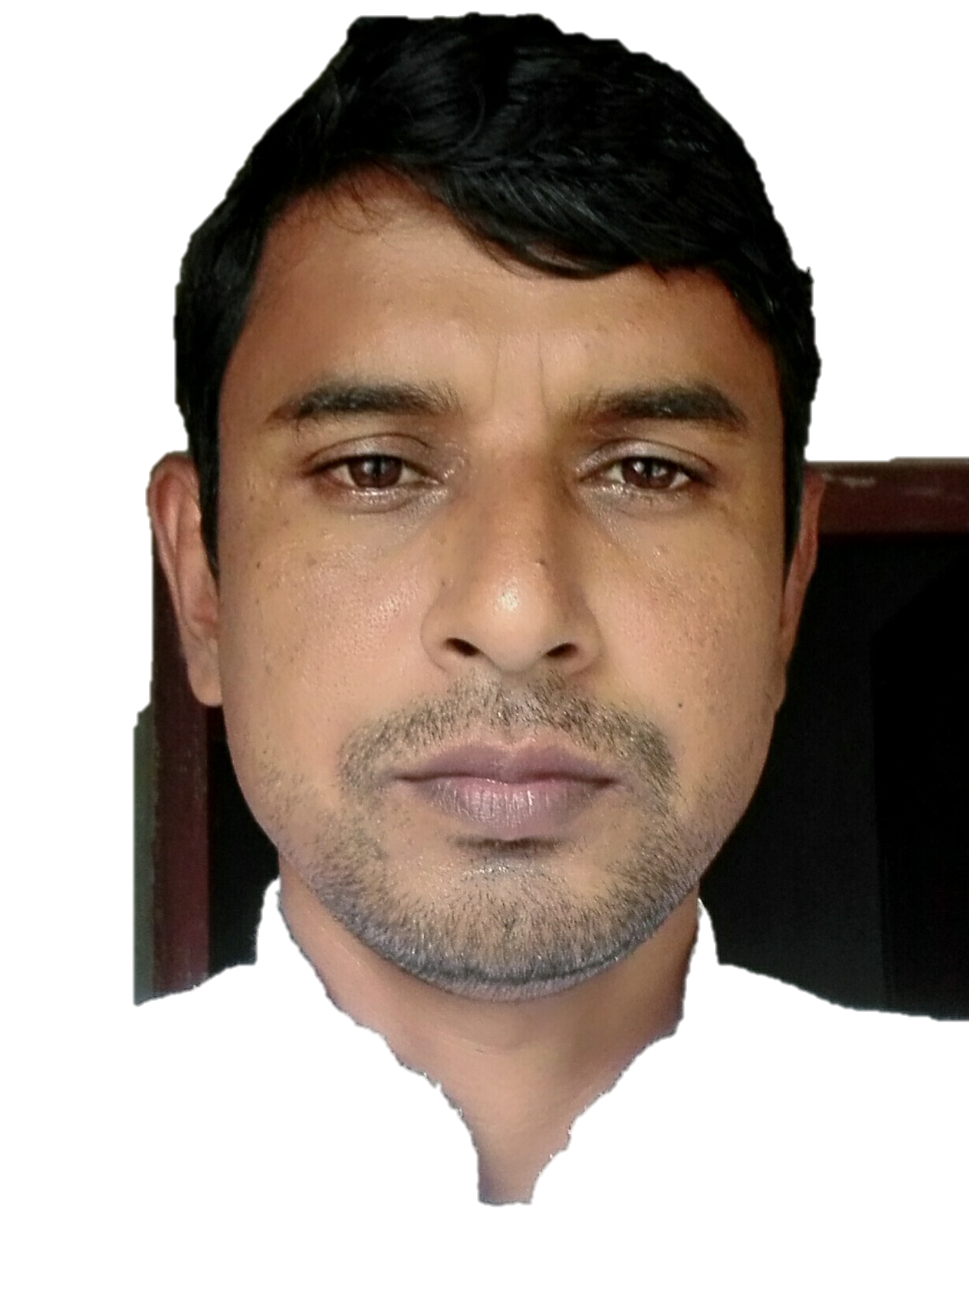
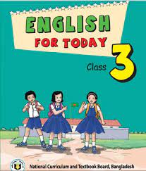
IDENTITY
ABU SAYEEM
Assistant Teacher
Bhulbaria Government Primary School. Singra, Natore.
01717852715
Class: Three
Subject: English
Unit: 23
Lesson: 4
Time: 45 mins

Slide 3
Learning outcomes
Students will be able to-
Listening;
1.1.1 Recognize English sound differences in the context of words.
Speaking;
1.1.1 repeat words, phrases and sentences after the teacher with proper sounds and stress.
1.1.2 say words, phrases and sentences with proper sounds and stress.
Reading;
1.5.1 read simple sentences with proper pronunciation and tress.
5.1.3 read text.

Slide 4
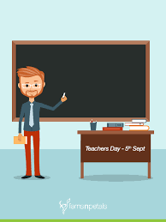
Today we’ll learn…
What do they do ?
Lesson 4

Slide 5
Open your English book at Page 47
What do you see in the picture?
What do they do?

Slide 6
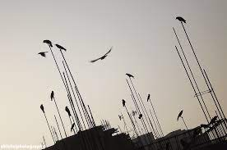
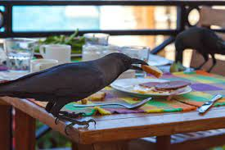
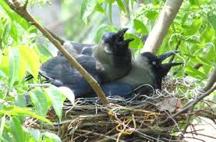
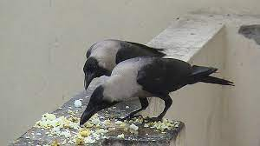
Sometimes the crow eats dirty things.
Sometimes the crow takes food from people.
The crow gets up early in the morning.
The crow lives in a tree.
Sometimes the crow eats dirty things.

Slide 7
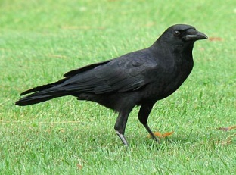
New word:
A Kind of Bird
Crow

Slide 8
New word:
Fly
Move through the air on wings.

Slide 9
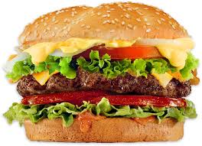
New word:
Food
Meal, what we eat.

Slide 10
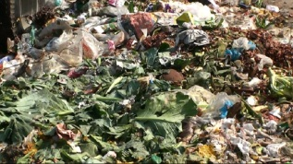
New word:
Dirty
Unclean.

Slide 11
Tearchers Reading

Slide 12
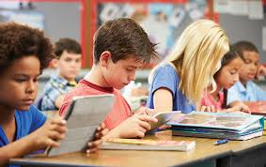
Student Reading

Slide 13
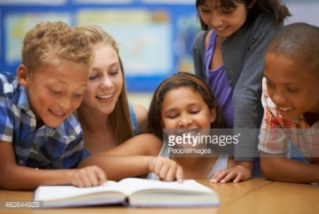
GROUP READING

Slide 14
I.W
Where does the crow live?
In a tree.
When does the crow get up?
Early in the morning..

Slide 15
P.W.

Slide 16
G.W
Say True or False
1. The crow lives in tree .
True .
2 .The crow gets up late in the morning.
False
3 .The crow is lazy.
False
4. The crow takes food from people.
True.
5. The crow is slow
False.
6. The crow doesn’t eat dirty things.
False.

Slide 17
Task
Say 3 sentences about Goat

Slide 18
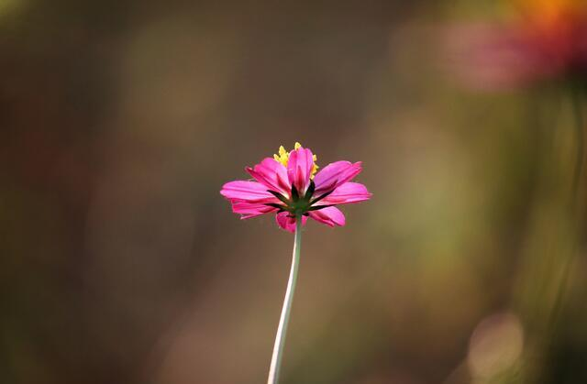
Thank You
Good bye

