Slide 2
Welcome

Slide 3
আমার পরিচয়
মোঃ নাসির উদ্দিন
সহকারী
শিক্ষক
বর্দ্ধনপুর
সরকারি প্রা.বিদ্যালয়
দুর্গাপুর
রাজশাহী

Slide 4
Lesson
Subject:
Lesson
Class:
Unite:
Two
English
One
4-6

Slide 5
LEARNING OUTCOMES:
Student will be able to say the name of the alphabet.
Student will be able to write the alphabet.

Slide 6
CREATE EMOTION.
A B C- Song:
Add Video:

Slide 7
Alphbet- A, B, C, D, E.

Slide 8
What is this ?
Ant
Egg
Bat
Cup

Slide 9
Look , Listen And Say.
A - For ant.
B- For bat.
C- For cup.

Slide 10
D-For doll.
E- For egg.

Slide 11
What is this?
This is an ant.

Slide 12
What is this?
This is a bat.

Slide 13
What is this?
This is a cup.

Slide 14
What is this?
This is a doll.

Slide 15
What is this?
This is an egg.

Slide 16
Read and say . Trace and write.
a
A

Slide 17
B
b

Slide 18
c
C

Slide 19
D
d

Slide 20
e
E

Slide 21
Say the missing letters.
A
N
T
B
A
T

Slide 22
Look and say.
Ant
Bat
Egg
Doll
Cup

Slide 23
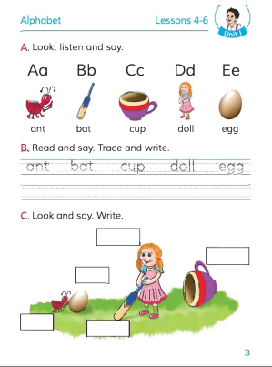
Open Your English Book and watch sometime

Slide 24
GROUP WORK:
Group -A: Write the capital letter-A-E.
Group-B: Write the small letter- a-e.

