Slide 1
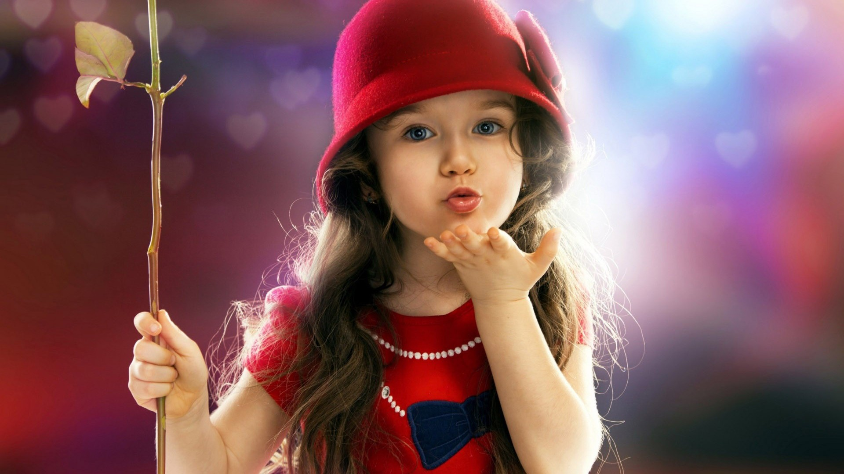
Welcome

Slide 2
PRESENTED BY
Md.Abul Kashem Sarder
Assistant Teacher
Hazrakati Govt.Primary School
Tala, Satkhira.

Slide 3
Subject: English
Class: One
Unit: 02
Lesson: 20

Slide 4
Learning Outcomes
By the end of the lesson students will be able to –
Listening-
4.1.1- To enjoy the rhythm of simple rhymes.
Speaking-
4.1.1 – To repeat rhythm after the teacher.
4.1.2-To recite the rhyme individually.

Slide 6
Lesson Declaration
Rain, rain, go away

Slide 7
Rain, rain, go away,

Slide 8
Come again another day.

Slide 9
Little children want to play,

Slide 10
Rain, rain, go away.

Slide 11
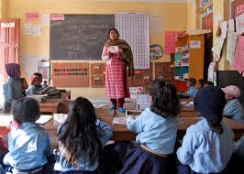
Teacher’s reading

Slide 12
Now recite the rhyme with me
Rain, rain,go away
Rain, rain, go away,
Come again another day.
Little children want to play
Rain, rain, go away.
,

Slide 13
Group reciting

Slide 14
Pair Reciting

Slide 15
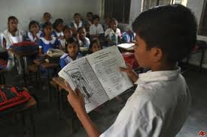
Individual Reciting

Slide 16
Evaluation
Recite the rhyme one by one with action.

Slide 17
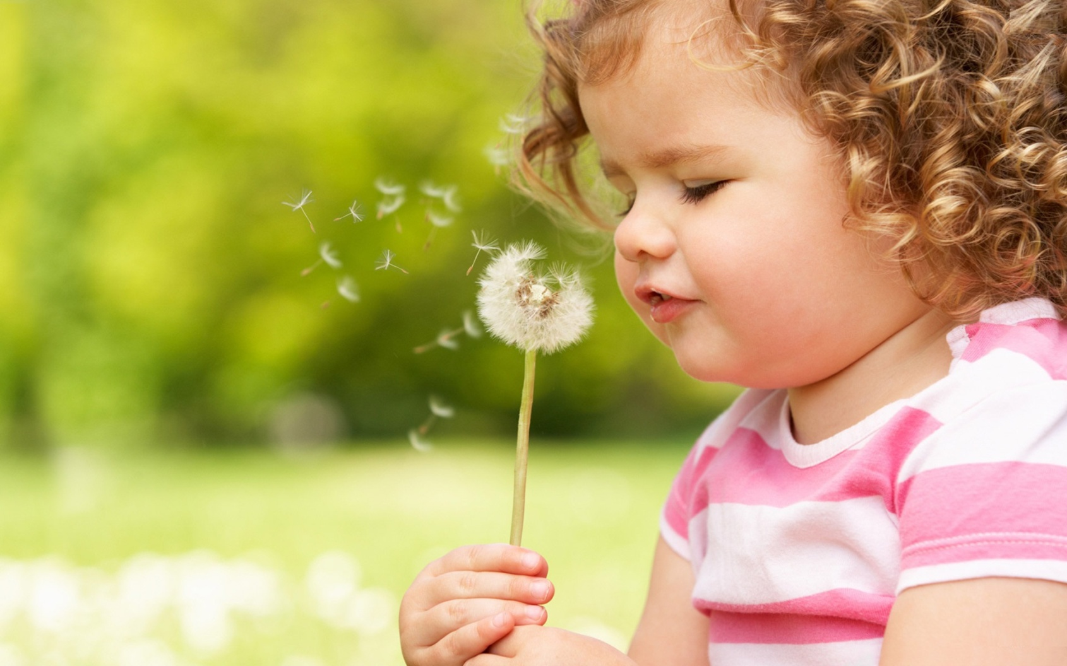
THANKS
BYE BYE

Slide 18
SOURCE
EFT Book , Class – One.
Internet

