Slide 1
Welcome

Slide 2
Introduction
Md.Ashikur Rahaman
Asst Teacher
Rashiknagar Dakhil Madrasah
Dighinala,Khagrachari

Slide 3
What do you see…

Slide 4
Introduction
Sub : ICT
Class : Ten
Unit : Five

Slide 5
What do you see…

Slide 6
What do you see…

Slide 7
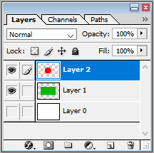
Todays lesson is…
Use of Layer in Photoshop

Slide 8
A picture in photoshop

Slide 9
Thumbonail Icon

Slide 10
Adobe photoshop window

Slide 11
Backgraound selectsion

Slide 12
Green colour with backspace

Slide 13
Creat a circle selection

Slide 14
Creat red colour Alt +background

Slide 15
Write : Ban:Flag

Slide 16
See you ….
Thank you

