Slide 1
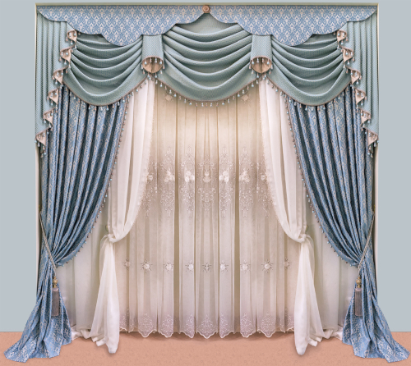

Slide 2
WELCOME TO OUR
MULTIMEDIA CLASS

Slide 3
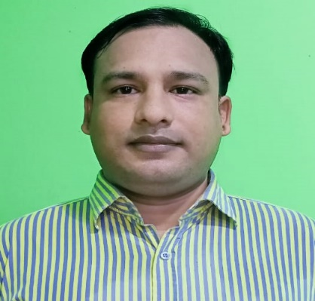
INTRODUCTION
Presented by:
Class: Five
Sub:English
unit:4 (Leisure time)
Lesson:3-4
Time: 40 minutes.
MD.AZIZUR RAHMAN
Assistant Teacher
Kandigoan Govt. Primary School.
Kamalgonj, Moulvibazar .

Slide 4
Learning outcomes:
Listening:
3.1.1 uderstand questions asked by the teacher about topics.
Speaking:
3.1.1 ask and answer wh questions.
Reading:
1.6.1 recognize and read statements, commands, questions and answers.

Slide 5
Let’s recall our previous class
1. Who lives in the UK?
Ans: Sima’s cousin lives in the UK.
2. How does Sima spend her free time?
Ans: Sima spends her free time by walking
in the park, singing song and sometimes
talking with her cousin on internet.

Slide 6
Let’s try to read the activity A again .

Slide 7
Today’s Lesson
Leisure time
Unit: 4
Lesson: 3-4

Slide 8
Individual work
Try to answer the questions
1. Who are the reporters?
Ans: Tamal and Nasreen are the reporters.
2. What kind of magazines does Biju like?
Ans: Biju likes magazines about sports, especially football and cricket.

Slide 9
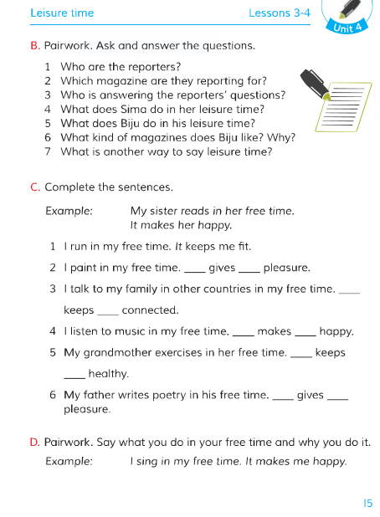
Open your book at page 15 and try to understand

Slide 10
Group work
It
me
It
me
It
me
It
her
It
him

Slide 11
Let’s practise in pair
Example :
I sing in my free time. It makes me happy.
What do you do in your free time?

Slide 12
Assessment
1. Who is answering the reporter’s questions?
Ans: Sima is answering the reporter’s questions.
2. What kind of books does Sima love to read?
Ans: Sima loves to read funny stories, especially stories of Nasiruddin Hojja .

Slide 13
One Day One Word
Story
=
গল্প

Slide 14
Home work
** You will write down activity A on your notebook.

Slide 15
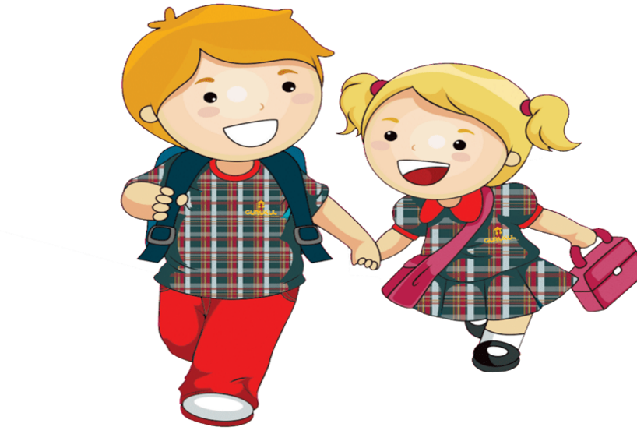
Thank you all.
See you in the next class

