Slide 1
Welcome

Slide 2
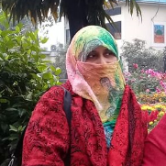
Presented by
Mst. Mafuza Akter
Senior Lecturer
Department of English
Kushtia City College, Kushtia
Cell: 01729307060

Slide 3
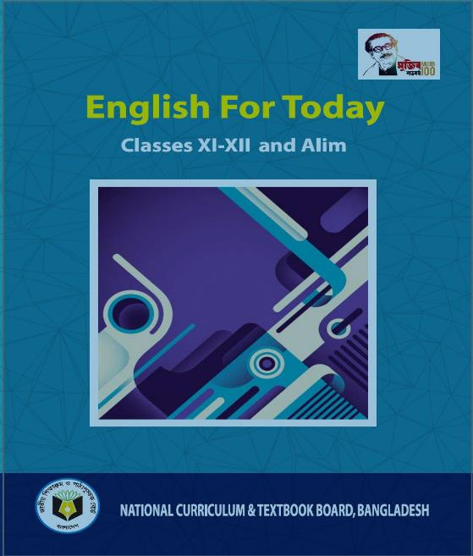
Class: Eleven - Twelve
Subject: English First Paper
Unit: One
Lesson: Two
(Nelson Mandela, from Apartheid Fighter to President)
Time: 45 Minutes
Date: 4th April, 2021.

Slide 4
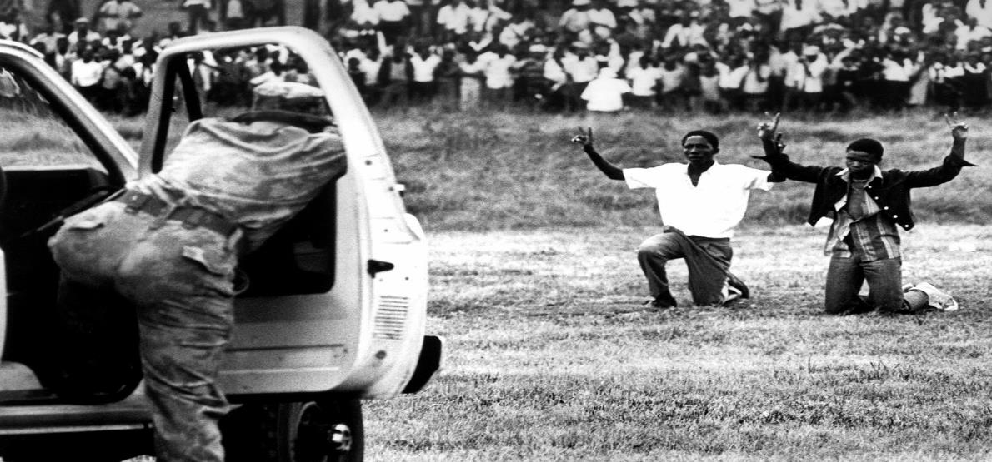
Lets see some pictures

Slide 5
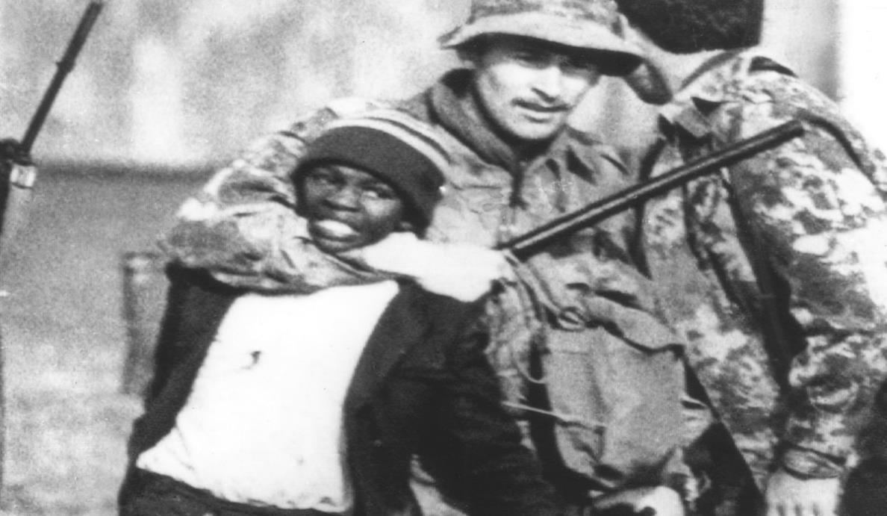

Slide 11
Learning Outcome
At the end of the session, students will be able to ...
Describe works of Nelson Mandela;
Make relationship between Nelson Mandela and FW de Klerk;
Define the race discrimination;
Describe the Philosophy or Ideology of Nelson Mandela.

Slide 12
Nelson Mandela was a South African anti-apartheid revolutionary, political leader, and philanthropist, who served as President of South Africa from 1994 to 1999. People called him ‘Madiba’.

Slide 13
Born: July 18, 1918,
Mvezo, South Africa.
Died: December 5, 2013,
Houghton Estate,
Johannesburg,
South Africa.

Slide 14
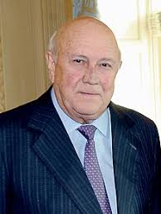
Frederik Willem de Klerk DMS is a South African politician who served as State President of South Africa from 1989 to 1994 and as Deputy President from 1994 to 1996.

Slide 15
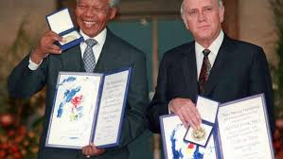
In 1993, Mandela was awarded the Nobel Peace Prize, an honor he shared with F.W. de Klerk, the white African leader who had freed him from prison three years earlier and negotiated the end of apartheid.

Slide 16
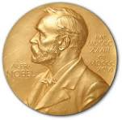
Nobel prize is awarded for outstanding contribution to the field of Physics, Chemistry, Physiology or Medicine, Literature, Peace and Economics.
The prize was instituted by Sir Alfred Nobel , the father of the science of destruction.

Slide 17
He fought against
Injustice
Oppression
Corruption
Race discrimination
Gender discrimination
Autocracy
Domination

Slide 18
He spoke for
Peace
Reconciliation
Human dignity
Freedom
Human rights
Respect.

Slide 19
He spoke for
Justice
Democracy
Free society
Equality
Honesty
Political emancipation
Social emancipation

Slide 20
Individual Work (MCQ Test), Time: 5 minutes
1. What does apartheid refer to in the title?
a. apart b. distance c. discrimination d. dialogue
2. The word icon in the text means.
a. portrait b. image c. symbol d. idol
3. What does shackles refer to?
a. restraints b. sick c. stigma d. spur
4. Race discrimination refers to?
a. differences on the basis of caste, creed and colour
b. competition among the members of a race
c. demoralisation of people
d. domination of others

Slide 21
Group Work (Rearrangement), Time: 15 minutes
Read the jumbled text and rearrange it into a cohesive paragraph.
In his later years in prison, he met President P.W. Botha and his successor de Klerk. He was behind bars when an uprising broke out in the huge township of Soweto in 1976 and when others erupted in violence in the 1980s. “As I finally walked through those gates ... I felt even at the age of 71 that my life was beginning anew. My 10,000 days of imprisonment were at last over,” Mandela wrote of that day. When he was released on 11 February 1990, walking away from the Victor Verster prison hand-in-hand with his wife Winnie, the event was watched live by millions of television viewers across the world. But when the regime realized it was time to negotiate, it was Mandela to whom it turned.

Slide 22
Home Work
Make a shote note about “Nelson Mandela”.

Slide 23
References:
NCTB prescribed text book (English For Today, Class XI – XII and Alim)
Google
YouTube

