Slide 1
Welcome
Notes:
Identity of teacher & class.

Slide 2
Teacher’s Information
Md. Shamsul Alam
BA(Hons.)MA in English.
Assistant Teacher( English)
Nabodoy Girl’s High School
Shailkupa, Jenaidah.
Phone:01917-452052,01722-922691
Email:shamsul101085@gmail.com

Slide 3
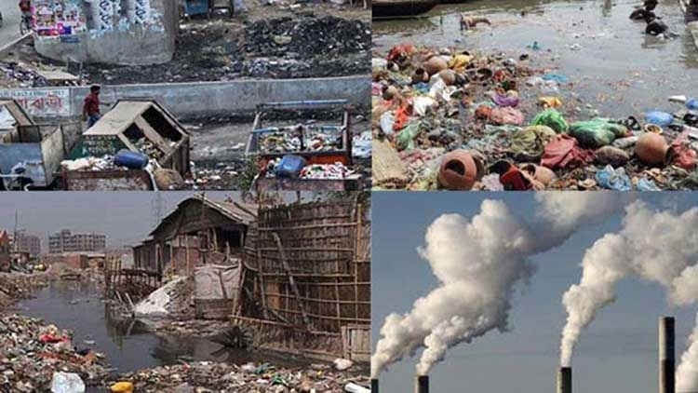
Lets see some pictures-

Slide 4
Our today’s lesson is-
Environment Pollution

Slide 5
Learning Outcomes
After studying this, Ss will be able to-
-describe about environment
explain about water pollution
narrate about sound pollution
tell about air pollution
say about soil pollution

Slide 6
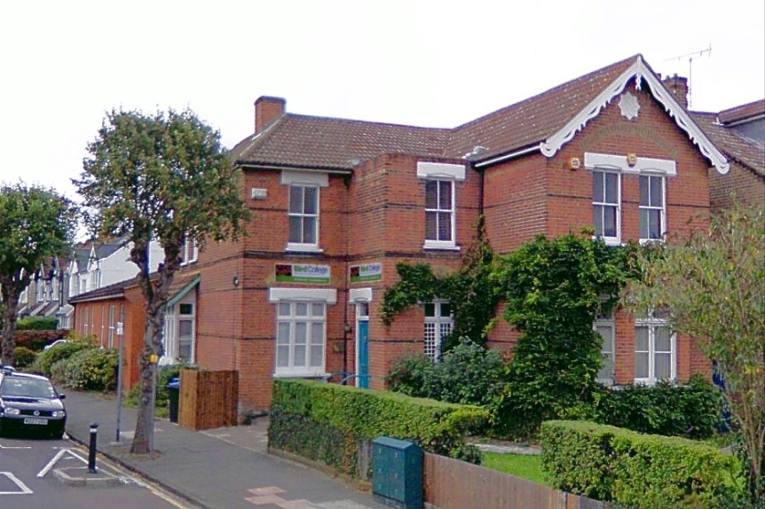
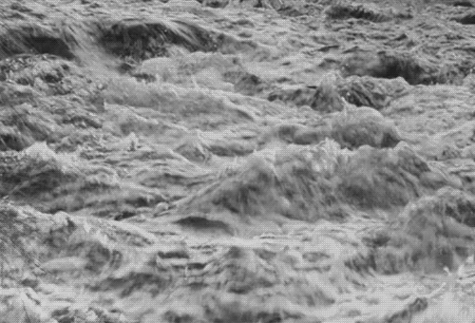
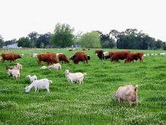
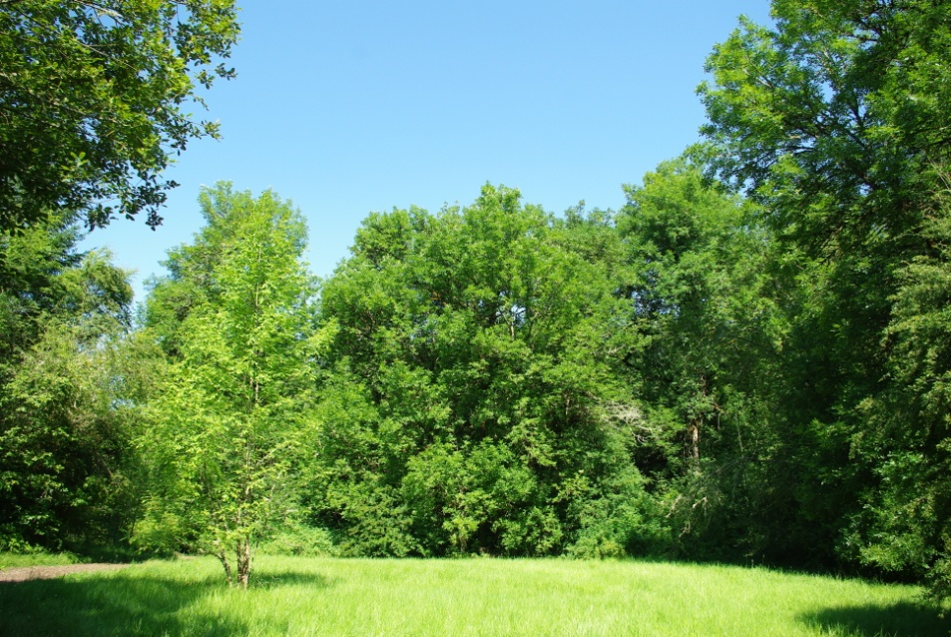
Environment is a combination of -
What is Environment?
House
River
Animals
Trees

Slide 7
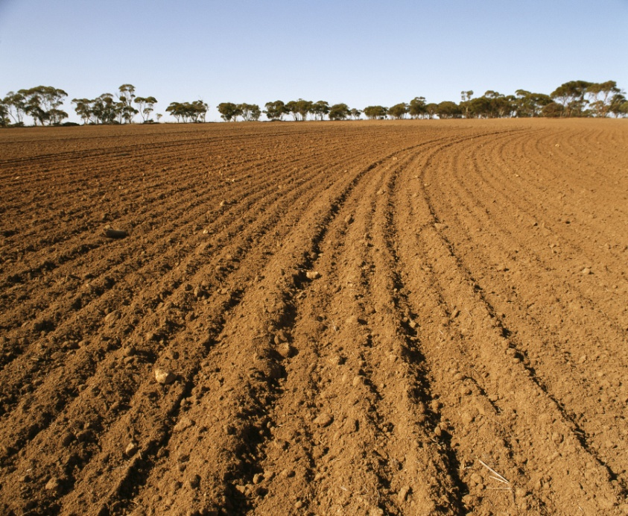
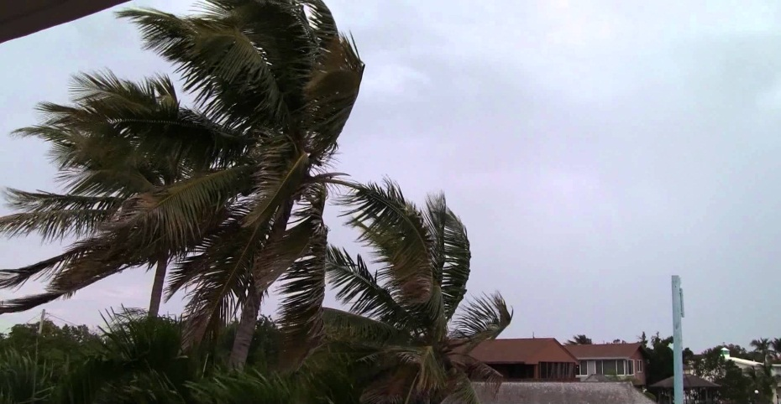
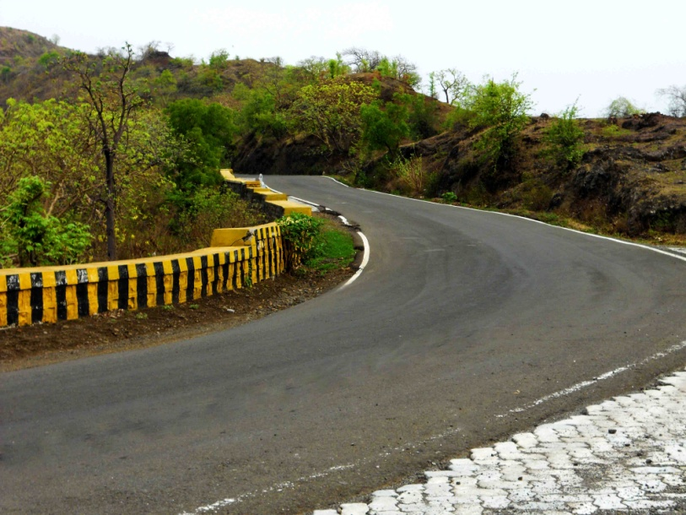
Soil
Air
Roads
And water

Slide 8
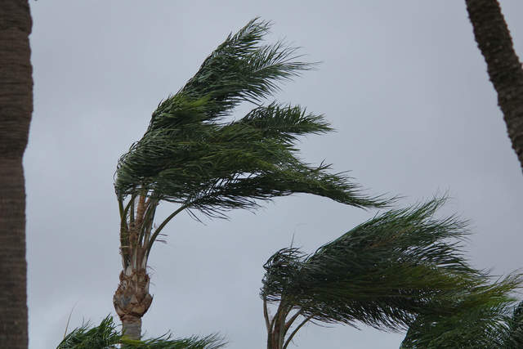
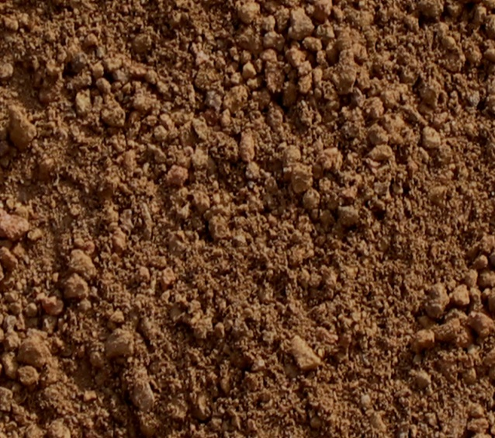
Which elements are important among them?
air
water
soil
Among them these are the main elements of the environment.

Slide 9
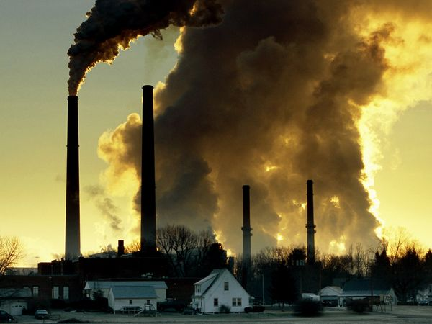
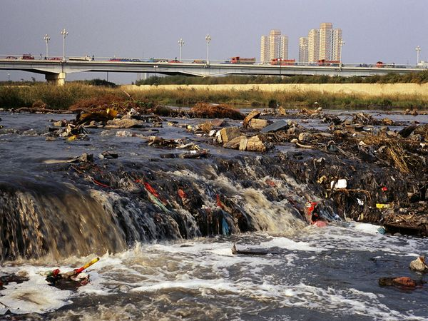
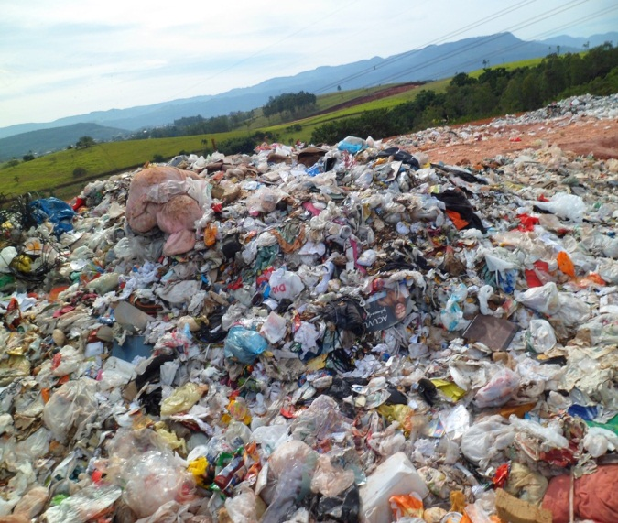
What is the condition of the environment now?
The condition of the environment is not at all good because of environmental pollution.

Slide 10
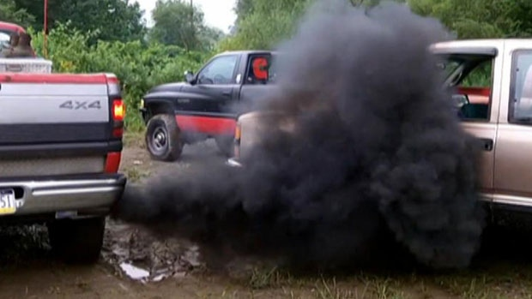
Reasons of environment pollution.
Firstly we burn fuels, that creates smoke and the smoke is mixed with air and air is polluted.

Slide 11
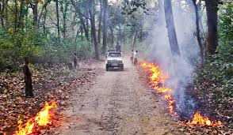
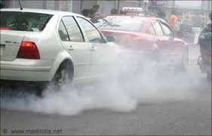
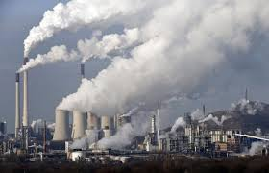
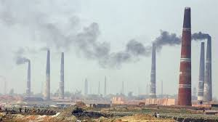
Air is also polluted by
Emitting smoke from vehicles
Burning forest
Smoke from
brick fields
Industrial smoke

Slide 12
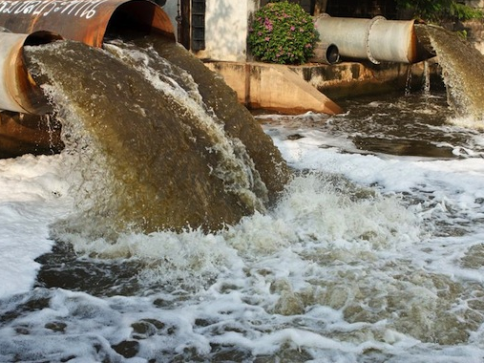
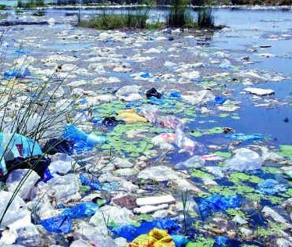
Water pollution is another problem that we are facing now. Sea and river water is being polluted by industrial waste thrown in it.

Slide 13
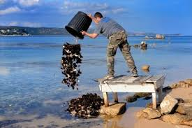
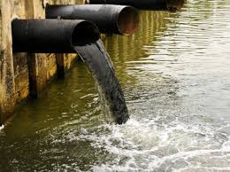
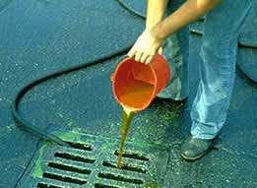
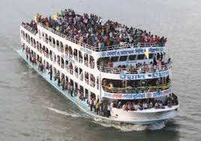
`Water is being polluted by
Draining industrial
wastes
Throwing wastes
Chemicals leaking
Human wastes and filths

Slide 14
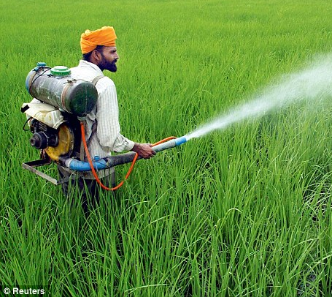
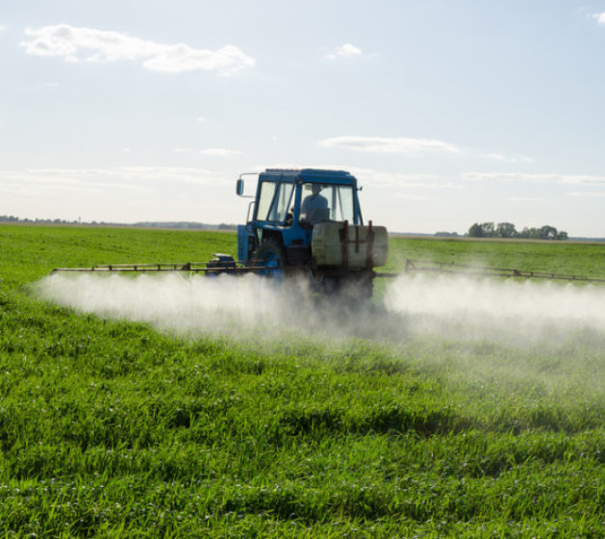
Pesticides and chemical Fertilizers used by the farmers are washed away by rain water and mixed with rivers and pond water.

Slide 15
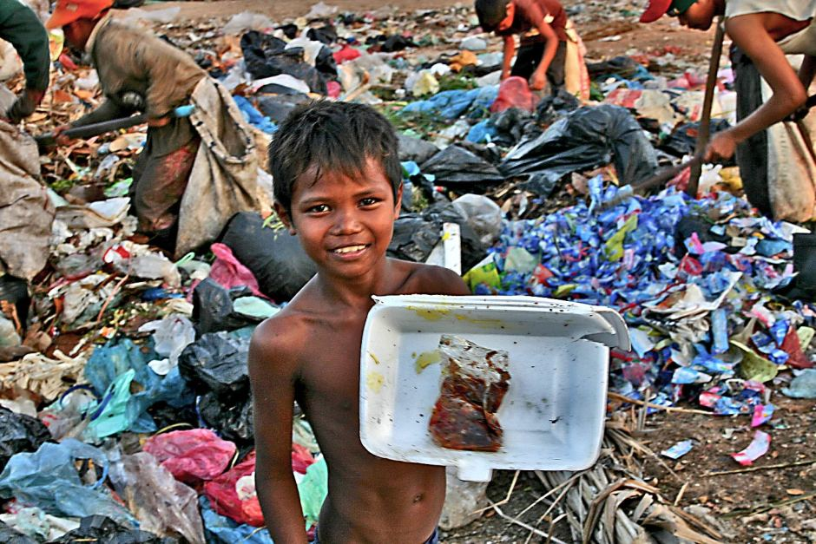
Among the most significant causes of soil pollution is the enormous volume of industrial waste and polybag.

Slide 16
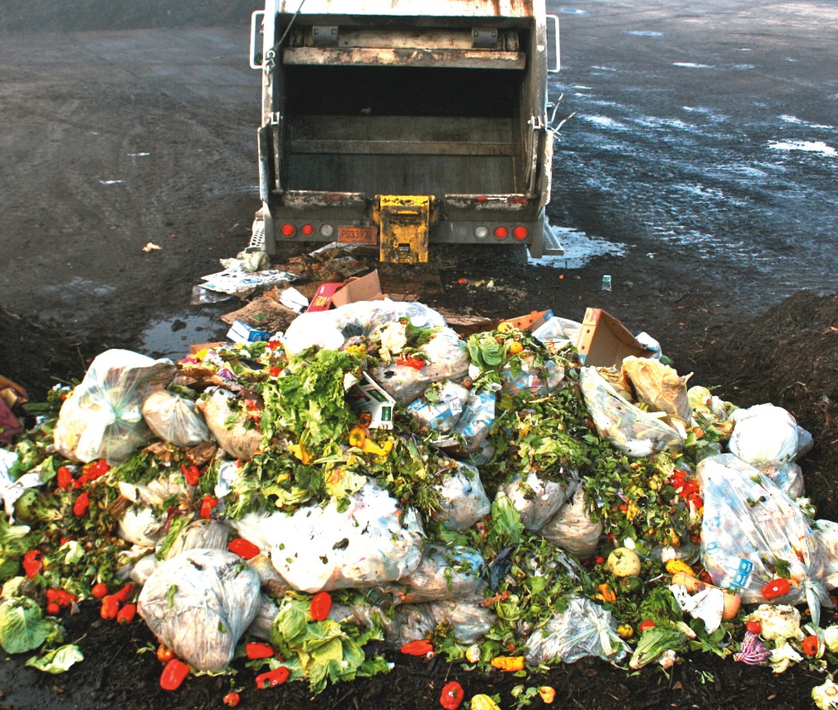
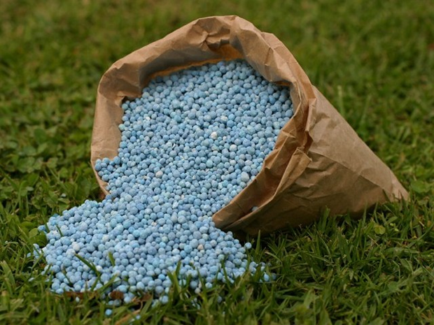
The mismanagement of household wastes, use of fertilizers is the another cause for soil pollution.

Slide 17
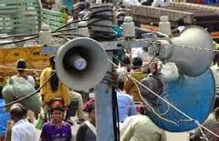
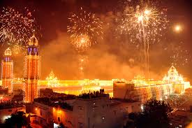
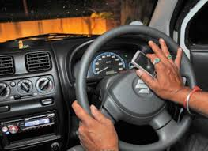
Sound is being polluted by
Using sound system
Industrial works
Playing whistle
Potka playing

Slide 18
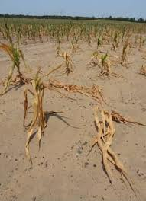
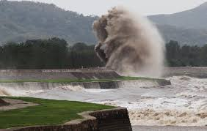
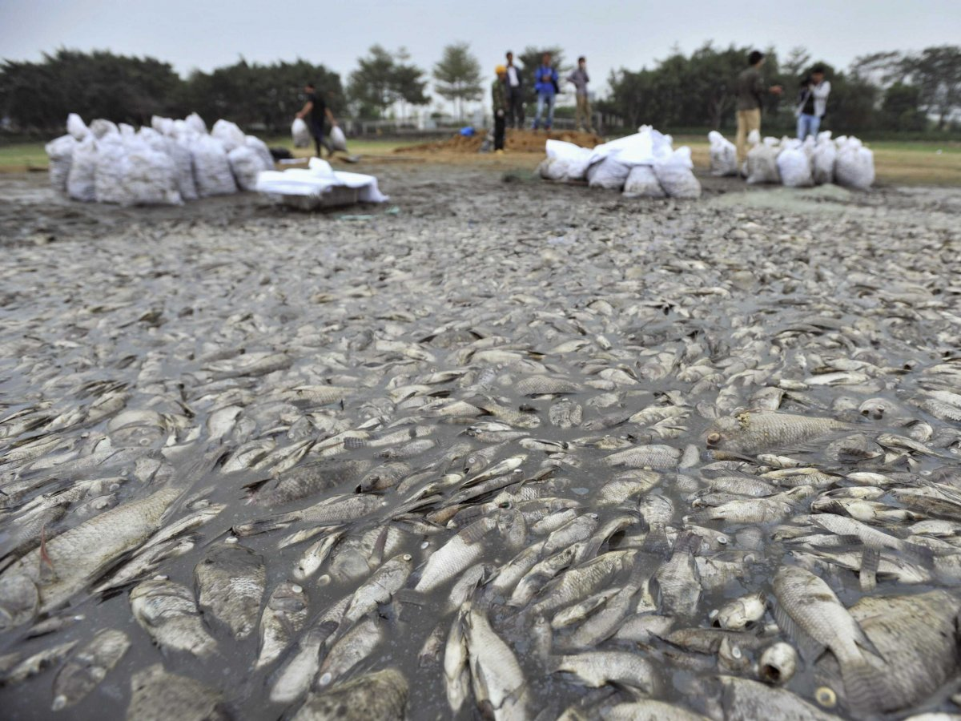
Effects of pollutions
drought
tidal bores
animals die indiscriminately

Slide 19
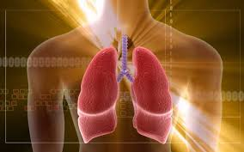
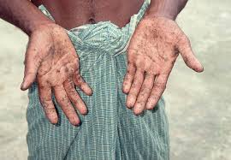
Effects of pollution
Lung disease
Spores in hands

Slide 20
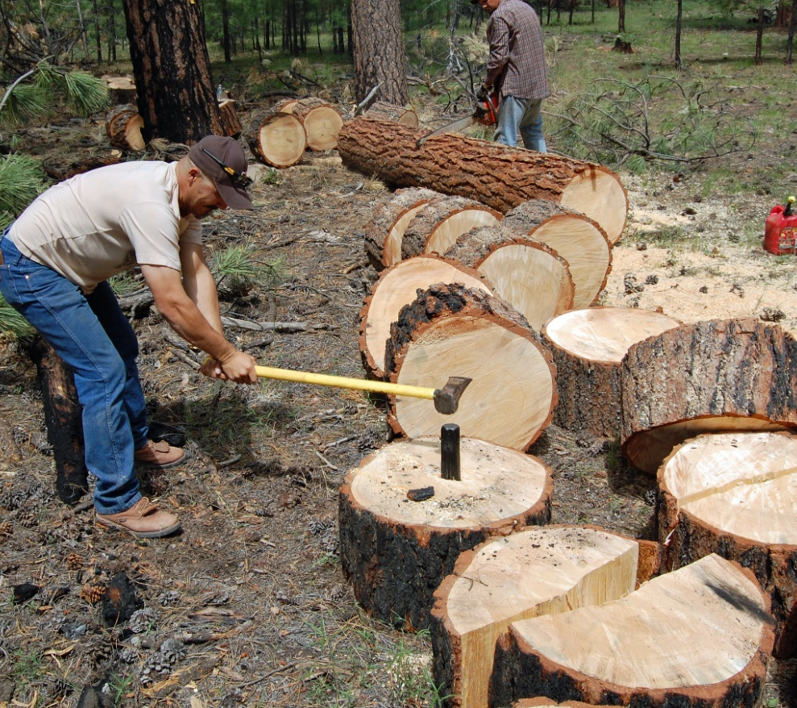
In order to stop these pollution. We should control the burning of Fuels, stop cutting trees at random

Slide 21
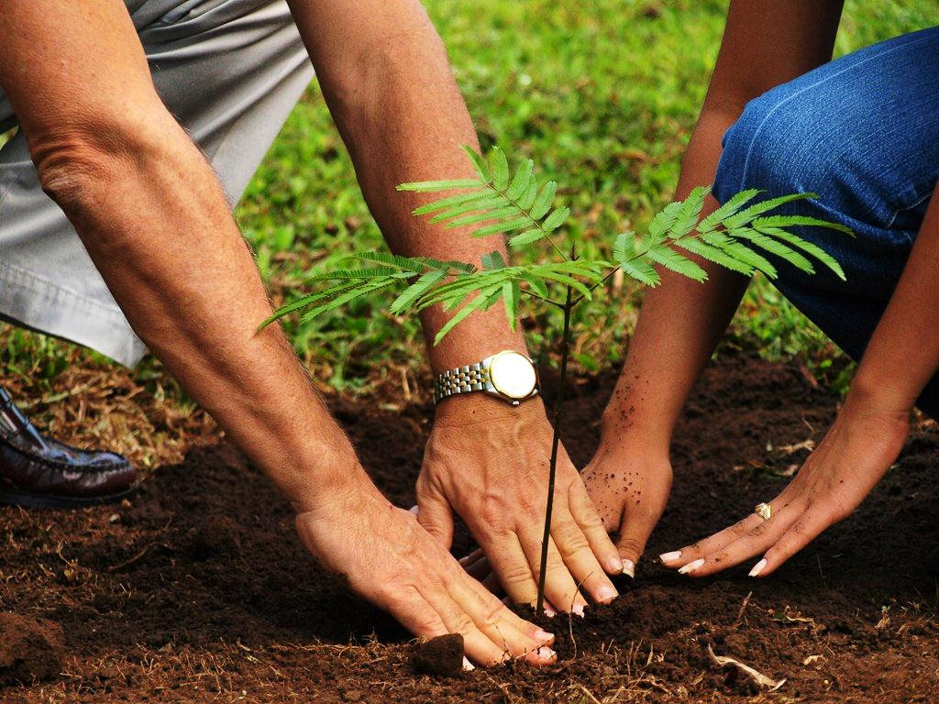
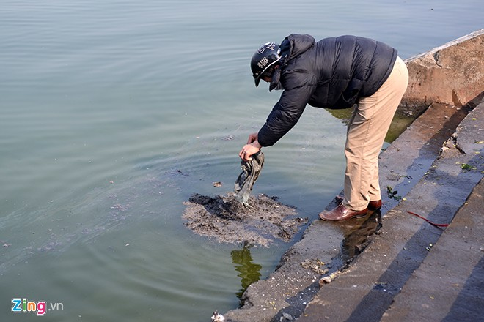
Planting more trees regularly.
and stop throwing waste materials in the rivers and canals

Slide 22
Group work
Group- A
Group- B
Write 5 stypes of pollution causes.
How can you prevent pollution.

Slide 23
evaluation
What is environment ?
How is it polluted ?
What is the main reason of water pollution?
How can we prevent pollution?

Slide 24
Write a short paragraph about”Environmental pollution”.

