Slide 1
Welcome to the class

Slide 2
IDENTITY
MD. AFSAR ALI
SENIOR TEACHER(ENGLISH)
MAJHIRA MODEL HIGH SCHOOL
SHAJAHANPUR, BOGURA
01757966577

Slide 3
INTRODUCTION
ENGLISH FOR TODAY
CLASS: Eight
uNIT: 8 lESSON: 1

Slide 4
What do you see in the pictures?

Slide 5
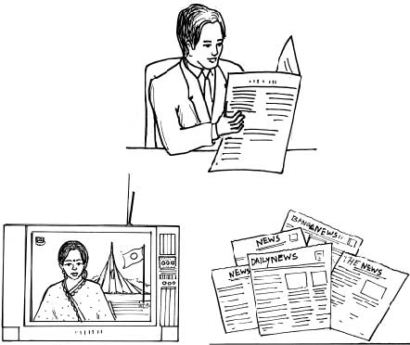
Look at the following pictures.
Discuss with your partner what you see in them.

Slide 6
Our Today’s lesson is-
Unit-8
News! News! News!
Lesson-1
What is news?

Slide 7
Learning outcomes
At the end of this lesson, we will be able to---
ask and answer questions
read and understand text materials
participate in short dialogues and conversation
write answers to questions

Slide 8
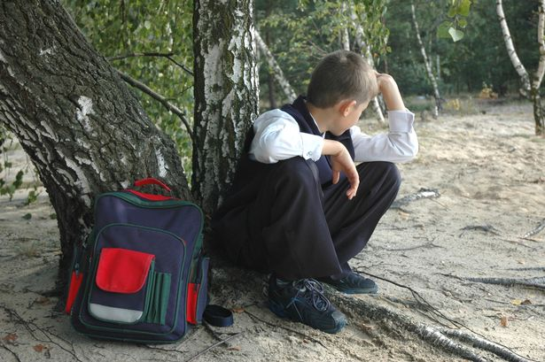
Let’s introduce with some new words:
Word
Meaning
Bunk off
To run away from school
Play truant

Slide 9
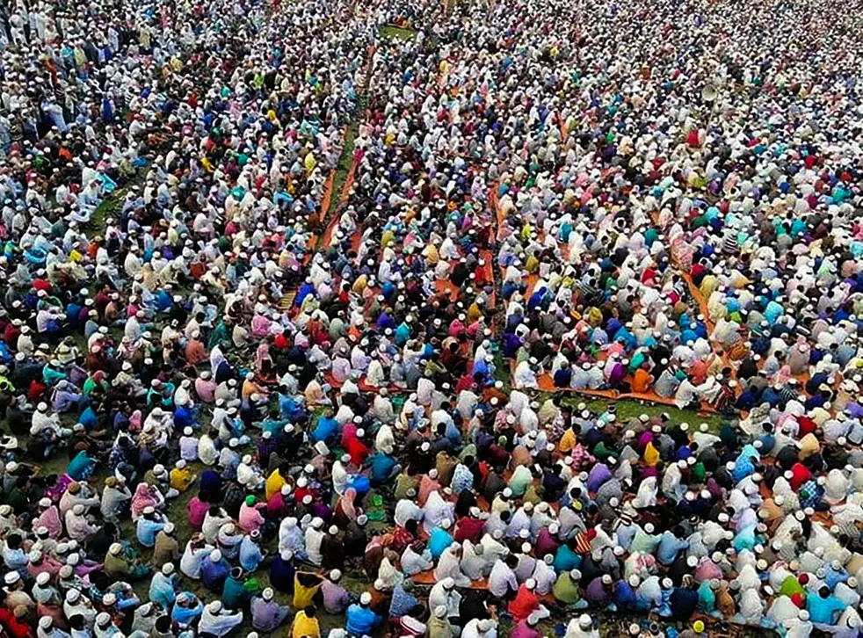
Let’s introduce with some new words:
Word
Meaning
People in general
Mass people
Large gathering of People

Slide 10
Let’s introduce with some new words:
Word
Meaning
Based on facts
Objective
actual
realistic

Slide 11
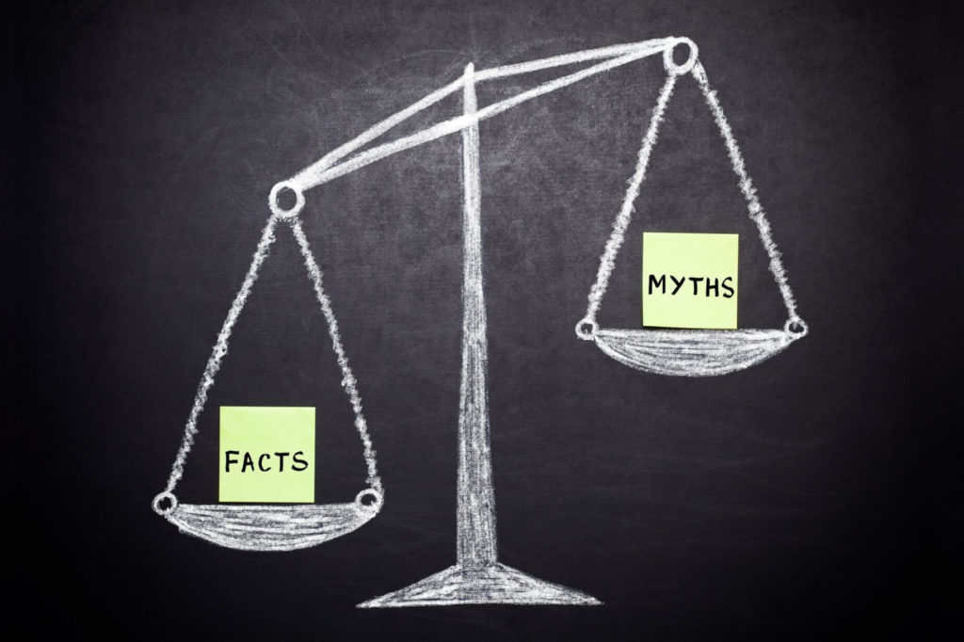
Let’s introduce with some new words:
Word
Meaning
Bias
Preference
Favour
Partiality

Slide 12
B. Read the text and answer the following questions.
‘I eat rice every day. I play cricket. I don’t bunk off school, blah…blah…blah…’ These are common events. They happen every day or on some occasions. Are these events news? Should they be published in newspapers? The answer is a big ‘ NO’. Then what is news anyway? What do we want to know from the media ? ‘When a dog bites a man that is not news, but when a man bites a dog that is news’, says Charles Anderson Dana.
The first think is that the news should be a piece of information . Secondly, the information should be recent or new, and hence it is ‘news’. Thirdly, mass people should take interest in it. --------- Recently, another aspect has been added: news is either printed or broadcast or on internet.
There are opinions that the term `news’ comes from `new’. Other’s says it is news because it comes all directions: North, East, West, and South.

Slide 13
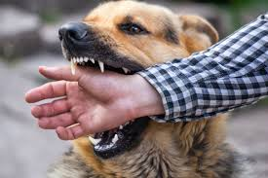
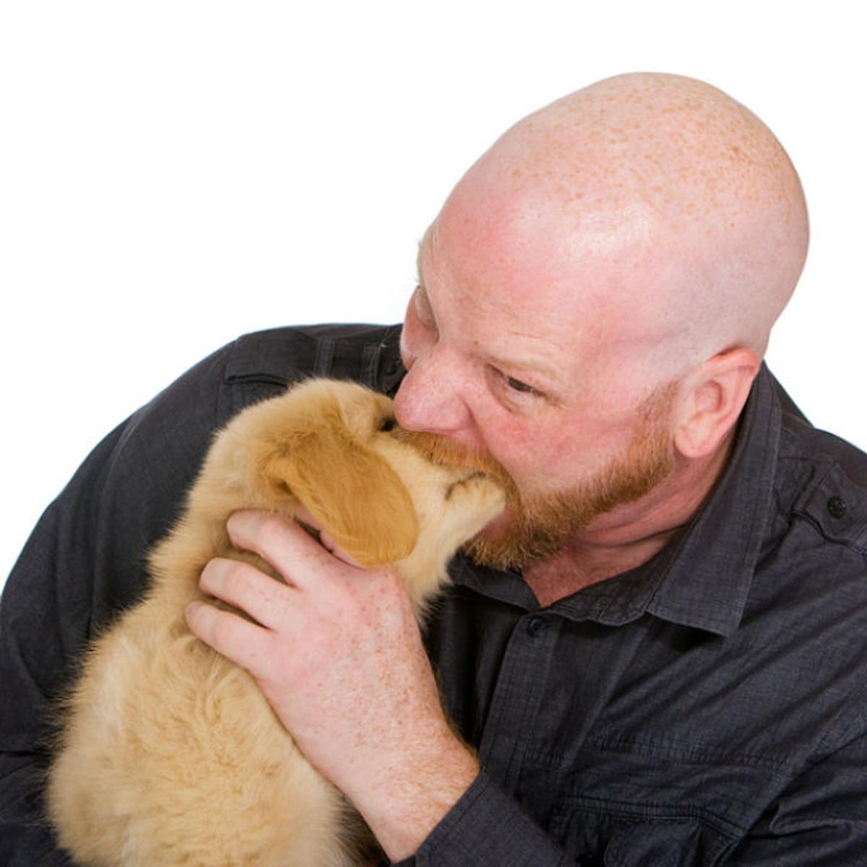
“When a dog bites a man that is not news, But when a man bites a dog that is news,’ Says Charles Anderson Dana.

Slide 14
What is news?
A News is a piece of information about current events that is happening around us.
What is new is news

Slide 15
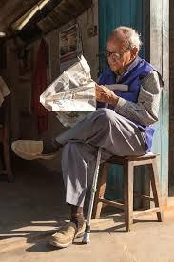
The first thing is that the news should be a piece of-
Secondly, the information should be recent or new,
Thirdly, mass people should take interest in it.

Slide 16
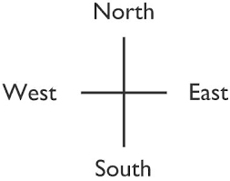
Fourthly, it should be self explained.
Recently , another aspect has been added ; news is either printed or broadcast or the internet.
Other’s says it is news because it comes all directions: North, East, West, and South.

Slide 17
Individual work
Now choose the correct answer:
1. A news must be -----
(a) informative (b) negative (c) positive (d) historic
2. The information of a news should be –
(a) old (b) ancient (c) recent (d) importance less
3. News plays an ---- role in our society.
(a) illogical (b) irregular (c) important (d) extra
4. The ‘occasion’ means –
(a) event (b) mint (c) unused (d) additional

Slide 18
Answer the following questions:
What is news according to Charles Anderson Dana?
Ans. That a man bites a dog is a news according to Charles Anderson Dana.
2. What is the first thing of news?
Ans. The first thing is a piece of information.
3.How can news be published nowadays?
Ans. Nowadays news can be published by either printings or by broadcasting or on the internet.

Slide 19
4. What features should news have?
Ans: A news should be informative, recent, self-explained, objective in which mass people cane take interest.
5. What is the difference between news and an event?
Ans: An event happens everyday, but a piece of news is not a natural phenomenon.
6. ‘……it should be self-explained...’. What does ‘it’ mean here?
Ans: Here `it’ means news.

Slide 20
7. What are the opinions about the term ‘news’?
Ans: There are opinion that the term `news’ comes from `new’. Others say that it is news because it comes from all directions: North, East, west and south.
8. What must be there in the information in a newspaper?
Ans: A piece of news must have the answers of all the questions with who, which, what, where, when, why and how.

Slide 21
Pair Work
C. Find the following words/phrases in italics in the text in B. Discuss with your partner and try to guess their meaning from the context. Then look at the table below and match the words with their meaning in the right column. First one is done for you.
Word/Phrase | Meaning
Bunk of | Not influenced by personal feelings/opinions
Media | To send out prorammes on TV or radio
Objective | Ways of getting information e.g. Radio, TV, newspaper, etc.
Broadcast | Stay away /leave school/work without permission

Slide 22
E. Look at the following comment.
Group Work
The advertisement is the most truthful part of a newspaper.----Thomas Jefferson
Now make similar sentences from the substitution table
The editorial page | is | The most attractive | Part of a newspaper
The cartoon page |  | The most educative
The sports page |  | The most valuable
The learners’ page |  | The most interesting
Ans
The editorial page is the most valuable part of a newspaper.
The cartoon page is the most attractive part of a newspaper.
The sports page is the most interesting part of a newspaper.
The learners’ page is the most educative part of a newspaper.

Slide 23
F. Ask and answer with your partner.
1. Do you read any newspaper/magazine?
2. When do you usually read it?
3. Which newspaper/magazine do you read?/magazine?
4. What make it different from other newspaper/magazine?
5. Which news items do you like most---international affairs, sports, movie, culture, politics etc.
6. Do you share your favourite news item/s with your friends

Slide 24
Home Work
G. Write a paragraph on your habit of reading newspapers. You can take your cues from the questions in section F.

Slide 25
Good bye
See you again

