Slide 2
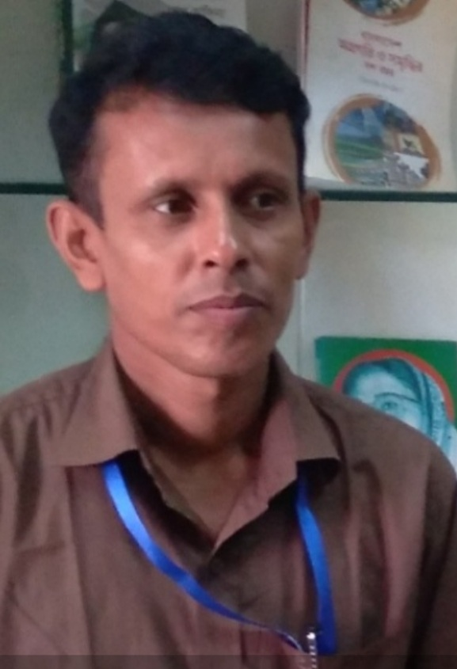
IDENTITY
Md Tipu Sultan
Assistant teacher
Islamabad Dakhil Madrasah,Narail.

Slide 5
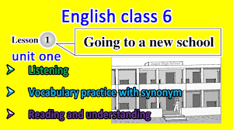

Slide 8
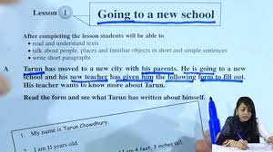

Slide 9
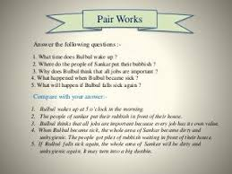

Slide 12
