Slide 1
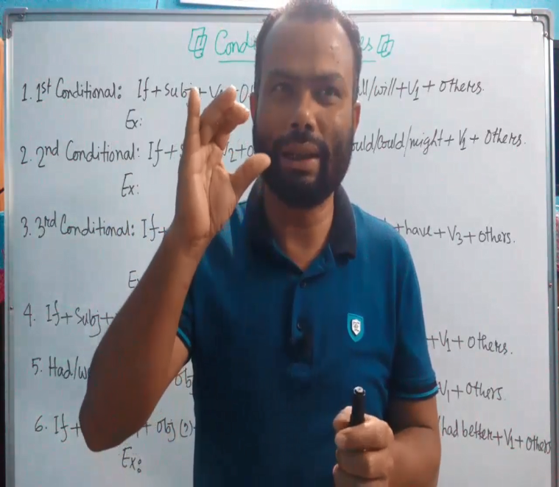
Introduction
Md. Anisul Haque
Assistant Teacher (English)
Jafargonj School & College
Mahanagar, Rangpur
Mobile: 01557125271

Slide 2
AN IDEAL SENTENCE
1. They eat .
Desire/আকাংখা
2. They football in the play field.
Agreement/ আসক্তি
3. The cow flies in the sky .
Expression/ যোগ্যতা

Slide 3
AN IDEAL SENTENCE
1. Desire/ Order (আকাংখা)
2. Expression (যোগ্যতা)
3. Agreement (আসক্তি)
Subject + verb + object/complement/adverbial+ Sign.
Ex: They play football in the field.

Slide 4
Ideal sentence এর গঠন প্রনালীঃ
Structures
Example
1.Subject + Verb+ object.
He writes a poem.
2. Subject + verb + adverb.
Bolt runs swiftly.
3. Subject +verb+ adjective+ noun.
Rana is a good runner.
4. Subject + verb + adverbial complement.
I walk in the morning.

