Slide 1
Welcome

Slide 2
Introduction
Md.Shakhawat Hossain
Assistant Teacher
Borogangni Government Primary School, Alamdanga,Chuadanga.
Class:Three
Subject:English
Unit:5
Lesson:4-6(Activity B)
Commands and INSTRUCTIONS
Page No:11

Slide 3
Learning outcomes
Listening
2.1.1 carry out commands and instructions.
Speaking
1.1.1 repeat wards .phrases and sentences after the teacher with proper sound and stress.
1.1.2 say wards .phrases and sentences with proper sound and stress.
7.1.1 give simple commands and instructions and carry out.
Reading
1.5.1 read simple sentences with proper pronunciation and stress.
1.5.1. recognize and read simple sentences,commands,greetings, questions and answer.
6.1.1 read instructions and and carry them out.

Slide 4
Tender learners,
How are you?
I’m fine and hope you are fine too by the grace of almighty Allah.

Slide 5
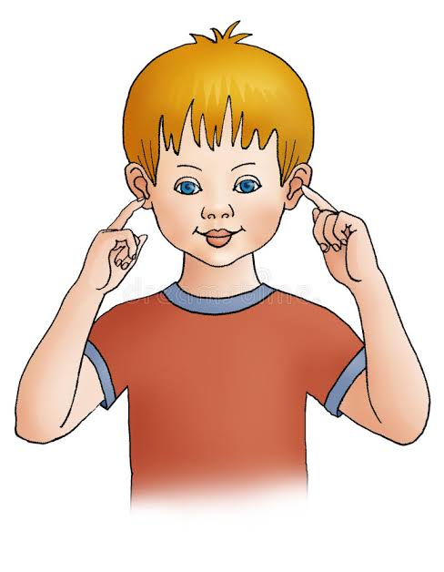
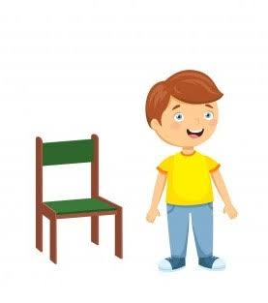
Now four of you come to me and carry the commans out which one I’ll Say.
Raise your hand.
Stand up.
Stand up.
Touch your ear.

Slide 6
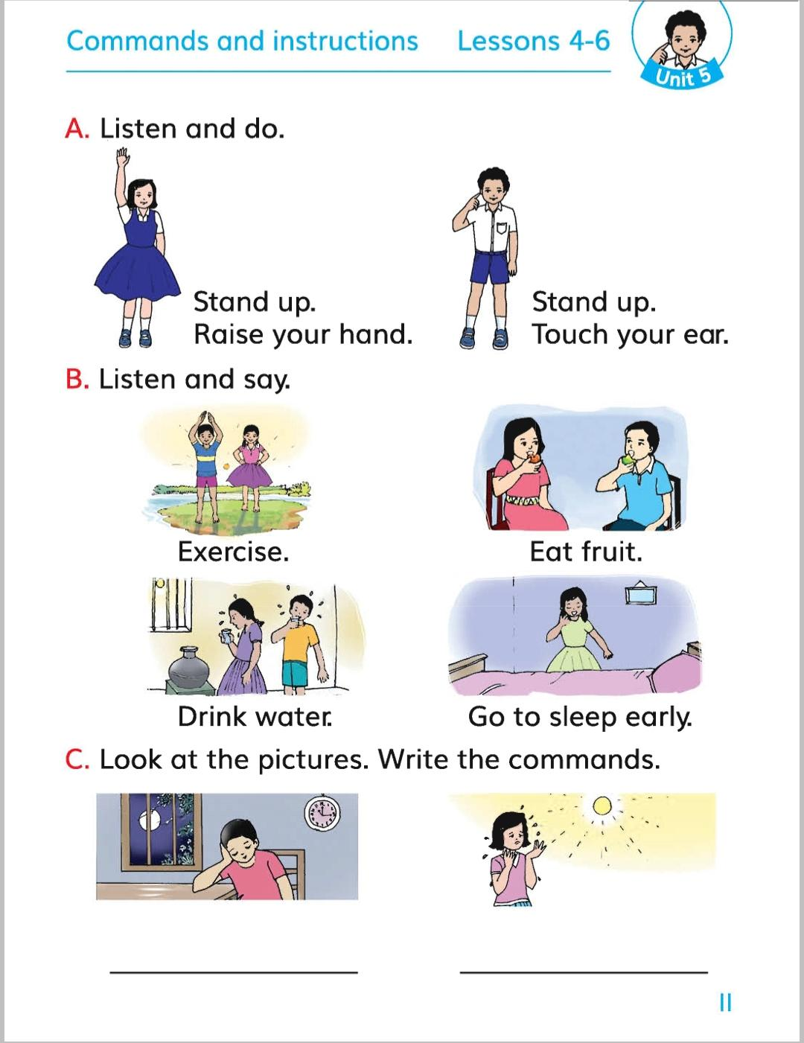
Now open at page no 11 and describe about the picture of activist B.

Slide 7
Now firstly I’ll read the text and you’ll listen silently.After that I’ll read again you’ll listen attentively and put your finger under the line.
Exercise.
Eat fruit.
Drink water.
Go to sleep early.

Slide 8
Today’s Lesson
COMMANDS AND INSTRUCTIONS

Slide 9
Read with me loudly one time more.
Exercise .
Eat fruit.
Drink water.
Go to sleep early.

Slide 10
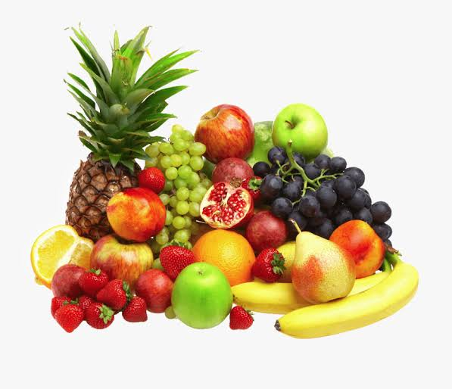
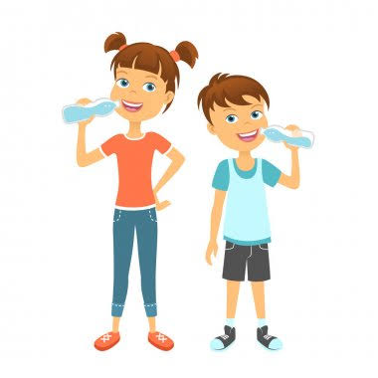
Now four of you come to me and act the command out which one I’ll Say.
Eat fruit.
Drink water.
Exercise .
Go to sleep early.

Slide 11
Now work in pairs. At first you’ll command your pair will listen carefull and act it out. After that you’ll listen carefully and act it out which one your pair will say.
If needed just ask for help.

Slide 12
Now we‘ll carry the commands out through chain drill technique. (At the beginning the first student from the front will command and the next student will act it out.After that he’ll command the next to him will act the command out and it will continue till the end.Finally the last student will command and first student who started will carry it out.)
If needed just ask for help.

Slide 13
Home work
Write down three common commands which you often follow in your family.

Slide 14
Thanks to all of you.

