Slide 1
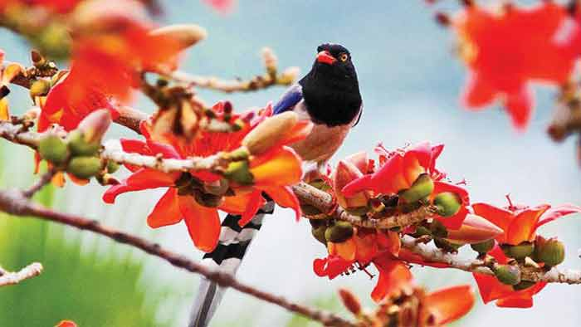
WELCOME TO MY MULTIMEDIA CLASS

Slide 2
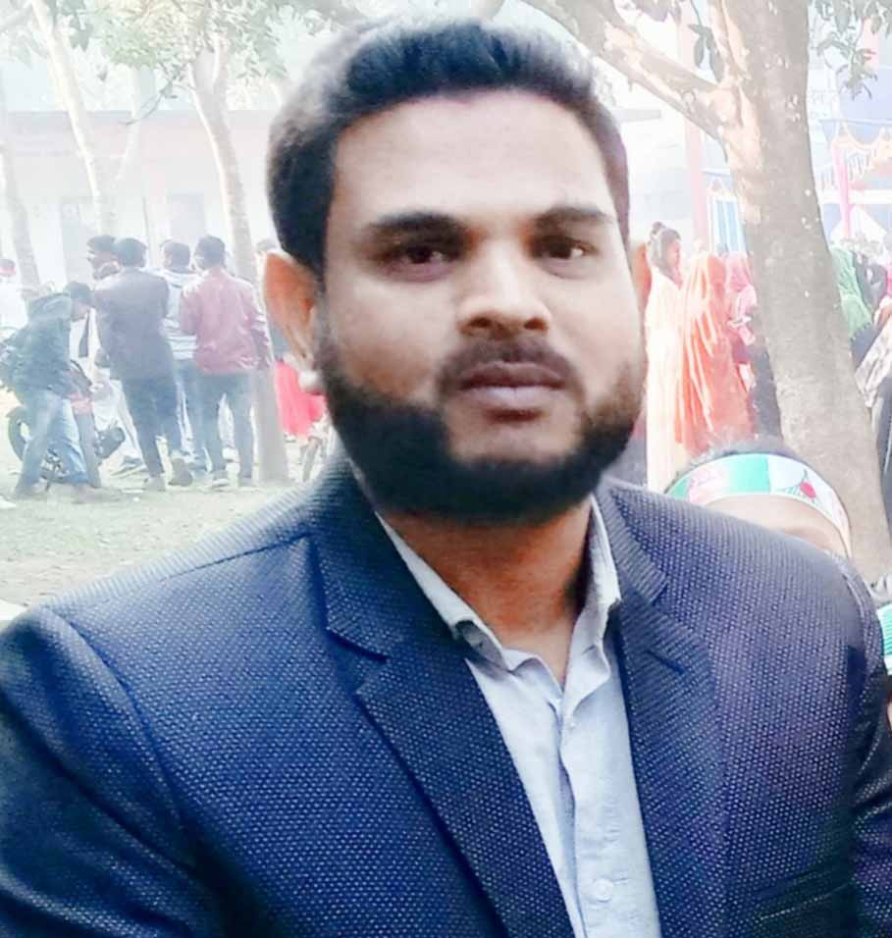
Presented By
Md.Hafizur Rahman
Assistant Teacher
Haripur Government Primary School
Haripur , Thakurgaon .
Phone: 01716437086
Email:hafizict5@gmail.com

Slide 3
Lesson Identity
Subject : English
Class: Five
Time: 40 minutes
Date: 01-11-2022

Slide 4
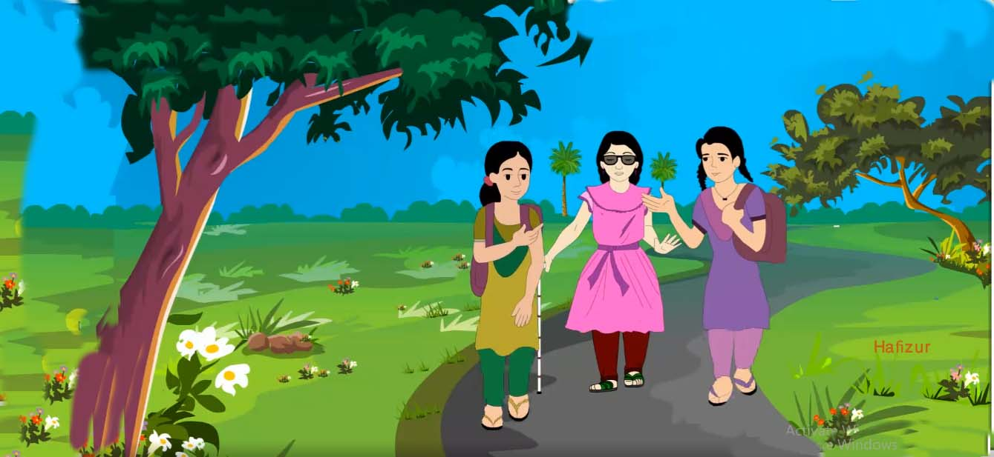
Dear Student ,what do you see in the picture?
What is the girl doing in the picture ?
Thank You

Slide 5
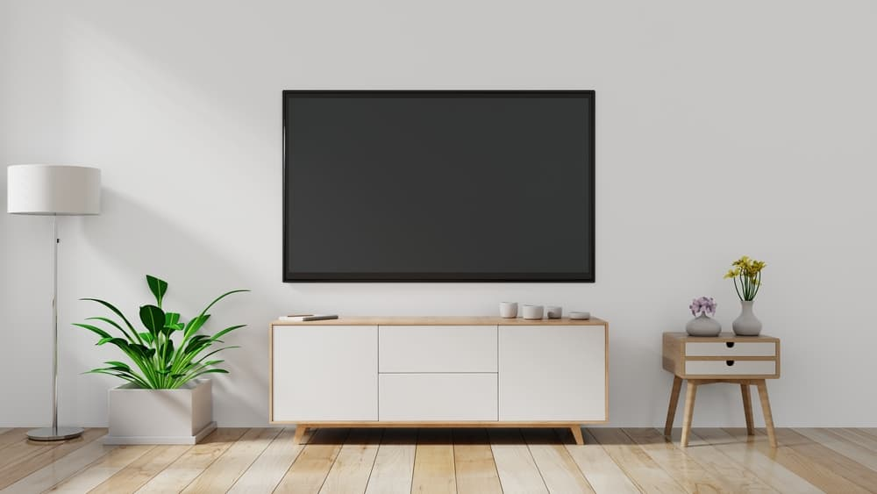
Today lesson
Life is beautiful
Lesson: 1-2
Unit: 20
Page No. 78

Slide 6
Learning Outcomes
By end of the lesson student will be able to-
Listening:
1.3.1- recognize which words in a sentence are stressed
3.4.1- understand statements made by the teacher and student.
Speaking
1.1.1: Say words, phrases and sentences with proper sound and stress.
3.2.1- understand questions about family and friends of students.
Reading
1.6.1- recognize and read statements, commands, greetings, questions and answers.
I .5.1- read silently with understanding text

Slide 7
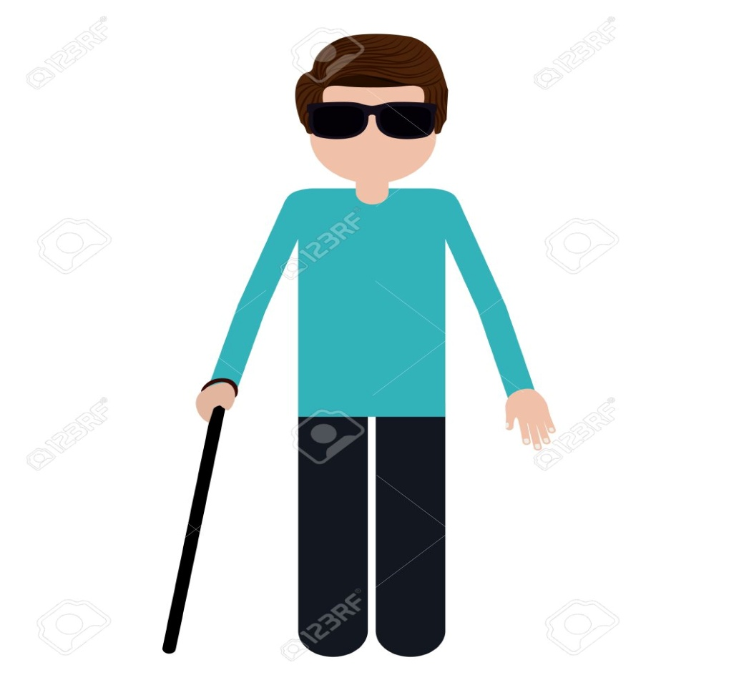
Visually impaired
Introducing new words
partially or completely blind
দৃষ্টি প্রতিবন্ধী
She is visually impaired since birth.

Slide 8
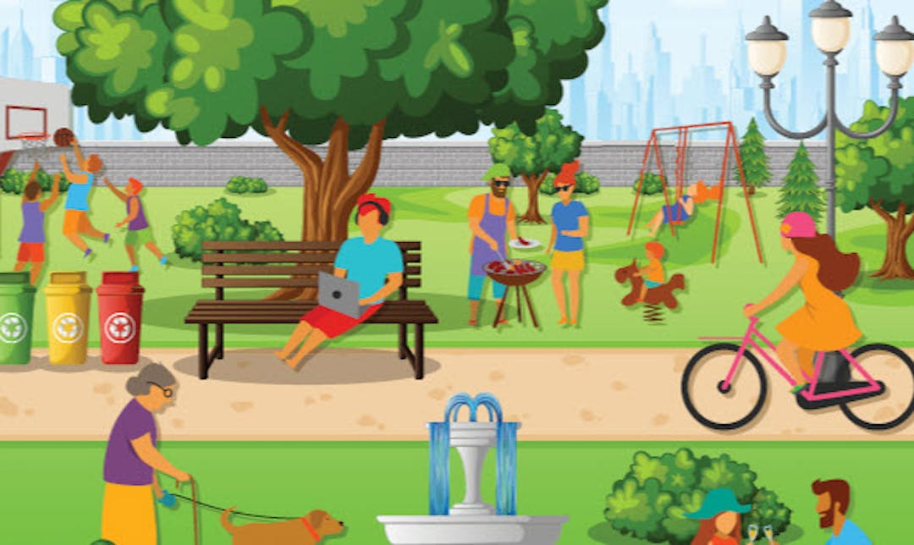
Introducing new words
Neighbourhood
A District or community within a town or city.
প্রতিবেশি
she lived in a wealthy neighbourhood of Dhaka.

Slide 9
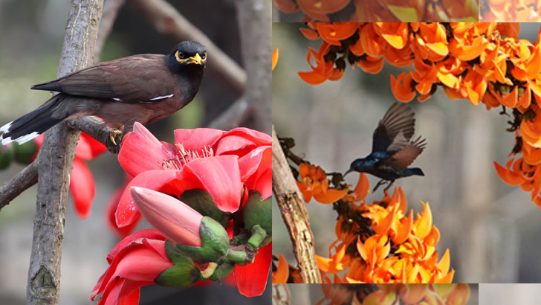
Spring
Introducing new words
The season after winter and before summer
বসন্তকাল
It is a beautiful spring day.

Slide 10
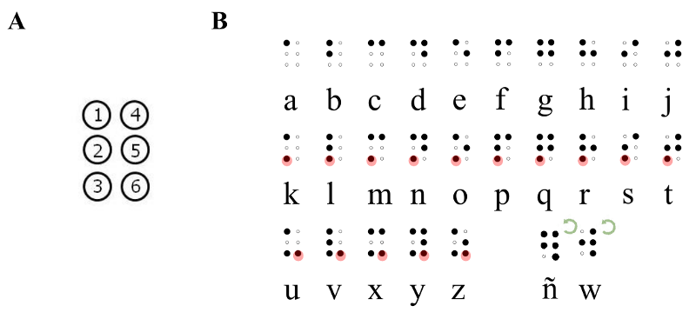
Introducing new words
Braille
a form of written language for blind people
অন্ধদের পড়ার পদ্ধতি
A blind people can learn by Braille

Slide 11
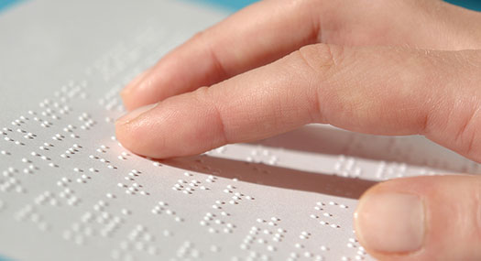
Introducing new words
Raised dots
a system of writing for blind people
উচু লেখা
A blind people can learn by raised dot.

Slide 12
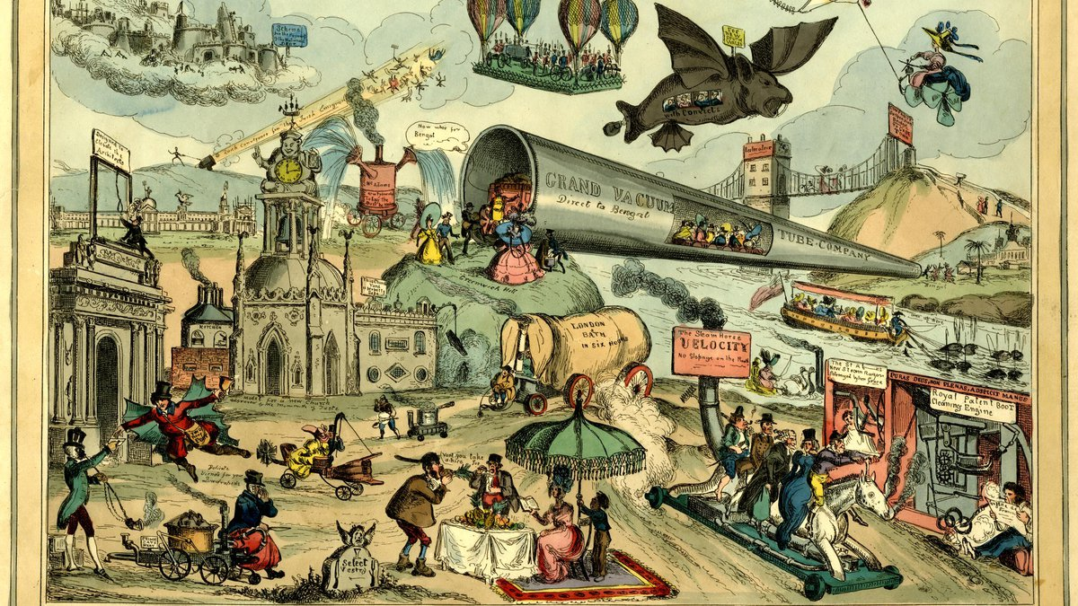
Introducing new words
History
the study of past events,
ইতিহাস
I like the history book.

Slide 13
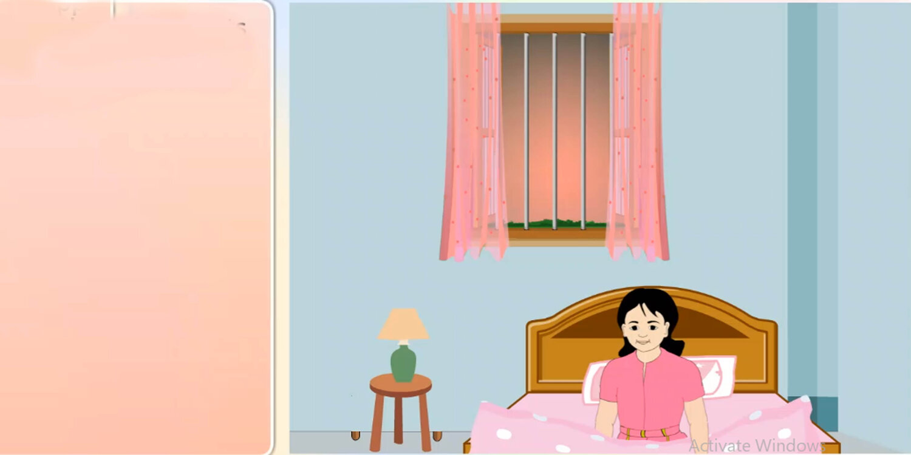
Let’s know the lesson with picture
It's a beautiful spring
day.
Maria gets up early.
She feels happy.

Slide 14
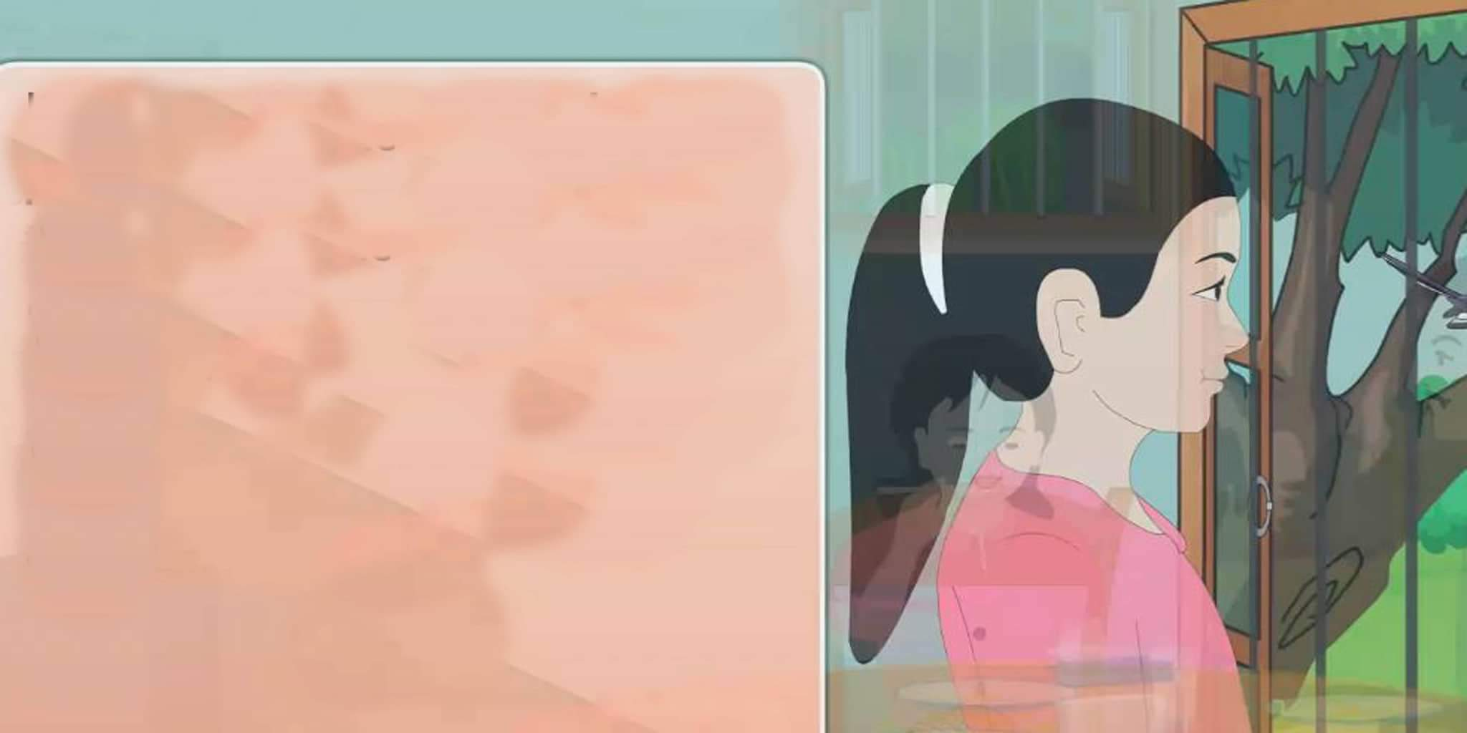
She knows that it’s a nice day because she puts her hand on the glass of the window.
It is very warm. She opens the window and
the singing of the birds fills the room. She can smell the flowers outside her home. They smell sweet and fresh.

Slide 15
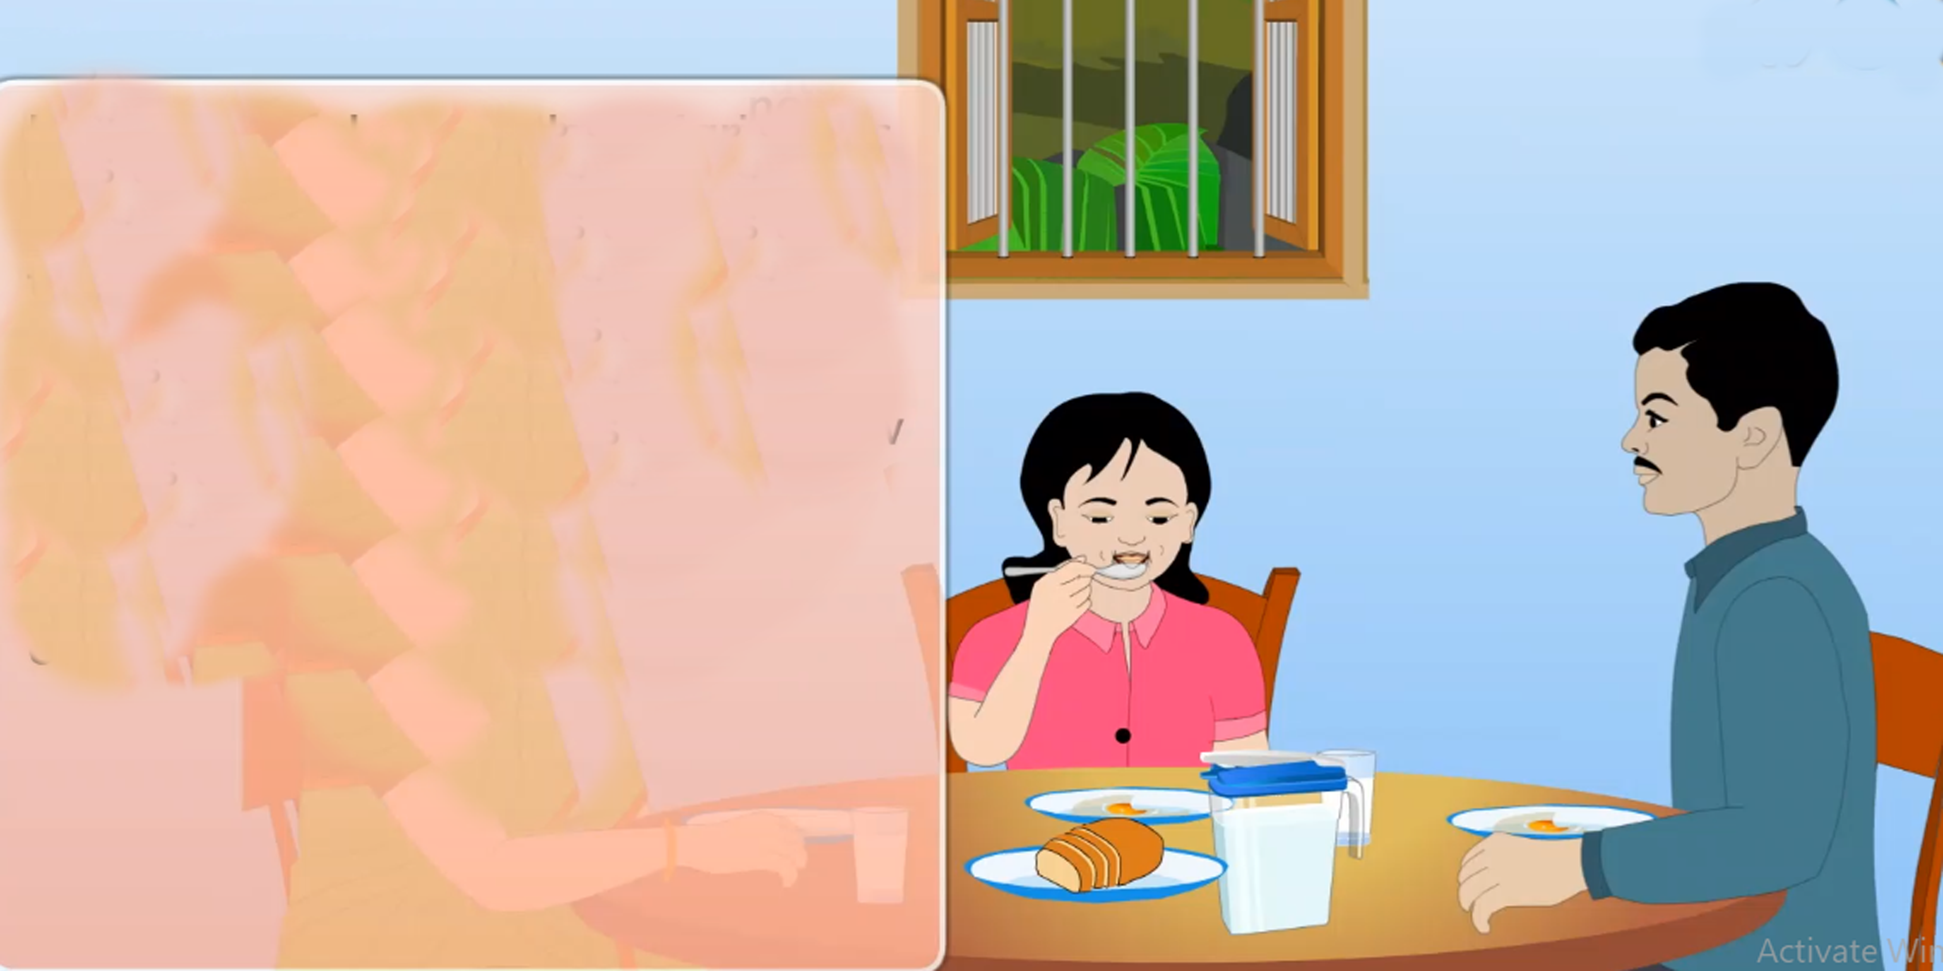
After Maria gets
dressed and has her breakfast, she puts her books in her bag.
She is ready for school.

Slide 16
Maria is a lot like any other students in her neighbourhood. She goes to school and likes to be with her friends.
But Maria cannot see the
beautiful spring day . She cannot see the flowers, the blue sky, or the singing birds . She cannot
see the new green leaves on the tress . She cannot see these because she is visually impaired . She has been unable to see since
she was born.

Slide 17
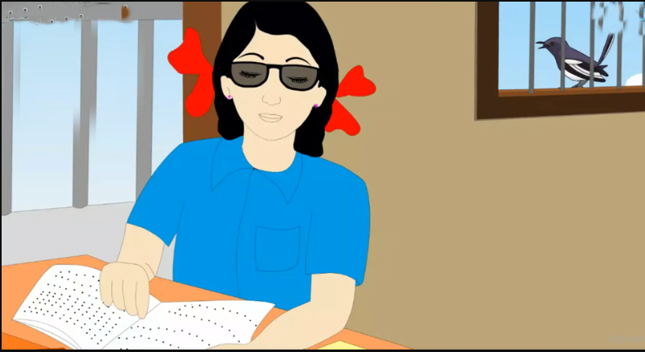
But Maria is happy. She goes to school everyday. She can learn the information because she reads Braille. Braille is a script that uses raised dots . Each letter is made from dots. People move their fingers across the raised dots to read. Maria learned to read Braille as a young child. Her books at school are in Braille. She enjoys reading poems and history . Maria's teacher says that she is a good learner.

Slide 18
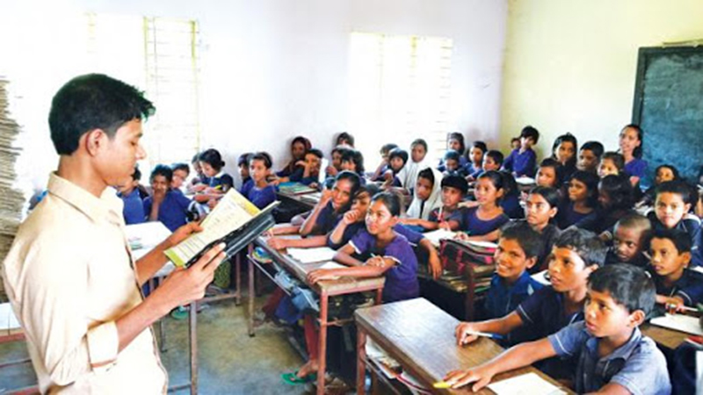
Teacher speaking loudly

Slide 19
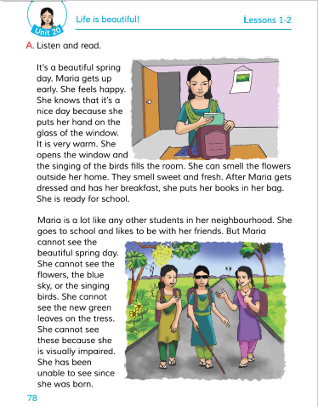
Open your book and turn to page 78

Slide 20
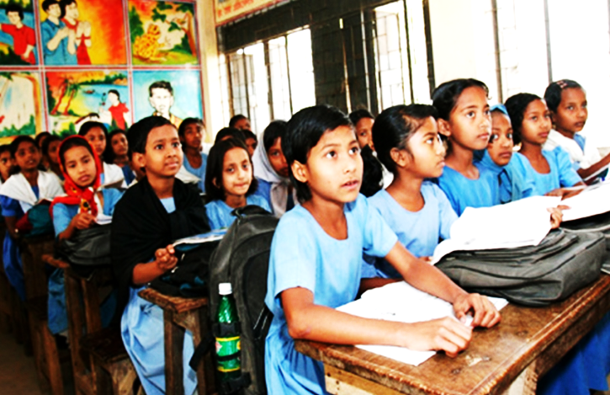
Students reading loudly

Slide 21
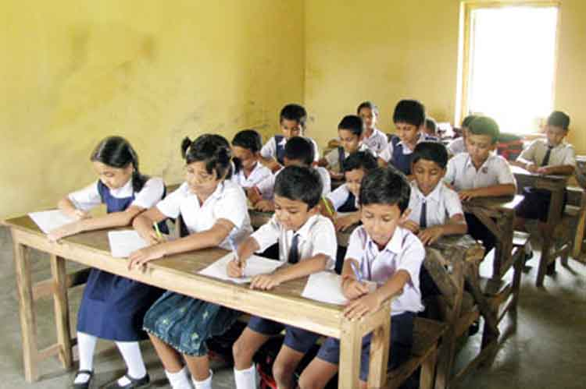
Students silent reading

Slide 22
Individual work
True or False
True
a) Maria can hear the singing of the bird.
False
b) Maria is a slow learner.
False
c) Maria enjoys reading story book.
False
d) A visually impaired student is not able to study.
True
e) Maria can read Braille.

Slide 23
Pair work
Fill in the blanks.
enjoys
learner
School
enjoys
read
learner
School
read
sweet
sweet
a. The flower smell ------------ and fresh.
b. Maria gets ready for ------------
c. Maria is a good -------------.
d. Visually impaired person can ------------with the help of Braille.
e. Maria ----------- her daily life.

Slide 24
Pair work
Match the words of the column A with their meanings in column B
Column-A | Column-B
a. Visually impaired | i) District or community within a town or city.
b. Neighbourhood | ii) A person who fight for his/her country
c. Spring | Iii) partially or completely blind
d. History | iv) a form of written language for blind people
e. Braille | v)The season after winter and before summer
 | vi). the study of past events
b
a
e
c
d

Slide 25
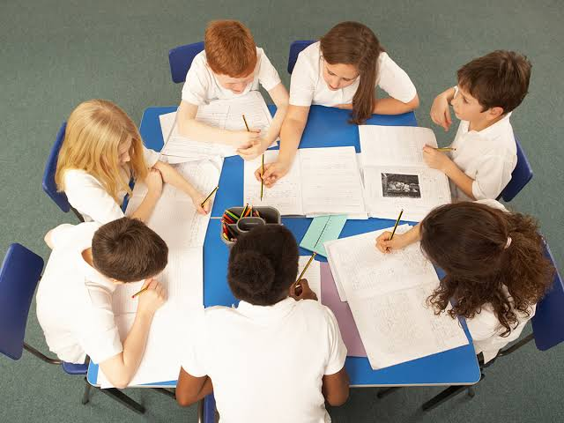
Group work
Group
A
Group
B
Group
C
Group
D
Write three sentence about “Braille”.

Slide 26
Evaluation
Ques:1. When does Maria gets up?
Ques:2. What does Maria do before going to school?
Ques:3.Why can’t Maria see the beautiful spring day?
Ques:4. What is Braille?
Ques:5. Why is Maria called a good learner?

Slide 27
One day one word
Learner
শিক্ষার্থী
sentence making
He is a good learner.

Slide 28
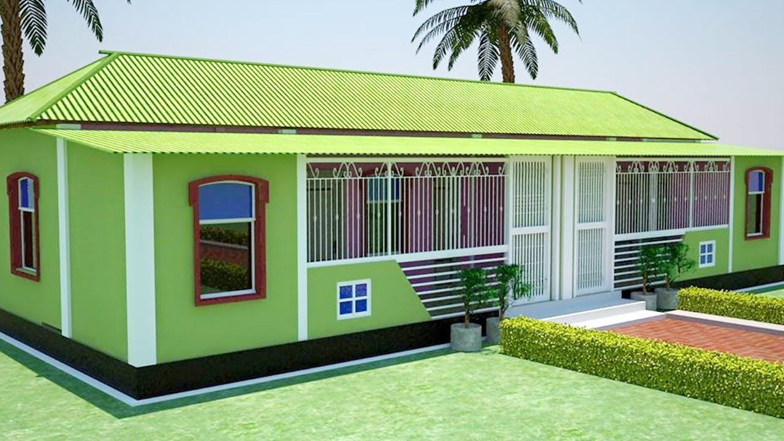
Home Task
Write five sentence about a visually impaired person you know.

Slide 29
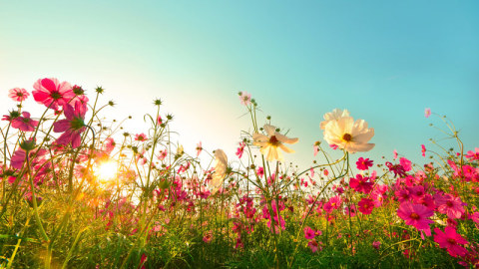
Good Bye

