Slide 1
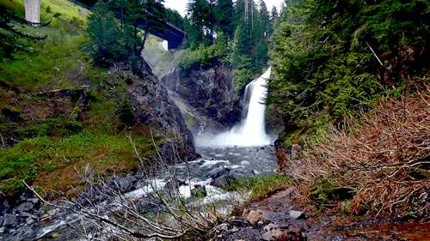
Welcome

Slide 2
Introduction
English Grammar and Composition
Mst. Sewli Khatun
Assistant Teacher of Bangala Kazi Sydhur Rahman Smrity High School, Ullapara, Sirajgonj .
Topic: Connector

Slide 3
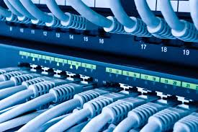
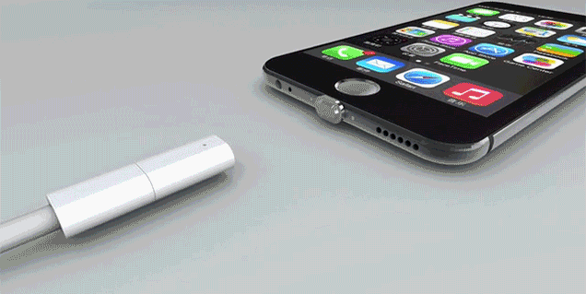
Look at the pictures.
( Teacher have to explain about connectors.)

Slide 4
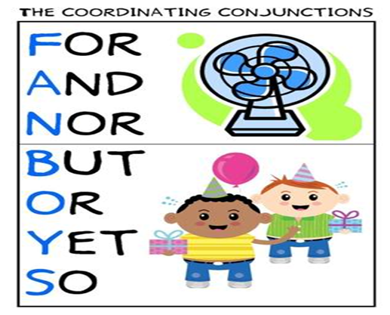

Slide 6
Today’s lesson: connectors
Learning Outcomes:
By the end of the lesson the students will be able to
 say what a connector means.
 identify connectors in texts.
 use connectors.

Slide 7
Read the following text and look at the underlined words.
Our environment consists of objects and forces. Objects are of two types. They are man-made objects and natural objects. Objects such as roads, houses, bridges, industries are man-made. Objects like forests, rivers, canals, animals are natural. Forces are of two types. They are also man-made and natural. Electricity is man-made. But forces namely sun, storms, currents, earthquakes, volcanoes are natural.

Slide 8
What does a connector mean?
A connector is a word or a phrase that links other words or phrases or clauses in a sentence or composition or speech in order to maintain sequence and coherence of events.
Such as: already, and, therefore, but, yet, in brief, on the other hand , finally.

Slide 9
List of connectors:
Words or phrases used to show sequence
of events:
first, firstly, already, before, after , at first, earlier, formerly, previously , at the beginning etc.
second, secondly, third, thirdly, in the middle of, at the end, lastly, at last, finally etc.
Example: Tamim wants to go abroad. First he has to have some skills. Then he has to have a passport. After that he has to get visa from the country he wants to go.

Slide 10
2.Words or phrases used to give additional information:
and, besides, moreover, furthermore, and more importantly, alternatively, anyway .
both…and, in addition to, not only…but also, also, too, that, so…that etc.
Example: yesterday I went to market to buy some necessary things for me. I bought a stapler, a pen holder, a vase and a bag. I also bought a newspaper so that I could know sports news.

Slide 11
Words or phrases used to give example:
namely, like, such as, in other words, for example, that is, for instance etc.
as follows, including, especially, particularly, mainly, chiefly, notably, mostly etc.
Floods do some benefits to us, for example they make the soil fertile.
Example: Five people were killed in the accident including the driver.

Slide 12
Words or phrases used to show similarity:
as, similarly, less, least, in the same way, in the same manner etc.
same as, as…as, so…as, more…than etc.
Example: The USA won most of the track and field events. Similarly in swimming, the top three places went to Americans.
Iron is not so costly as gold.

Slide 13
Words or phrases used to show contrast or dissimilarity:
instead, but, yet, still, nevertheless, though, although, however, rather, anyhow, lest etc.
in spite of, on the contrary, on other hand, while etc.
Example:
Bangladesh is a democracy but the democratic institutions are active enough.
Many people suffer from hidden hunger though they eat a lot.

Slide 14
Activity-1
Read the text first. Then find out the connectors and underline them: ( Sheet will be supplied to Ss)
Nature has given her wealth to us more generously than many other countries of the world. Think about our land. It is soft and fertile. Our farmers who have simple handmade tools can easily dig, plough and prepare the soil with them. But in most other countries the land which is both hard and rocky, cannot be easily dug, ploughed and prepared. We have also a great natural advantage. We can use most of our land for the purpose of our agriculture as well as industry.

Slide 15
Activity-2
Complete the sentences with these connectors:
already, until, whereas, that, although, so…as, at last, yet, not only…but also, lest.
1. -------- the man is rich, he is unhappy.
2. My friend can ------ dance ------- sing.
3. The tortoise has -------- reached the wining post.
4. Everyone likes the baby ------- does not cry.
5. The crow is ugly ---- it is useful.
6. Read attentively ----- you should fail.
7. China is not ---- densely populated ---- Bangladesh.
8. I will appear at the eaxm ---- I pass.
9. Rana is hardworking, ------- his brother is lazy.
10. The Pakistan Army gave in ------- .
Although
not only
but also
already
that
yet
lest
so
as
until
whereas
at last
Answer

Slide 16
Activity-3
Complete the passages with suitable connectors
1. The Olympic games were originated in Greece. ------ contests ---- running, leaping, boxing, wrestling, throwing the discus and the javelin were included. ------ , contests with horses were introduced. The games went on in Greek and Roman times. ----- in 394 A.D. the Roman Emperor stopped the games. ----- the games were revived towards the end of nineteenth century by French man.
2. Ours is a densely populated country. ----- , the number of vehicles plying on the roads is more in comparison of the roads. The roads of big cities ----- Dhaka remain very busy all the time ------ , road accidents have become daily occurrences to us. The reasons of road accidents are careless driving ---- over taking tendency, ------ disobedient to traffic rules.
First
like
Later
But
At last
Moreover
like
So
and
above all
Answer

Slide 17
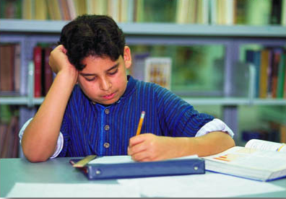
Home work
Write a paragraph on ‘How to make a cup of tea’. In your paragraph use the following connectors.
At first, then, next, after that, finally.

Slide 18
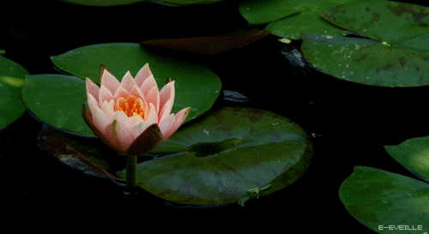
Message:
‘Try to be an enlightened person.’
Thank you.
Goodbye!

