Slide 1
Welcome to my presentation

Slide 2
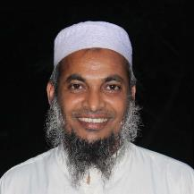
Introduction of the teacher
Dewan Rezaul Hassan
(Assistant Teacher)
Baropakhia Rothindrapara Government Primary School
Delduar, Tangail.
E-mail:drezaulhassan@gmail.com

Slide 3
Introduction of the lesson
Sub: English
Class: Two
Unit: 9, Numbers review
Lessons: 4
Page No: 19
Activity : A

Slide 4
LEARNING OUTCOMES
By end of the lesson students will be able to-------
Speaking: 1.1.2 say simple words and phrases with proper sounds and stress.
Reading: 2.1.1 recognize and read cardinal numbers up to 30.
Writing: 2.1.1 write numbers up to 10 in figures and in words.

Slide 5
Let’s listen and do the song

Slide 6
Checking homework
and justify the previous lesson.

Slide 7
Checking homework and justify the previous lesson.

Slide 8
Count and say.
Now try to say-
What can be the topic of our today’s lesson?

Slide 9
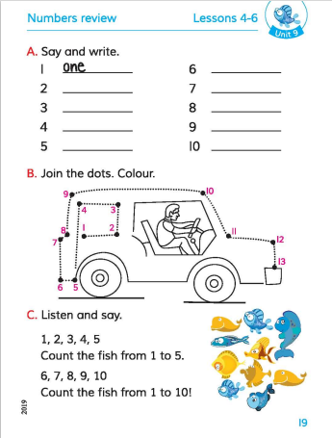
Our today’s lesson is—
Unit: 9, Numbers review
Lessons: 4
Page No: 19
Activity : A, say and write

Slide 10
Dear students,
Say the numbers 1-10 and spell in words.
1
-one
2
-two
3
-three
4
-four
-five
5
6
-six
7
-seven
8
-eight
9
-nine
10
-ten

Slide 11
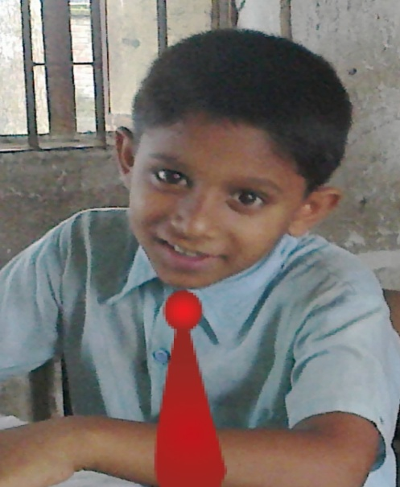
Say the number.
8
Pair work.
One more.

Slide 12
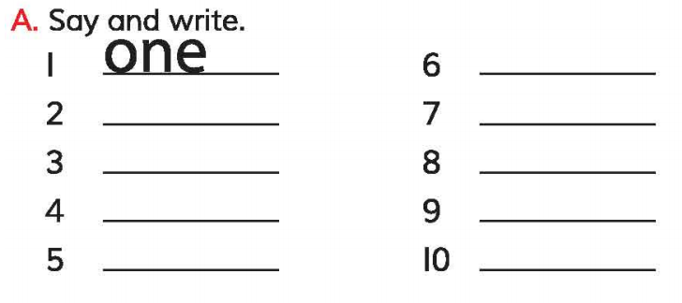
Open your English book at page-19 and see the Activity-A.
six
two
seven
three
eight
four
nine
five
ten
Exchange your book and check the text of other.

Slide 13
Spell out the numbers in words.
7
-seven
-nine
2
-two
4
-four
10
-ten
9
6
-six
3
-three
8
-eight
5
-five
1
-one

Slide 14
Read and say.
seven
nine
two
four
ten
six
three
eight
five
one
four
seven
ten
two
nine
six
three
eight
five
one

Slide 15
One day one word
Read and say.
Daily--প্রতিদিন

Slide 16
Home work
Page 18 will be well read and written.

Slide 17
Thanks
for
watching?

