Slide 2
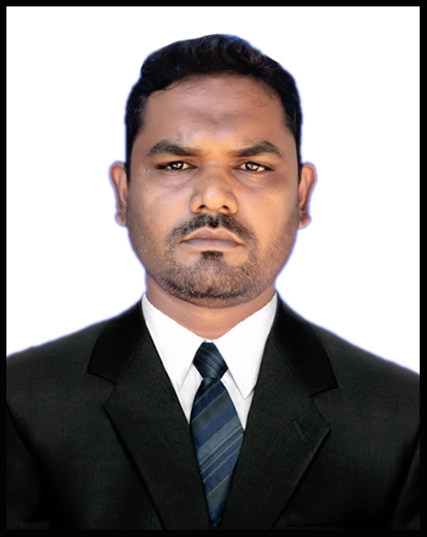
Presentation
For Class ix/x
By-
Abdul Jabber
Assistant Teacher
Rabita Model High School,
Mainimukh,Rangamati.

Slide 3
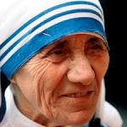
Raise your hand who can say who is this woman?

Slide 4
The woman of this picture is Mother Teresa.

Slide 5
What is she famous for?
Love for humanity.

Slide 6
Yes, Dear students our today’s topic
is …………………….?
Love for humanity
Unit-7, lesson-6

Slide 7
Vocabulary:
Destitute:
Poor
All of us should help the destitute people around us.

Slide 8
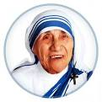
Missionary:
Preacher
Mother Teresa wanted to be a missionary from fer childhood.

Slide 9
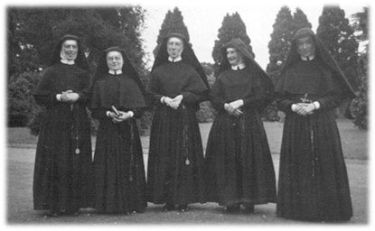
Community:
People/Society
They are a community of missionary.

Slide 10
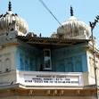
Institute:
Organization
Mother Teresa founded an institution named Nirmal Hridoy.

Slide 11
Salute:
Showing honour
The people of whole world salute Mother Teresa.

Slide 12
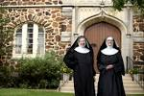
Mother Teresa founded Nirmal Hridoy for the poor and helpless people.
They took the dying and sick people from the street of Calcutta.

Slide 13
Missionaries of charity
The helpless people live happily in Nirmal Hridoy in a caring environment.

Slide 14
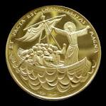
Mother Teresa got Pope John xxiii peace prize in 1971.
Mother Teresa was awarded Nehru Prize in 1972.

Slide 15
Mother Teresa got Balzan prize in 1978.
Mother Teresa was awarded Nobel Peace Prize in 1979.

Slide 16
Pair Work:
Section-C:
Now , read the text carefully again and say the following statements are true or false. If false, give the correct information.

Slide 17
Section –D:
Group work:
Read the text in A again and answer the questions.
Why do you think Mother Teresa won so many awards?
2. What does Nirmal Hridoy stand for?
3. Why do you think the home is named Nirmal Hridoy?
4. Why did Mother Teresa want the dying people to feel that they too deserve care and love?
5. What are the things that we have learnt from Mother Teresa?

Slide 18
Evaluation:
Answer the questions.
Of the sick and dying on the street of Calcutta
Moved by the sight?
Nirmal Hridoy
She founded?
At the age of 87, on 5th September 1997
When she died?
Pope John xxiii Prize, Nehru Prize, Balzan Prize, Nobel Peace Prize and Bharat Ratna Prize.
The awards she got?

Slide 19
Homework:
Write a
Short
Description on
“ Mother Teresa”.

Slide 20
THANK YOU ALL

