Slide 1
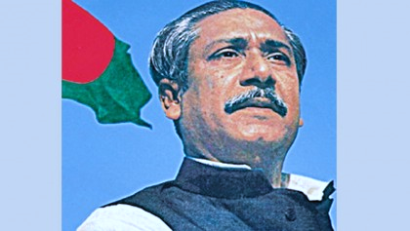

Slide 2
Introduction

Slide 3
Can you say about what the video is ?
The video is about the Language Movement.

Slide 4
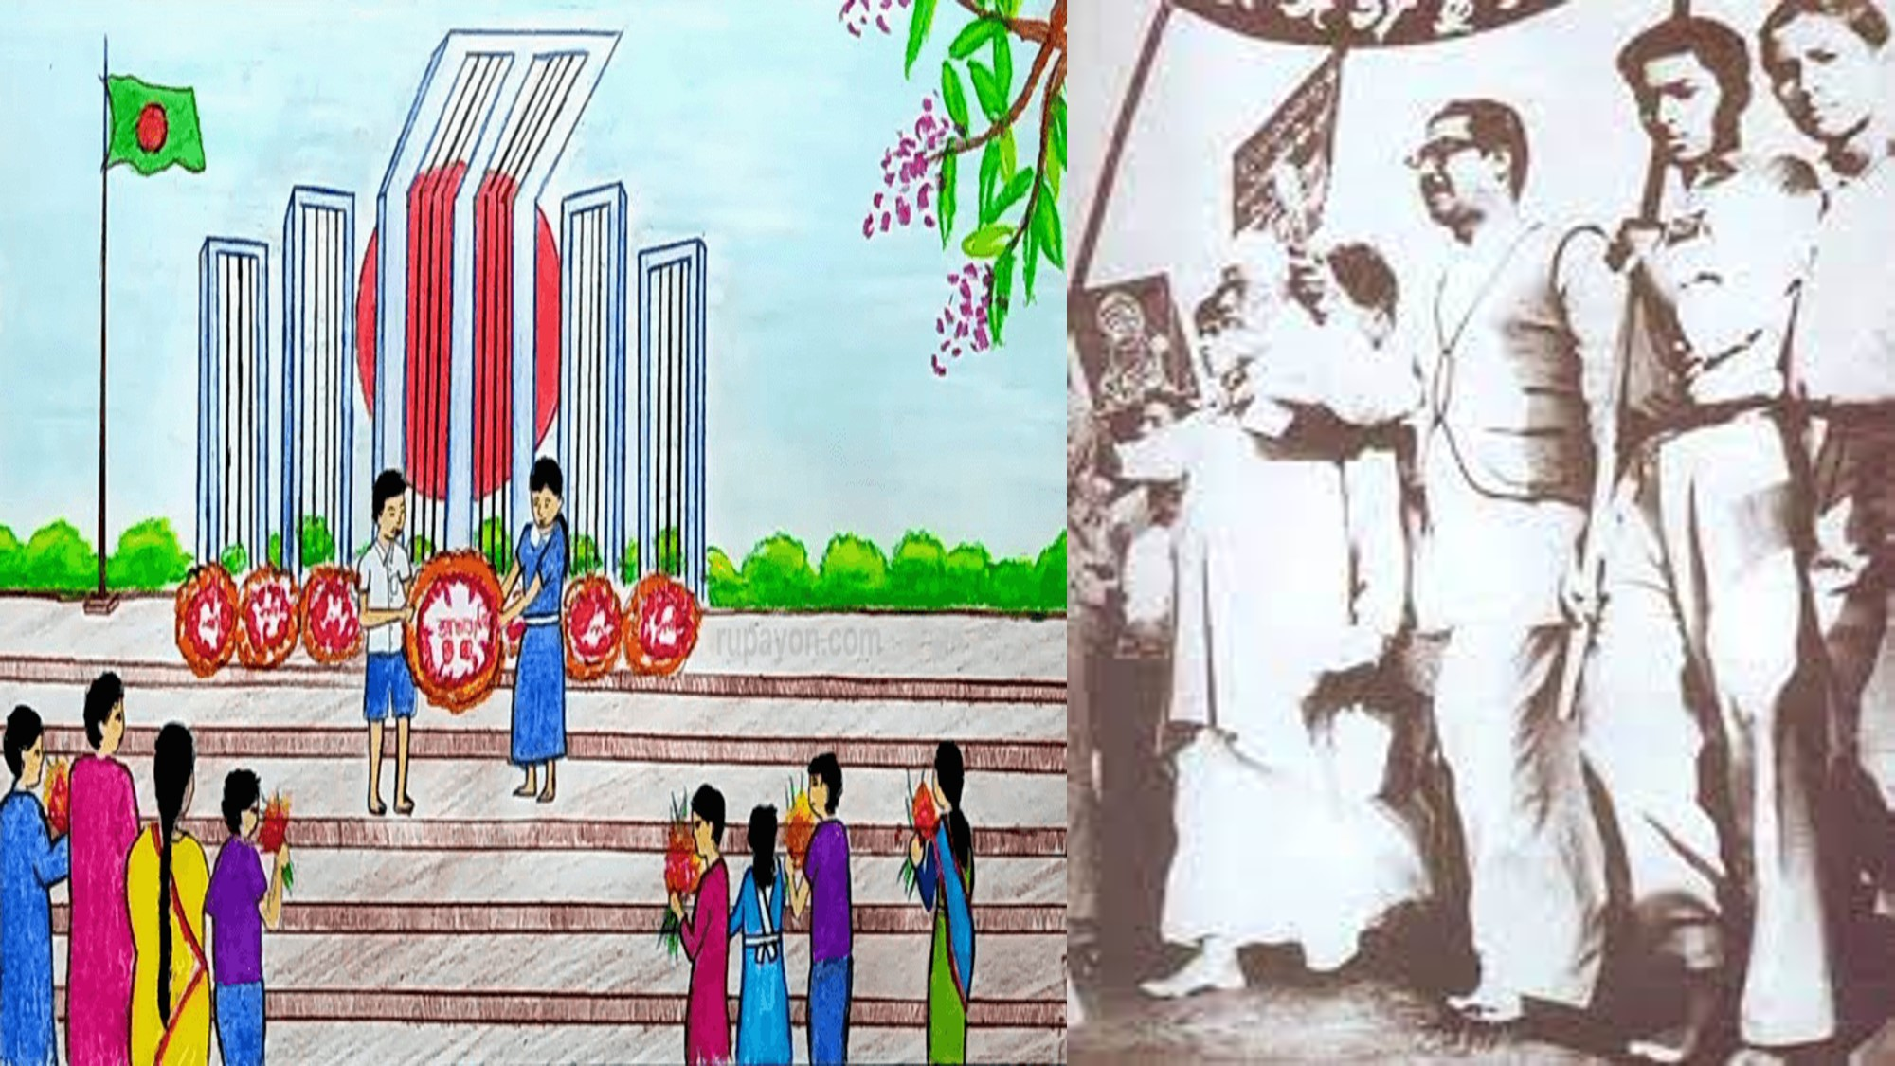
Today’s lesson is on
“ Bangabandhu and Bangladesh ”
“Bangabandhu and The Language Movement”
Unit - Five
Lesson- 1

Slide 5
read and understand texts through silent reading.
tell the meaning of the new/key words.
ask and answer questions.
develop listening skills.
write paragraph or short compositions.

Slide 6
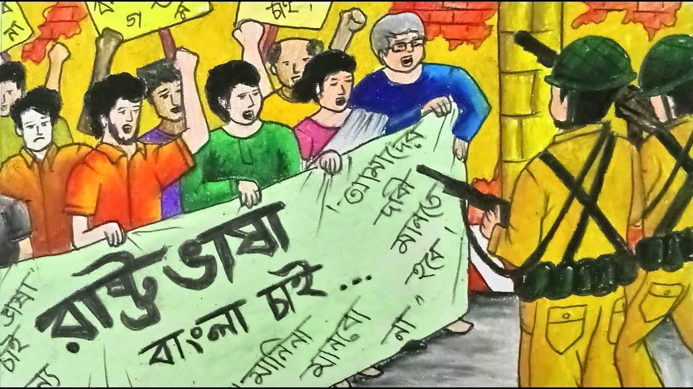
Movement
The act or process
of changing a situation.
Sheikh Mujibur Rahman played a vital role in Language Movement.

Slide 7
Discriminatory
Making or showing an unfair or prejudicial distinction between different categories of people or things, especially on the grounds of race, age, or sex.
West Pakistan
East Pakistan
The students of east Pakistan protested against the discriminatory language policy of Pakistan.

Slide 8
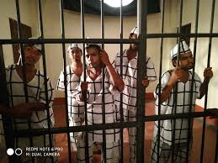
Prison
Jail
Bangabandhu started a hunger strike in the prison on 14 February, 1952 .

Slide 9
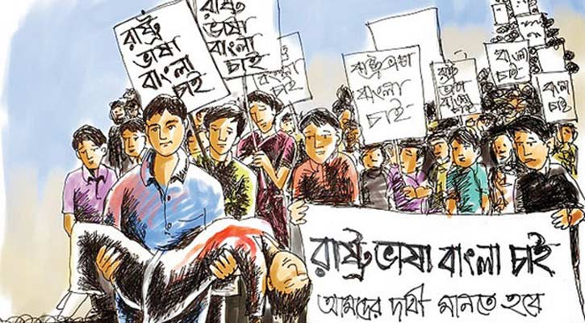
Rally
Assembly, gather
The students organized rally on International Mothers Language day.

Slide 10
Now read the text silently.
Sheikh Mujibur Rahman was one of the few student leaders who played a significant role in turning the language movement into a mass movement. As a student leader, he was the central figure in organizing mass gatherings, rallies and strikes for raising awareness against the discriminatory language policy of Pakistan.

Slide 11
The language movement started when the Governor General of Pakistan, Muhammad Ali Jinnah, declared "Urdu and only Urdu shall be the state language of Pakistan" on 19 March 1948 at the Racecourse Maidan while addressing a public gathering . He again uttered the same on 24 March 1948 at the University of Dhaka during his convocation speech. The students instantly protested against this announcement vehemently.

Slide 12
It was the time when young Mujib started organizing the student front of Muslim League in East Pakistan. He was proud of his Bengali identity and very active to initiate strikes and protests against the language policy of Pakistan government. Later, the then Prime Minister of Pakistan Khwaja Nazimuddin echoed the statement of Mr. Jinnah on 26 January, 1952. Mujib was in prison during this time due to his political activism and was admitted to the Dhaka Medical College under police custody.

Slide 13
However, he stayed in constant touch with other leaders directly engaged in the movement to make Bangla the state language. His directions from prison led the movement to a success. On 14 February, he started a hunger strike there.
During a general strike on 21February, 1952 the protesting students tried to defy Section 144 imposed by the government. The police opened fire and killed a number of students including Abdus Salam, Rafiq Uddin Ahmed, Abul Barkat, Abdul Jabbar and others.

Slide 14
Answer the following questions.
1. Where was Sheikh Mujibur Rahman during the Language Movement in 1952?
2. What happened on 21 February in 1952?
Check your answers.
Ans-1. Sheikh Mujibur Rahman was admitted to the Dhaka Medical College under police custody.
Ans- 2. The police opened fire and killed a number of students including Abdus Salam, Rafiq Uddin Ahmed, Abul Barkat, Abdul Jabbar and others on 21 February in 1952.

Slide 15
Now read the text aloud with correct pronunciation.
Sheikh Mujibur Rahman was one of the few student leaders who played a significant role in turning the language movement into a mass movement.
As a student leader, he was the central figure in organizing mass gatherings, rallies and strikes for raising awareness against the discriminatory language policy of Pakistan.

Slide 16
The language movement started when the Governor General of Pakistan, Muhammad Ali Jinnah, declared "Urdu and only Urdu shall be the state language of Pakistan" on 19 March 1948 at the Racecourse Maidan while addressing a public gathering .
He again uttered the same on 24 March 1948 at the University of Dhaka during his convocation speech. The students instantly protested against this announcement vehemently.

Slide 17
It was the time when young Mujib started organizing the student front of Muslim League in East Pakistan. He was proud of his Bengali identity and very active to initiate strikes and protests against the language policy of Pakistan government.
Later, the then Prime Minister of Pakistan Khwaja Nazimuddin echoed the statement of Mr. Jinnah on 26 January, 1952. Mujib was in prison during this time due to his political activism and was admitted to the Dhaka Medical College under police custody.

Slide 18
However, he stayed in constant touch with other leaders directly engaged in the movement to make Bangla the state language. His directions from prison led the movement to a success. On 14 February, he started a hunger strike there.
During a general strike on 21February, 1952 the protesting students tried to defy Section 144 imposed by the government. The police opened fire and killed a number of students including Abdus Salam, Rafiq Uddin Ahmed, Abul Barkat, Abdul Jabbar and others.

Slide 19
In his autobiography, Sheikh Mujibur Rahman says, “We decided in the meeting in my room to observe 21 February as State Language Day and to form a committee that day to conduct the movement to establish Bengali as the state language.”

Slide 20
Find the answers from column B to the questions in column A. Column B has their meanings. Match the phrases with their contextual meanings.
A | B
Discriminatory | be in a communication
Vehemently | involved in
Open fire | strongly
Stay in touch | begin to shoot
Engaged in | involved
Raise awareness | unfair

Slide 21
Check your answer
A | B
Discriminatory | Unfair
Vehemently | Strongly
Open fire | Begin to shoot
Stay in touch | Involved
Engaged in | Involved in
Raise awareness | Be in a communication

Slide 22
Check the answer.
Sheikh Mujibur Rahman played a significant role in our Language Movement.
What does the underlined word mean here?
a) Famous
b) Important
c) infamous
d) Active
2. The protesting students tried to defy section 144 imposed by the government.
What does the underlined words mean in this sentence ?
a) to refuse
b) to agree
c) to accept
d) to obey
3. What is the meaning of the word “autobiography” in the passage ?
a) The story of a person’s life written by somebody else.
b) The story of a person’s life written by his friends.
c) The story of a person’s life written by that
person himself.
d) The story of a person’s life written by a journalist.
4. Which of the following words is the meaning of “central” in the passage?
a) Most important
b) Less important
c) unimportant
d) popular

Slide 23
Write a short paragraph on
“ International Mothers’ Language Day.”

