Slide 1
WELCOME to EVERYONE

Slide 2
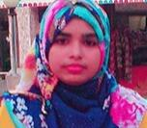
Teacher’s Identity
Mst. Sewli Khatun
Asst. Teacher in English
Bangala Kazi Sydhur Rahman Smrity High School, Ullapara, Sirajgonj.

Slide 3
Look at the picture below
A small house
A house

Slide 4
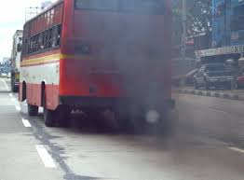
Look at these pictures
Smoke is emitting

Slide 5
Writing Skill
Paragraph Writing

Slide 6
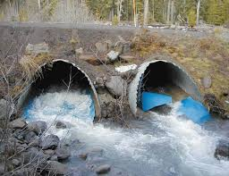
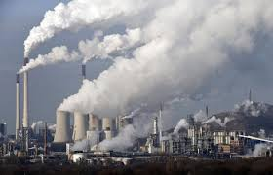
Look at the picture below
Polluted water is mixing with river water
Industrial smoke is mixing with air

Slide 7
Let’s watch the video below

Slide 8
Topic : Environment Pollution

Slide 9
Learning Outcomes
After studying this ss will be able to-
Describe about environment
Explain about water pollution
Narrate about sound pollution
brief about air pollution
explain about soil pollution

Slide 10
Definition of Environment
Bio-physical elements surrounding us that may inter-act with the system by exchanging mass, energy or other elements/ properties , are made of our Environment.

Slide 11
Elements of Environment
Environment
water
soil
Air
plants
Light
Houses
Animals
Roads

Slide 12
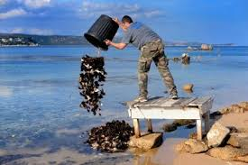
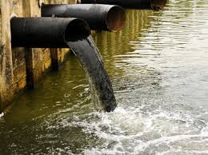
`Water is being polluted by
Draining industrial wastes
Throwing wastes

Slide 13
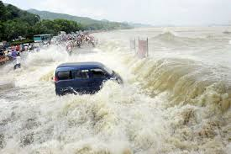
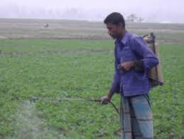
Water can be polluted by
Draining insecticides
Tidal bores

Slide 14
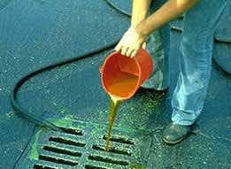
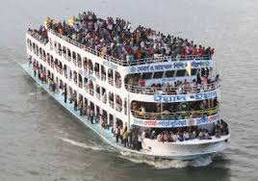
These are also the reasons of water pollution
Chemicals leaking
Human wastes and filths

Slide 15
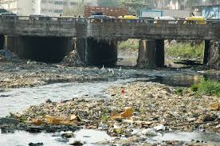
Water Is Polluted By
Drainage system with rain water from the land

Slide 16
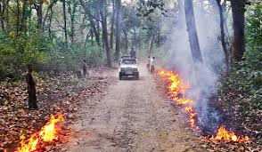
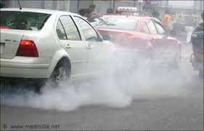
Air is polluted by
Burning forest
Emitting smoke from vehicles

Slide 17
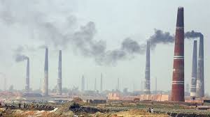
Air is polluted through
Industrial smoke
Smoke from brick fields

Slide 18
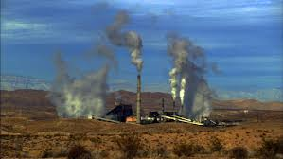
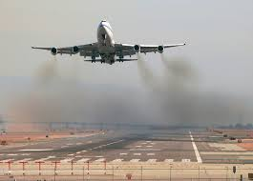
Air pollution is caused by
Bomb blasting
War by air

Slide 19
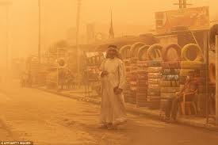
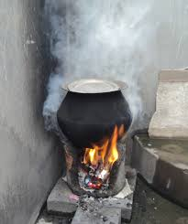
Air is also polluted by
Dust storm
Cooking with firewood/cow dung

Slide 20
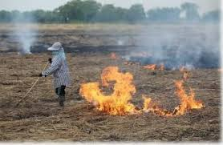
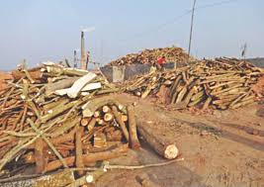
Soil pollution is caused by
Cutting down trees
Burning straw in the fields

Slide 21
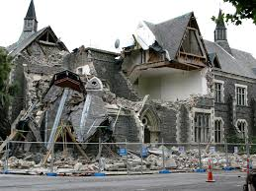
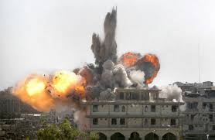
Earth is polluted by
War with bombing
Earth quake

Slide 22
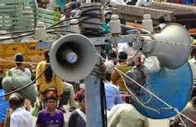
Sound is being polluted by
Industrial works
Using sound system

Slide 23
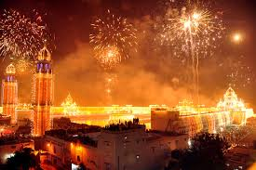
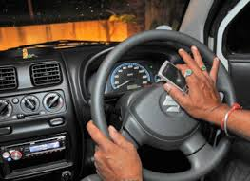
Sound pollution is causing by
Potka playing
Playing whistle

Slide 24
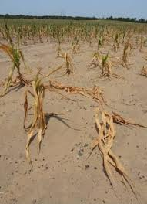
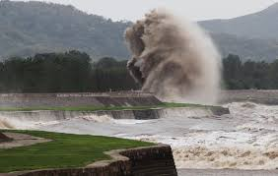
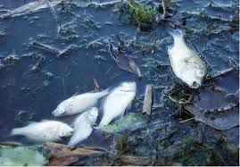
Effects of pollutions
drought
tidal bores
animals die indiscriminately

Slide 25
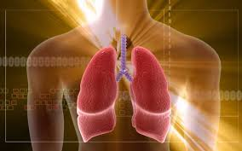
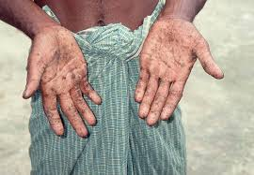
Effects of pollution
Lung disease
Spores in hands

Slide 26
Pair work
Reasons of water pollution
Reasons of air pollution

Slide 27
Evaluation
-What is environment?
-What do cause air pollution?
-What is caused for pollution?
- How can pollution be lessened?
- What are caused for pollution to human health?

Slide 28
Home work
Write a paragraph on ‘ Environment pollution’ or ‘ Water pollution’ or ‘Air pollution’ or ‘Sound pollution’

Slide 29
You have done well. Thank you all.

