Slide 1
Welcome to my class

Slide 2
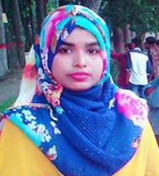
Introduction
Mst. Sewli Khatun
Assistant Teacher of Bangala Kazi Sydhur Rahman Smrity High School, Ullapara, Sirajgonj.

Slide 3
Class: 9/10
Subject: English For Today
Unit:3
Lesson:05
Page:36
Time: 50 mins
Lesson info

Slide 4
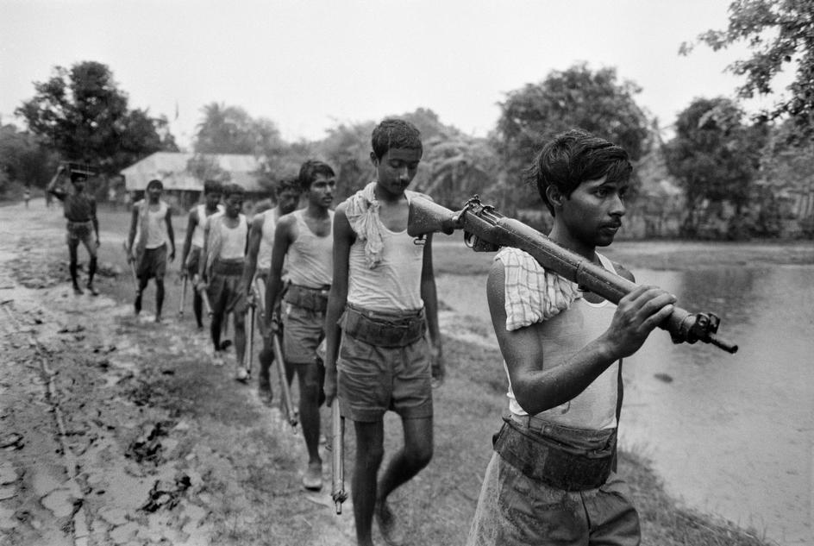
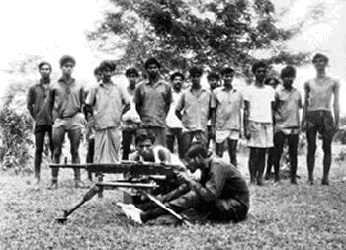
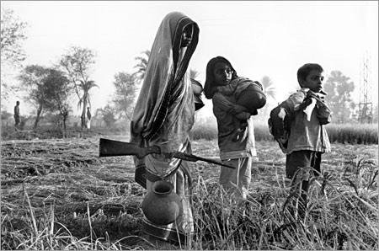
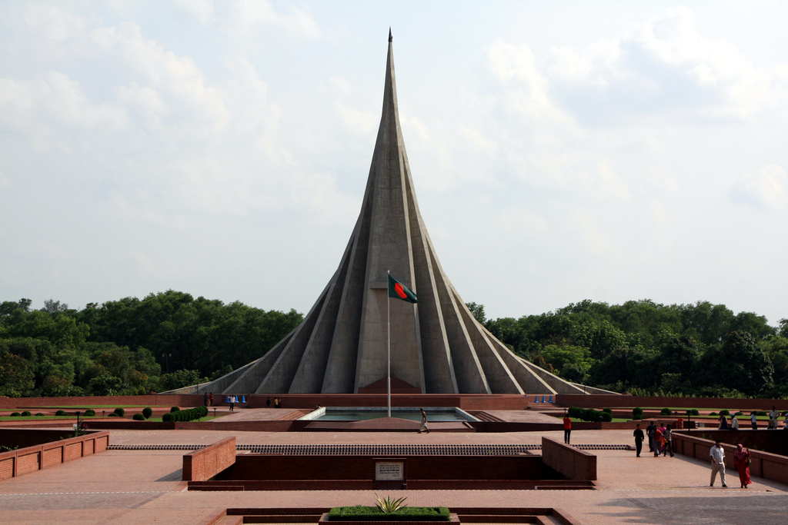

Slide 5
Let’s discuss about……
Independence day

Slide 6
Lesson output
By end of the lesson SS will be able to
# Ask and answer question
# read and understand text
through silent reading
# Infer meaning from the context

Slide 7
Look at the picture and ask and anwser the question
1. What can you see in the picture ?
2. Where is it ?
3. Why was it built ?

Slide 8
Probable answer
In the picture I can see a great tower. This is our National Memorial.
2. It is situated at Saver near Dhaka.
3. It was built with a view to keeping the memory of the supreme sacrifice of the great sons of our country in the war of Independence. The memorial is also a symbol of the nation’s respect and live to the martyrs of the Independence.

Slide 9
B. Silent Reading

Slide 10
Vocabulary
Word | meaning | image | antonym
Independence | Liberty, free from other countries |  | Dependence
Enthusiasm | Eagerness ,intensive curiosity |  | apathy
Fervour | Enthusiasm ,A strong feeling of excitement |  | apathy
Diplomat | ambassador
Organisation | institution

Slide 11
Word | meaning | image | antonym
Entertain | Amuse, recreation |  | bore
Alike | As like as, similar |  | different
Illuminate | Enlighten, to light up |  | darken
Display | Showing a extra ordinary skill , Act of performing skill
spectator | Observer, a man who watches an event
Arrange | organize

Slide 12
C .Match the words with their meanings
Solution
word | meaning
Fervour | Act of performing skill
Alike | To light up
Spectator | In a similar way
Display | A strong feeling of excitement
illuminate | A person who watches an event
word | meaning
Fervour | A strong feeling of excitement
Alike | In a similar way
Spectator | A person who watches an event
Display | Act of performing skill
illuminate | To light up

Slide 13
D. Choose the best answer
1. Our biggest state festival is..
Victory day b) Shaheed day c) Pahela Boisakh d) Independence day.
2.The celebration of Independence day begins with..
Procession b) gun salute c) placing wearth at the National Memorial d)none of them
3. The National Mausoleum is
a)On Dhaka University campus b)at Ramna c) at Savar d) near Dhaka Medical college
4. on Independence day a National Parade is held
a)At the national parade ground b)in the street c)in the decorated vehicle d)In Bangobondhu stadium

Slide 14
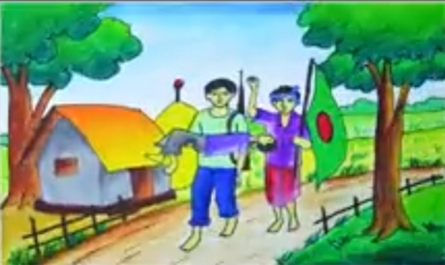
E. Group work
Write in brief , how you have celebrated this year’s Independence day at your school.

Slide 15
Evaluation
Fill in the gap from the sec A
26th march …is Independence day. This day starts …31 gun salute. On behalf of the nation, the president and the Prime Minister ……..put the ..at the national memorial at Saver. The country also enjoy a exciting display in National Parade ground.

Slide 16
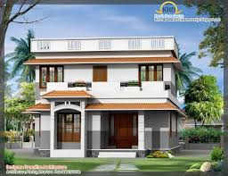
Home work
Write a dialogue with your friend about how you have observed the Independence Day in your school campus.

Slide 17
See
you
again

