Slide 1
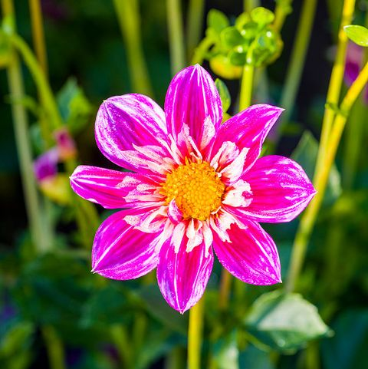

Welcome
to
You
To
Attend
the
Digital
Class

Slide 2

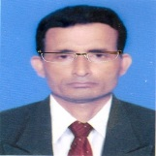

Identity
Manik Chandra Majumder
Senior Teacher
Gazirhat High School
Senbag, Noakhali.
Mobile No: 01717155169
Email: manikmajumder01@gmail.com
Class : Seven
Subject : English
Time: 7.50 hours
Date : 00/00/2023

Slide 3
What do you guess about the picture?
What can you see in the picture?
Notes:
Note: Teacher will show picture and ask above Question and ss will Answer.

Slide 4
Do you like this school?
Almost all the students like to study such a dream school.
What type of school do you like to study?
Notes:
Take answer from SS

Slide 5
So dear, Our today’s Lesson is---
A Dream School
Notes:
SS will Reply one by one

Slide 6


The focus of this unit is on
Competency 3: Ability to practice democratic norms in accordance with relevant social practices.
Therefore, in this unit
SS will experience, reflect on, maintain and use basic democratic norms and social practices while engaged in simple oral and written communication.

Slide 7

Learning Experience (7.5 hours):
Firstly, SS will take part in a questionnaire survey.
Then, they will be exposed to a story (a narrative of a student containing his/her school experience in an ideal environment/scenario).
After that, they will be engaged in identifying problems of their school in comparison to the story’s stated facts and discuss.
Finally, they will write a text about their dream school.

Slide 8
New vocabulary:
Available, Tiny, Bin, Facility, Unfortunate, Improve,
Remove,Vacation, Muddy Road.
Key Word: Tiny
Meaning: Very small (ক্ষুদ্র)
Example Sentence:
My room is tiny but cosy .
Your Sentence: We live in a tiny apartment.

Slide 9
New vocabulary:
Available, Tiny, Bin, Facility, Unfortunate, Improve,
Remove,Vacation, Muddy Road.
Key Word: Bin
Meaning: A container to put rubbish
Example Sentence:
Always throw the rubbish in the bin.
Your Sentence: We put domestic rubbish in the bin.

Slide 10
New vocabulary:
Available, Tiny, Bin, Facility, Unfortunate, Improve,
Remove,Vacation, Muddy Road.
Key Word: facility
Meaning: Something that make our work easier
Example Sentence:
The library has all the facilities to read as many books as you like.
Your Sentence: City dwellers enjoy many modern facilities.

Slide 11
New vocabulary:
Available, Tiny, Bin, Facility, Unfortunate, Improve,
Remove,Vacation, Muddy Road.
Key Word: Unfortunate
Meaning: Unlucky
Example Sentence:
It is very unfortunate that I couldn’t join the picnic.
Your Sentence: It is unfortunate that he couldn't get a job.

Slide 12
New vocabulary:
Available, Tiny, Bin, Facility, Unfortunate, Improve,
Remove,Vacation, Muddy Road.
Key Word: improve
Meaning: become better/ develop
Example Sentence:
Try to improve your computer skill.
Your Sentence: We should try to improve our proficiency in English

Slide 13
New vocabulary:
Available, Tiny, Bin, Facility, Unfortunate, Improve,
Remove,Vacation, Muddy Road.
Key Word: Remove
Meaning: delate/ take out
Example Sentence:
To be better speaker you have to remove shyness.
Your Sentence: Work sincerely to remove poverty from the country.

Slide 14
New vocabulary:
Available, Tiny, Bin, Facility, Unfortunate, Improve,
Remove,Vacation, Muddy Road.
Key Word: Vacation
Holiday/A time when someone does not go to work or school
Example Sentence:
In summer vacation, Iwill go to my village home.
Your Sentence:In winter vacation, I will visit Cox’s Bazar.

Slide 15
New vocabulary:
Available, Tiny, Bin, Facility, Unfortunate, Improve,
Remove,Vacation, Muddy Road.
Key Word: Muddy road
Meaning: A road that is covered in mud.(কর্দমাক্ত রাস্তা)
Example Sentence:
The roads will be muddy as it is raining outside.
Your Sentence. Rural roads becomes muddy during rainy season.

Slide 16
New vocabulary:
Available, Tiny, Bin, Facility, Unfortunate, Improve,
Remove,Vacation, Muddy Road.
Key Word: Available
Meaning: Ready for use (সুলভ)
Example Sentence:
Many videos are available to develop our listening skills on YouTube.
Your Sentence: In rainy season we get available fish.

Slide 17
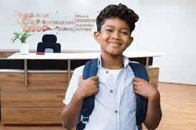
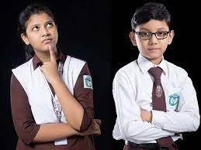
1.1 Look at the picture of a school. Now, write 5 sentences on what you love about this school. (Pair/Group)
Look friend! Its environment is also nice. Everything is neat and clean. There are trees, birds and squirrels.
Hi! Sakib,Would you tell me what you love about this school?
I also love it. Besides. I love its spacious and tidy classrooms.
Right Apon, The school has a wonderful flower garden. I love it very much.
Sure, I love the beautiful playground.
What about you?
Really, wonderful.
Apon
Sakib
Notes:
SS will Reply one by one

Slide 18

Now, write 5 sentences on what you love about this school.
The five things that I love of the school are given below:
There is a beautiful flower garden in front of the school which I like most.
There is a wide playground where the students can play.
There is a canteen from where students can take tiffin.
Besides, there is a library from where students can take and
read various books.
The school is well decorated and neat and clean.

Slide 19
Pair Work
1.2 Work in pairs. Identify which of these facilities you have in your school. Tick under Yes if you have the facilities and tick under No if you don't have the facilities in your school. One is done for you.
Follow next page-------

Slide 20
Question | Yes | No
1. Do you have a playground in your school?
2. Do you have a garden in your school?
3. Do you have a library in your school?
4. Do you have a canteen in your school?
5. Do you have clean classrooms?
6. Do you have enough light and air in the class-room?
7. Do you have comfortable benches/desks?
8. Do you have a white/blackboard in the class-room?
9. Do you have a computer lab in your school?
Follow next page-------

Slide 21
Questions | Yes | No
10. Do you have multimedia/ projectors in the class-room?
11. Do you have a freely available Wifi network in the school?
12. Do you have pure drinking water in your school?
13. Do you have clean toilets in your school?
14. Do you have bins in your school?
15. Do you have a first aid box in the school?
16. Do you have trees and birds in your school?
17. Do you have a notice board in your school?
18. Do you have pictures/charts on the wall of your classroom?
Notes:
Firstly, SS will take part in a questionnaire survey. Then, they will be exposed to a story (a narrative of a student containing his/her school experience in an ideal environment/scenario).
After that, they will be engaged in identifying problems of their school in comparison to the story’s stated facts and discuss.
Finally, they will write a text about their dream school.

Slide 22
Two students will make a pair (the boy/girl next to you is your partner)
Hi Sakib, Do you have a playground in your school?
Of course, But it is not so large like you.
Apon
Where do you play outdoor games?
Don’t say more. We have no spacious play ground. We play some indoor games.
Sakib
But we have large play ground. We arrange inter school Football/Cricket competition.

Slide 23
1.3 Read the conversation. And then, act it out in pairs.
Faria and Raihan are cousins. Faria lives in a village and Raihan lives in a city. During summer vacation, Raihan visits his grandparent’s house. Faria is showing Raihan around. Their conversation goes like that -
Faria: Hey Raihan, do you like my village?
Raihan: Very much. I really like the calmness here.
Faria: That’s true. Okay, let’s go to our school.
Notes:
Instructions: (i) ' Engage 2 students to read and act out the conversation. One of the SS will be Faria and the other will be Raihan. The rest of the SS will listen.

Slide 24
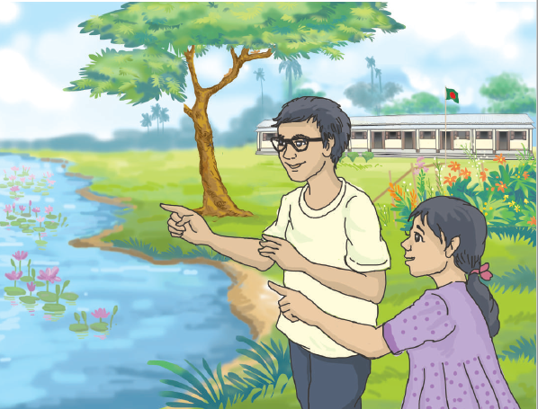
Faria: Hey Raihan, do you like my village?
Raihan: Very much. I really like the calmness here.
Faria: That’s true. Okay, let’s go to our school.
Notes:
ii) Ask ss to find unknown words and elicit the meaning. The teacher will help if necessary.

Slide 25
Raihan: That’s great! I’ll love that.
Faria: Here is my school. (Standing in front of the school)
Raihan: Let’s get inside, will that be all right?
Faria: It will be just fine.
Raihan: Look at that!! So nice, I must say. (Pointing to a large body of water)

Slide 26
Faria: Hey Raihan, do you like my village?
Raihan: Very much. I really like the calmness here.
Faria: That’s true. Okay, let’s go to our school.
Raihan: That’s great! I’ll love that.

Slide 27
Faria: That’s a “Dighi”, my dear cousin. Don’t you have one in yours?
Raihan: We have a small one, a pond you can say and it is surrounded by a multi-storied
school building.
Faria: This’s our school garden (pointing to a garden), we all love it.
Raihan: We have a tiny one too (smiling).
Faria: So, what do you like most about your school?
Raihan: We have a huge library. Do you have a library here?

Slide 28
Faria: Yes, but it’s a small one. You know what, here, one thing I don’t like at all.
It is muddy roads in the rainy season.
Raihan: Our school is next to a very busy road. The vehicles and their horns
make me crazy. Also, it’s very risky to cross the road. Hey, look how many birds!
Faria: Yeah, they nest in the nearby trees.
Raihan: We don’t have too many trees around our school, so unfortunate.

Slide 29
Faria: Let’s go to the playground.
Raihan: That’s your playground! Where does it end? If we had such a big one in
our school!
Faria: A playground is a must in a school. I will love to see your school.
Raihan: Sure, visit us on your next vacation. I’ll show you.
Faria: Won’t it be great if we find a school that has all the good things from both
of our schools?
Raihan: ‘A dream school’ that will be……

Slide 30
1.4 Read the conversation again and match the words/ phrases with their meaning.
Follow next page-------

Slide 31
1.4 Read the conversation again and match the words/phrases with their meanings. One is done for you.
Notes:
iii) Ask SS to read the conversation again and match the table referring to 1.4 and engage in peer checking. (iv) Complete the activities in One and a half hours.

Slide 32
Words/Phrases | Meaning
1. Calmness | My own
2. In front of | Soiled
3. Mine | A motor car/bus/truck used for transporting people or goods
4.Huge | Bird’s house
5. Muddy | Close
6. Multi-storied | Peacefulness
7. Vehicles | Very big/large
8. Nest | Before
9. Nearby | Holiday
10. Vacation | Having more than two floors /levels

Slide 33
1.5 Read the conversation again, and in pairs/groups write the similarities and dissimilarities (differences) between Faria’s and Raihan’s schools.
Similarities: The things both the schools have.
For example, both schools have gardens.
Dissimilarities: The things that one school has but the other school doesn’t have.
For example: There is a big playground in Faria’s school
but there is not a big playground in Raihan’s
school.

Slide 34
Similarities |  | Dissimilarities
Raihan’s school | Faria’s school | Raihan’s school | Faria’s school
1. A small pond | A large water body | 1. Noisy | Calmness
2. A tiny garden | A big garden | 2. Risky and busy roads | Muddy Roads
3. Huge library | Small library | 3. No tree | Lots of trees
4. Small playground | Big playground | 4. Multi -storied school building | Two -storied school building
Notes:
Thus ss will make Similarities and Dissimilarities according to TG

Slide 35
1.6 Now, in pairs/groups discuss and then make a list of similarities and dissimilarities of your school with Faria’s and Raihan’s schools.
Similarities | Dissimilarities
1. Spacious classroom | 1. Trees
2. School canteen | 2. Garden
3. School library | 3. Pond
4. Four storeyed Building | 4. Birds
5. School gymnasium
6. Club Activities

Slide 36
1.7 In pairs/groups, discuss and make a list of-
a) The good things in your school.
b) What you need in your school.
c) What should be improved or removed from your school to
make your school a dream school?
Notes:
SS will do and Teacher will be monitoring

Slide 37
a) The good things in your school.
There are many good things of our school. Some of them are :
1. Big play ground
2. flower garden
3. Pond
4. Canteen
5. Library
6. Shaheed Minar
7. Auditorium
8. School Magazine
Notes:
SS will do and Teacher will be monitoring

Slide 38
b) What you need in your school.
In addition many good things, our School need many other things that help us to progress our education.
The most important items are :
1. Language Club
2. Literary Club
3. Science Club
4. Sanitary product
5. Mosque
6. Internet facilities
7. Sports club
Notes:
SS will do and Teacher will be monitoring

Slide 39
c) What should be improved or removed from your school to
make your school a dream school?
To make a dream school the following issues should be removed :
1.Reading pressure
2. Class test
3. Punishments
4. Old furniture
To make a dream school the following issues should be improved :
1. Multimedia classroom
2. Increase library books
3. Increased Common room facility
4. Increased Smart board

Slide 40
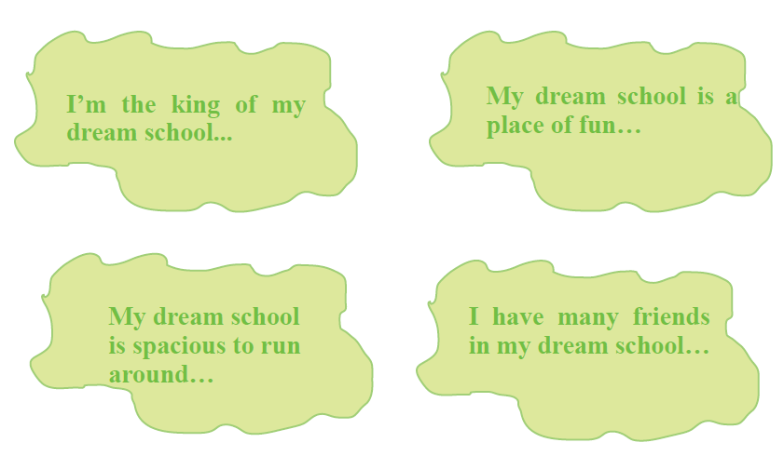
1.8 Read Orin’s speeches in the bubbles about her dream school. Now, draw/ design a poster of your dream school and present it to your class/ school.

Slide 41
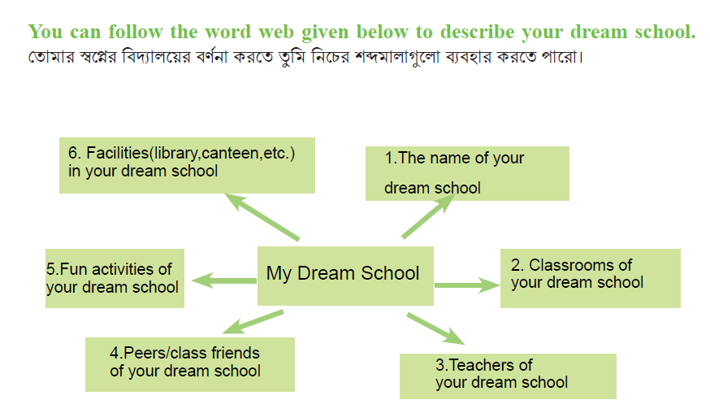
Describe your dream school following the word web given below

Slide 42
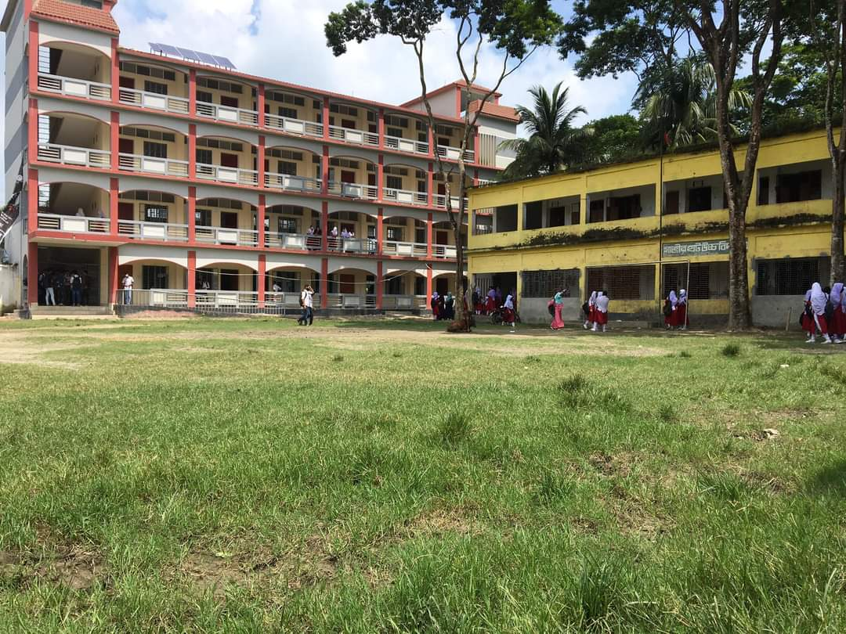
Gazirhat High School
The name of my dream School is Gazirhat High School. It has a L shaped modern multi storied building. Its design is really unique. There is a very spacious play ground in front of it. We use both electricity and solar panel.

Slide 43
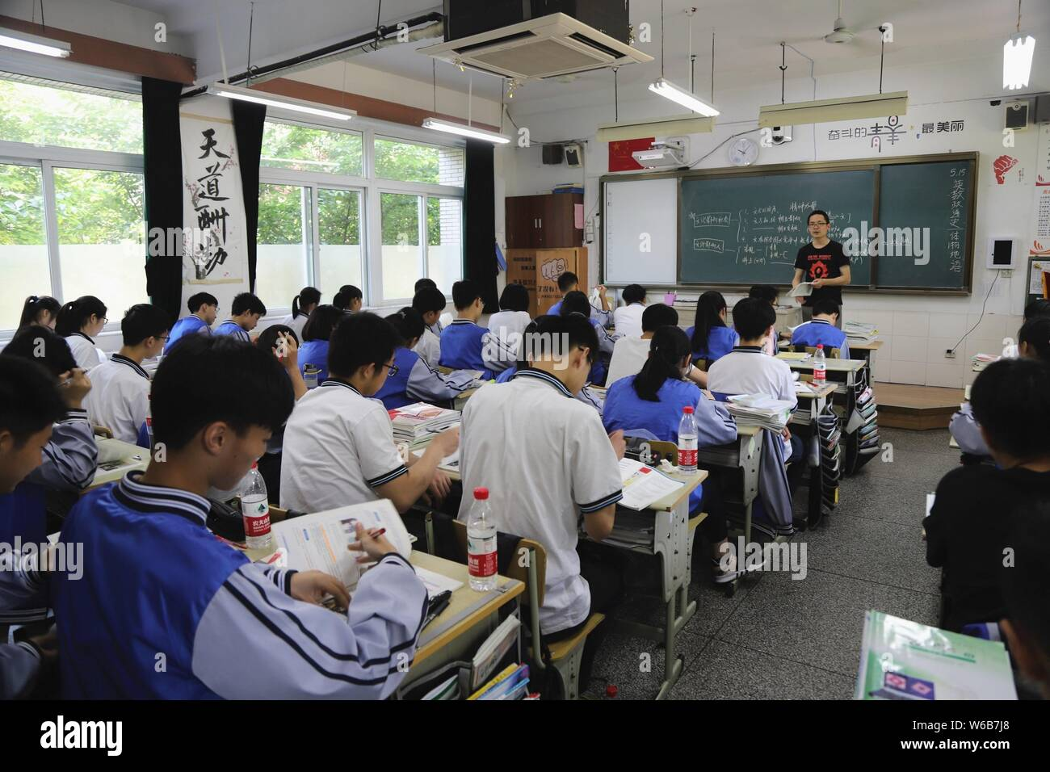
The Class rooms are well equipped with modern technology such as laptops, smartboard, nice sitting arrangement.

Slide 44
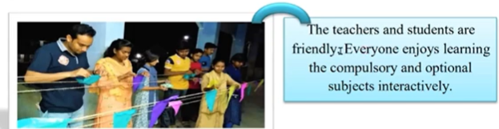
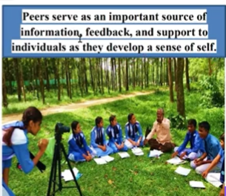
Here the teachers of my dream school are very friendly and cooperative. They are very helpful. We all enjoy very friendly learning atmosphere as we are family members.
The peers are supportive. We help each other, share information. We are always helpful to weaker students.

Slide 45
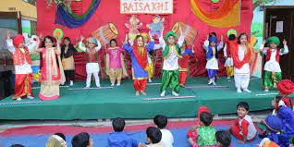
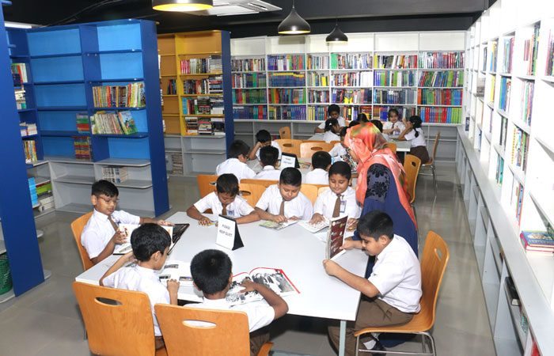
The school also provide us curricular and co-curricular activities. We arrange music, drama. Dance, debate and cultural program on various occasion.
The school has a library which is enriched with not only academic books but also novels, poems, story, science fiction etc. it helps us to develop our potentialities.
We get fresh and hygienic food from our school canteen at a very cheap rate.

Slide 46

Practise it more and more at home.
Tuesday, December 12, 2023
46

Slide 47

Good
Bye
For
Today,
Thank you

