Slide 1
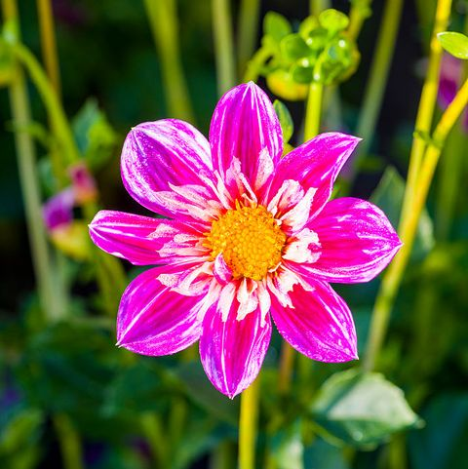
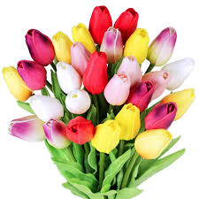
Welcome
to
You
To
Attend
the
Digital
Class

Slide 2

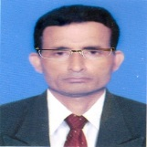
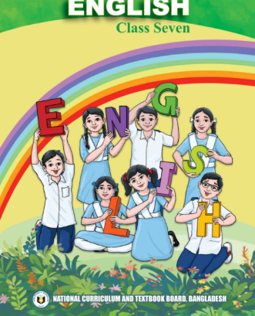
Identity
Manik Chandra Majumder
Senior Teacher
Gazirhat High School
Senbag, Noakhali.
Mobile No: 01717155169
Email: manikmajumder01@gmail.com
Class : Seven
Subject : English
Time : 6.5 Hours
Date : 00/00/2023

Slide 3
Make meaningful word with disorder letter.
Disorder letter
nme
Oomn
Perlya
Wdro
Mitper
usn
Meaningful word
Men
Moon
Player
Word
Permit
Sun

Slide 4
Play another Game with word
Dis
like
Dislike
Spirit
less
Spiritless
Un
friendly
Unfriendly
Un
happy
Unhappy
Un
Unsupportive
support
ive
Un
comfort
able
Uncomfortable
Sun
ny
Sunny
Moon
lit
Moonlit

Slide 5
So dear, Our today’s Lesson is---
Playing with words

Slide 6
The focus of this unit is on
Competency 2: Ability to recognize and transform different sentence structures.
Therefore, in this unit
SS will go through the experience of identifying different sentence structures and will transform sentences from one form to another in relation to the purpose.
(Grammar –prefixes & suffixes)
This content is very large. Honourable teachers will run activities according to TG and follow the time allocation in your school routine.

Slide 7
Experience (6.5 hours):
Firstly, SS will engage in developing a vocabulary list following some clues.
Secondly, SS will reflect to identify the root words and the positions of prefixes and suffixes.
Then, SS will engage in identifying the required features of prefixes and suffixes and their appropriate uses from the text.
Finally, SS will demonstrate the appropriate use of prefixes and suffixes in the given situations.

Slide 8
New vocabulary:
New vocabulary: Scold, Supportive, Create, Remove, Permit, Unlike, Instead,Seem, Likewise.
Key Word: Scold ( verb)
Meaning: To find fault angrily (তিরস্কার করা)
Example Sentence:
If I am late today, my mother will surely scold me.
Your Sentence: If I don’t make good result, my mother will scold me.

Slide 9
New vocabulary:
Key Word: Supportive (Adj)
Meaning: To give help (সহায়ক)
Example Sentence:
Our librarian is very supportive to the students.
Your Sentence: Our teachers are very supportive to students .

Slide 10
New vocabulary:
Key Word: Create (verb)
Meaning: To make or produce (সৃষ্টি করা)
Example Sentence: Please don’t create any new problems.
Your Sentence: He always creates problem in the class.

Slide 11
New vocabulary:
Key Word: Remove (verb)
Meaning: To take something away from somewhere (অপসারণকরা)
Example Sentence: Please remove all the unused things from the table.
Your Sentence: The light of moon removes darkness

Slide 12
New vocabulary:
Key Word: Permit (verb)
Meaning: officially allow to do something
Example Sentence:
Our headteacher permits us to organise tree plantation programme.
Your Sentence: year we will organize Baishakhi Mela in our school campus.

Slide 13
New vocabulary:
Key Word: Unlike (adj)
Meaning: Not similar to (অন্যরকম)
Example Sentence: Unlike you, I am not a great singer.
Your Sentence: She is unlike her mother in everyway, except her black eyes.

Slide 14
New vocabulary:
Key Word: Instead of
Meaning: An alternative (পরিবর্তে)
Example Sentence:
Try to make friends instead of enemies.
Your Sentence. I bought a shirt instead of T-shirt.

Slide 15
New vocabulary:
Key Word: Seem (verb)
Meaning: Appear to be true (মনে হওয়া )
Example Sentence:
It seems that you are thrilled to day.
Your Sentence. The old man seems very tired.

Slide 16
New vocabulary:
Key Word: Likewise (adv)
Meaning: In the same way(একইভাবে )
Example Sentence:
He is our leader and likewise our friend.
Your Sentence. He helped me with money likewise mental support.

Slide 17
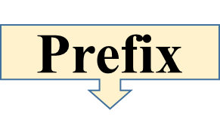
Follow the instruction carefully
able
able
Suffix
Able + ity = ablity
‘E ’ omitted
Un + able = unable
Added after word
Added before
The letter or letters added before any word and changes its meaning is called prefix.
The letter or letters added after any word and changes its form is called suffix.
Notes:
SS will do and Teacher will be monitoring

Slide 18
2.1 Look at the following illustration and in pairs/groups ask and answer the following questions. You can choose any option but tell the class why you choose it.
Notes:
Take answer from ss

Slide 19
Try to answer these Questions in pairs/ groups.
a. Do you like or dislike cricket?
b. Are the players spirited or spiritless?
c. Are the two teams friendly or unfriendly?
d. Are the audience happy or unhappy?
e. Are they supportive or unsupportive?
f. Are the seats comfortable or uncomfortable?
g. Do you agree or disagree that playing cricket is helpful for making friends? If yes, how?
Notes:
Take answer from ss

Slide 20
a. Do you like or dislike cricket?
Ans: Yes, I like cricket because it is very exciting game.
b. Are the players spirited or spiritless?
Ans: Yes, The players are spirited as they are enjoying.
c. Are the two teams friendly or unfriendly
Ans: Yes, they are friendly because they are playing co-operatively.
Notes:
Take answer from ss

Slide 21
d. Are the audience happy or unhappy?
Ans: Yes, they are happy as they are enjoying the game.
e. Are they supportive or unsupportive?
Ans: Yes, They are supportive as they are cooperating with one another
f. Are the seats comfortable or uncomfortable?
Ans: Not so uncomfortable.
Notes:
Take answer from ss

Slide 22
g. Do you agree or disagree that playing cricket helps make friends? If yes, how?
Yes, I agree. As playing cricket is a team work. Players need help, cooperation, understanding and self confidence. These help them to make friendship.
Notes:
Take answer from ss

Slide 23
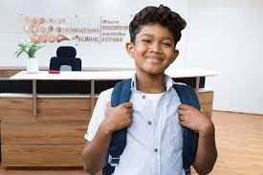
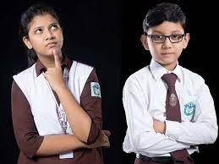
Not so uncomfortable. Do you agree or disagree that playing cricket is helpful for making friends? If yes, how?
Yes, they are happy as they are enjoying the game. You tell me are they supportive or unsupportive?
Are the two teams friendly or unfriendly?
Do you like or dislike cricket?
I would like to talk to you about the picture.
Are the players spirited or spiritless?
Hello Sakib! Have you seen the picture?
Yes, I agree. As playing cricket is a team work. Players need help, cooperation, understanding and self confidence. While playing player get closer and become friends.
Yes, they are friendly because they are playing co-operatively. Tell me are the audience happy or unhappy?
Yes, The players are spirited as they are enjoying.
Certainly, I like cricket very much because it is very exciting.
Of course. Let’s start.
Yes, They are supportive as they are cooperating with one another. Are the seats comfortable or uncomfortable?
Yes, But what happened?
Apon
Sakib

Slide 24
2.2 Now in pairs/groups, read the note given below and divide the words into prefixes, root or root words and suffixes. Then, do pair/group checking. One is done for you.

Slide 25
Affixation:
Affixation is the most common way of making new words in English. It is the process of adding a group of letters to a root word to create either a different form of that word or a new word with a different meaning. The two primary kinds of affixation are prefixation (the addition of a prefix) and suffixation (the addition of a suffix). Prefixes and suffixes are known as affixes.
Prefixes and suffixes are added to a root word.
So, let’s know about root words, prefixes and suffixes!

Slide 26
Affixation দুই প্রকারের। যথা- Prefixation (Prefix বা উপসর্গের যোগ) এবং Suffixation (suffix বা প্রত্যয়ের যোগ) । Prefix এবং Suffix গুলো Affix হিসাবে পরিচিত। মূল শব্দের সাথে উপসর্গ এবং প্রত্যয় যোগ করা হয়।
তাহলে , চল এবার জেনে নেই মূল শব্দ (Root words), উপসর্গ (Prefixes) এবং প্রত্যয় (Suffixes) সম্পর্কে

Slide 27
Root word: Here are two terms, root word and root of a word.
A root word is the most basic meaningful part of a word. It can stand on its own as a complete word. If you remove all the prefixes and suffixes, you will get the root word. For example- Friendly and unfriendly. Here, the friend is the root word and it is, by itself a meaningful word. A root, on the other hand, does not usually have a complete word of its own.
For example- Permit. Here, per is the prefix and mit is the root word. Mit is not a complete word as it does not have any meaning.

Slide 28
মূল শব্দ: এখানে দুটি পদ বা ধারণা রয়েছে । যথা- মূল শব্দ এবং শব্দের মূল।
মূল শব্দ একটি শব্দের সবচেয়ে মৌলিক ও অর্থপূর্ণ অংশ। এটি একটি সম্পূর্ণ শব্দ হিসাবে ব্যবহার পারে ।
উপসর্গ এবং প্রত্যয় সরিয়ে মূল শব্দটি পাওয়া যায় । যেমন- Friendly এবং Unfriendly. এখানে friend হল মূল শব্দ এবং friend নিজে একটি অর্থপূর্ণ শব্দও।
অন্যদিকে, একটি শব্দমূল নিজে নিজে একটি সম্পূর্ণ ও অর্থবহ শব্দ না ও হতে পারে । যেমন- Permit.
এখানে , per হল উপসর্গ (Prefixes) এবং mit হল মূল শব্দ (root word). mit একটি সম্পূর্ণ শব্দ নয় কারণ এর নিজস্ব কোন অর্থ নেই।

Slide 29
Prefix:
Prefix is a letter or a group of letters that we add to the beginning of a root or a root word to make a new word.
For example, notice the word prefix. Here pre is the prefix and fix is the root word. A prefix often changes the meaning of a word. For example: when you add the prefix un with the root word happy, it changes its meaning and becomes unhappy which is the opposite of happy

Slide 30
Suffix:
Suffix is also a letter or a group of letters that we add after a root or a root word to make a new word. But unlike a prefix, a suffix usually does not significantly change the meaning of the word. Instead, a suffix adds more specification. For instance, if you say someone is wise, you will think someone is knowledgeable. However, when we add suffixes like r, it will be wiser. Still, l the word means the knowledge of a person.
Sometimes, we use a suffix to make a word plural, which just means that there is more than one of something. The most popular suffixes are s and es. We use them to make a word plural. For instance, if you say suffix it means only one but if you add the suffixes then it means more than one suffix.

Slide 31
Again, some words have a prefix, a root or a root word and a suffix that means ALL-IN-ONE. For example- Unacceptable. Here, un is the prefix, accept is the root word and able is the suffix. So, by adding prefixes and suffixes, you get a different form of the word accept with a different meaning. Finally, it seems that words can be long and difficult at times. But if you
understand root words and affixes, it will help you to get the meaning of those words easily.

Slide 32
Activity: Divide the words into prefixes, root or root words and suffixes.
In pairs/groups, read the passage given below and discuss what prefixes and suffixes you will add to the underlined root words to make the sentences meaningful. Note that you may need to add only prefixes or suffixes, and for some words you may need to add the both.
Notes:
Instructions: (i) ' Engage 2 students to read and act out the conversation. One of the SS will be Faria and the other will be Raihan. The rest of the SS will listen.

Slide 33
Observe the formation of the words
Prefix
Root word
Suffix
New word
Unfriend
un
Friend
Unfriend
ly
Unfriendly
This is Affixation

Slide 34
Word | Prefix | Root or root word | Suffix
Dislike | Dis | like | No suffix
Spiritless | No prefix | Spirit | less
Unfriendly | Un | friendly | ly
Unhappy | Un | happy | No suffix
Unsupportive | Un | Support | ive
Uncomfortable | Un | comfortable | able
Disagree | Dis | agree | No suffix
Notes:
ii) Ask ss to find unknown words and elicit the meaning. The teacher will help if necessary.

Slide 35
2.3 In pairs/groups, read the passage given below and discuss what prefixes and suffixes you will add to the underlined root words to make the sentences meaningful. Note that you may need to add only prefixes or suffixes, and for some words you may need to add the both.

Slide 36

Our Unique Team
I am a great fan of cricket. I am also a member of our local cricket team. Every holiday we play cricket. On a summer evening, we all were 1) enjoy our holidays by 2) watch a cricket match with a neighbouring team. We were very tense about our team’s 3) perform though we had two great players, Nabil and Junayed. I still could remember the day we got Junayed as a 4) play in our team. In the evening we were playing. When it came to Nabil’s turn to bat, we got scared as he was known for his long shots. He used to bat so hard that we often ended up losing the ball. Today was no different, Nabil hit the ball and it broke a 5) wind of the 6) near a building.

Slide 37
All of us ran from the spot fearing that we would be given a nice scolding. But Nabil didn’t move and he stood 7) proud with the bat in his hand. A few minutes later a young boy came down with the ball. He introduced himself as Junayed and gave the ball to Nabil. As Junayed turned around, Nabil said thank you to him but he didn’t respond. Nabil patted his shoulder and said thank you to him once again. This time the boy read his lips and replied 8) come. He then told Nabil that he had lost his power of listening when he was young. Nabil asked him if he would like to play with them. He agreed 9) happy. Since then, he has been giving a tough 10) test to Nabil in breaking window panes with his long shots.

Slide 38
Prefix | Root or root word | Suffix | Word
 | Enjoy | ing | Enjoying
 | Watch | ing | Watching
 | Perform | ance | Performance
 | Play | er | Player
 | Win | dow | Window
 | Near | by | Nearby
 | Proud | ly | Proudly
Wel | Come |  | Welcome
 | Happy | ily | Happily
 | Test | ing | Testing

Slide 39
2.4 More to read!
You have already learned about a prefix, root or root word and suffix. Also, you knew how to add prefixes or suffixes or both to the root or root words to express yourselves in a better way.
Now, let’s learn some of the most commonly used prefixes and suffixes:
Notes:
Thus ss will make Similarities and Dissimilarities according to TG

Slide 40
A. Prefixes
Write at least two words with each prefix:
Prefix | Meaning | Example word | Your words | Your sentences
Re- | doing again | restart | recharge, Rehearse recall | 1. Mom needs to recharge her mobile phone. 2. I will definitely rehearse my role as many times as possible.
Pre- | before/earlier | preorder | Preview Prepare | let’s see the preview the of the movie. My mother prepares our food.
Notes:
Thus ss will make Similarities and Dissimilarities according to TG

Slide 41
Prefix | Meaning | Example word | Your words | Your sentences
En- | in/ within | enlist | enclose, endanger | 1.Please enclose the file in an envelope. 2. Pollution endangers our lives.
Un- Dis- Non- Ir- Il- In- Im- | The opposite of something or someone | unhappy dishonour | Uncommon Disconnect Non-violent Irregular Illegal Inadequate Immortal | The crow is not an uncommon bird. The link has been disconnected. Finland is a non-violent country. He is irregular in his class. He is involve in illegal activities. We have inadequate job facilities. Man is not immortal.
Notes:
Thus ss will make Similarities and Dissimilarities according to TG

Slide 42
Prefix | Meaning | Example word | Your words | Your sentences
Anti- | against/the opposite of someone or something | antibody | Antisocial Antiseptic | 1. Don’t involve in antisocial activities 2. I need a tube of antiseptic cream.
Mis- | incorrect/ wrong | misspell | Misguide Misfortune | 1. My friend misguided me. 2. Misfortune never comes alone.
Non- | not/no/none | nonstop | Nonsense nonprofit | 1. I have never seen such a non-sense person like you. 2. School is a nonprofitable organization.
Uni- | One | uniform | Unique United | 1.India is a land of unique culture. 2.United efforted is necessary for success.
Notes:
Thus ss will make Similarities and Dissimilarities according to TG

Slide 43
Prefix | Meaning | Example word | Your words | Your sentences
Co- | together/with | Cooperate | Coordinate | 1. He coordinated the whole work. 2. Coexistence is necessary for peaceful society.
Sub- | Under | Subject | Submarine Subway | 1. I have never seen a submarine. 2. Have you travel in a subway?
Notes:
Thus ss will make Similarities and Dissimilarities according to TG

Slide 44
B. Suffixes
Write at least two words with each suffix.:
Suffix | Meaning | Example word | Your words | Your sentences
-Able | The adjective form of the word | achievable | comfortable | 1.The seat is very comfortable. 2. I am capable of leading my class.
-ion | condition/ result/process | situation | action Demolition | Every action has its reaction. The house was rescued from demolition.
Follow your text book------
Notes:
Thus ss will make Similarities and Dissimilarities according to TG

Slide 45
Suffix | Meaning | Example word | Your words | Your sentences
-ion -tion -ation | condition/ result/process | situation | Realization | 1. After the realization of his faults, he apologized to all.
-ive | The adjective form of the word | active | Constructive Communicative | 1.He is active in politics. 2. We need communicative English.
Follow your text book------
Notes:
Thus ss will make Similarities and Dissimilarities according to TG

Slide 46
Suffix | Meaning | Example word | Your words | Your sentences
-tion -ation | condition/ result/process | situation | Realization | 1. After the realization of his faults, he apologized to all.
-ive | The adjective form of the word | active | Constructive Communicative | 1.He is active in politics. 2. We need communicative English.
-al ial | The adjective form of the word | cordial | Approval National | I am waiting for your approval. We need national unity For our overall development.
Follow your text book------
Notes:
Thus ss will make Similarities and Dissimilarities according to TG

Slide 47
Suffix | Meaning | Example word | Your words | Your sentences
-y | The adjective form of the word | lucky | Muddy Sleepy | 1.You look sleepy. 2. The road is muddy.
-ly | The adverb form of the word | Quickly | Rapidly Politely | 1. Speak politely. 2. She reads rapidly.
-ness | state/ condition | politeness | Kindness Brightness | Kindness is a good virtue. The brightness of fullmoon is beautiful.
Follow your text book------
Notes:
Thus ss will make Similarities and Dissimilarities according to TG

Slide 48
Suffix | Meaning | Example word | Your words | Your sentences
-ous | possessing a quality | Virtuous famous | Various curious spacious | 1.The virtuous are happy. 2. The road is spacious. 3. She made various type of Cake.
-ful | The adjective form of the word | careful | useful beautiful | 1. Iron is a useful metal. 2. The brightness of full moon is beautiful
-ing | making continuous tense | writing | playing Working | 1. The boys are playing ludu. 2. He was working in the field.
Follow your text book------
Notes:
Thus ss will make Similarities and Dissimilarities according to TG

Slide 49
2.5 In pairs/groups, read the following text and fill in the gaps with words from the box. Then, share your answers with the whole class. One is donefor you.
meaning, prefixes, opposite, new, added, suffixes, end, group
Notes:
Thus ss will make Similarities and Dissimilarities according to TG

Slide 50
meaning
prefixes
opposite
new
added
Suffixes
end
group
There are many ways of making (a) new words. One important way is using
prefixes and suffixes. Prefix and suffix are (b) …….. of letters added to a root or root word. A Group of letters (c) ……… at the beginning of the root words are known as prefixes. For example, ‘ir’ in ‘irregular’ (ir+regular) is a prefix that makes the root word’s meaning negative. Un (unfortunate), anti (anti-climax),em (empower), dis (disqualified) etc. are some examples of (d)………. On the other hand, a group of letters added to the (e) ………… of the rood words are called suffixes. For example, ‘less’ in ‘Helpless’ (Help + less) is a suffix. Other commonly used (f) ……….. are ly (commonly), ion (promotion), ness (kindness),ful (hopeful). Both prefixes and suffixes change the (g) ………….of the root words differently including changing parts of speech (e.g. ‘rich’ is an adjective, ‘enrich’ is a verb), making (h) ………… (e.g. real ~ unreal) meaning etc. Affixation is a fun way of increasing our vocabulary, isn’t it?
Notes:
Thus ss will make Similarities and Dissimilarities according to TG

Slide 51
2.6 Work in a group of 4-6.
Write a short text (15-20 sentences) about someone (father, mother, teacher, sister, brother etc.) or something (a book, a gift, a movie, a poem, a picture etc.) that inspires you most to fulfil one of your dreams. To write your text you can use the ‘Affixation Tree’. Also, you can use any roots or root words, prefixes or suffixes of your own. Later underline all the root or root words, prefixes or suffixes you used in your writing. Finally, present it to the whole class.

Slide 52
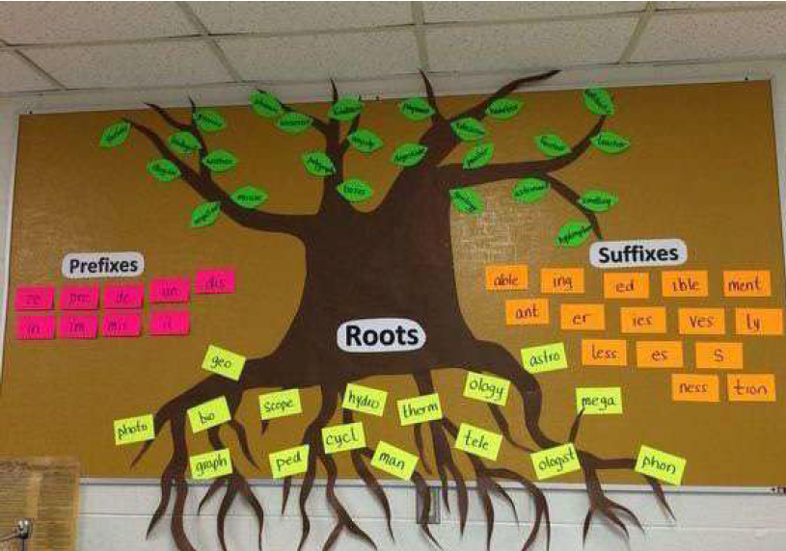

Slide 53
Our class teacher
Mr. Abdul Kader is our class teacher. He is an M.Sc, M-Ed. He teaches us Mathematics. He is young and intelligent. His method of teaching is praiseworthy and friendly. He has a clear and pleasant voice. He always makes is lecture attractive and educative. He knows how to increase the curiosity among the students. He can make any mathematical problem easy. He tries heart and soul to better our situation. He creates encouragement in our mind. His presentation, attitude, and humane qualities please us. He makes the lesson very interesting. He takes good care of us. If we don’t understand any lesson, he tries to make us know it several methods. He is very kind –hearted to the poor. He helps us with our difficulty. He is a loving person to all. For his qualities, we like him most.

Slide 54
OR My Mother
The most important woman in the world is my mother. My life is impossible without my mother. Undoubtedly she is an ideal person. She is very careful to us. She behaves nicely. She guides us properly. She is our key to happiness. She has greatness, kindness, guidance, in her life. I would be unlucky in absence of my mother. She is very adorable, affectionate and followable. I am fond of her greatness, politeness and lovely behaviour. She is really well-behaved. She is actually followable. I’m proud of her guidance. She is lovely one to me. I’m proud of her kindness. She is my beloved one.

Slide 55
The picture is to get an idea of the affixation tree.
List of root words- gift, love, care, guide, model, grow, study, proper, stand, happy, luck, polite, friend, follow, grate, joy, pen, way
Prefixes: en, mis, role, en, pre, re, anti, non, un, sub, co, ex, al, im
Suffixes: s, es, sive, ful, able, al, ive, ness, ly, ing, tion, less, ed, one, ance, tice

Slide 56
Suffixes
Prefixes
En= enjoy/enlarge/ encourage
Mis= misbehave
Pre= prefix/ prepaid
Re= retake/ rearrange
Anti- antiparty
Non= Nongovernment
Un= unlucky/ Unhappy
Sub= sublet/ sub-ordinate
Co= co-operation
Ex= Ex-chairman
Al= already/always
Im= impossible/ immortal
s= books/pens
es= goes/ potatoes
sive= aggressive/ progressive
ful= useful /beautiful
Able= capable/readable
ive-active/passive
al= national/ arrival/approval
ness= kindness/fitness
less= helpless/ colourless
ed= verified/purified
one = everyone/someone/
Re = retake/ rearrange
anti- antiparty
ance =importance
tice =justice /notice

Slide 57
2.7 Time to play a game! (Every pair is a group)
Choose any ten things that you possess/have from the box. Then, in pairs ask and answer the following question to check the similarities between you and your friend. Ask all ten questions. For every similarity, you will get one point. Later share your score with the class. And, appreciate the highest scorer.
Follow next page-------

Slide 58
Question: Do you eat vegetables?
Answer: Yes, I do. Or, No, I don’t. (If yes, your group will get one point)
Eat vegetables | Do household chores | love to listen to music | Love playing games on the field | know how to swim
Love sweets | Do exercise regularly | Favourite subject- English | Love writing more than reading | Like online classes more than offline classes
Love group Work more than Individual work | Walk to school | Parents or siblings help in doing homework | Have a large family | Love to draw pictures

Slide 59
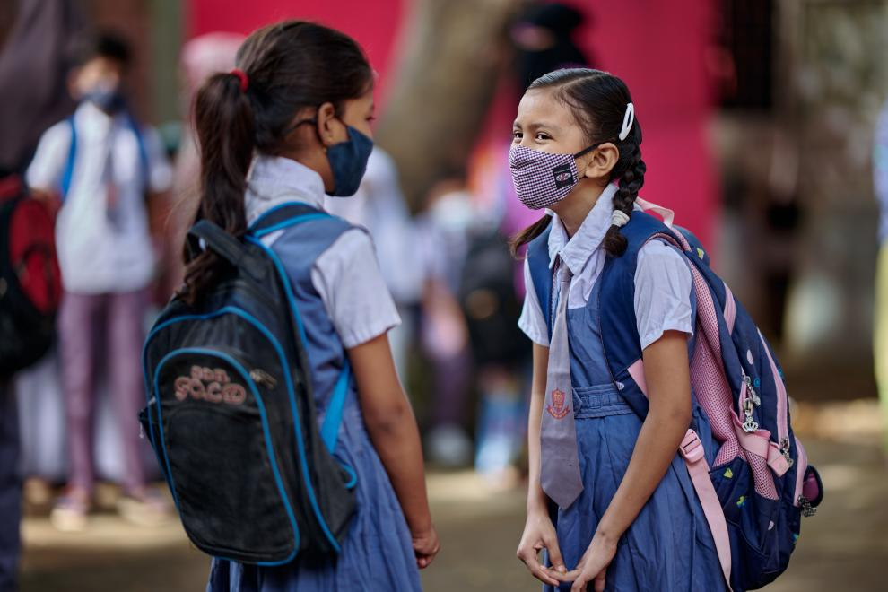
Playing game with friend.
Do you eat vegetables?
1 point
Yes I do.
Do you do household chores?
Yes I do.
1 point
Do you love to listen to music?
No I don’t.
0 point
Sonia
Silvia

Slide 60
Playing game with friend.
Do you love sweets?
1 point
Yes I do.
Do you exercise regularly?
0 point
No I don’t.
Do you have a large family?
No I don’t.
0 point
Sonia
Silvia

Slide 61
So, we have similarities and dissimilarities among us. Likewise, in the English language, there are some words which have similar meanings and some are with opposite meanings. Let’s know about them.
Synonym:
A synonym is a word or phrase that has the same or nearly the same meaning as another word or phrase in the same language.
For example - small is a synonym for little/tiny.
Antonym:
An antonym is a word opposite in meaning to another word.
For example - big is the antonym of small/tiny.

Slide 62
Let’s have a look at the common synonyms and antonyms:
Word | Synonym | Antonym
Wrong
Incorrect
Correct
Unmarried
Single
Married
Choose
Select
Reject
Writer
Author
Reader
Behave
Act
Misbehave
Old
Ancient
Young/ New
Buy
Purchase
Sell
Common
Usual
Uncommon
End
Finish
Endless

Slide 63
Let’s have a look at the common synonyms and antonyms:
Word | Synonym | Antonym
Fast
Quick
Slow
Neat
Tidy
Dirty
Rich
Wealthy
Poor
Encourage
Inspire
Discourage
Respect
Honour
Disrespect
Complete
Finish
Incomplete

Slide 64
Column A (Words) | Column B (Antonyms)
Accept | Difficult
Alive | Subtract
advantage | Simple
Deep | refuse
Easy | Create
Divide | Empty
Add | Dead
Brave | Unite
Complex | Tiny
Destroy | Shallow
Full | Disadvantage
Huge | Coward
2.8 Now, in pairs/groups find the antonyms of words given in column A from column B and draw a line to match them. Then, check the answers with the whole class.

Slide 65
2.9 In pairs/groups, read the following text and write the antonyms of the underlined words using appropriate prefixes in the given table. Then, share your answers with the whole class. One is done for you.

Slide 66
Be Respectful to Others
It was a 1) happy day for Anik. What made him 2) pleased as his mother had been charging her mobile phone. After 30 minutes, she noticed the charger was 3) connected. The phone had not even been charged. “Who has disconnected the charger?” asked his mother. “This is me” Anik answered sadly, “I 4) plucked your mobile phone and added my Tab for charging. If the Tab is not charged timely, the games 5) appear!” “This is 6) fair, Anik” his mother added, “My son, don’t 7) obey the rules! I told you several times that you must ask me before doing it. Besides, an electric charger should be handled carefully.” “Sorry, mom for my 8) responsible behaviour. I’ll never 9) regard you.” “That’s okay Anik”his mother replied. Though it made him unhappy, he understood he should think about others.

Slide 67
Be Respectful to Others
It was a 1) happy day for Anik. What made him 2) pleased as his mother had been charging her mobile phone. After 30 minutes, she noticed the charger was 3) connected. The phone had not even been charged. “Who has disconnected the charger?” asked his mother. “This is me” Anik answered sadly, “I 4) plucked your mobile phone and added my Tab for charging. If the Tab is not charged timely, the games 5) appear!” “This is 6) fair, Anik” his mother added, “My son, don’t 7) obey the rules! I told you several times that you must ask me before doing it. Besides, an electric charger should be handled carefully.” “Sorry, mom for my 8) responsible behaviour. I’ll never 9) regard you.” “That’s okay Anik”
his mother replied. Though it made him unhappy, he understood he should think
about others.
unhappy
displeased
disconnected
unplucked
disappeared
unfair
disobey
irresponsible
disregard

Slide 68
Word | Prefix | Antonym
1.
2.
3.
4.
5.
6
7.
8.
9.
happy
Un
Unhappy
pleased
Dis
Displeased
connected
Dis
disconnected
plucked
Un
Unplucked
appeared
Dis
Disappeared
fair
Un
Unfair
obey
Dis
Disobey
responsible
Ir
Irresponsible
regard
Dis
Disregard

Slide 69
2.10 Let’s reflect on our learning from this unit!
From this unit, you have learned many words, their synonyms and antonyms. Now, prepare a poster in a group of 5-6 with all the words you have learned from this unit. Then write their synonyms and antonyms. Finally, hang it on the wall for others to learn.

Slide 70

Let’s make a poster paper.
Words | Synonym | Antonym
Like | Love/Prefer | Dislike
Create | Make | Destroy
Happy | Joyful | Unhappy
Hot | Warm | Cold
Write | Compose/print | Read
Fast | Quick | Slow
Buy | Purchase | Sell

Slide 71


Home Task
Recall it and practice more and more and at home.

Slide 72
Always bear in mind
Tense
Sentence
The Heart of Grammar
Parts of speech

Slide 73

Good
Bye
For
Today,
Thank you

