Slide 1
O
E
W
L
M
E
C

Slide 2
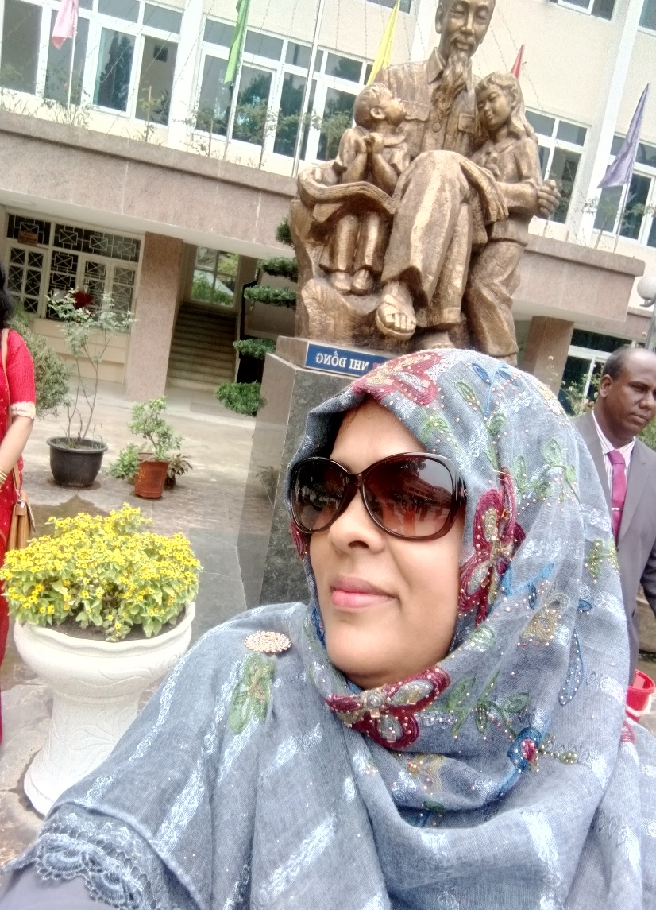
Teacher’s identity
Fahima Akter
Assistant teacher
Uttar kendua GPS
Kendua, Netrakona
Email:fahimakendua@gmail.com

Slide 3
Lesson Introduction
Class: One
Sub: English
unit:2
Lesson:2(C,E)
Time: 50 minutes

Slide 4
Learning outcomes
At the end of the lesson students will be able to-
3.1.1 say proper sounds of the letters in familiar words..
4.1.2 recognize and read aloud the capital letters properly.
4.1.3 recognize and read aloud the smalll letters properly.

Slide 5
Let’s watch a video
https://www.youtube.com/watch?v=gsb999VSvh8&t=20s

Slide 6
Today’s lesson
aA
bB
Md. Mofakkarul Alam, Assistant Teacher, Gamruli govt. Primary School, Kendua, Netrokona.

Slide 7
Arm

Slide 8
Look ,listen and say.
Aa
arm

Slide 9
Tell the name of the letter and it’s sound
A
a

Slide 10
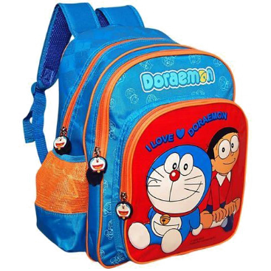
What can you see in the picture?
Bag

Slide 11
Look, listen and say.
Bb
Bag

Slide 12
Tell the name of the letter and it’s sound
b
B

Slide 13
Sound and letter case practice
A
B
a
b

Slide 14
Match the picture with the word
Bag
bag
Arm
arm

Slide 15
the first letter of the picture
a
b

Slide 16
Checking learning
rm
A
--------------
ag
B
--------

Slide 17
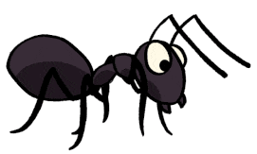
Identify the first letter and match capital and small letters
b
a
B
A

Slide 18
Tell the name of the letter and it’s sound
a
b
B
A

Slide 19
Read and match the small and capital letters
a
b
B
A

Slide 20
Goodbye

